Slide 1


Bosch and Genetec.
End-to-end security, day after day

Slide 2



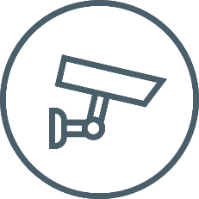










IoT changes the role of video security
From capturing images to smart sensors
Focus on images and managing bitrates
Camera acts as versatile sensor within IoT
Storing
Capturing
Viewing
3
Bosch Security and Safety Systems | ST-VS/MKC | 2018-03-09
© Robert Bosch GmbH 2018. All rights reserved, also regarding any disposal, exploitation, reproduction, editing, distribution, as well as in the event of applications for industrial property rights.
Notes:
The Internet of Things changes the role of video security.
The video security camera is no longer simply part of a “closed” system, solely focused on the gathering, recording and viewing of images.
In an increasingly connected world the video security camera will be the most versatile sensor and integration platform, enabling other “things” to extract and interpret data to elevate security, life safety, and business intelligence to another level.
At Bosch, we believe that the logical next-step for security is to enable customers to interpret these huge volumes of video data and repurpose them for a greater end benefit.
The ability to interpret video data directly at the source helps to substantially improve levels of security, as well as offering clear business advantages.

Slide 3




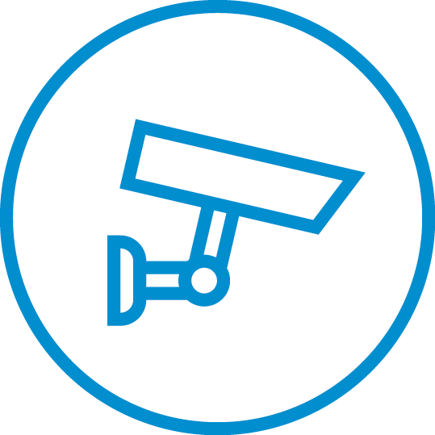

IoT changes the role of security
From domain solutions to data-driven solutions
Access
control
Management
software
The merging of
security domains
Video
security
Data-driven solutions
Intrusion
systems
4
Bosch Security and Safety Systems | ST-VS/MKC | 2018-03-09
© Robert Bosch GmbH 2018. All rights reserved, also regarding any disposal, exploitation, reproduction, editing, distribution, as well as in the event of applications for industrial property rights.

Slide 4




Creating connections with real benefits that improve daily life
Today and in the future
Seamlessly connecting mobility
Connected Industry
Smart Home. Newly invented
Smart Cities
5
Bosch Security and Safety Systems | BT-SC/MKC | 2018-03-09
© Robert Bosch GmbH 2018. All rights reserved, also regarding any disposal, exploitation, reproduction, editing, distribution, as well as in the event of applications for industrial property rights.
Notes:
Bosch IoT manifesto Connectivity is more than just technology. It’s part of our lives. It improves mobility, shapes the cities of the future, makes homes smarter, industries better connected, and healthcare more efficient. In every sphere, Bosch is working towards a connected world.

Slide 5


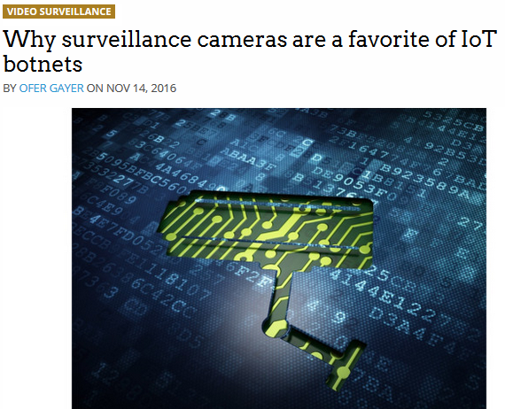
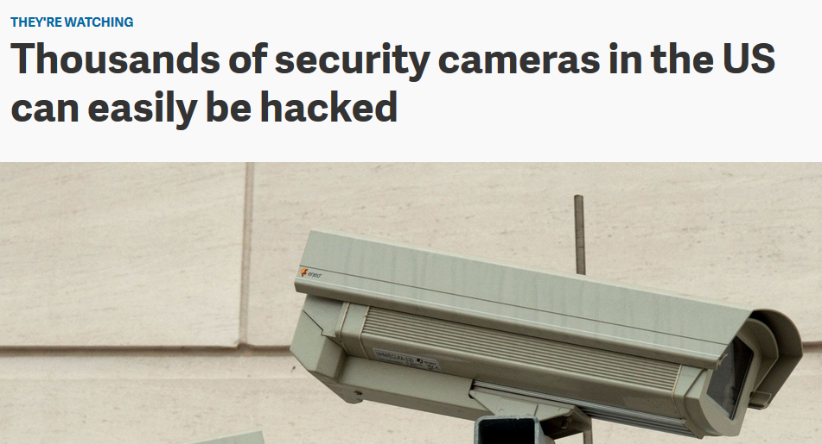
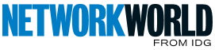
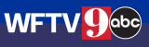
Video security as part of IoT
Balancing between
Enjoying limitless possibilities
Worrying about the consequences
Enjoying limitless possibilities
IoT security camera
infected within 98 seconds
of plugging it in
9 Investigates hacked
surveillance cameras
across Central Florida
6
Bosch Security and Safety Systems | ST-VS/MKC | 2018-03-09
© Robert Bosch GmbH 2018. All rights reserved, also regarding any disposal, exploitation, reproduction, editing, distribution, as well as in the event of applications for industrial property rights.
Notes:
Video security is no longer isolated. Today, cameras are becoming an integral part of the vast digital connectivity infrastructure.
Video security devices, like the majority of devices these days, are becoming more and more ‘connected’. In fact, by 2025, it is expected that 75 billion devices will be connected to the Internet*.
*) Statista Research 2018.
This means we need to take into consideration the changing role of video security within the Internet of Things to stay ahead of trends.
The reality is, we cannot continue to simply shift cameras and boxes.
We need to consider other challenges in order to lead the industry.
A connected world brings enormous benefits.
But connectivity is more than just technology.
It is part of our lives…
It makes mobility safer and easier.
It makes cities smarter, factories more productive and healthcare more efficient.
New possibilities, like remotely controlling your home appliances or parking your car, provide fascination and fun.
It is clear that the Internet of Things brings us limitless possibilities that we should embrace and enjoy.
At the same time, we should not be worried about the consequences, but be mindful of them and implement necessary measures such as data security.

Slide 6
Should we be worrying about the consequences of IOT?

Slide 7
Online hacking has become so
widespread that, by 2021, it’s estimated that cybercrime damages will be costing
us a staggering $6 trillion every year*.
*Source - Official 2017 Annual Cybercrime Report.
8
Bosch Security and Safety Systems | ST-VS/MKC | 2018-03-09
© Robert Bosch GmbH 2018. All rights reserved, also regarding any disposal, exploitation, reproduction, editing, distribution, as well as in the event of applications for industrial property rights.

Slide 8



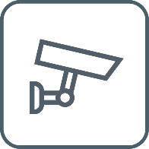

Likely scenarios
Worrying about the consequences?
Side channel attacks
Malware infection
via firmware or
3rd party software
Distributed
Denial-of-Service (DDoS)
Intrusion
of privacy
Physical theft
Privilege misuse
9
Bosch Security and Safety Systems | ST-VS/MKC | 2018-03-09
© Robert Bosch GmbH 2018. All rights reserved, also regarding any disposal, exploitation, reproduction, editing, distribution, as well as in the event of applications for industrial property rights.
Notes:
Malware infection aimed at gaining control of systems
Program codes entering the system via the downloading of new fake Software packages. Or by inserting storage media into a device which contains viruses, Worms etc.
Privilege misuse
Once a user has rights to access the system these privileges could become known to another person who could misuse those access rights.
Or a person leaving a company may retain their access rights for a period of time.
Or an internal person intentionally misuses his/her access rights against the company.
Physical theft
Cameras can be physically stolen to gain access to the network, or to avoid further recording of images.
Denial of Service attacks
A Distributed Denial of Service (DDoS) attack is an attempt to make an online service unavailable by overwhelming it with traffic from multiple sources. Attacks can target a wide variety of important resources, from banks to news websites, and present a major challenge to people wishing to publish and access important information.
Side channel attacks
This is when a device is opened, or electro-magnetic waves are measured to find out what the device is executing at that moment. This kind of attack also makes it possible to use a spectrum analyzer to measure what the passcode is by simply analyzing the BUS traffic and/or the EMI spectrum of the device.

Slide 9



Protecting personal data
Worrying about the consequences?
General Data Protection Regulation (GDPR)
Unify and strengthen the
data protection of individuals
May 25 2018
What is personal data?
Fines
up to 4% of worldwide revenues or
20 Million Euros
Name
Date of birth
Phone number
Email
Social security no.
License plate number
Photos
Videos
10
Bosch Security and Safety Systems | BT-SC/MKC | 2018-03-09
© Robert Bosch GmbH 2018. All rights reserved, also regarding any disposal, exploitation, reproduction, editing, distribution, as well as in the event of applications for industrial property rights.
Notes:
Connectivity and the collection of (personal) data also leads to more stringent regulations concerning its protection.
General Data Protection Regulation (GDPR) is one of the first official data protection acts but is certain to be followed by many others. This new set of rules govern how data controllers and data processors collect, use and share personal data. One of the main goals of GDPR is to protect the personal data of EU subjects and provide a new set of rights to individuals. Organizations have to build data and privacy protection into their system design and infrastructure. Businesses that do not comply will face hefty fines.
GDPR’s main goal is to unify and strengthen the data protection of individuals.
Personal data is defined as information that can identify a person, directly or indirectly, by reference to one or more factors specific to them.
On May 24th, 2018, the EU Data Protection Directive will be updated for the first time since 1995.
The directive is now becoming a regulation – or a comprehensive, enforceable law – and the drastic changes will affect organizations everywhere.
The new set of guidelines is known as the EU GDPR. Here are the key pillars of the regulation:
•Consent.
•If personal data is to be collected, organizations have to get valid and explicit consent from the individuals.
•Individuals may withdraw their consent.
•The right to be forgotten.
•Organizations have to erase personal data at the subject’s request, without undue delay.
•Risk and impact assessments.
•Organizations have to perform a privacy impact assessment, which states what personally identifiable information (PII) is collected and how that information is maintained, protected and shared.
•Privacy by design.
•Systems and technology across the organizations need to be designed to limit data collection, retention and accessibility.
•Breach notifications.
•Organizations have to notify the supervisory authority about data breaches involving personal data no later than 72 hours after becoming aware of the breach.
•Users have the right to be informed about data breaches involving their personal data.
•Right to access.
•This guideline relates to data portability.
•Upon request, organizations have to provide individuals with their personal data in a structured and commonly used format.
Enforcement date GDPR: 25 May 2018.

Slide 10



Protecting personal data
Worrying about the consequences?
Privacy by design
Right to access
Right to be forgotten
Protecting your data and
privacy with confidentiality,
integrity and availability.
Provide individuals with
their personal data in a
structured & common format.
Erase personal data at
the subject’s request,
without undue delay.
11
Bosch Security and Safety Systems | BT-SC/MKC | 2018-03-09
© Robert Bosch GmbH 2018. All rights reserved, also regarding any disposal, exploitation, reproduction, editing, distribution, as well as in the event of applications for industrial property rights.

Slide 11
protecting security and privacy of data

Slide 12






What this involves
Protecting security and privacy of data
Considering entire infrastructure
Minimizing risk
of hacking
Protecting privacy
Meeting international laws and regulations
Little point of focusing on a single component
Implement latest measures
Ensure end-to-end data encryption
  In-transit
  At-rest
By managing user access rights
E.g. GDPR
13
Bosch Security and Safety Systems | BT-SC/MKC | 2018-03-09
© Robert Bosch GmbH 2018. All rights reserved, also regarding any disposal, exploitation, reproduction, editing, distribution, as well as in the event of applications for industrial property rights.
Notes:
Securing the privacy of data starts with considering the entire video security infrastructure:
•Cameras, servers, clients, video management, storage devices, network protocols and standard key infrastructures.
We have to plan for the worst, and assume that every cyberattack will be successful.
Therefore, we have to continuously implement the latest measures (FW updates, security patches, latest technology) to minimize the risk of hacking, and ensure that (video) data captured is secure at all times – both in-transit (video/data streams) and at-rest (stored data).
Another consideration is the need to protect software, data, and functions from unauthorized access and manipulation in order to protect privacy.
We have to ensure that we meet local, regional and global legislation.

Slide 13







An end-to-end data security solution is required
Protecting security and privacy of data
14
Bosch Security and Safety Systems | ST-VS/MKC | 2018-03-09
© Robert Bosch GmbH 2018. All rights reserved, also regarding any disposal, exploitation, reproduction, editing, distribution, as well as in the event of applications for industrial property rights.
Notes:
When it comes to mission-critical video security projects, one name you can count on is Genetec. Having access to the VMS expertise of Genetec and the innovation behind Bosch surveillance cameras gives you the upper hand over the hackers, because Bosch cameras are fully integrated with Genetec systems, resulting in an end-to-end data security solution incorporating all Bosch network video surveillance cameras, plus Genetec Archiver and Security Center. All network-wide communications between Bosch cameras and Genetec Archiver and Security Center are assigned an authentication key. This electronic signature enables us to verify the legitimacy of network components like cameras or storage units, and viewing clients, making it possible to build an infrastructure of trust before network-wide communications start.

Slide 14
Employ a data security solution that is completely effective from end-to-end

Slide 15
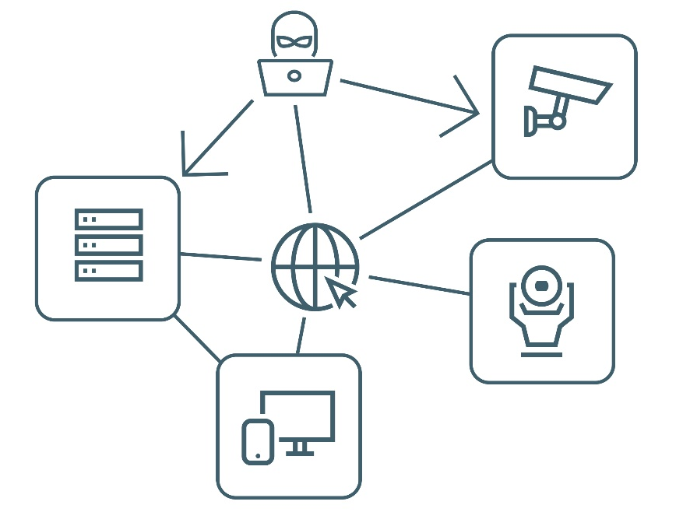



Designed to ensure
Employing an end-to-end data security solution
Communication between trusted devices
Encrypted video
  In-transit (video / data streams)
  At-rest (stored data)
Secure connection for command
and configuration
Manageable user access rights
16
Bosch Security and Safety Systems | ST-VS/MKC | 2018-03-09
© Robert Bosch GmbH 2018. All rights reserved, also regarding any disposal, exploitation, reproduction, editing, distribution, as well as in the event of applications for industrial property rights.

Slide 16



The Bosch approach
End-to-end data security
CREATE TRUST
SECURE DATA
MANAGE USER
ACCESS RIGHTS
17
Bosch Security and Safety Systems | BT-SC/MKC | 2018-03-09
© Robert Bosch GmbH 2018. All rights reserved, also regarding any disposal, exploitation, reproduction, editing, distribution, as well as in the event of applications for industrial property rights.
Notes:
End-to-end security, day after day.
The Bosch approach.
The Internet of Things makes our lives more connected.
As a consequence, video surveillance data is increasingly connected across local and global networks.
An ever-increasing number of network cameras send their data to servers over the Internet, leaving us vulnerable to cybercrime.
Video surveillance data can be particularly susceptible to security breaches when it’s connected across local and global networks.
Digital intruders are drawn to this method of data transfer, particularly if there are weak links in the network. To cancel out this risk, employ a data security system that’s effective from end-to-end.
Focusing on only one element, for example, cameras, would be insufficient.
A 360-degree view of data security is needed, that covers the entire security network including cameras, servers, clients, storage devices, network protocols and standard key infrastructures. Bosch believes that a systematic approach is key to achieve the highest standards in end-to-end data security.
This systematic approach involves:
-Creating trust
-Securing data
-Managing user access rights

Slide 17



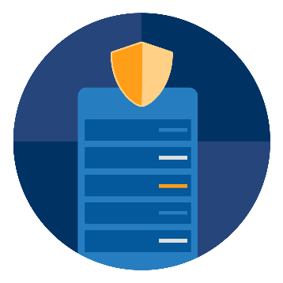


The Genetec approach
End-to-end data security
AUTHENTICATION
ENCRYPTION
AUTHORIZATION
Who is allowed to access the system and how
do they gain access?
How is data protected
or hidden from
unauthorized users?
Once users have
access, what can
users see and do?
18
Bosch Security and Safety Systems | BT-SC/MKC | 2018-03-09
© Robert Bosch GmbH 2018. All rights reserved, also regarding any disposal, exploitation, reproduction, editing, distribution, as well as in the event of applications for industrial property rights.
Notes:
End-to-end security, day after day.
The Genetec approach.
Authentication:
Who is allowed to access the system and how do they gain access?
Authorization:
Once users have access, what can users see and do?
Encryption:
How is data protected or hidden from unauthorized users?

Slide 18



Partners in data protection solutions
End-to-end data security
AUTHENTICATION
ENCRYPTION
AUTHORIZATION
CREATE TRUST
SECURE DATA
MANAGE USER ACCESS RIGHTS
19
Bosch Security and Safety Systems | BT-SC/MKC | 2018-03-09
© Robert Bosch GmbH 2018. All rights reserved, also regarding any disposal, exploitation, reproduction, editing, distribution, as well as in the event of applications for industrial property rights.
Notes:
Bosch and Genetec are companies that share similar DNA when it comes to protecting security and privacy of captured video.
Video surveillance data is particularly susceptible to security breaches due to the method often used to connect across local and global networks. Typically, a number of edge components (cameras) send their data to core components (servers) via a network. Sounds simple. And that’s the problem, because to a digital intruder, this method of data transfer is easy pickings.
To cancel out this risk, employ a data security system that’s been configured by experts with vast cybersecurity knowledge to make it completely effective from end-to-end.

Slide 19
Bosch and Genetec
end-to-end data security solution
20
Bosch Security and Safety Systems | BT-SC/MKC | 2018-03-09
© Robert Bosch GmbH 2018. All rights reserved, also regarding any disposal, exploitation, reproduction, editing, distribution, as well as in the event of applications for industrial property rights.

Slide 20




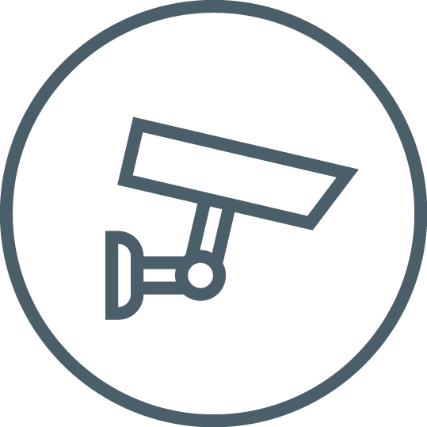


End-to-end data security
Create trust with authentication
Verify the legitimacy of network components
Avoid man-in-the-middle attacks
with certificates
Use certificates and (public) keys
for authentication
Safely store keys in camera’s
built-in Trusted Platform Module (TPM)
Employ the above before communication
(data transfer) starts
Genetec
Archiver
Genetec
Security Center
21
Bosch Security and Safety Systems | ST-VS/MKC | 2018-03-09
© Robert Bosch GmbH 2018. All rights reserved, also regarding any disposal, exploitation, reproduction, editing, distribution, as well as in the event of applications for industrial property rights.
Notes:
Creating trust with authentication involves the process of determining whether an entity is who they claim to be.
Verifying the legitimacy of network components involves:
•Authenticating the client/server communications
•Authenticating the edge devices
•
Why use authentication?
Authentication is used to prevent unauthorized entry by providing access to known entities only, and for whom we can verify their identity. Entities can be users, servers and workstations and web sites.
How we create trust
•By assigning every component in the network an authentication key.
•These keys are safely stored in the camera’s built-in Trusted Platform Module (TPM) to deliver an extra layer of security.
•
Cryptographic operations required for authentication are only executed inside the built-in Trusted Platform Module of the camera.
•
Note: Bosch cameras are factory-loaded with unique certificates to ensure authenticity of the device.
•
Trust must be established amongst all components before communication (transfer of data) starts.

Slide 21

Secure data
End-to-end data security
HTTPS
Data is encrypted in camera before streaming
Encrypted data is streamed via secured
connection (SRTP)
Encrypted data is stored
Configuration and commands are sent via
a secured channel (HTTPS)
Cryptographic operations are executed inside TPM*
*) Trusted Platform Module
SRTP
Genetec
Archiver
SRTP
HTTPS
SRTP
Genetec
Security Center
22
Bosch Security and Safety Systems | ST-VS/MKC | 2018-03-09
© Robert Bosch GmbH 2018. All rights reserved, also regarding any disposal, exploitation, reproduction, editing, distribution, as well as in the event of applications for industrial property rights.
Notes:
Encryption is the process of transforming information to make it unreadable for unauthorized users.
Why use encryption?
Encryption ensures privacy and protection of your data and secures intellectual property.
The Bosch – Genetec end-to-end data security solution starts by encrypting the video data at the point of capture (camera).
Encrypted data is streamed via a secured SRTP (Secure Real-time Transport Protocol) connection either towards:
•Genetec Archiver or
•Genetec Security Center
•
Data sent to the Genetec Archiver for storage remains encrypted to ensure that video data is secured both in-transit and at-rest.
All remote configuration requests or commands (e.g. steering of a PTZ (moving) camera) are sent via a secured channel (HTTPS).
Cryptographic operations needed for data encryption are only executed inside the built-in Trusted Platform Module of the camera.

Slide 22

User access rights
End-to-end data security
Only authorized users have access to the system
Permissioning scheme
  Specific users
  User groups
Partitions determining what users can see
Privileges determining what users can do (> 300 privileges)
Support of Microsoft’s Active Directory
Genetec
Archiver
Genetec
Security Center
23
Bosch Security and Safety Systems | ST-VS/MKC | 2018-03-09
© Robert Bosch GmbH 2018. All rights reserved, also regarding any disposal, exploitation, reproduction, editing, distribution, as well as in the event of applications for industrial property rights.
Notes:
The function of specifying which access rights someone has over resources, data and applications.
Authentication and encryption aren’t guaranteed to prevent unauthorized people gaining access to data, therefore a good user access right or authorization system needs to be in place.
Managing user access rights is necessary for control and flexibility over what users or entities can see and what activity they can undertake once authenticated to the system.
The Genetec Security Center has an incredibly comprehensive set of “Privileges” at its disposal, which gives administrators complete control, at a granular level, over the permissions each user or user group can select in order to gain access to the system. The options include over 300 privileges that can be denied or granted to any user, or to an entire user group.
•Privileges determining what users can do
•Partitions determining what users can see
Any users added to a certain group will automatically inherit all existing privileges assigned to that group. Examples of how sophisticated these privileges can be include the ability for a user to view live video, view playback, add a bookmark to a video timeline, and even move a PTZ (pan, tilt and zoom) camera.
Active directory
For an extra level of security and support, Security Center also integrates with Active Directory, allowing user management to be monitored and centralized at Windows level. In addition to individual users, user groups from Active Directory can also be synchronized with Security Center, so that when new users are added or removed from an Active Directory User Group, the action will be replicated at Security Center. As mentioned previously, new users will automatically inherit existing Security Center privileges defined for that group.

Slide 23


End-to-end data security
Advantages of using Bosch and Genetec
End-to-end encryption.
From camera to archiver to client.
Secure
Bosch cameras are preloaded with fully trusted certificates
Built-in Trusted Platform Module to safely store cryptographic keys
Camera firmware update only via Bosch signed firmware files
Genetec Security Center is SAFETY act certified*
Flexible
Use of 3rd party certificates on camera (E.g. Escrypt / SXI)
Support of Microsoft Active Directory
*) US department of Homeland Security for Anti-Terrorism Technology
24
Bosch Security and Safety Systems | ST-VS/MKC | 2018-03-09
© Robert Bosch GmbH 2018. All rights reserved, also regarding any disposal, exploitation, reproduction, editing, distribution, as well as in the event of applications for industrial property rights.
Notes:
Advantages of the Bosch and Genetec data security solution
End-to-end encryption:
Video data encrypted in-transit
Video data encrypted at-rest
Secure
Flexible

Slide 24

End-to-end data security
Advantages of using Bosch and Genetec
Set-up of multicast network possible
Effective use of SRTP
Reduces network strain
Makes multiple client connections simple
and efficient
Up to 50% saving on processing power
Encryption takes place at source (camera)
Results in savings on storage / server side
25
Bosch Security and Safety Systems | ST-VS/MKC | 2018-03-09
© Robert Bosch GmbH 2018. All rights reserved, also regarding any disposal, exploitation, reproduction, editing, distribution, as well as in the event of applications for industrial property rights.
Notes:
Another advantage of using SRTP throughout the whole infrastructure is that customers are enabled to set up a secured multicast network, so you get security and good network scalability at the same time.
Bosch and Genetec offer an end-to-end encryption solution for all security measures at hardware level that are combined with SRTP. All video data is encrypted at the moment it is captured and remains encrypted throughout the whole video security infrastructure. Compared to transmitting RTSP via a HTTPS tunnel this can create a saving on computing power of 50%, because additional encryption is not needed.

Slide 25
What if secure is not secure enough?
26
Bosch Security and Safety Systems | BT-SC/MKC | 2018-03-09
© Robert Bosch GmbH 2018. All rights reserved, also regarding any disposal, exploitation, reproduction, editing, distribution, as well as in the event of applications for industrial property rights.

Slide 26
CHAVE™
Best data protection solution

Slide 27








Best data protection solution
Credentialed High-Assurance Video Encryption (CHAVE™)
FOR WHO?
REQUIRING
HOW?
Government
Critical infra structure
Regulated industries
(e.g. defense, medical, finance)
To meet NIST* and the U.S. Department of Homeland Security regulations:
Authentication via smart cards
Multi-factor authentication
Public Key Infrastructure (PKI)
End-to-end data encryption
CHAVETM developed by Bosch, Genetec and SecureXperts
*National Institute of Standards and Technology
28
Bosch Security and Safety Systems | ST-VS/MKC | 2018-03-09
© Robert Bosch GmbH 2018. All rights reserved, also regarding any disposal, exploitation, reproduction, editing, distribution, as well as in the event of applications for industrial property rights.
Notes:
Mission critical and critical infrastructure environments must have an IP video security solution that maximizes data security.
The National Institute of Standards and Technology and the U.S. Department of Homeland Security mandate the use of smart cards and multi-factor authentication for these facilities.
Together, Bosch, Genetec™ and SecureXperts offer an IP video security solution that is resilient against unauthorized access, malware, brute force cracking and other exploit techniques.
The solution uses Credentialed High Assurance Video Encryption (CHAVE™) technology to ensure highly-secure identification and authentication through multi-factor smart card credentials.

Slide 28





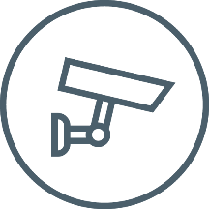



Best data protection solution
Typical CHAVE™ System
Archiver Server
Authentication via multi-factor
smart card credentials
End-to-end (video) data encryption
Secure communications even over internet and untrusted network connections.
Bosch CHAVE™ enabled cameras add extra layer of protection
Public Key Infrastructure using signed Federal or commercial trusted X.509 certificates
x.509
x.509
x.509
x.509
x.509
x.509
CHAVE™–enabled
cameras
Security Center Workstation
End user
Smart Card
29
Bosch Security and Safety Systems | ST-VS/MKC | 2018-03-09
© Robert Bosch GmbH 2018. All rights reserved, also regarding any disposal, exploitation, reproduction, editing, distribution, as well as in the event of applications for industrial property rights.
Notes:
A typical CHAVETM system has following elements:
Signed Federal or commercial trusted X.509 certificates issued by Certification Authority Secure Experts.
Bosch CHAVETM-enabled cameras preloaded with X.509 certificates.
Genetec CHAVETM-enabled Security Center 5.7 SR2 including Genetec Archiver.
The CHAVETM video security solution offers:
End-to-end data encryption (both in-transit and at-rest)
Authentication via multi-factor smart card credentials*
Camera password log-on is lock-out by default**.
Secure connection of internet and untrusted network connects
Public Key infrastructure
*) Smartcards and card readers are issued by the government or commercially once face-to-face identity checks and background checks have been completed satisfactorily, and can be enhanced with PIN and biometric (such as fingerprint) authentication.
**) An extra level of security. The use of smartcards makes them unnecessary, and therefore eliminates the risk of password-sharing, ‘brute force’ password-guessing and the inconvenience of constant password management, e.g. monthly resets.
Bosch CHAVETM-enabled cameras
Video data is encrypted directly at the point of capture via a CHAVETM-enabled Bosch camera, and remains encrypted throughout the entire video security network, so even in the unlikely situation of a cybercriminal gaining access to data it cannot be decrypted without authorized credentials.
CHAVETM also sets a precedence in the category by not using passwords. Password sign-on for CHAVETM-enabled cameras is locked-out by default adding an additional layer of security. The use of smartcards makes them unnecessary, and therefore eliminates the risk of password-sharing, ‘brute force’ password-guessing and the inconvenience of constant password management, e.g. monthly resets.
All Bosch IP cameras use a unique embedded Trusted Platform Module to ensure the highest data security. Bosch CHAVE™-enabled cameras add an extra layer of protection that meets Federal Information Processing Standard (FIPS) Publication 140-2 Level 3 cryptographic validation requirements from NIST. Using techniques known as Public Key Infrastructure (PKI) and Transport Layer Security (TLS), Bosch CHAVE™-enabled cameras allow secure communications over the Internet and other untrusted network connections.
In terms of camera compatibility, CHAVE TM -enabled Bosch cameras offer unique and strong cryptographic login via smartcards and can be preloaded with Federally or commercially Trusted signed X.509 Digital Certificates, and feature an embedded Trusted Platform Module (TPM) to securely store cryptographic keys and digital certificates. The cameras also meet Federal Information Processing Standard (FIPS) Publication 140-2 Level 3 cryptographic validation requirements.
It is a trusted solution. Digital certificates from trusted Certificate Authority SecureXperts establish a secure system. Communication between devices can only take place after both devices have been verified via certificates. In the Bosch CHAVE TM -enabled cameras is a Trusted Platform Module (TPM) that implements the on-camera security features and securely stores signed digital certificates issued by SecureXperts.
Complete IP video solution
Providing a complete solution, Genetec’s open-architecture, unified security platform Security Center 5.7 SR2 is CHAVE™ enabled, supporting the use of end user smart cards and Federal or commercial trusted X.509 digital certificates for authentication and encryption. Users must authenticate with a unique smart card credential in order to gain access to Security Center and video from CHAVE™-enabled Bosch cameras.
Security Center also uses the latest encryption standards such as TLS, AES-128, and RSA, which results in more secure communications between all Security Center client and server applications.
CHAVE-enabled IP cameras:
FLEXIDOME IP starlight 7000 VR
DINION IP starlight 8000 MP
FLEXIDOME IP panoramic 7000 MP
AUTODOME IP starlight 7000 HD
MIC IP starlight 7000 HD
DINION IP imager 9000 HD

Slide 29


Best data protection solution
CHAVE™ benefits
Unique solution for facilities mandated by the NIST* and the U.S. Department of Homeland Security
Bosch CHAVE™ enabled cameras
Meet Federal Information Processing
Standard (FIPS) Publication 140-2 Level 3
cryptographic validation requirements
Preloaded with signed Federal or commercially trusted X.509 certificates
Embedded Trusted Platform Module
to securely store cryptographic keys
and certificates
Password sign-on locked-out by default.
Certificate authentication only.
Genetec
Security Center 5.7 SR2 is CHAVE™ enabled
End-to-end video encryption
Supports the use of smart cards and
digital certificates
Genetec Security Center is SAFETY
act certified**
*) National Institute of Standards and Technology
**) US department of Homeland Security for Anti-Terrorism Technology
30
Bosch Security and Safety Systems | BT-SC/MKC | 2018-03-09
© Robert Bosch GmbH 2018. All rights reserved, also regarding any disposal, exploitation, reproduction, editing, distribution, as well as in the event of applications for industrial property rights.

Slide 30
How we help you improve your data security

Slide 31
Protecting security and privacy of data
What to expect from Bosch and Genetec?
Unique built-in Trusted Platform Module
Side channel attacks
No uploading of 3rd party SW
Firmware updates by Bosch signed files only
Fuzz testing to protect against memory corruption vulnerabilities
Embedded Login Firewall
Malware infection
via firmware or third party software
Distributed
denial-of-service (DDoS)
User access management
for cameras, recording solutions and video management software
Intrusion
of privacy
Tamper protection standard on all
Bosch network video security cameras
Unique built-in Trusted Platform Module
Support of Microsoft Active Directory
Support of token based authentication
Physical theft
Privilege misuse
32
Bosch Security and Safety Systems | ST-VS/MKC | 2018-03-09
© Robert Bosch GmbH 2018. All rights reserved, also regarding any disposal, exploitation, reproduction, editing, distribution, as well as in the event of applications for industrial property rights.
Notes:
Malware aimed at gaining control of systems
Measures:
•Uploading of 3rd party software not possible
•Firmware updates by Bosch signed files only
•Fuzz testing to protect against vulnerabilities associated with memory corruption
Privilege misuse
Measures:
•User access management in the cameras, recording solutions and software
Physical theft or loss
Measures:
•Tamper protection standard on all Bosch network video security cameras
•Unique built-in Trusted Platform Module
Side channel attacks
Measures:
•Unique built-in Trusted Platform Module (TPM) safely stores private keys for encryption
Distributed Denial of Service (DDoS)
Measures:
•Embedded Login Firewall

Slide 32
How we help you prepare for GDPR
Protecting security and privacy of data
Data collection
Data protection and privacy
Genetec offers
Cloud and on-site solutions to ensure
better control over collected data
Bosch offers
Camera built-in video analytics to intelligently decide which data to stream
Camera built-in privacy masking to hideaway sensitive information
Bosch and Genetec offer
Flexible ways to manage user access rights
to protect data and privacy
Support for Microsoft Active Directory for centralized user management
End-to-end data encryption
  In-transit (video / data streams)
  At-rest (stored data)
33
Bosch Security and Safety Systems | BT-SC/MKC | 2018-03-09
© Robert Bosch GmbH 2018. All rights reserved, also regarding any disposal, exploitation, reproduction, editing, distribution, as well as in the event of applications for industrial property rights.

Slide 33
Bosch and Genetec. Seamlessly integrated

Slide 34


Integration status
Genetec and Bosch
Video Management Software
Fire Alarm
Systems
Products / technologies
Video analytics alarm triggering | ✓
Video analytics alarm follow-up | ✓
Video analytics visualization | ✓
Metadata fusion (MIC IP fusion 9000i) | ✓
Image quality | ✓
Data management: Intelligent Dynamic Noise Reduction Intelligent streaming H.265 encoding | ✓ Q1/2018 SC 5.7 SR 2
Data security (end-to-end) | ✓
Intrusion alarm systems: B/G-Series | ✓
Public Address (Praesideo) | End 2018/2019
Fire Alarm system (FPA 5000 + AVIOTEC) | ✓
Safety
Security
Video Systems
Intrusion Alarm Systems
35
Bosch Security and Safety Systems | ST-VS/MKC | 2018-03-09
© Robert Bosch GmbH 2018. All rights reserved, also regarding any disposal, exploitation, reproduction, editing, distribution, as well as in the event of applications for industrial property rights.
Notes:
Note:
In an end-to-end data security solution with Genetec, VRM (Video Recording Manager) cannot be used.
If an end-to-end data security solution is required, Genetec’s Archiver needs to be used so that data transfer to and from the archiver is encrypted via SRTP.
Genetec is also working on the integration of wireless intercom systems from RTS/Telex: Radio Dispatch
It will be integrated in Genetec’s Security Center Sipelia module. Interface is C-soft (Integration on request by Genetec).
Integration is expected to be completed by the end of 2018.
FPA 5000 integration is done via OPC (Open Communication Protocol) and is a basic integration.

Slide 35
Protect yourself, end-to-end, day after day, with one of the world’s best security solutions. Bosch and Genetec.
36
Bosch Security and Safety Systems | BT-SC/MKC | 2018-03-09
© Robert Bosch GmbH 2018. All rights reserved, also regarding any disposal, exploitation, reproduction, editing, distribution, as well as in the event of applications for industrial property rights.

Slide 36

Thank you
Our focus is to keep your video data secure

