Slide 1
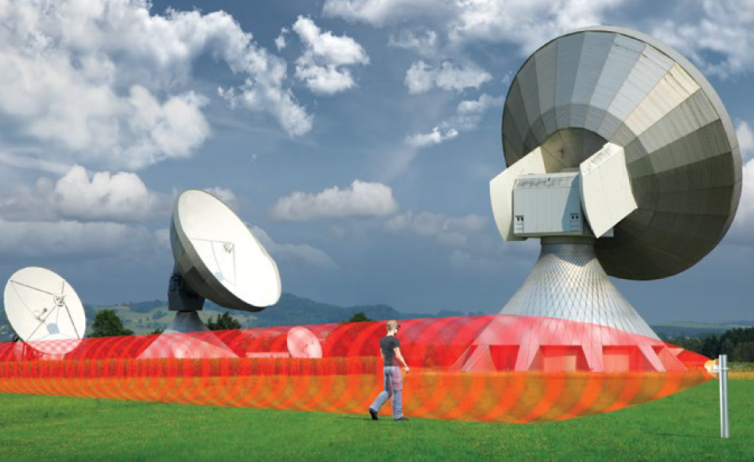
POWER OVER ETHERNET SENSOR SUITE

Slide 2
VALUE PROP: POE SENSORS
PoE for Fence and Microwave PIDS Solutions
On-board network servers enable new capabilities:
Sensor set-up / administration from a browser on any connected PC or mobile device
Real time alarm reporting to multiple controller types
Standard IP-network hardware for all connections
Power & data over Ethernet reduces hardware requirements:
No DC power supply or battery, EMI/RFI line filters, JB70A, data cables or power cables
Reduces labor, cost for device setup, and integration

Slide 3

POE DIGITAL MICROWAVE LINKS
X-band (334-POE) and K-band (336-POE) models
Same key features as digital microwave sensors
Power over Ethernet (IEEE 802.3af, Class 1)
Integration with IP / POE-enabled security devices
Alarm monitoring via server-based controller or third-party High Level Interface
Convenient, browser-based local or remote device management
IP-based infrastructure lowers installation time and cost

Slide 4
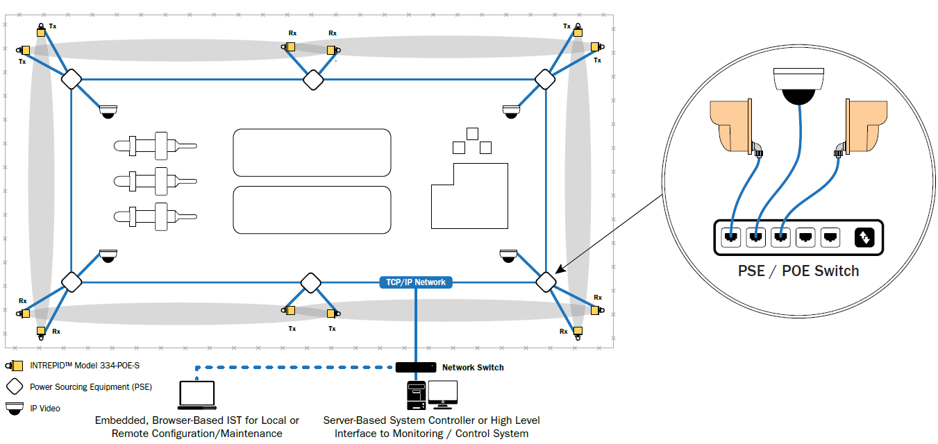
POE / IP-Based Microwave Sensors Simplified Infrastructure
Notes:
Here’s an example of the FSA in action. You’ll notice right away that the Microwave would normally be considered way too close to the fence. In this case, we’re using the digital microwave with the FSA turned on. When we play the video, you can see the razor wire shaking in the wind, as well as see the fence moving within the zone. The blue line is showing activity so it’s evident that the sensor is detecting that movement. However, that noise is reduced and the zone stays clear of an alarm.

Slide 5
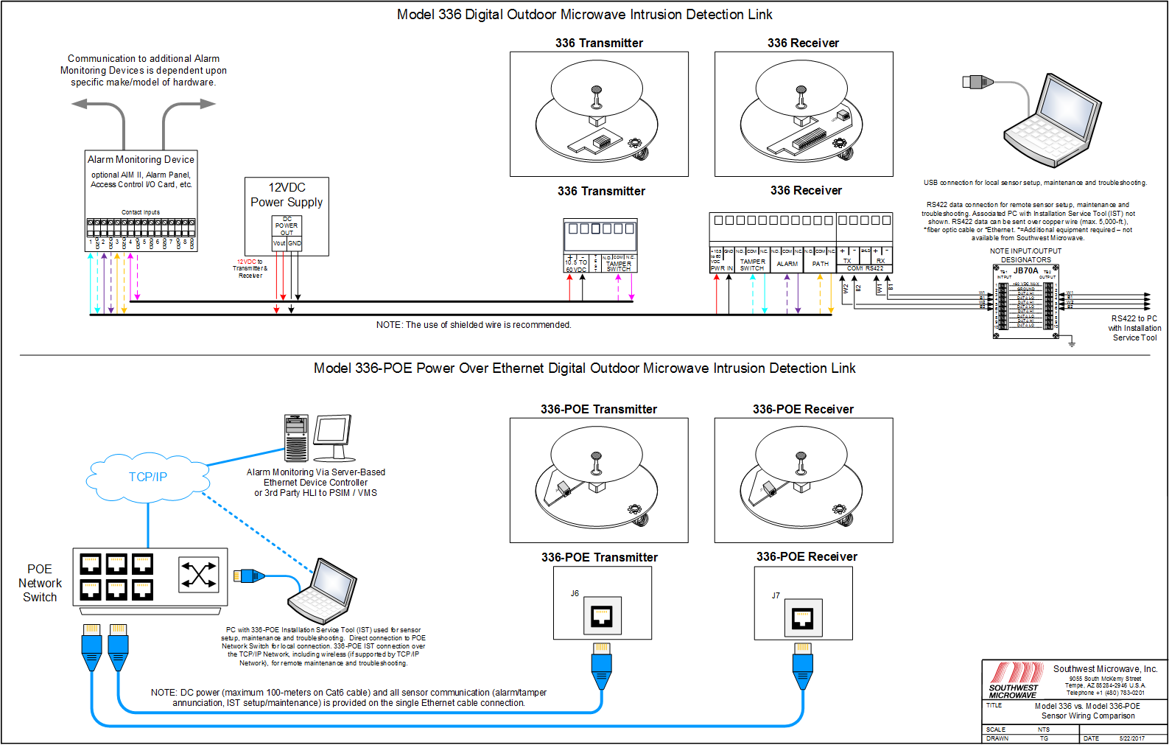
POE / IP-Based Microwave Sensors Simplified Infrastructure
Notes:
Here’s an example of the FSA in action. You’ll notice right away that the Microwave would normally be considered way too close to the fence. In this case, we’re using the digital microwave with the FSA turned on. When we play the video, you can see the razor wire shaking in the wind, as well as see the fence moving within the zone. The blue line is showing activity so it’s evident that the sensor is detecting that movement. However, that noise is reduced and the zone stays clear of an alarm.

Slide 6
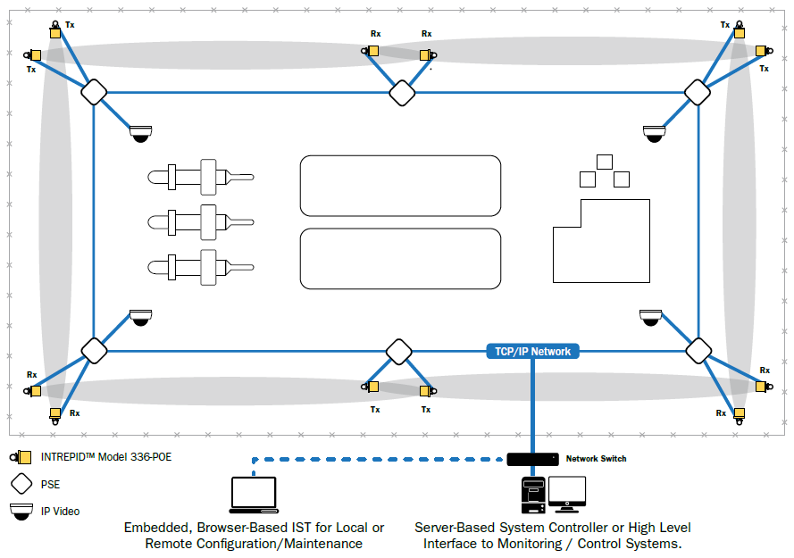
POE / IP-Based Microwave Sensors Simplified Infrastructure
Notes:
Here’s an example of the FSA in action. You’ll notice right away that the Microwave would normally be considered way too close to the fence. In this case, we’re using the digital microwave with the FSA turned on. When we play the video, you can see the razor wire shaking in the wind, as well as see the fence moving within the zone. The blue line is showing activity so it’s evident that the sensor is detecting that movement. However, that noise is reduced and the zone stays clear of an alarm.

Slide 7
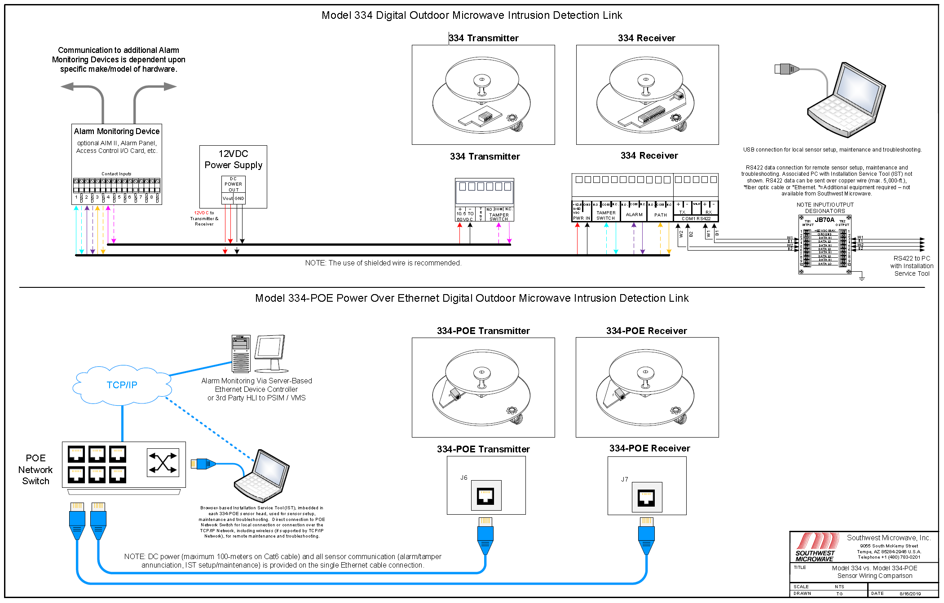
POE / IP-Based Microwave Sensors Simplified Infrastructure
Notes:
Here’s an example of the FSA in action. You’ll notice right away that the Microwave would normally be considered way too close to the fence. In this case, we’re using the digital microwave with the FSA turned on. When we play the video, you can see the razor wire shaking in the wind, as well as see the fence moving within the zone. The blue line is showing activity so it’s evident that the sensor is detecting that movement. However, that noise is reduced and the zone stays clear of an alarm.

Slide 8

MICROPOINT-POE FENCE SENSOR
Same key features as INTREPID MicroPoint II:
Intrusion location to within 3m
Calibration in 1m increments for uniform detection along fenceline (Sensitivity Leveling)
Alarms on ‘point impacts’, ignores harmless environmental disturbances
Power over Ethernet (IEEE 802.3af, Class 1)
Integration with IP / POE-enabled security devices
Convenient, browser-based local or remote device management via PC or mobile device
Alarm monitoring via server-based controller or third-party High Level Interface
IP-based infrastructure lowers installation time and cost

Slide 9
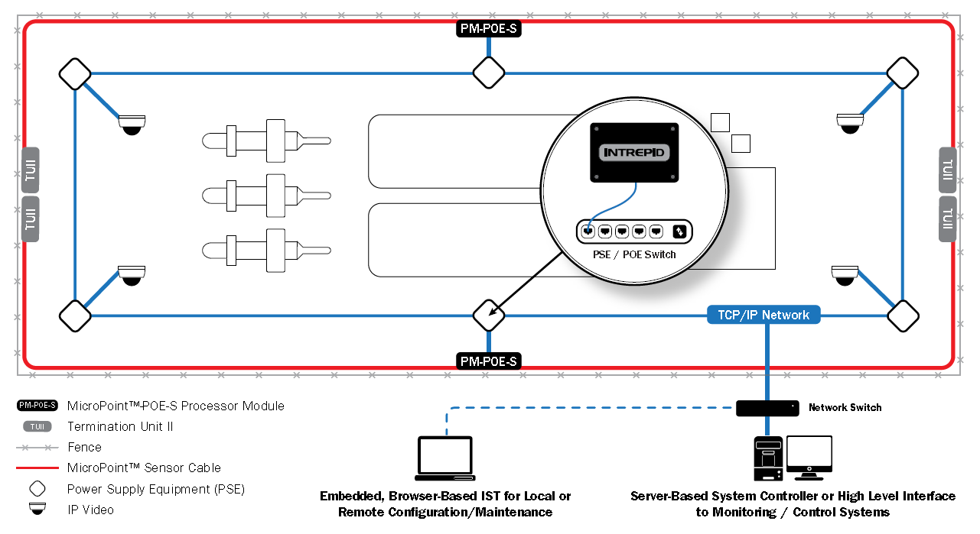
POE / IP-Based Fence Sensor Simplified Infrastructure
Notes:
Here’s an example of the FSA in action. You’ll notice right away that the Microwave would normally be considered way too close to the fence. In this case, we’re using the digital microwave with the FSA turned on. When we play the video, you can see the razor wire shaking in the wind, as well as see the fence moving within the zone. The blue line is showing activity so it’s evident that the sensor is detecting that movement. However, that noise is reduced and the zone stays clear of an alarm.

Slide 10
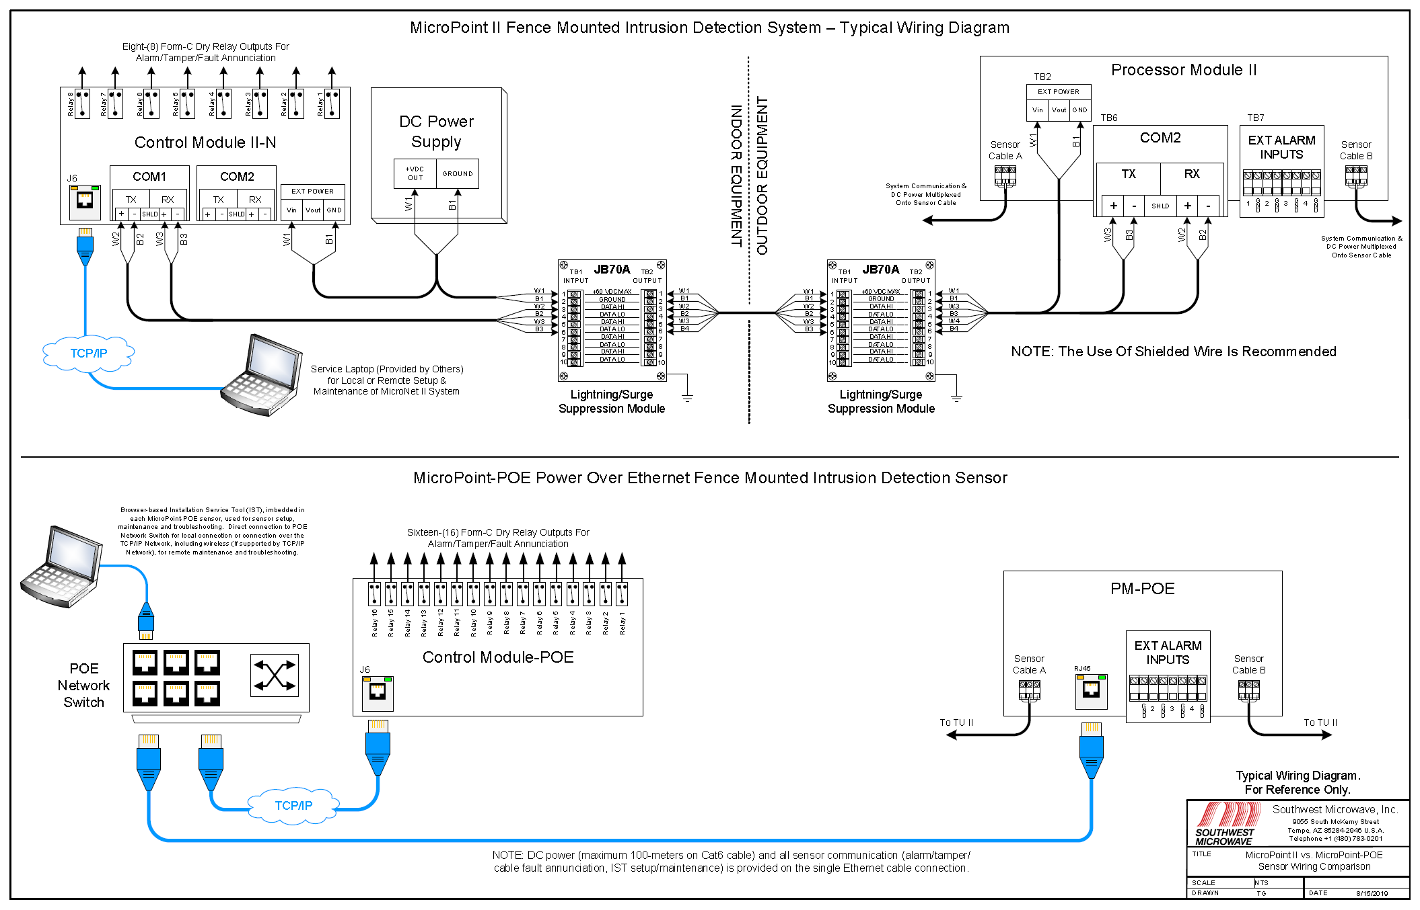
POE / IP-Based Fence Sensor
(MicroPoint-POE) Simplified Infrastructure
Notes:
Here’s an example of the FSA in action. You’ll notice right away that the Microwave would normally be considered way too close to the fence. In this case, we’re using the digital microwave with the FSA turned on. When we play the video, you can see the razor wire shaking in the wind, as well as see the fence moving within the zone. The blue line is showing activity so it’s evident that the sensor is detecting that movement. However, that noise is reduced and the zone stays clear of an alarm.

Slide 11
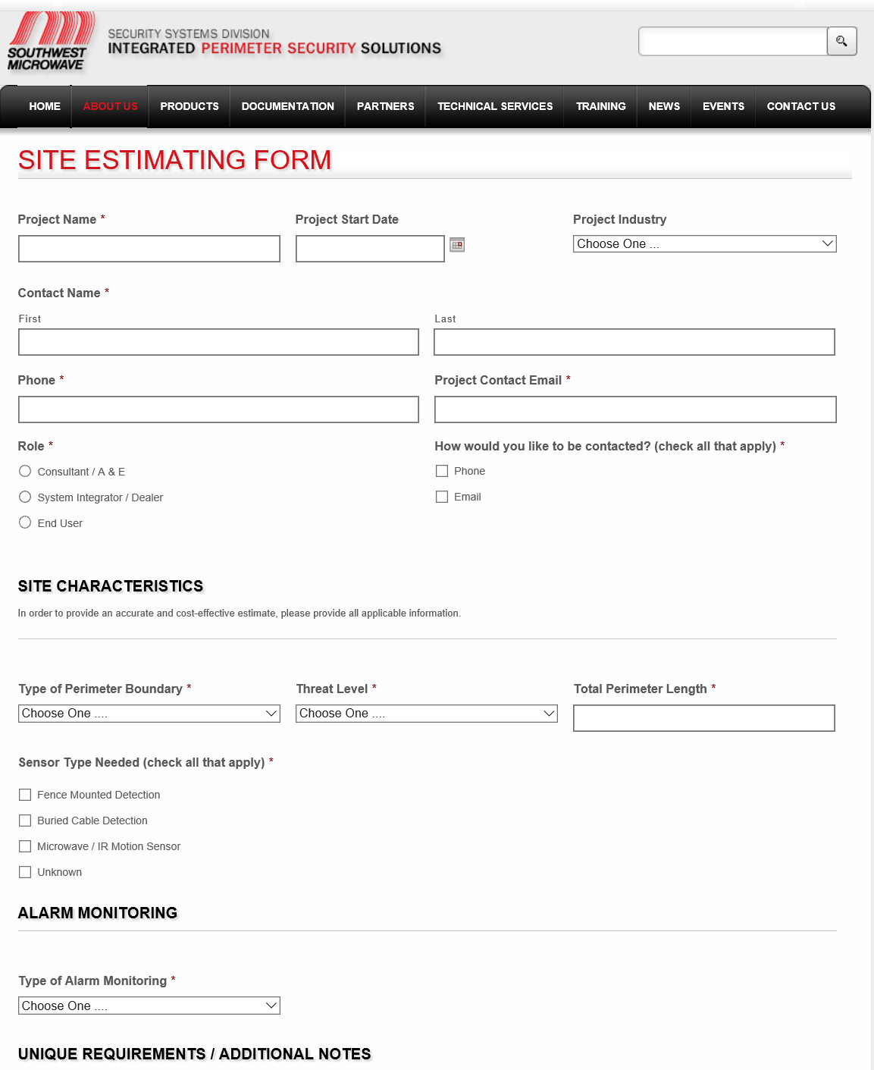
1. Submit a
Site Estimating Form
2. Upload a drawing
3. Expect prompt reply from our Sales Engineers to review your project needs and provide a proposal package

Slide 12
Local Support
Amy Leslie, Regional Sales Manager, Southwest Microwave
amyl@southwestmicrowave.com
Jeff Drews, Sr. Sales Manager - Federal / Military / Nuclear Systems, Southwest Microwave
jeffd@southwestmicrowave.com
Chesapeake and Midlantic Marketing (MidChes)
support@midches.com
(410) 612-9640
(610) 361-0500

Slide 13

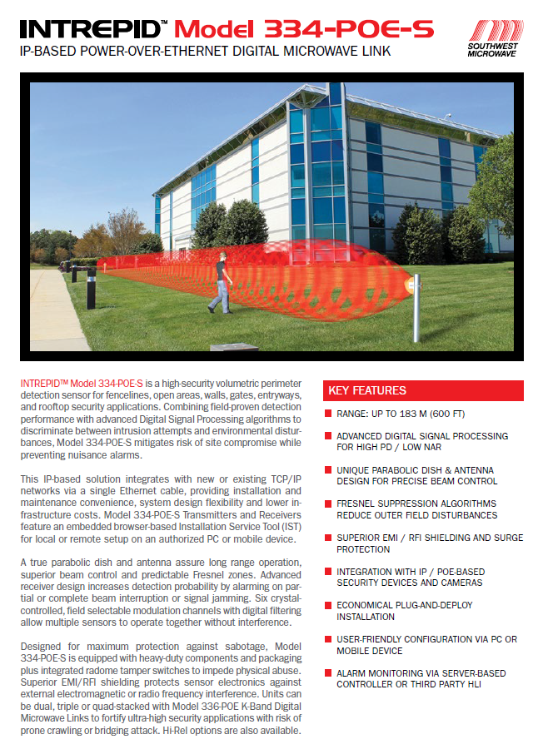


WEB LINKS TO POE DATA SHEETS
INTREPID™ MicroPoint™-POE-S Fence Detection Sensor Data Sheet
INTREPID™ Model 336-POE Digital Microwave Link Data Sheet
INTREPID™ Model 334-POE-S Digital Microwave Link Data Sheet
INTREPID™ POE System Controllers Data Sheet

