Slide 1
Bosch Security Certification Paths
New for 2023

Slide 2





New Commercial certification and 2-level structure in 2023
What will change?
Creation of a commercial certification in addition of the technical, and elimination of professional level, keeping only expert and master
TECHNICAL CERTIFICATION
COMMERCIAL CERTIFICATION
Expert
This Certification includes courses to acquire essential knowledge for the basic configuration and, in case of Public address, Communication and Fire Solutions, also system design
Expert
This Certification includes several training modules in order to obtain knowledge about product portfolio for sales prospects highlighting the key benefits
Master
This Certification builds upon the expert level by providing a deeper knowledge for advanced configurations of the corresponding system and troubleshooting
Master
This Certification includes several training modules in order to obtain knowledge about product portfolio for sales prospects highlighting the key benefits

Slide 3
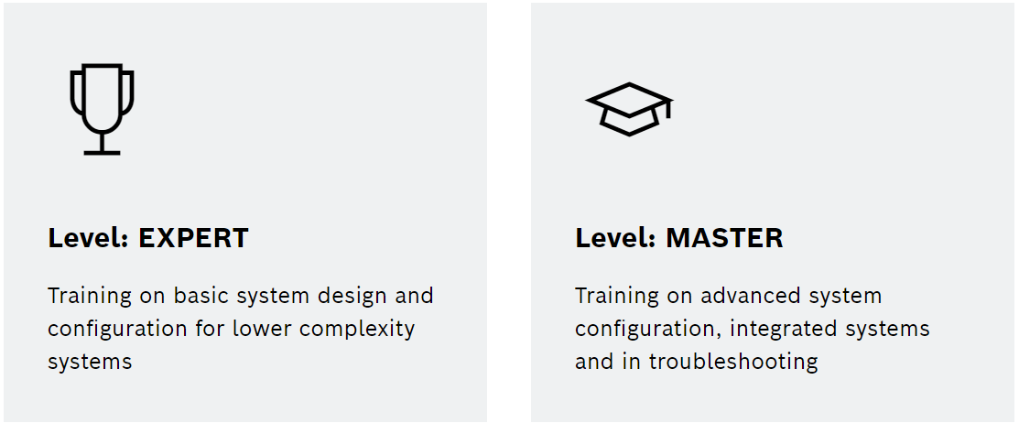
Targeted Roles
Commercial Paths
Expert (free online)
  Order Entry Admins
  SI/DI Sales
  New Hires/ Entry Level Associates
  End-Users
Master (free online)
  SI/DI Senior Sales
  Install/ Project Managers
  System Designers
  Solution/District Sales Managers

Slide 4
Targeted Roles
Technical Paths
Expert (chargeable blended)
  SI Installer/Service Technicians
  SI Programmers
  SI/DI Senior System Designers
Master (chargeable blended)
  Senior Installer/Service Technicians
  Advanced SI Programmers
  Advanced Integration System Designers
  Training and Technical Support

Slide 5
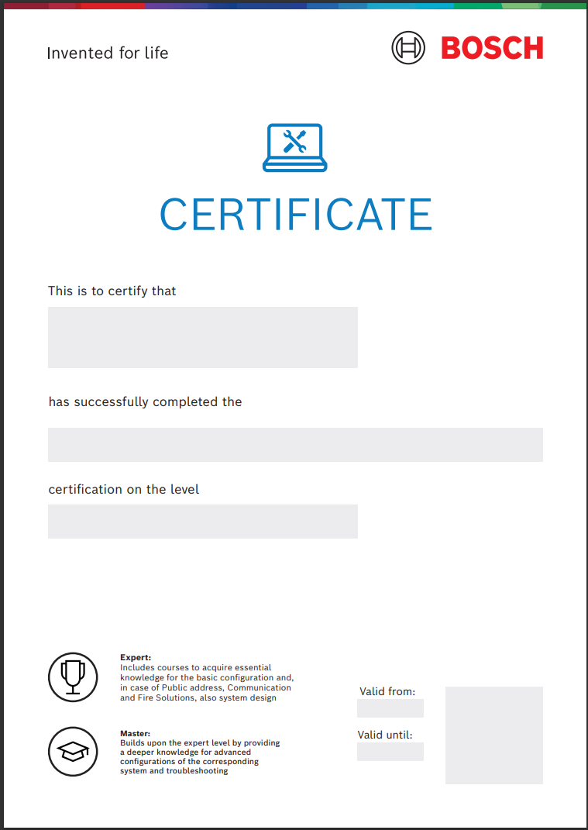
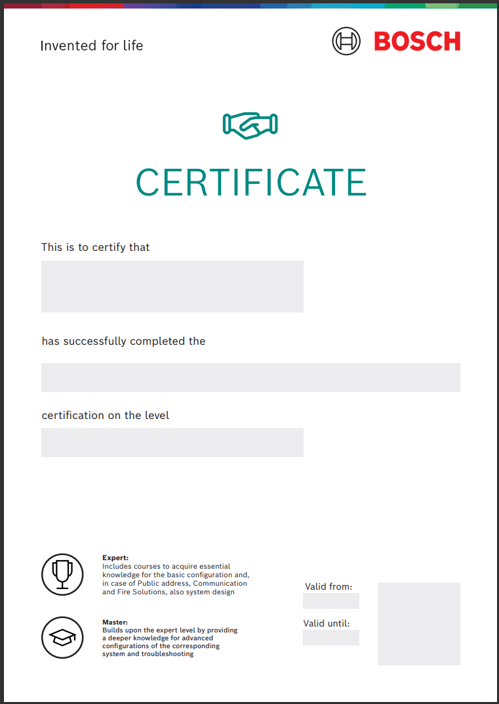
Certificates
New Look
Creation of new certificates to differenciate the Technical and Commercial certifications

Slide 6

Please contact us with any questions
support@midches.com

