Slide 1


FLEXIDOME IP starlight 8000i
R vs RT Lens Options
Calculations and Visual Examples
support@midches.com
Chesapeake & Midlantic Marketing (MidChes)
www.midches.com | support@midches.com
(410 ) 612-9640 | (610) 361-0500
EXPERT | SECURITY | ADVICE

Slide 2
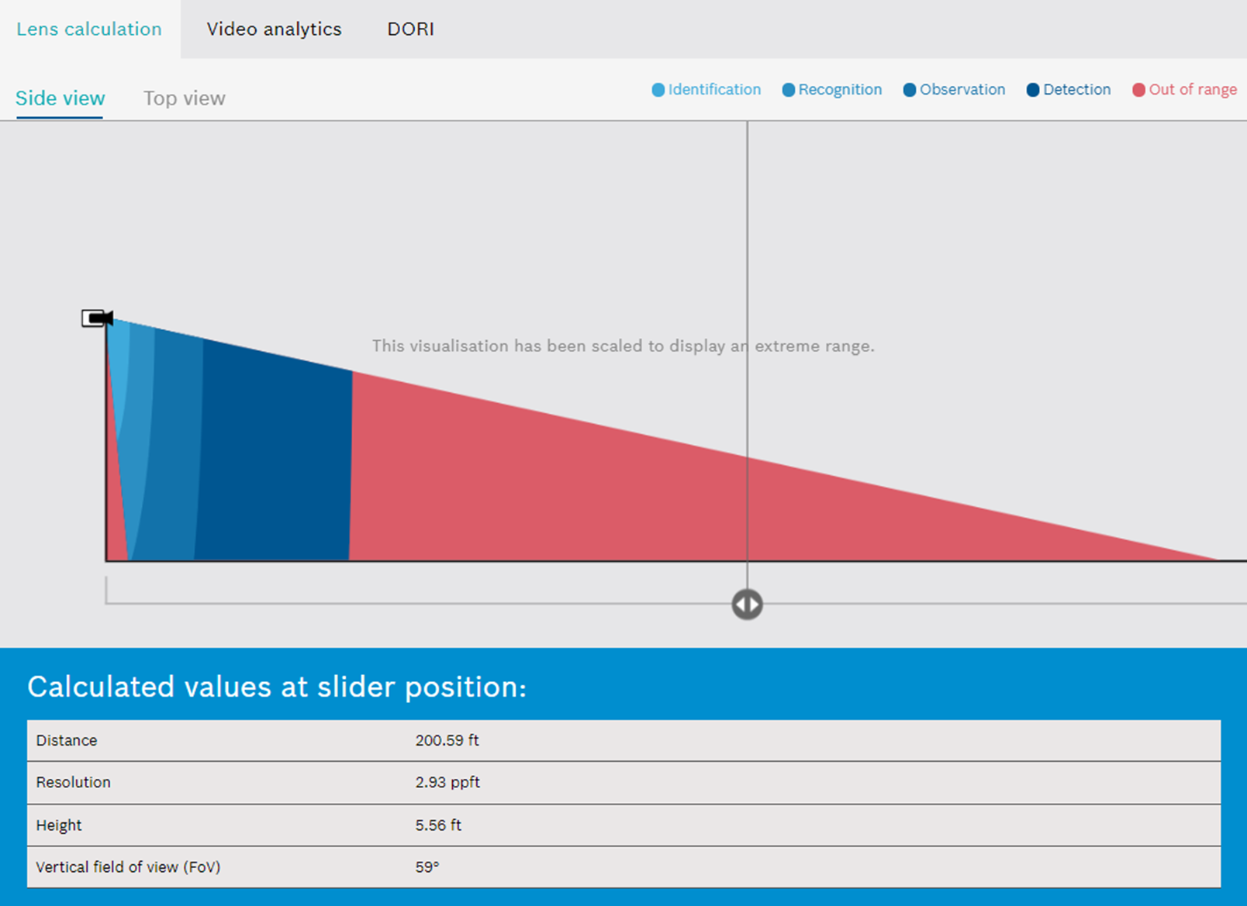
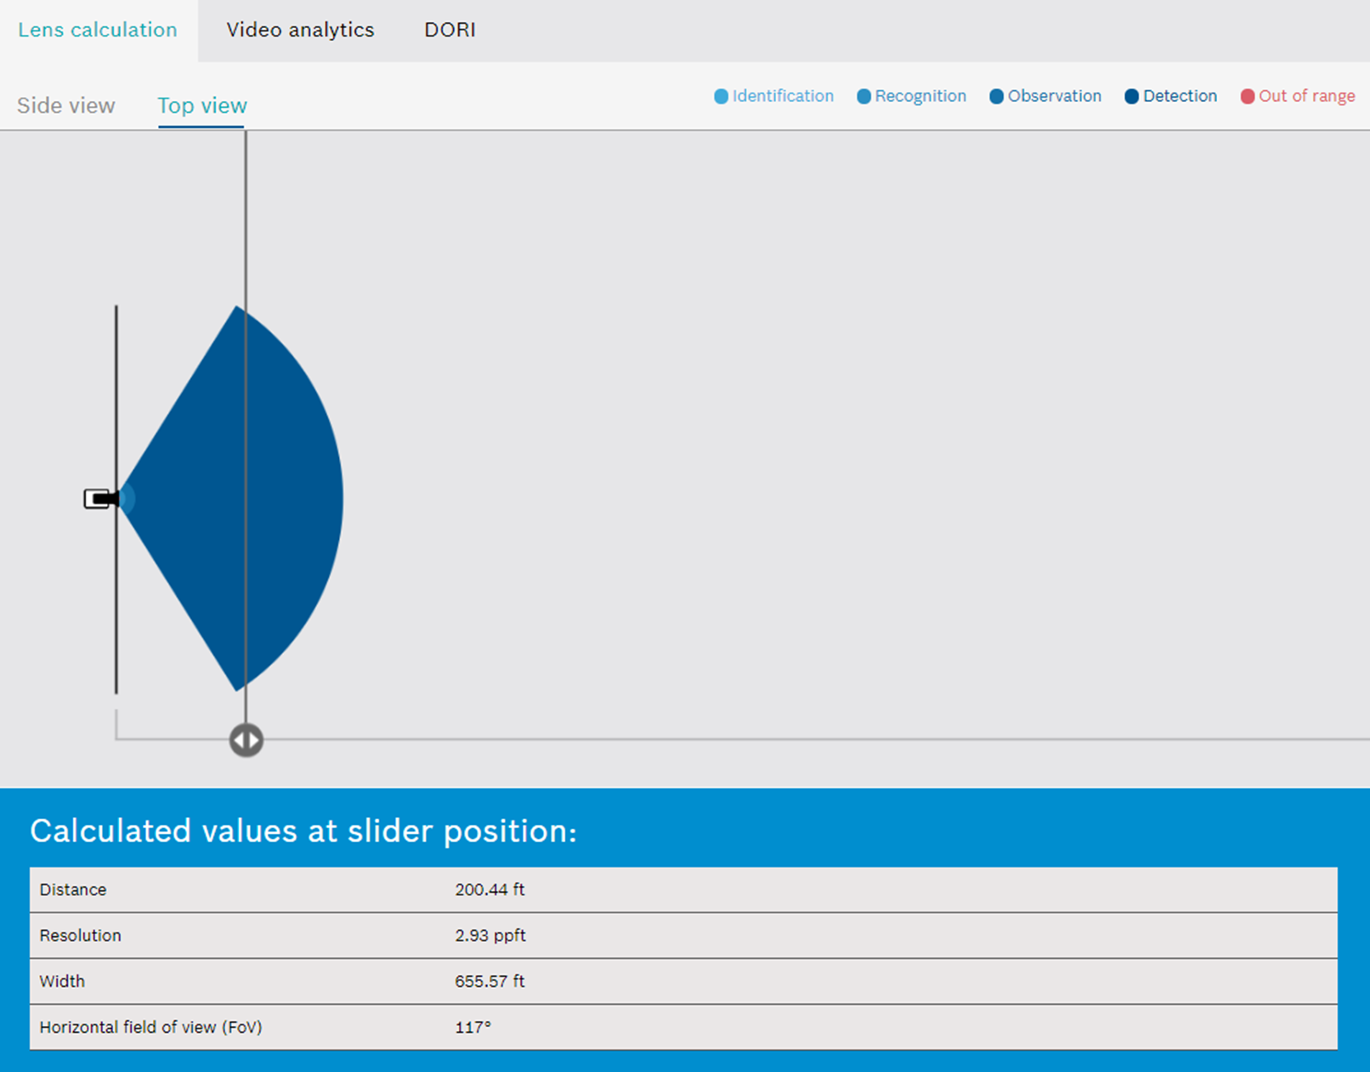
Calculation Examples
FLEXIDOME starlight 8000i R/RT 2MP (1080p)
3mm at 200’
©2021 Chesapeake and Midlantic Marketing www.midches.com | support@midches.com | (410) 612-9640 | (410) 610-0500
EXPERT | SECURITY | ADVICE

Slide 3
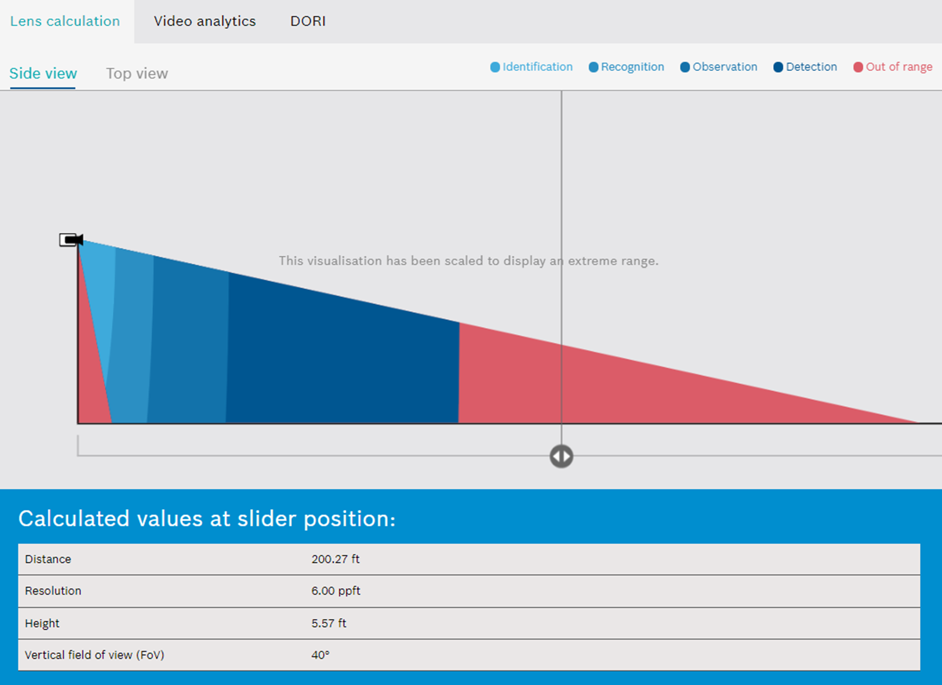
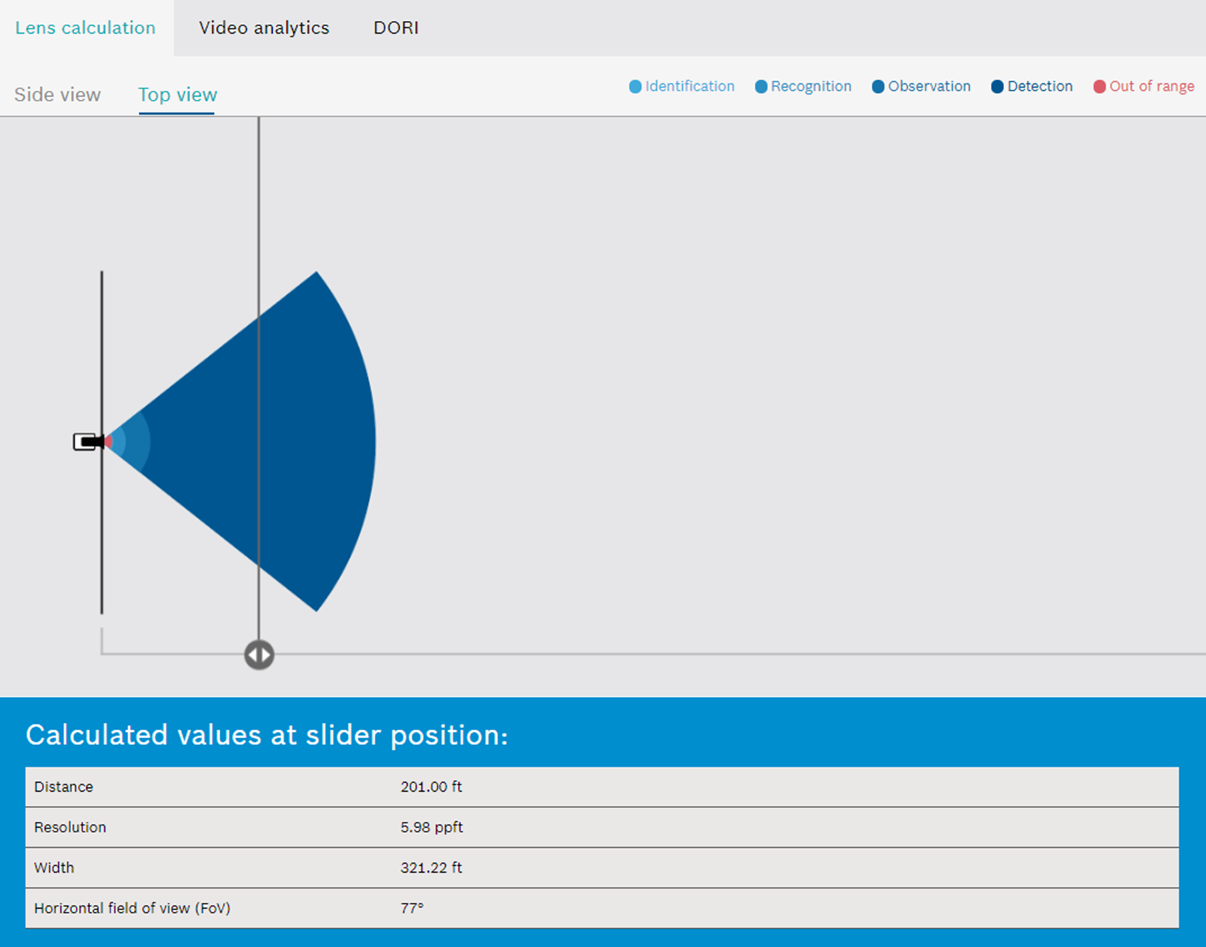
Calculation Examples
FLEXIDOME starlight 8000i R/RT 2MP (1080p)
6mm at 200’
©2021 Chesapeake and Midlantic Marketing www.midches.com | support@midches.com | (410) 612-9640 | (410) 610-0500
EXPERT | SECURITY | ADVICE

Slide 4
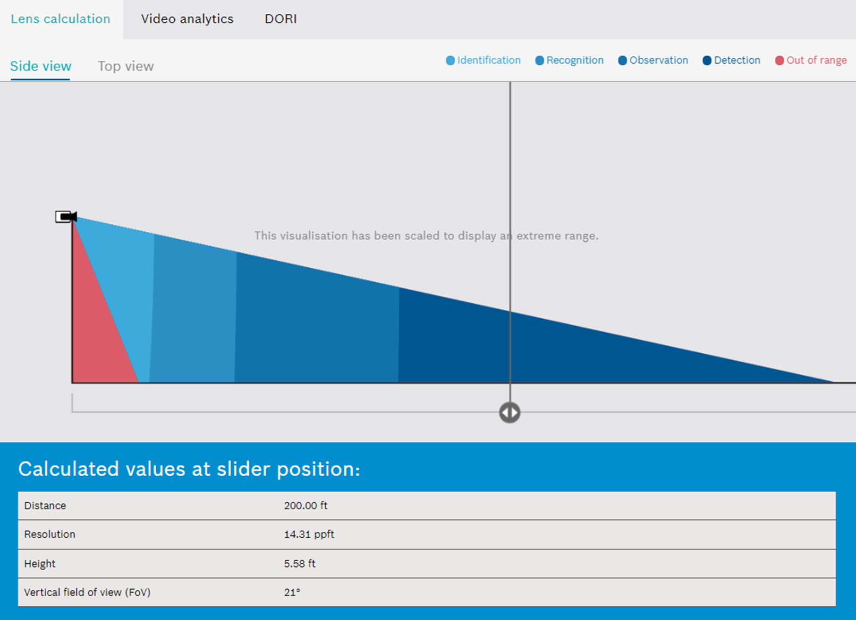
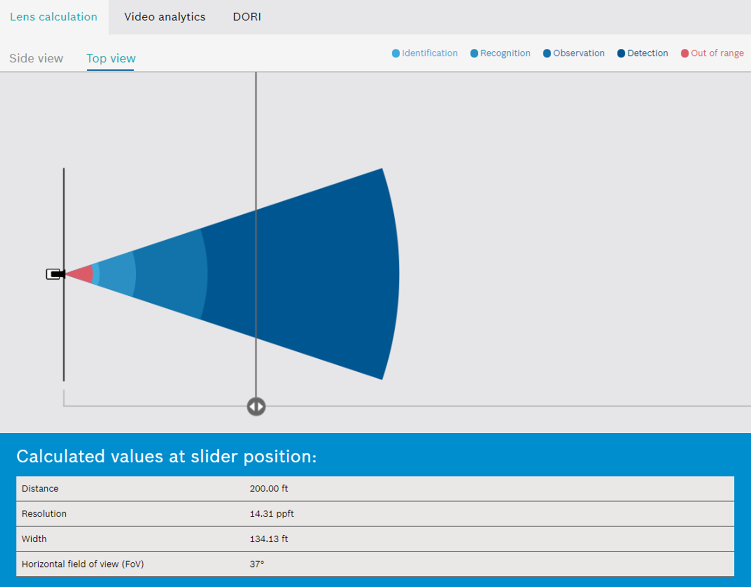
Calculation Examples
FLEXIDOME starlight 8000i R/RT 2MP (1080p)
9mm at 200’
©2021 Chesapeake and Midlantic Marketing www.midches.com | support@midches.com | (410) 612-9640 | (410) 610-0500
EXPERT | SECURITY | ADVICE

Slide 5
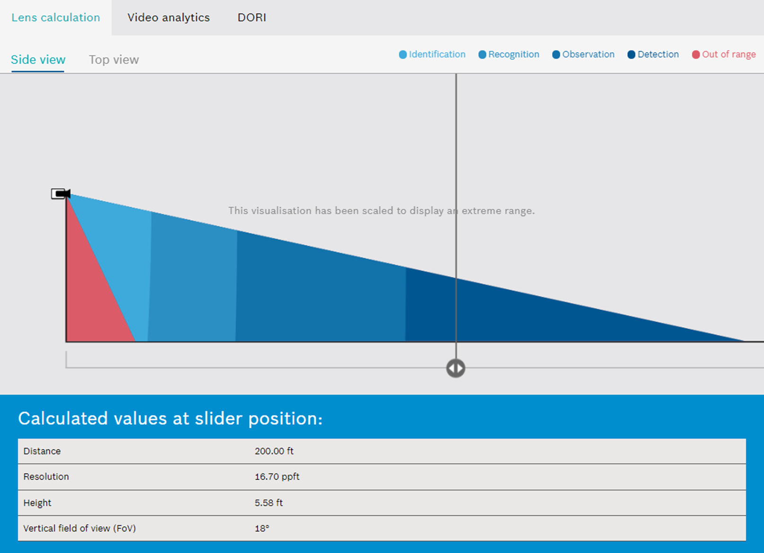
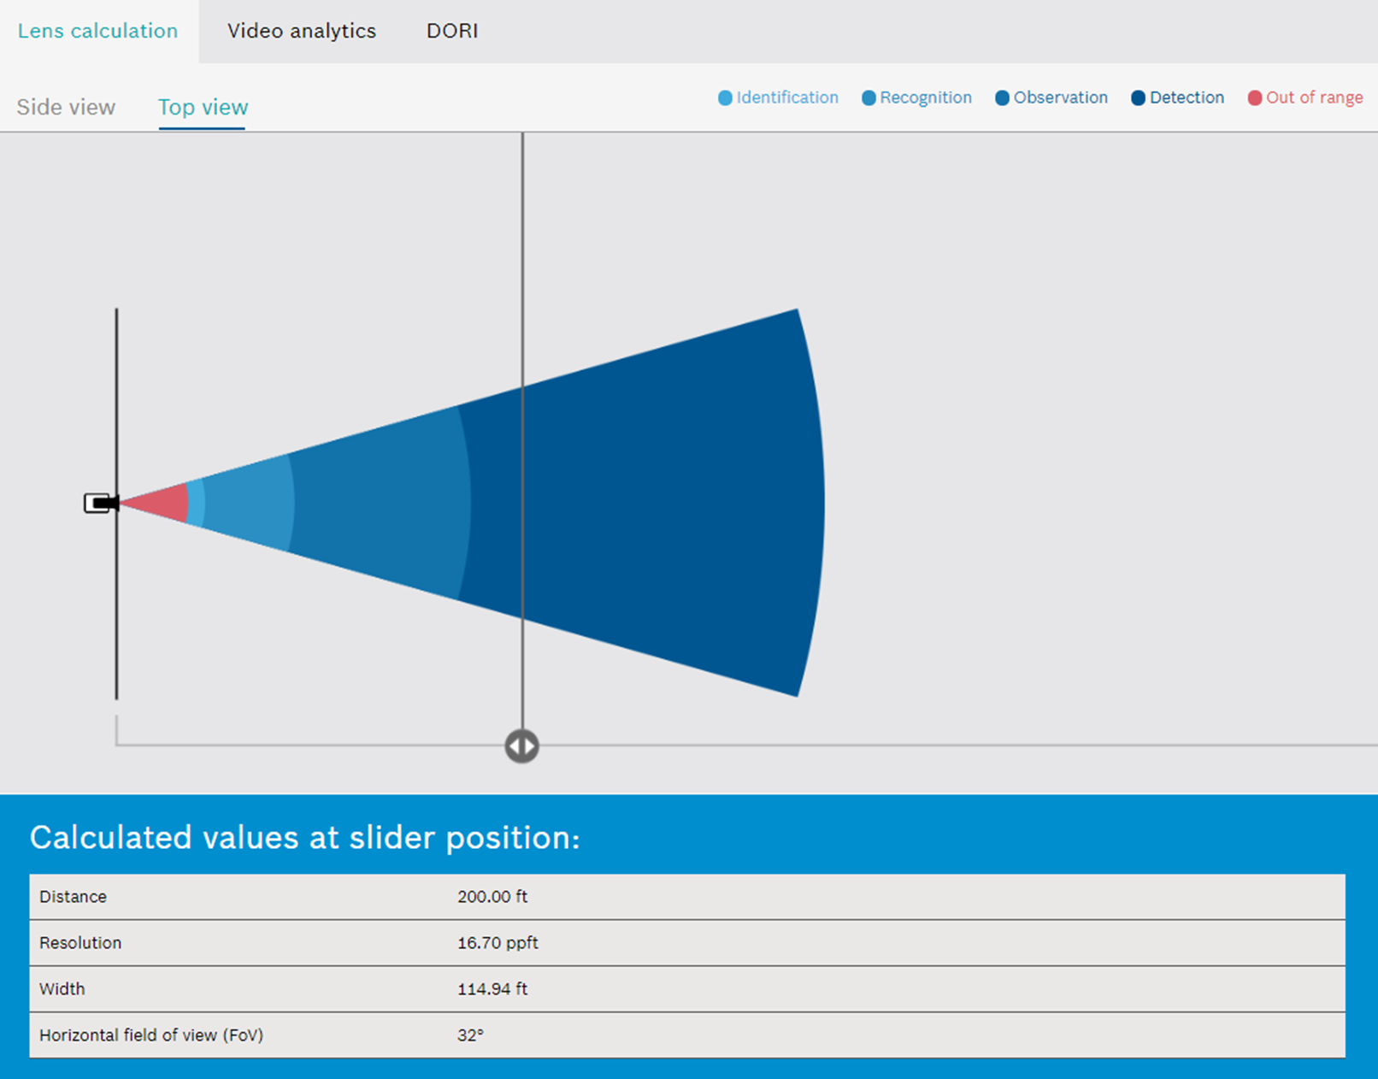
Calculation Examples
FLEXIDOME starlight 8000i R/RT 2MP (1080p)
10mm at 200’
©2021 Chesapeake and Midlantic Marketing www.midches.com | support@midches.com | (410) 612-9640 | (410) 610-0500
EXPERT | SECURITY | ADVICE

Slide 6
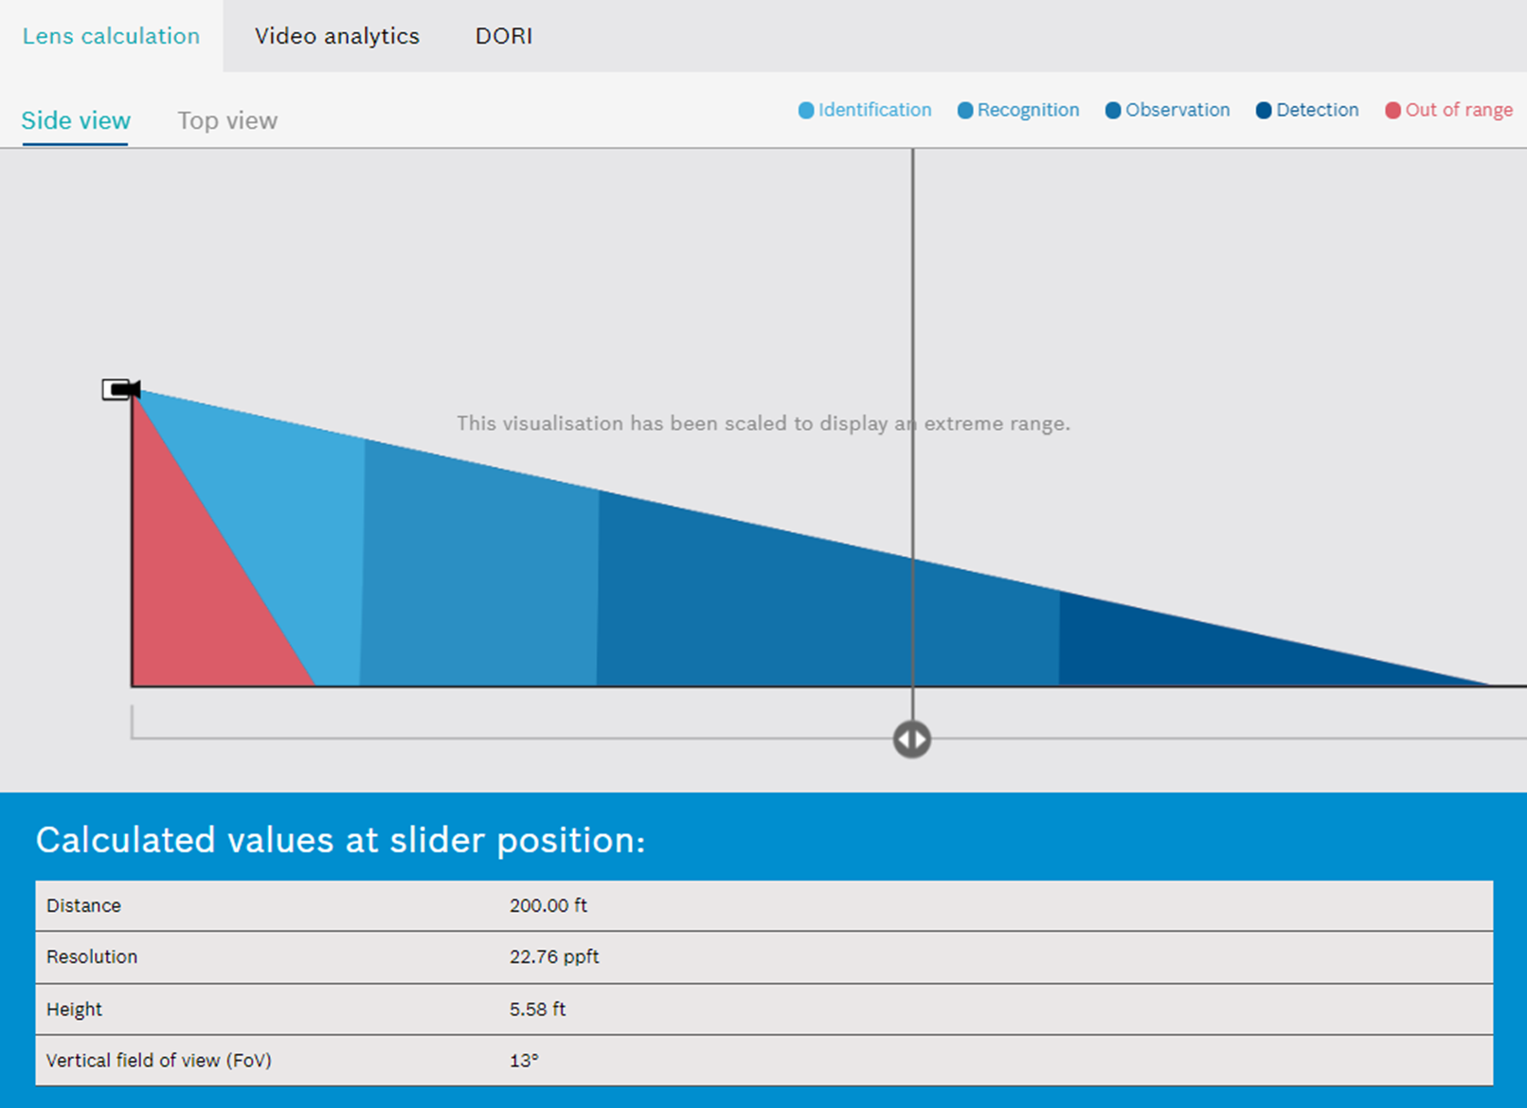
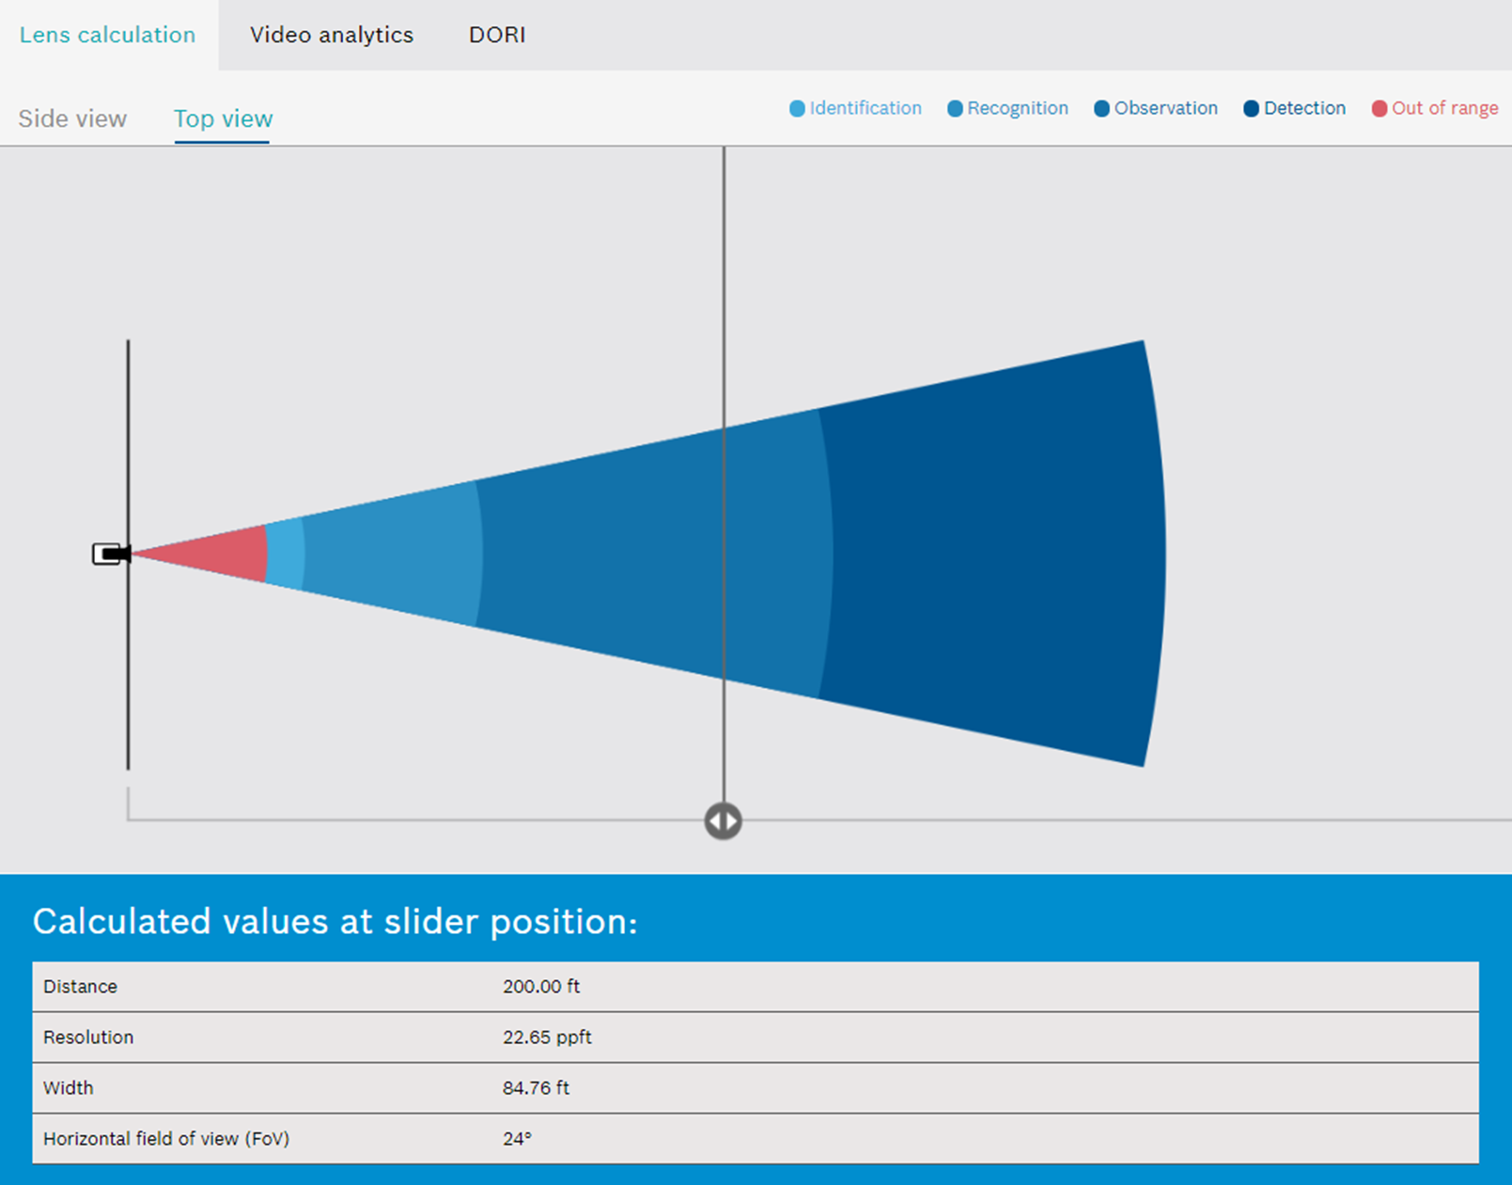
Calculation Examples
FLEXIDOME starlight 8000i R/RT 2MP (1080p)
16mm at 200’
©2021 Chesapeake and Midlantic Marketing www.midches.com | support@midches.com | (410) 612-9640 | (410) 610-0500
EXPERT | SECURITY | ADVICE

Slide 7
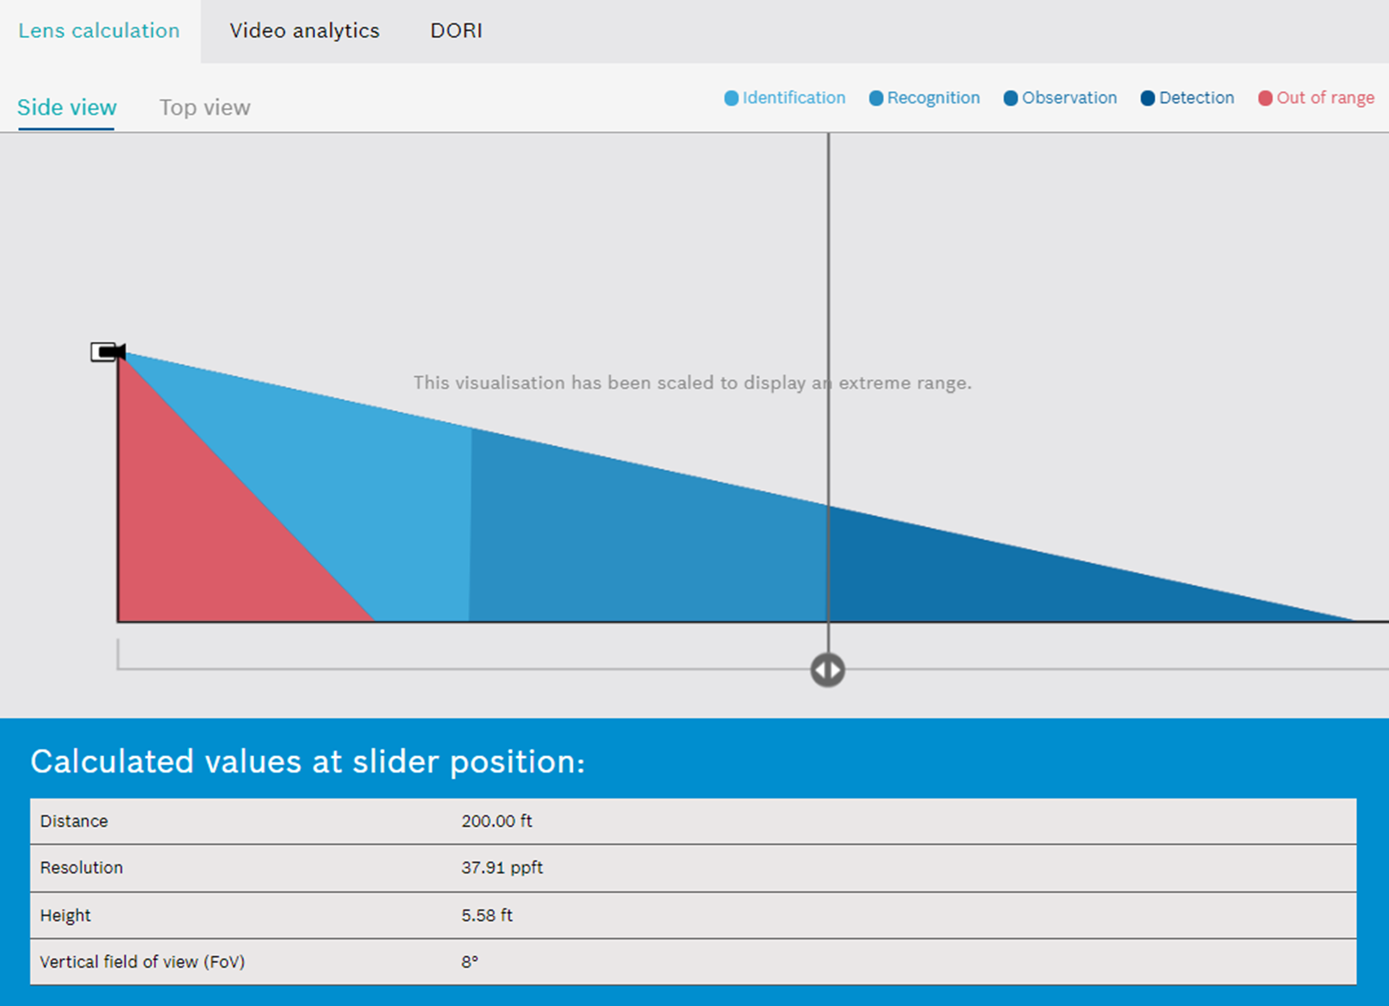
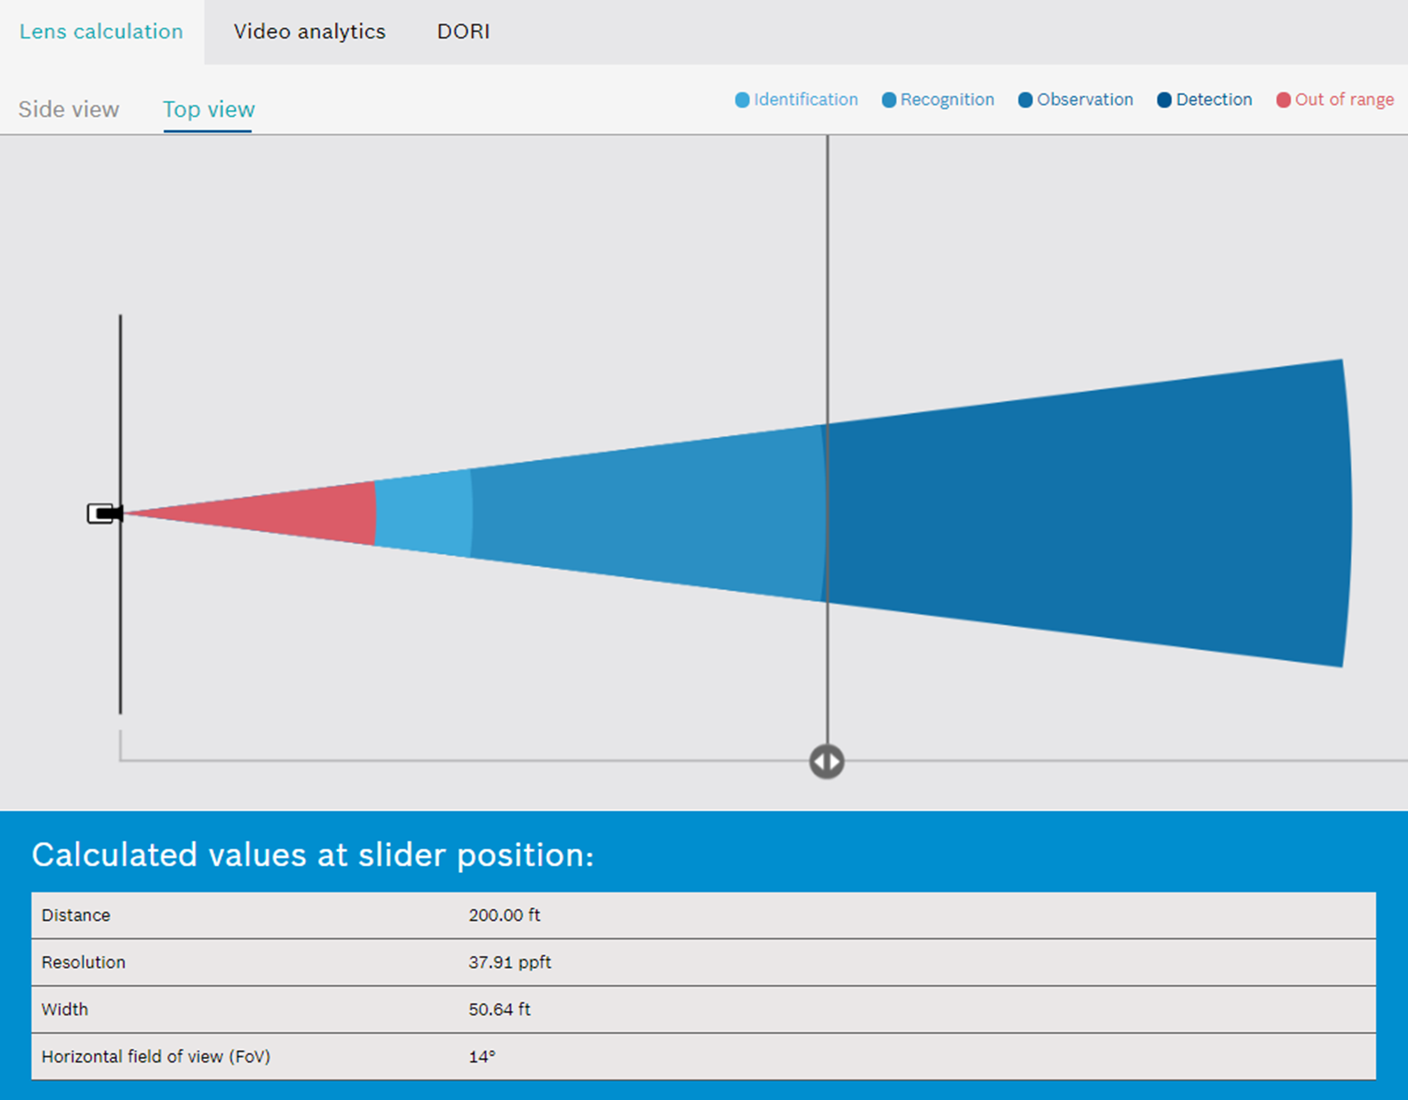
Calculation Examples
FLEXIDOME starlight 8000i R/RT 2MP (1080p)
23mm at 200’
©2021 Chesapeake and Midlantic Marketing www.midches.com | support@midches.com | (410) 612-9640 | (410) 610-0500
EXPERT | SECURITY | ADVICE

Slide 8
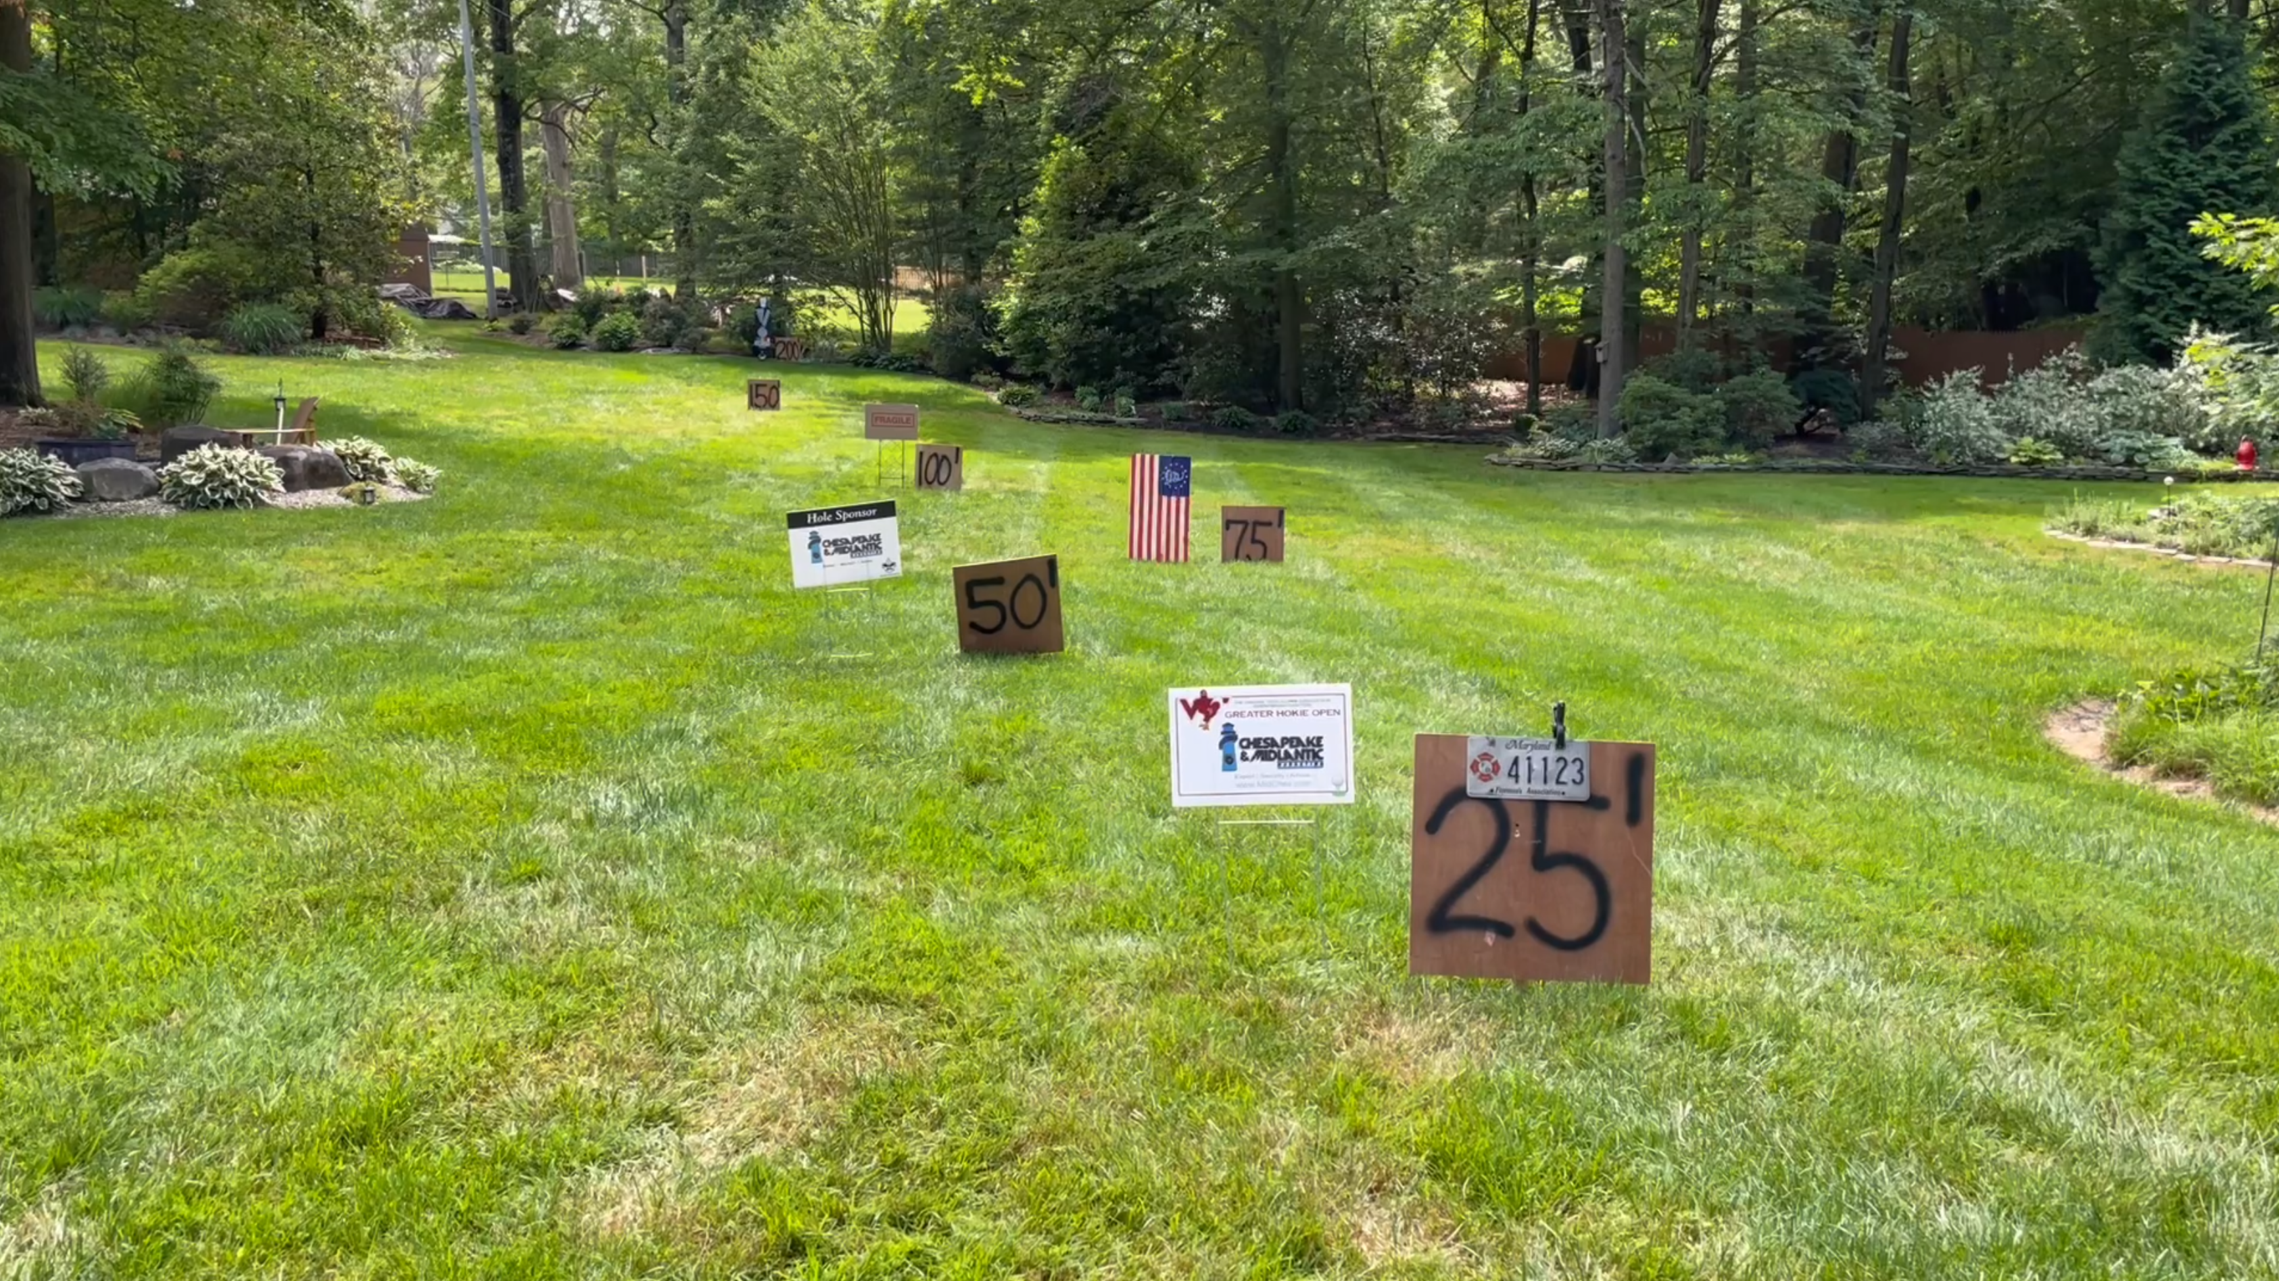
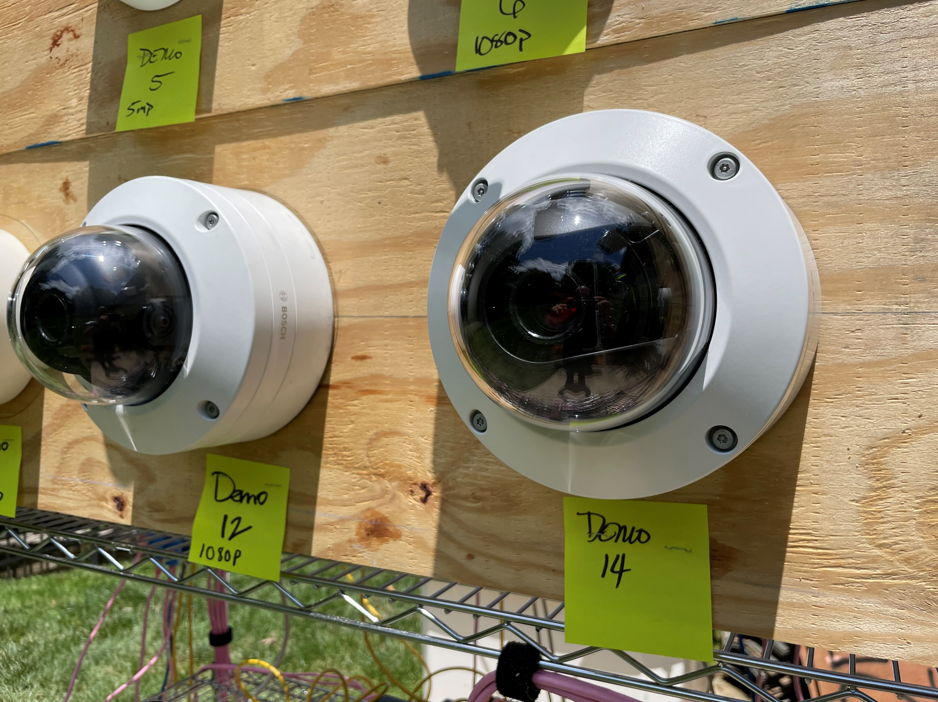
Demonstration Scene
©2021 Chesapeake and Midlantic Marketing www.midches.com | support@midches.com | (410) 612-9640 | (410) 610-0500
EXPERT | SECURITY | ADVICE

Slide 9
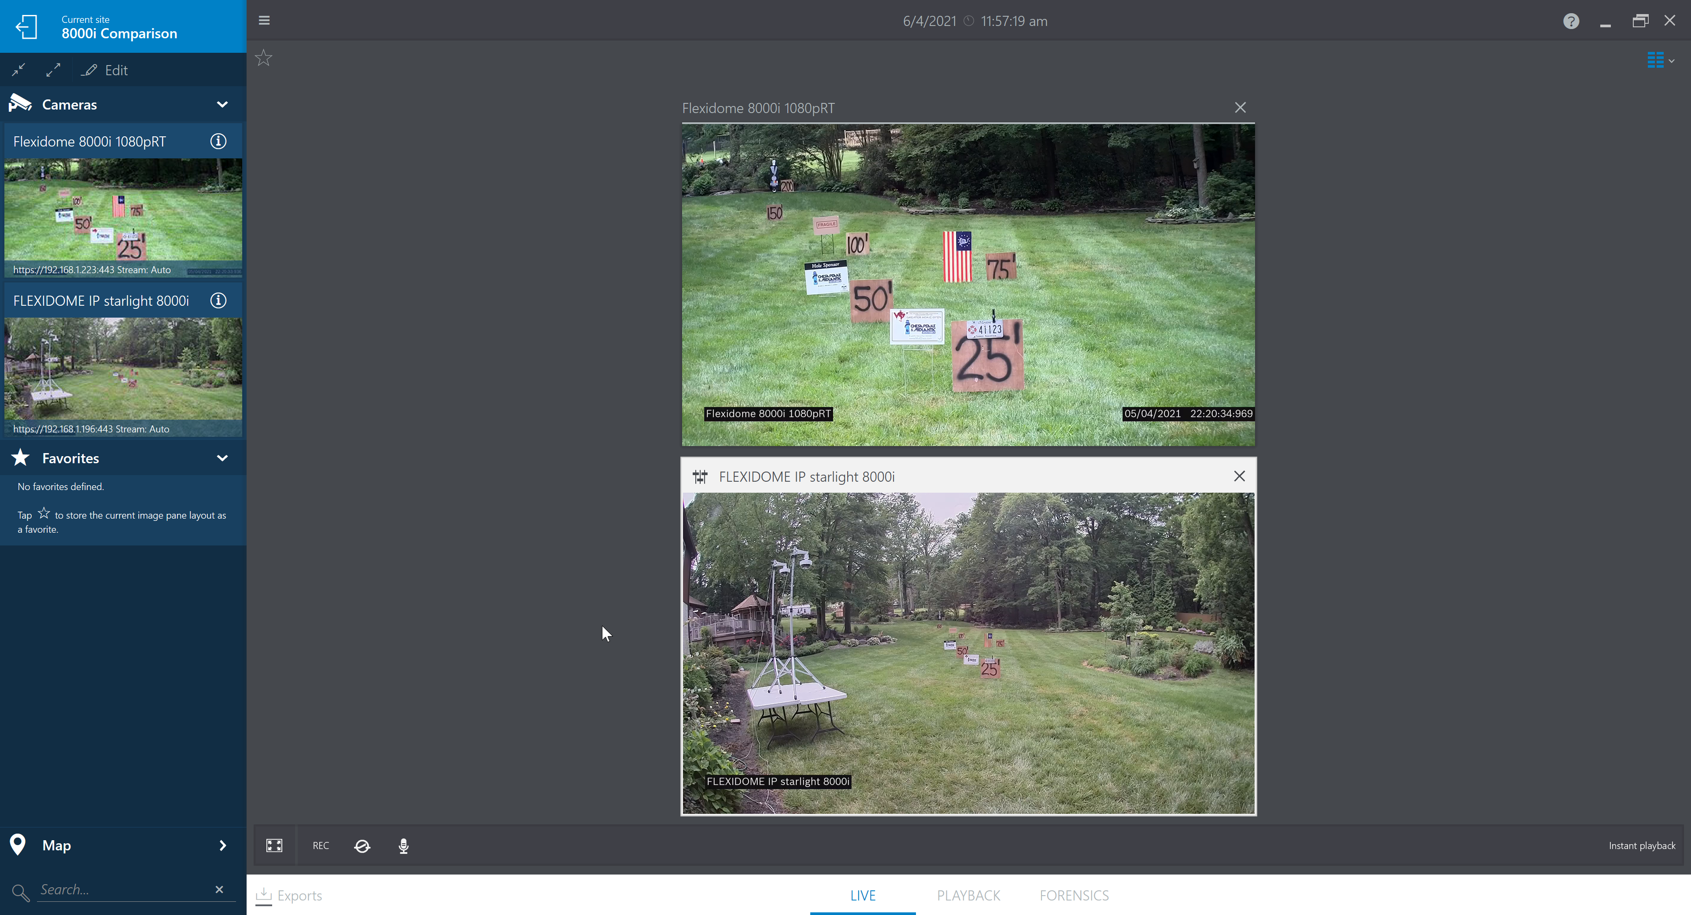
FLEXIDOME starlight 8000i
RT version 2MP (1080p)
Lens at ~10mm
Optical Zoom
FLEXIDOME starlight 8000i
R version 2MP (1080p)
Lens at ~3mm
©2021 Chesapeake and Midlantic Marketing www.midches.com | support@midches.com | (410) 612-9640 | (410) 610-0500
EXPERT | SECURITY | ADVICE

Slide 10
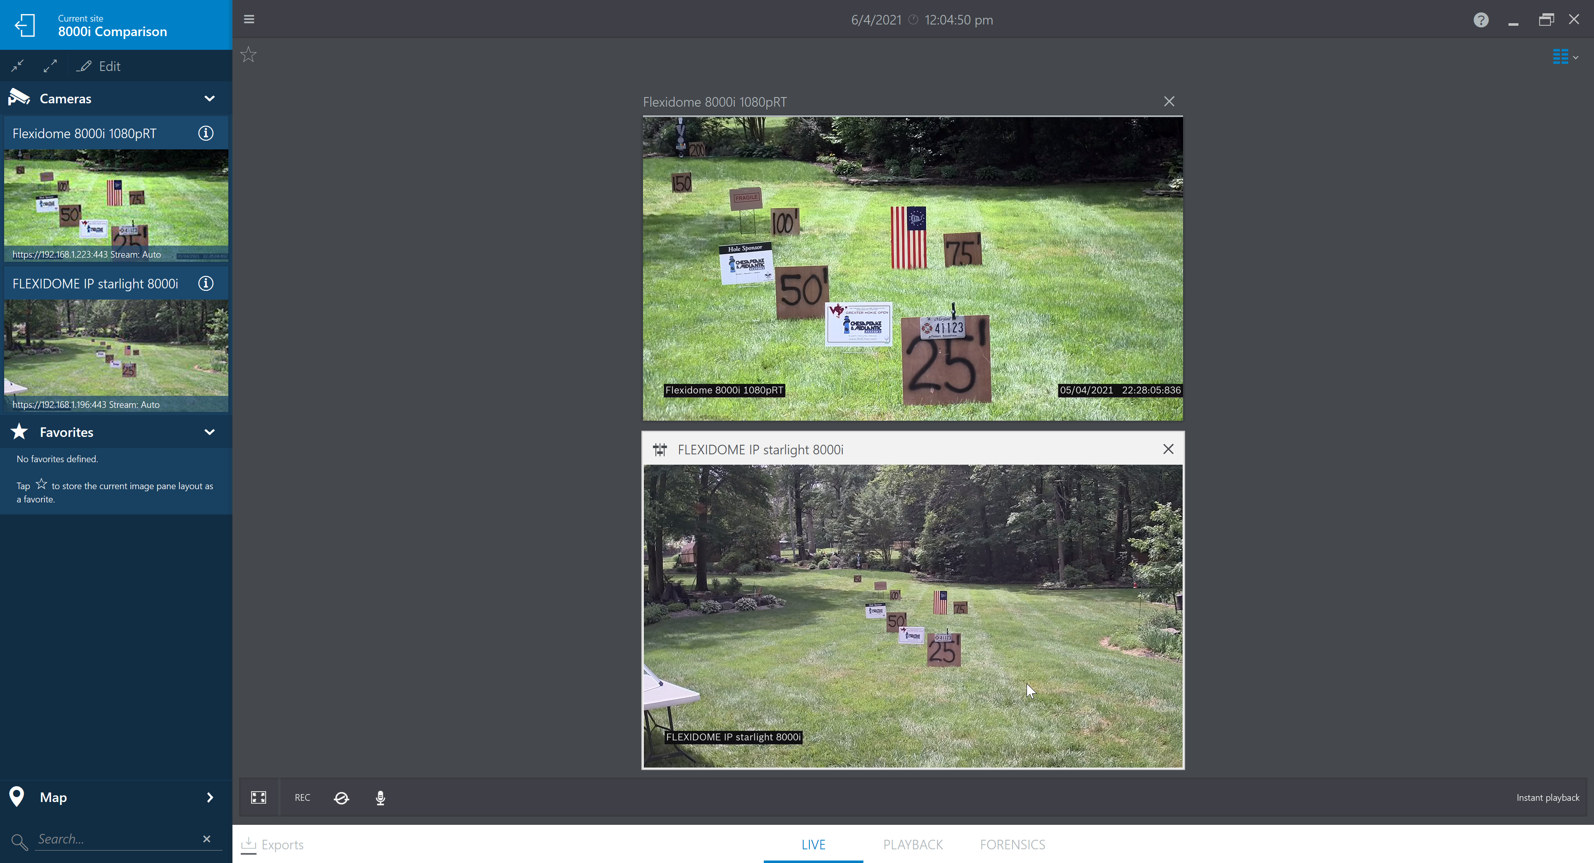
FLEXIDOME starlight 8000i
RT version 2MP (1080p)
Lens at ~17mm
Optical Zoom
FLEXIDOME starlight 8000i
R version 2MP (1080p)
Lens at ~6mm
©2021 Chesapeake and Midlantic Marketing www.midches.com | support@midches.com | (410) 612-9640 | (410) 610-0500
EXPERT | SECURITY | ADVICE

Slide 11
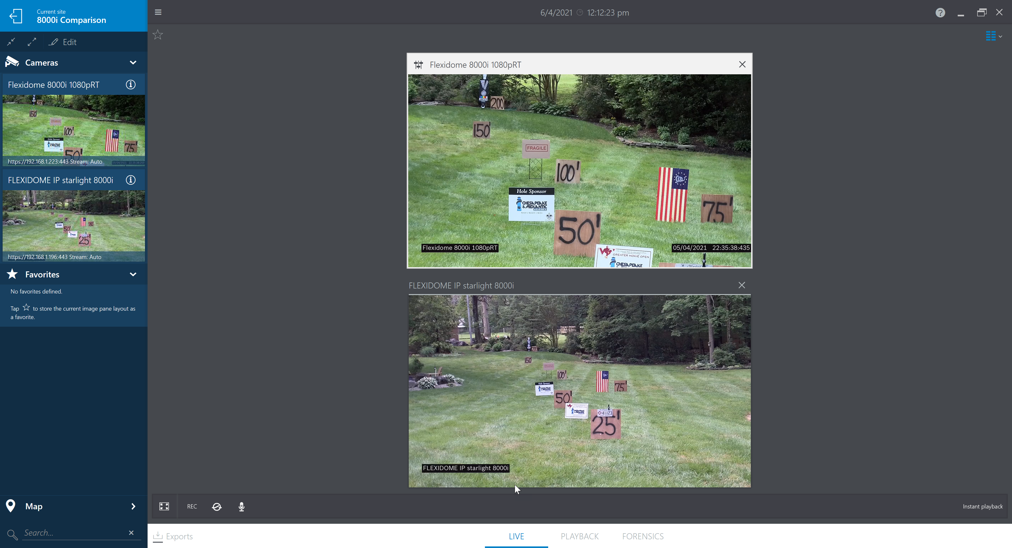
FLEXIDOME starlight 8000i
RT version 2MP (1080p)
Lens at ~23mm
Optical Zoom
FLEXIDOME starlight 8000i
R version 2MP (1080p)
Lens at ~9mm
©2021 Chesapeake and Midlantic Marketing www.midches.com | support@midches.com | (410) 612-9640 | (410) 610-0500
EXPERT | SECURITY | ADVICE

Slide 12
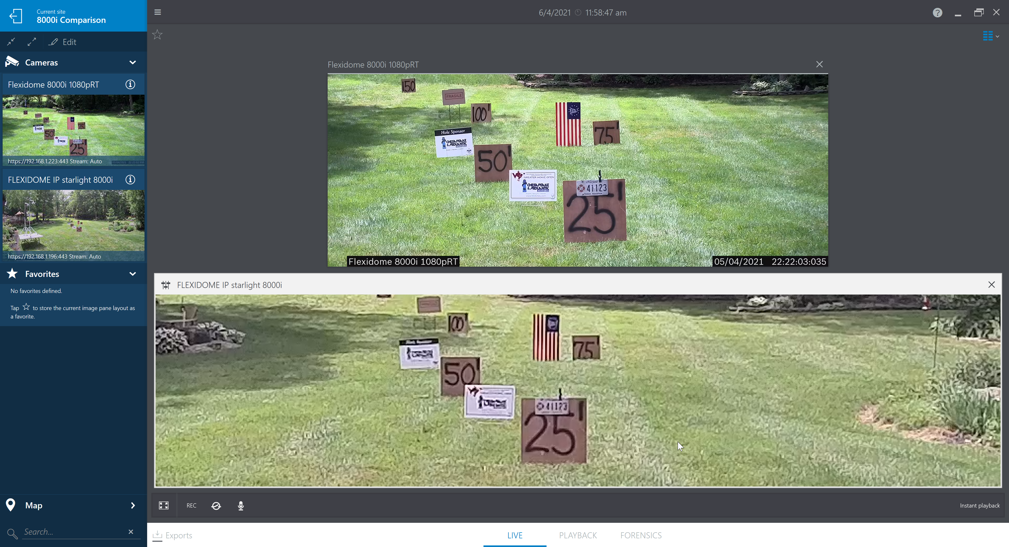
FLEXIDOME starlight 8000i
RT version 2MP (1080p)
Digital Zoom to Similar Field of View
Optical Zoom
FLEXIDOME starlight 8000i
R version 2MP (1080p)
©2021 Chesapeake and Midlantic Marketing www.midches.com | support@midches.com | (410) 612-9640 | (410) 610-0500
EXPERT | SECURITY | ADVICE

Slide 13
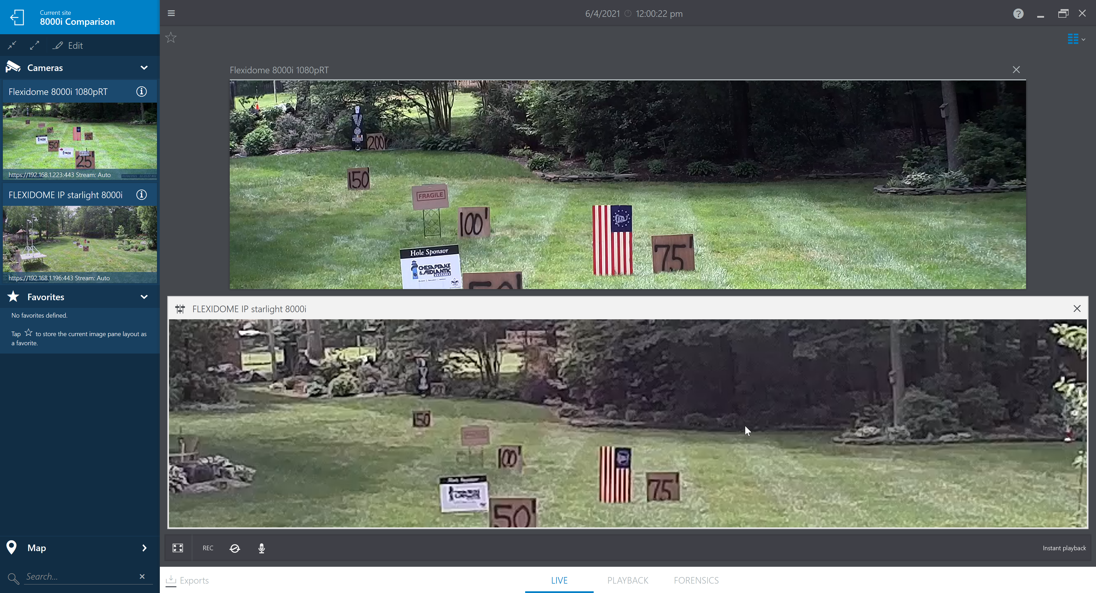
FLEXIDOME starlight 8000i
RT version 2MP (1080p)
Digital Zoom to Similar Field of View
Optical Zoom
FLEXIDOME starlight 8000i
R version 2MP (1080p)
©2021 Chesapeake and Midlantic Marketing www.midches.com | support@midches.com | (410) 612-9640 | (410) 610-0500
EXPERT | SECURITY | ADVICE

Slide 14
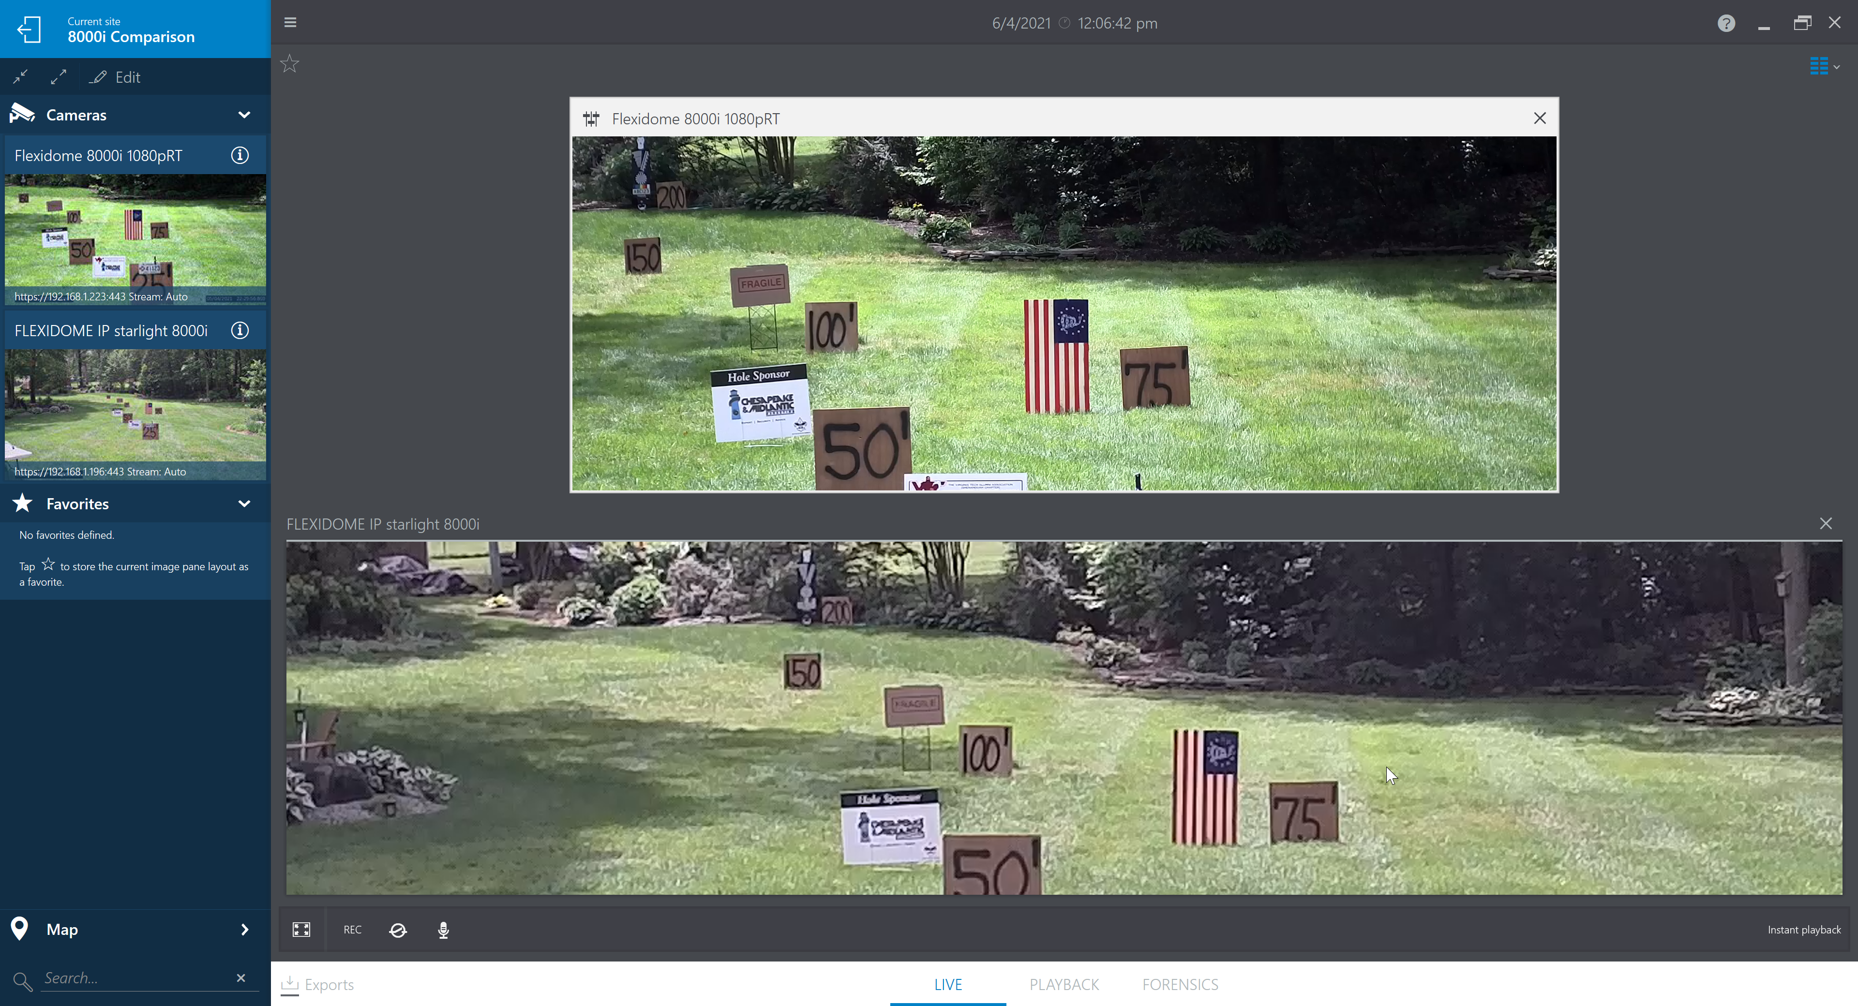
FLEXIDOME starlight 8000i
RT version 2MP (1080p)
Digital Zoom to Similar Field of View
Optical Zoom
FLEXIDOME starlight 8000i
R version 2MP (1080p)
©2021 Chesapeake and Midlantic Marketing www.midches.com | support@midches.com | (410) 612-9640 | (410) 610-0500
EXPERT | SECURITY | ADVICE

Slide 15
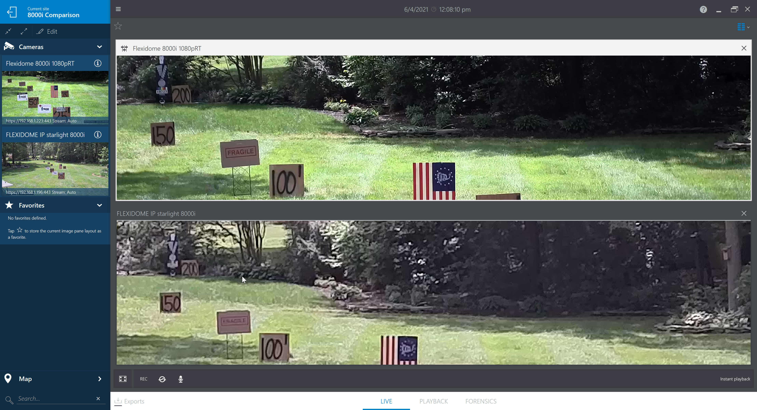
FLEXIDOME starlight 8000i
RT version 2MP (1080p)
Digital Zoom to Similar Field of View
Optical Zoom
FLEXIDOME starlight 8000i
R version 2MP (1080p)
©2021 Chesapeake and Midlantic Marketing www.midches.com | support@midches.com | (410) 612-9640 | (410) 610-0500
EXPERT | SECURITY | ADVICE

Slide 16
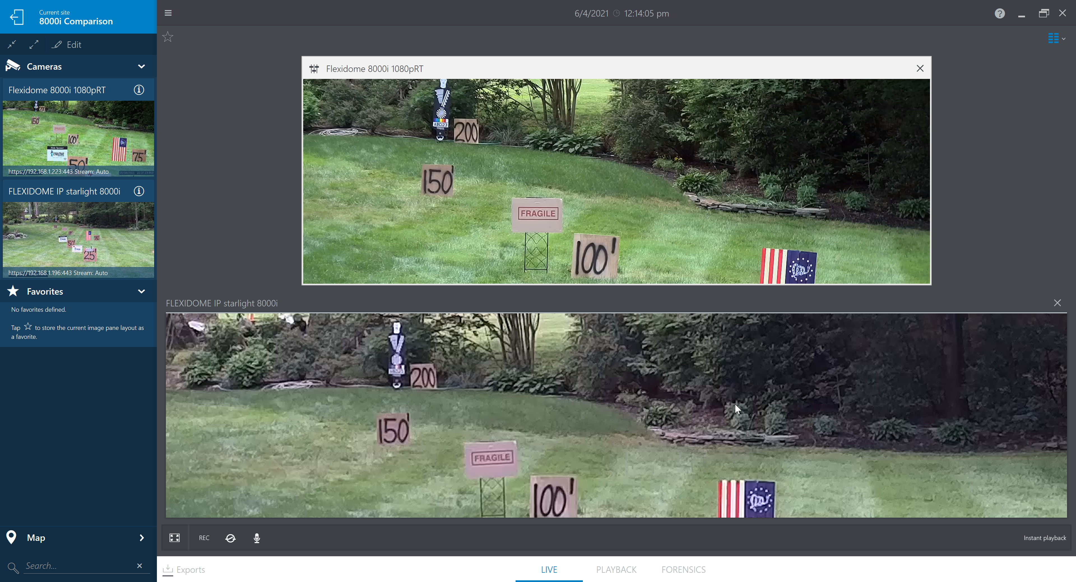
FLEXIDOME starlight 8000i
RT version 2MP (1080p)
Digital Zoom to Similar Field of View
Optical Zoom
FLEXIDOME starlight 8000i
R version 2MP (1080p)
©2021 Chesapeake and Midlantic Marketing www.midches.com | support@midches.com | (410) 612-9640 | (410) 610-0500
EXPERT | SECURITY | ADVICE

Slide 17
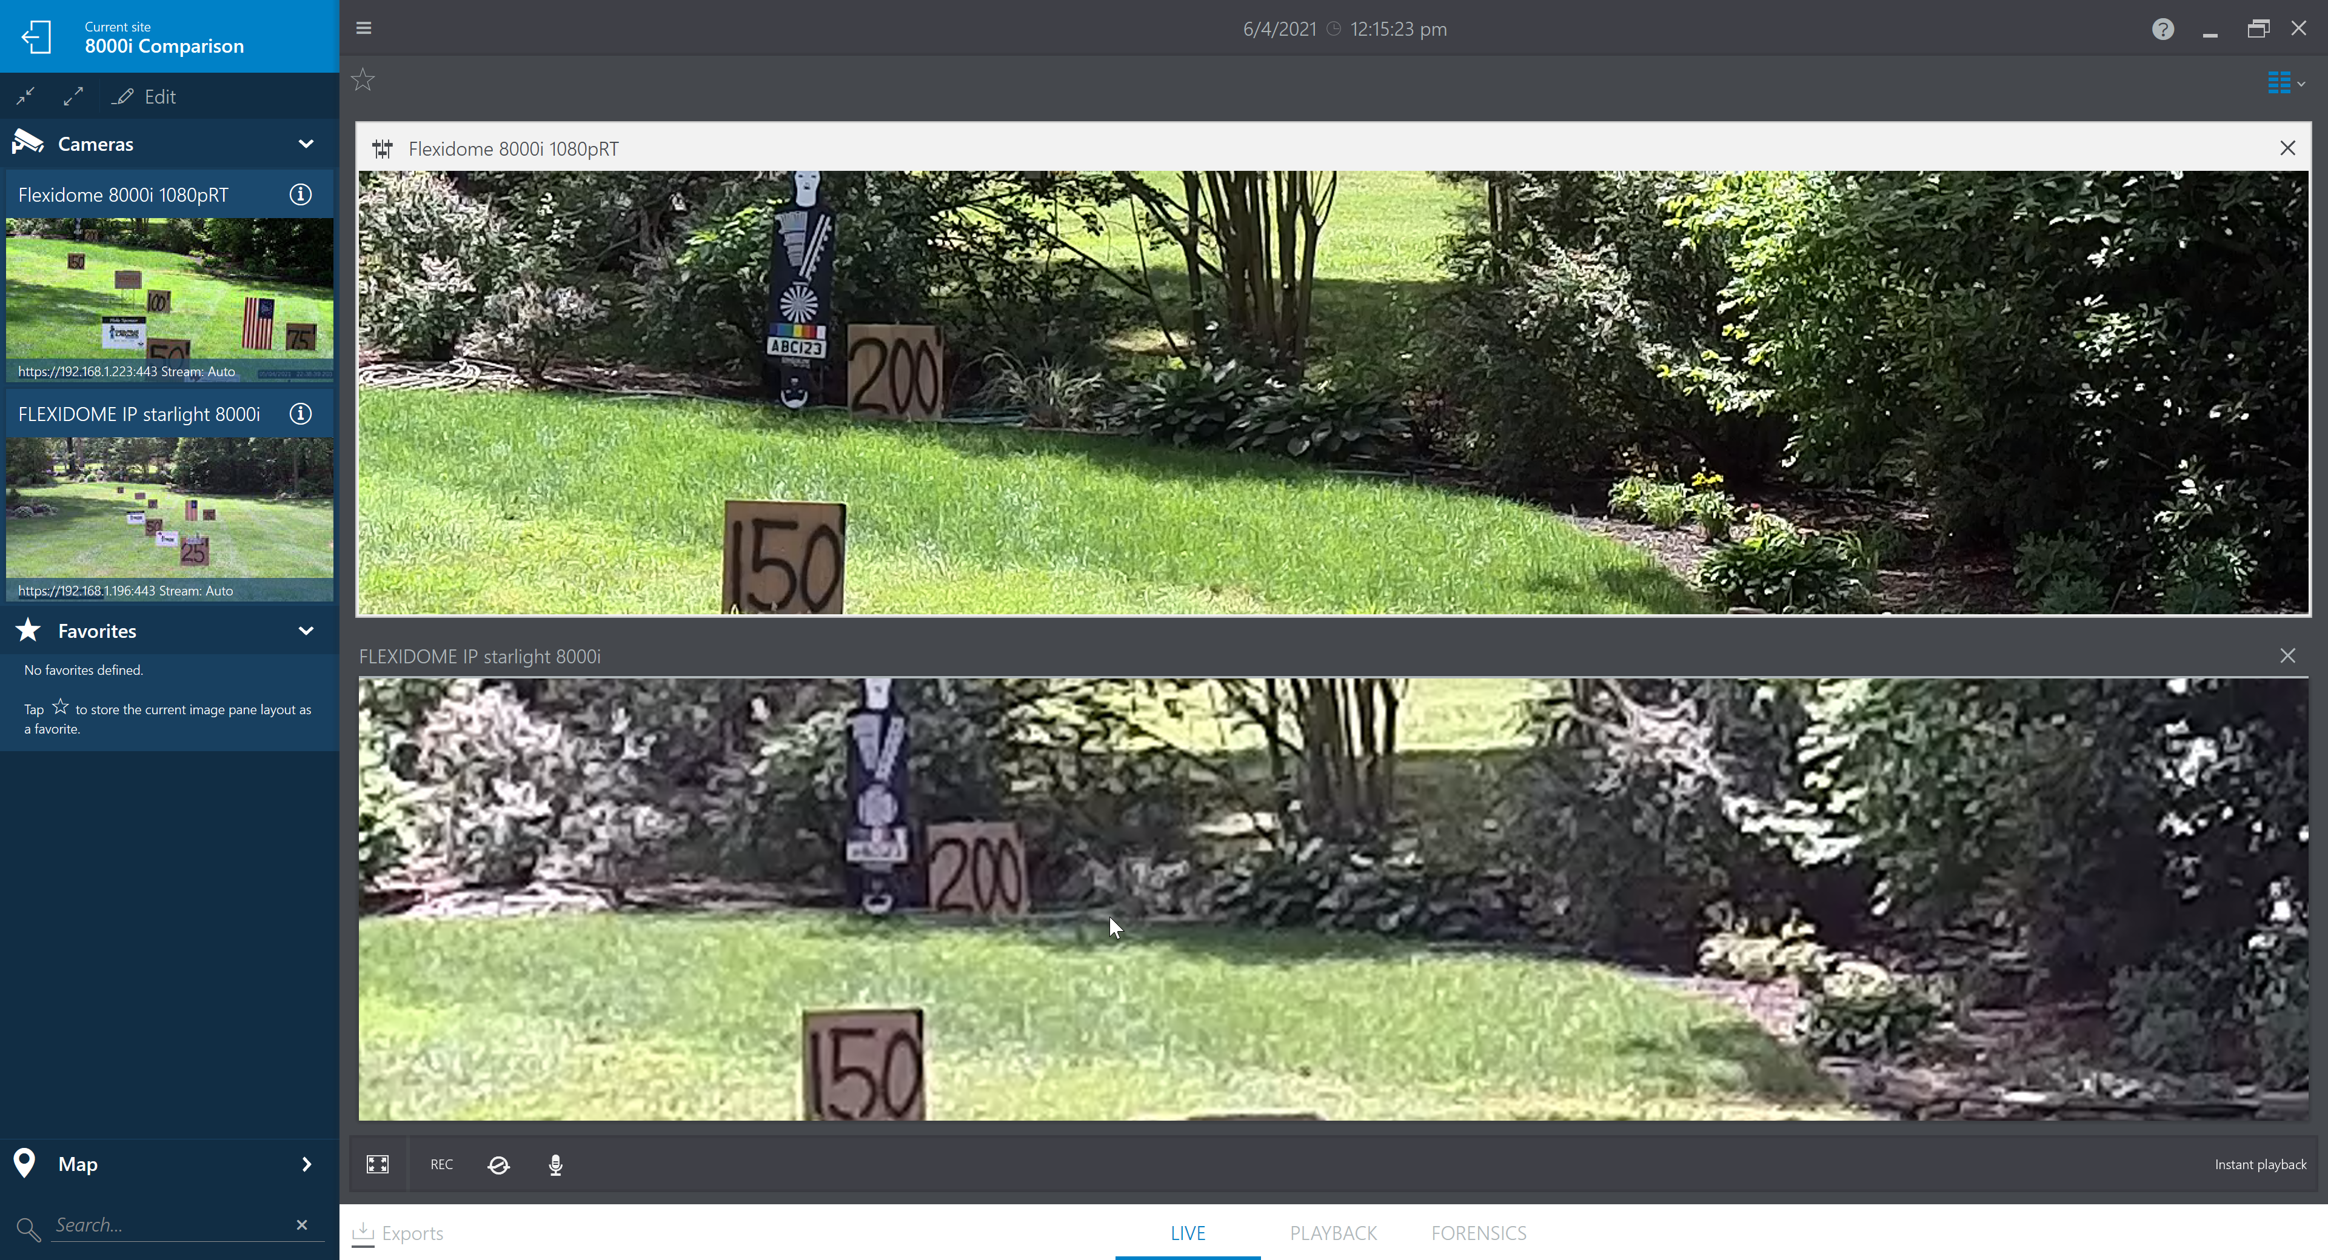
FLEXIDOME starlight 8000i
RT version 2MP (1080p)
Digital Zoom to Similar Field of View
Optical Zoom
FLEXIDOME starlight 8000i
R version 2MP (1080p)
©2021 Chesapeake and Midlantic Marketing www.midches.com | support@midches.com | (410) 612-9640 | (410) 610-0500
EXPERT | SECURITY | ADVICE

Slide 18
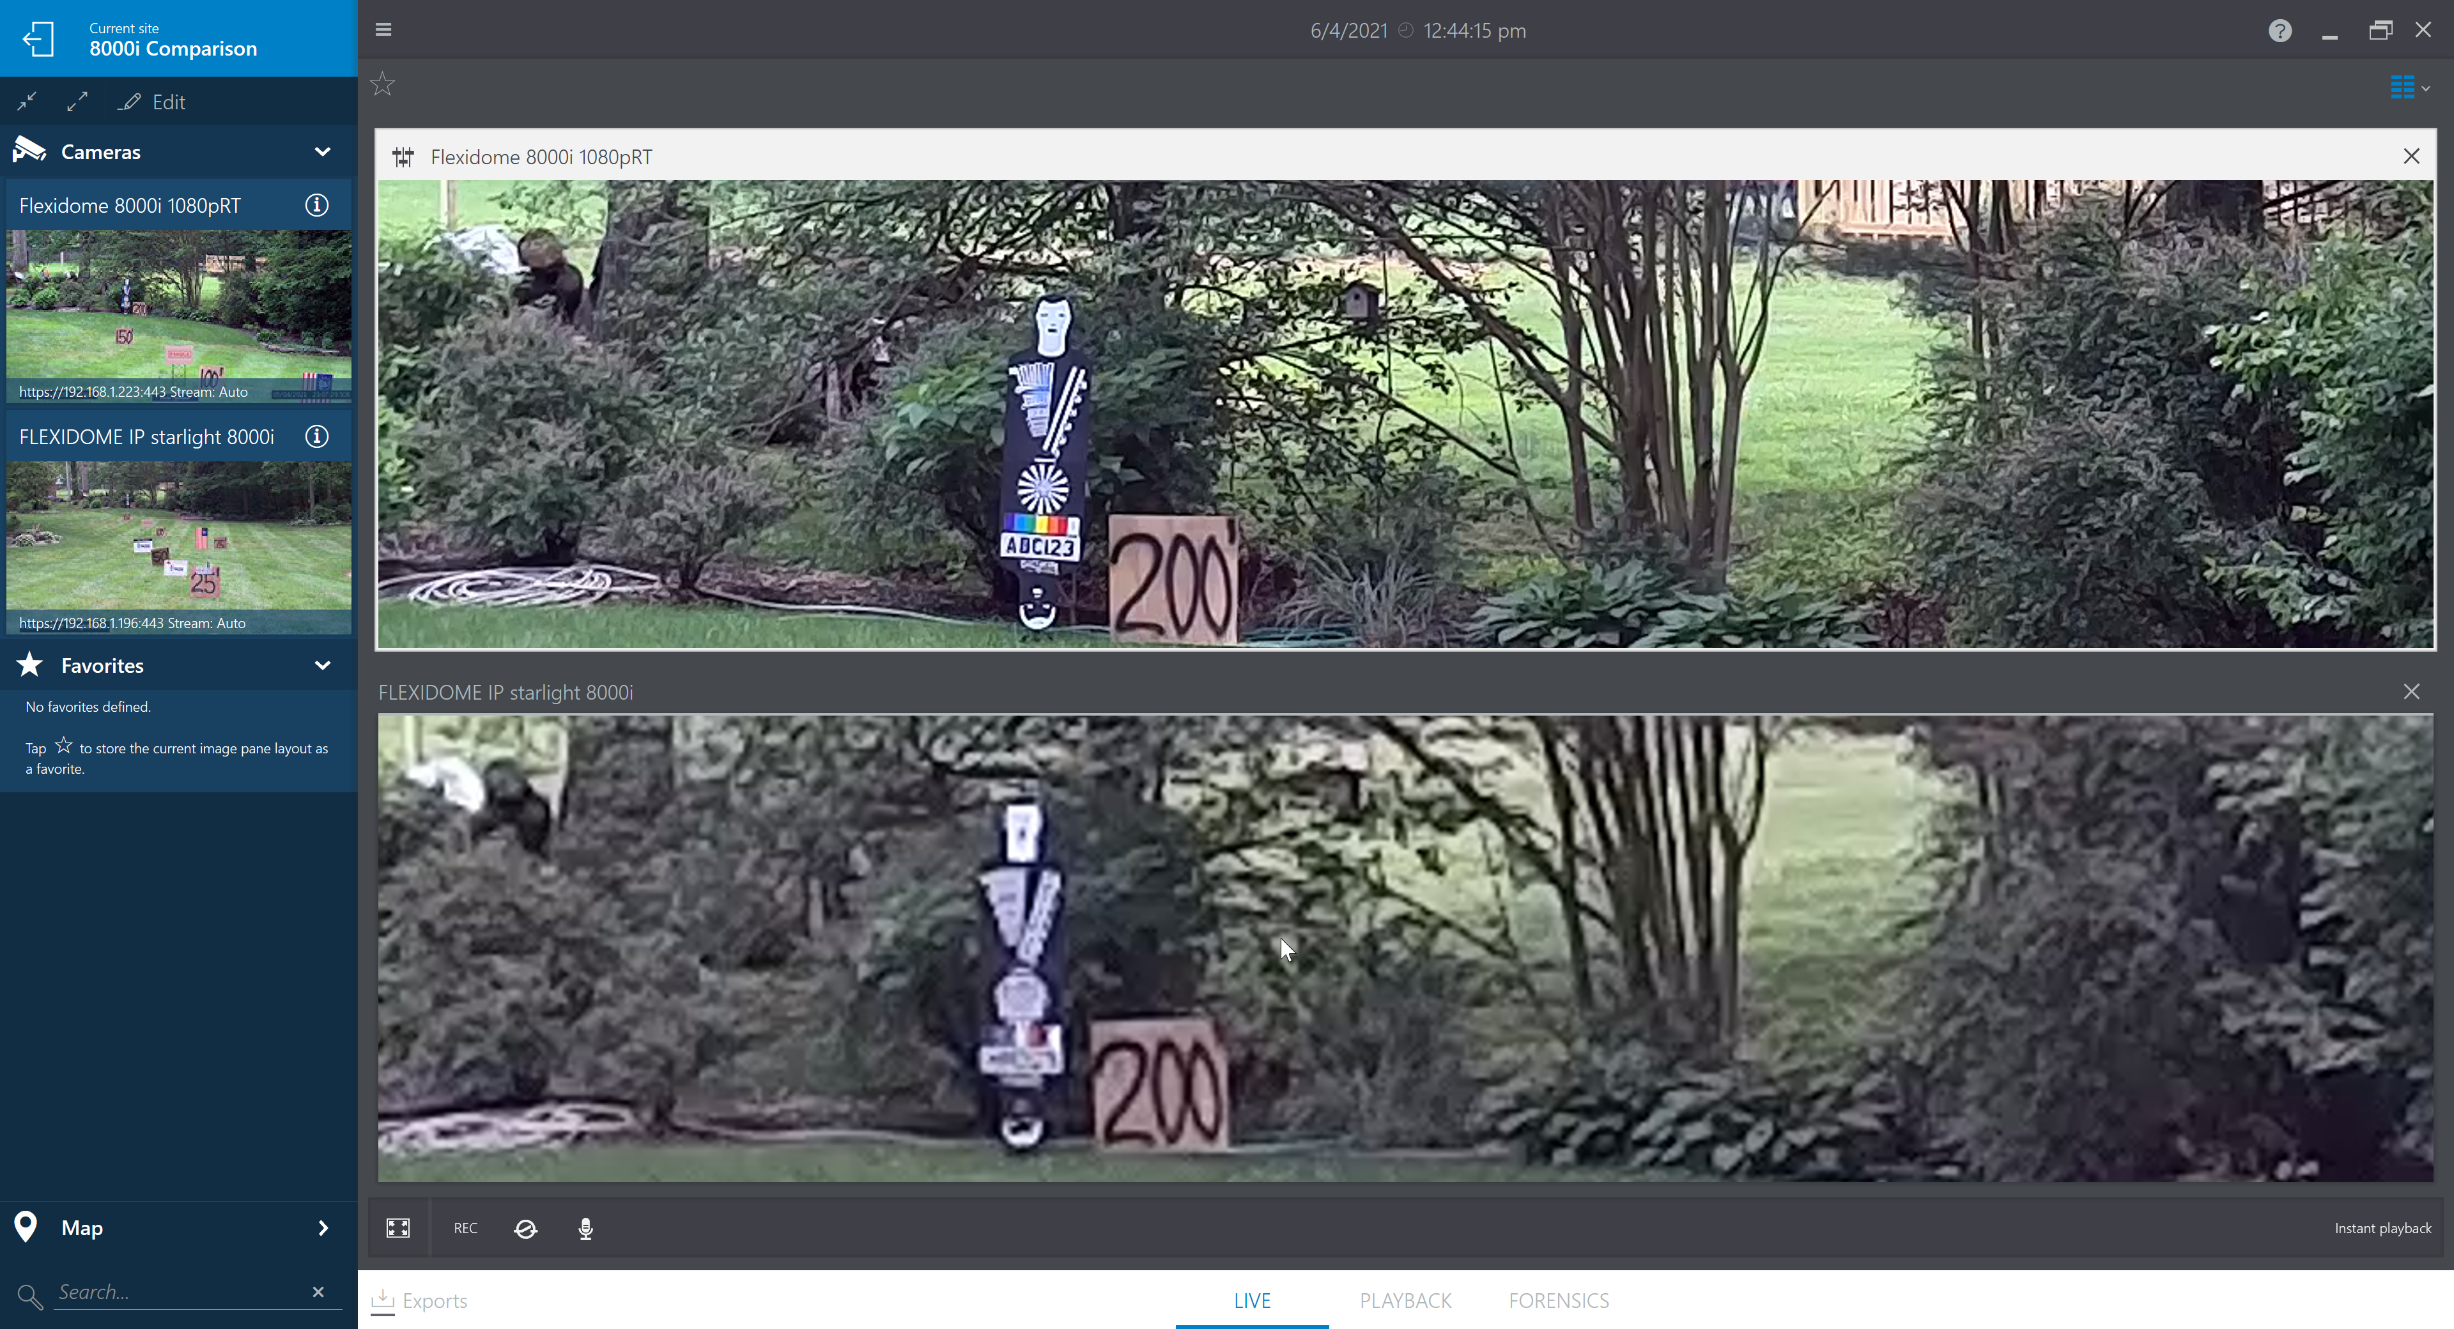
FLEXIDOME starlight 8000i
RT version 2MP (1080p)
Digital Zoom to Similar Field of View
Optical Zoom
FLEXIDOME starlight 8000i
R version 2MP (1080p)
©2021 Chesapeake and Midlantic Marketing www.midches.com | support@midches.com | (410) 612-9640 | (410) 610-0500
EXPERT | SECURITY | ADVICE

Slide 19
Contact us for a demonstration or field of view calculation support@midches.com
Chesapeake & Midlantic Marketing (MidChes)
www.midches.com | support@midches.com
(410 ) 612-9640 | (610) 361-0500
EXPERT | SECURITY | ADVICE

