Slide 1
Data security in a hyper-connected world
Bosch Video Systems and Solutions

Slide 2
Data security in a hyper-connected world
01
Data security trends
AGENDA
02
The consequences
NEW
03
How we maximize data security to meet the highest reliability standards
04
Cyber security certifications
05
Our four-step approach to secure the complete infrastructure
01

Slide 3
Data and connectivity are on a rise
Data security in a hyper-connected world
Notes:
Rising connectivity
Integration of sensors of all kinds into the network will continue. Collection and analysis of the data collected by these intelligent sensors is giving rise to numerous of applications.
By 2030 it is expected that over 29 billion devices will be connected to the Internet. *
As a consequence, we need to take into consideration the changing role of security within the Internet of Things.
The industry will move away from a pure hardware focus.
Software, services and connectivity become increasingly important. Increased value creation through software.
(Video) data will be key. Growing demand for video and image information enabled solutions.
“Classical” access control, management software, video security and intrusion solutions will merge into insight-driven solutions.
In the future customers will more and more rely on insights. It doesn’t really matter which sensor or hardware device (intrusion detector, access controller or video camera) provides the data.
It is all about the conversion of this data into relevant (business) insights for our customers.
*Worldwide; 2019 to 2022
Source(s): Transforma Insights; ID 1183457

Slide 4

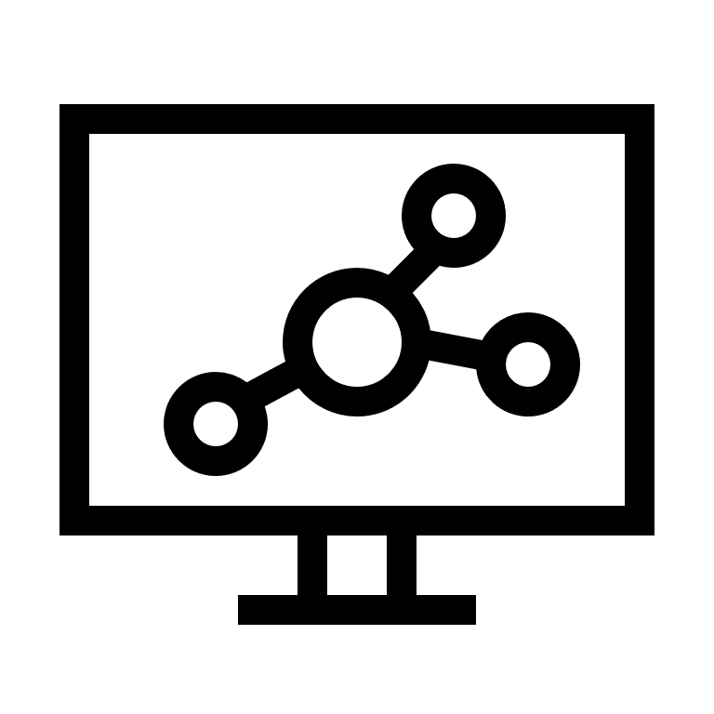



Data is key
Data security in a hyper-connected world
Access control
From
domain solutions
Management
software
To
data solutions
Video security
Intrusion systems
Notes:
Data is key
As already stressed the number of intelligent sensors in a network grid will continue to grow.
Therefore, we will move from domain to data driven solutions. Because the collection and analysis of data provided by intelligent sensors (from different domains) enables new applications beyond security.
When data is converted into insights.
The security industry will benefit from improved situational awareness and emergency management based on insights generated from video data.
Business insights generated offer the security and adjacent industries the opportunity to offer value-added services and ways to create new revenue streams.
Considering the impact of IoT customers and end users are more looking for solutions that provide smart data that helps:
to improve security,
increase efficiency,
reduce costs and
create new business opportunities.

Slide 5
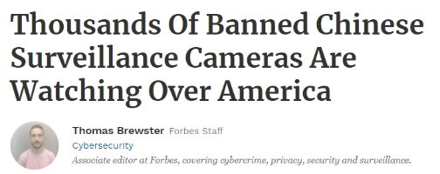
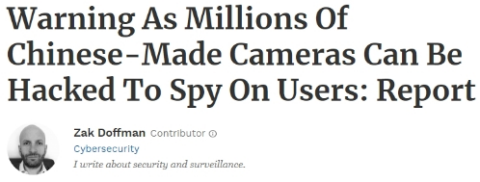
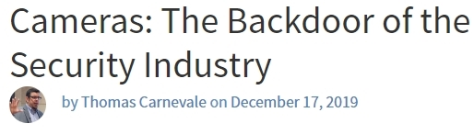


Data security and privacy
Data security in a hyper-connected world
Newly disclosed backdoor vulnerability means that millions of cameras have been carrying the potential to be used as eavesdropping devices
Private-label security cameras can be a threat to corporate security
Notes:
Privacy and security are becoming more and more important
Physical security applications involve the collection of video and data about people and assets.
Privacy regulations will continue to have a significant impact on the industry well into the future.
End users are now seeking out solutions designed with data security top-of-mind.
A key concern for customers and end users is the level of privacy protection.
Also, the protection of data in transit and when stored is critical.
Customers want the highest levels of data security across devices.
So, in the future it is likely that end users prefer companies that provide solutions designed with data security and privacy protection top of mind.

Slide 6


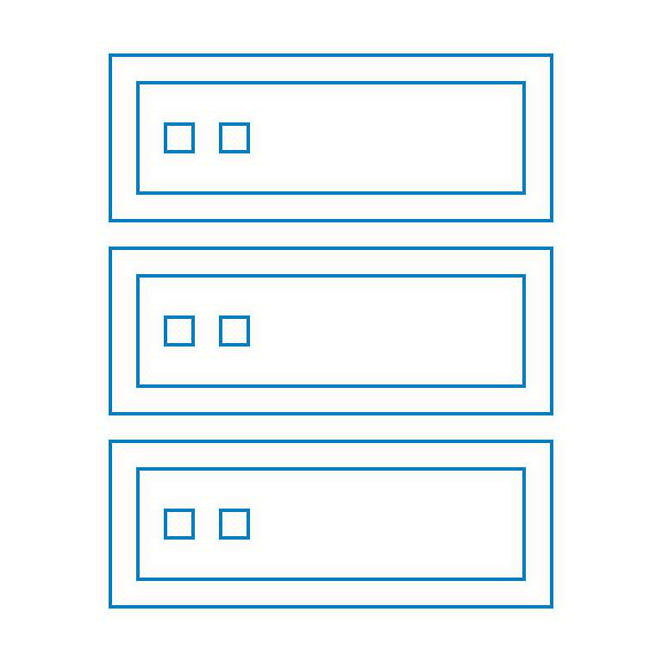








From capturing images to smart sensors
IoT changes the role of video security
Focus on images and managing bitrates
Camera acts as versatile sensor within IoT
Capturing
Storing
Viewing
Notes:
The Internet of Things changes the role of video security.
The video security camera is no longer simply part of a “closed” system, solely focused on the gathering, recording and viewing of images.
In an increasingly connected world, the video security camera will be the most versatile sensor and integration platform, enabling other “things” to extract and interpret data to elevate security, life safety, and business intelligence to another level.
The logical next-step for security is to enable customers to interpret these huge volumes of video data and repurpose them for a greater end benefit.
The ability to interpret video data directly at the source helps to substantially improve levels of security, as well as offering clear business advantages.

Slide 7

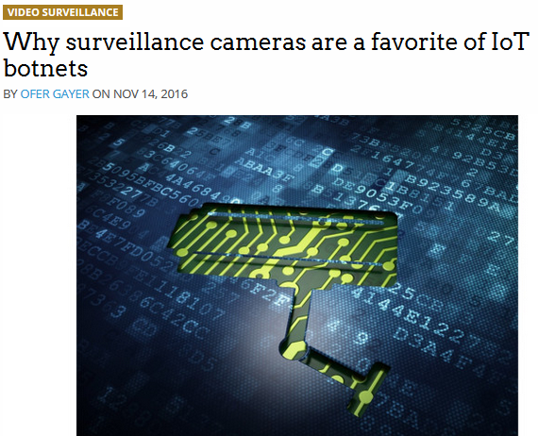
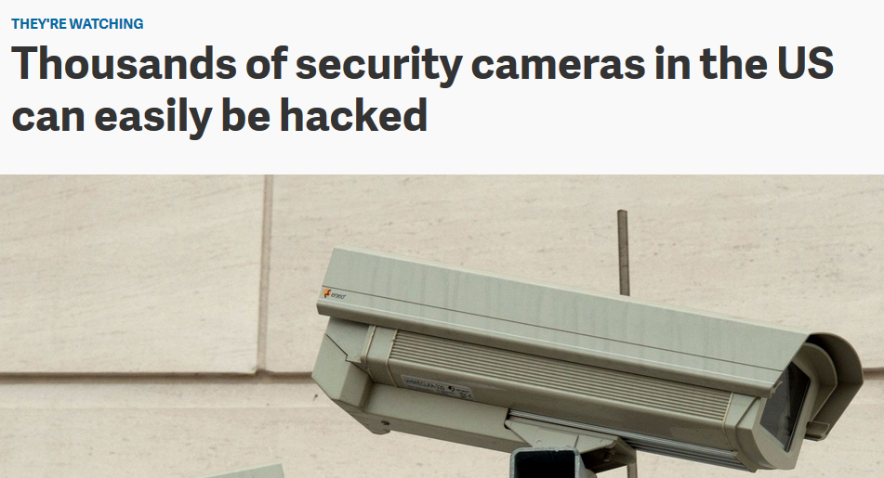
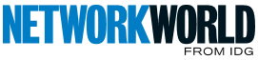
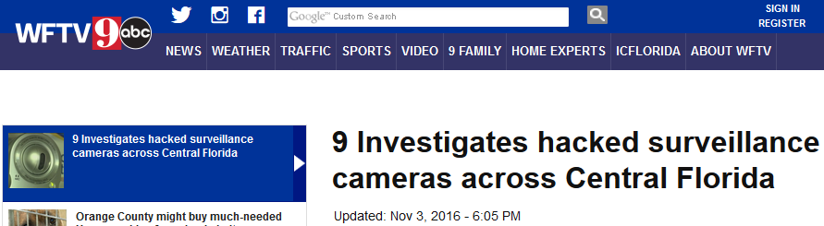
Balancing between
Video security as part of IoT
Enjoying limitless possibilities
Worrying about the consequences
IoT security camera
infected within 98 seconds of plugging it in
9 Investigates hacked
surveillance cameras
across Central Florida
Notes:
Video security is no longer isolated. Today, cameras are becoming an integral part of the vast digital connectivity infrastructure.
Video security devices, like most devices these days, are becoming more and more ‘connected’. In fact, by 2030, it is expected that over 29 billion devices will be connected to the Internet*.
*) Statista Research 2022.
This means we need to take into consideration the changing role of video security within the Internet of Things to stay ahead of trends.
The reality is, we cannot continue to simply shift cameras and boxes.
We need to consider other challenges in order to lead the industry.
A connected world brings enormous benefits.
But connectivity is more than just technology.
It is part of our lives…
It makes mobility safer and easier.
It makes cities smarter, factories more productive and healthcare more efficient.
New possibilities, like remotely controlling your home appliances or parking your car, provide fascination and fun.
It is clear that the Internet of Things brings us limitless possibilities that we should embrace and enjoy.
At the same time, we should not be worried about the consequences, but be mindful of them and implement necessary measures such as data security.

Slide 8

Should we be worrying about the consequences of IoT?

Slide 9


Likely scenarios
Worrying about the consequences?
Side channel attacks
Malware infection
via firmware or
3rd party software
Distributed
Denial-of-Service (DDoS)
Intrusion
of privacy
Man-in-the-middle attack
Physical theft
Privilege misuse
Notes:
Malware infection aimed at gaining control of systems
Program codes entering the system via the downloading of new fake Software packages. Or by inserting storage media into a device which contains viruses, Worms etc.
Privilege misuse
Once a user has rights to access the system these privileges could become known to another person who could misuse those access rights.
Or a person leaving a company may retain their access rights for a period of time.
Or an internal person intentionally misuses his/her access rights against the company.
Physical theft
Cameras can be physically stolen to gain access to the network, or to avoid further recording of images.
Denial of Service attacks
A Distributed Denial of Service (DDoS) attack is an attempt to make an online service unavailable by overwhelming it with traffic from multiple sources. Attacks can target a wide variety of important resources, from banks to news websites, and present a major challenge to people wishing to publish and access important information.
Side channel attacks
This is when a device is opened, or electro-magnetic waves are measured to find out what the device is executing at that moment. This kind of attack also makes it possible to use a spectrum analyzer to measure what the passcode is by simply analyzing the BUS traffic and/or the EMI spectrum of the device.

Slide 10



Protecting personal data
Worrying about the consequences?
General Data Protection Regulation (GDPR)
Unify and strengthen the
data protection of individuals
Since
May 25 2018
What is personal data?
- Name - Date of birth
- Phone number - Email
- Social security no. - License plate number
- Photos - Videos
Fines
Up to 4% of worldwide revenues or 20 Million Euros
Notes:
Connectivity and the collection of (personal) data also leads to more stringent regulations concerning its protection.
General Data Protection Regulation (GDPR) is one of the first official data protection acts but is certain to be followed by many others. This new set of rules govern how data controllers and data processors collect, use and share personal data. One of the main goals of GDPR is to protect the personal data of EU subjects and provide a new set of rights to individuals. Organizations have to build data and privacy protection into their system design and infrastructure. Businesses that do not comply will face hefty fines.
GDPR’s main goal is to unify and strengthen the data protection of individuals.
Personal data is defined as information that can identify a person, directly or indirectly, by reference to one or more factors specific to them.
On May 24th, 2018, the EU Data Protection Directive will be updated for the first time since 1995.
The directive is now becoming a regulation – or a comprehensive, enforceable law – and the drastic changes will affect organizations everywhere.
The new set of guidelines is known as the EU GDPR. Here are the key pillars of the regulation:
Consent
•If personal data is to be collected, organizations have to get valid and explicit consent from the individuals.
•Individuals may withdraw their consent.
The right to be forgotten
•Organizations have to erase personal data at the subject’s request, without undue delay.
Risk and impact assessments
•Organizations have to perform a privacy impact assessment, which states what personally identifiable information (PII) is collected and how that information is maintained, protected and shared.
Privacy by design
•Systems and technology across the organizations need to be designed to limit data collection, retention and accessibility.
Breach notifications
•Organizations have to notify the supervisory authority about data breaches involving personal data no later than 72 hours after becoming aware of the breach.
•Users have the right to be informed about data breaches involving their personal data.
Right to access
•This guideline relates to data portability.
•Upon request, organizations have to provide individuals with their personal data in a structured and commonly used format.
Enforcement date GDPR: 25 May 2018.

Slide 11



Protecting personal data
Worrying about the consequences?
Privacy by design
Right to access
Right to be forgotten
Protecting your data and privacy with confidentiality,
integrity and availability
Provide individuals with
their personal data in a
structured & common format
Erase personal data at the subject’s request, without undue delay

Slide 12




What this involves
Ensuring security and privacy of data
Considering entire infrastructure
Little point of focusing on a single component
Minimizing risk
of hacking
Implement latest measures
Ensure video data is secured
Protecting privacy
By managing user access rights
Meeting international laws and regulations
E.g., GDPR
Notes:
Securing the privacy of data starts with considering the entire video security infrastructure:
•Cameras, servers, clients, video management, storage devices, network protocols and standard key infrastructures.
We have to plan for the worst, and assume that every cyberattack will be successful.
Therefore, we have to continuously implement the latest measures (FW updates, security patches, latest technology) to minimize the risk of hacking, and ensure that (video) data captured is secure at all times – both in-transit (video/data streams) and at-rest (stored data).
Another consideration is the need to protect software, data, and functions from unauthorized access and manipulation in order to protect privacy.
We have to ensure that we meet local, regional and global legislation.

Slide 13

NEW
How we maximize data security to meet the highest reliability standards
10 leading measures

Slide 14






Maximizing data security to meet the highest reliability standards
Data security in a hyper-connected world
1 | 2 | 3 | 4 | 5 | 6
Secure Element | Embedded login firewall | Password enforcement | Minimum TLS 1.2 | Simple Certificate Enrollment Protocol (SCEP) | Software sealing
Bosch sets the standard with the most future-proof Secure Element with Trusted Platform Module (TPM) functionality Supporting 4096-bit keys. | It's about blocking threats, not functionality. An intelligent login firewall you can count on. | Security first: set a password, then connect. | A minimum version of TLS provides maximum security. Transport Layer Security: a cryptographic protocol that provides secure communication. | Simplifying cybersecurity at scale. An easy way to deploy and manage certificates on cameras. | Changes to a sealed camera configuration will trigger an alarm. Protects against unintentional or unauthorized changes.

Slide 15





Maximizing data security to meet the highest reliability standards
Data security in a hyper-connected world
7 | 8 | 9 | 10
Encrypted firmware | Cloud firmware check | Session timeout | Secure by default | PLUS: Our security levels and policies are certified to the highest levels by third parties. | Cyber security certifications
Verifies firmware authenticity and prevents malware insertion. | Stay up-to-date at all times. Checks Bosch Download Area for new firmware. | Manage how long a configuration session can be left unattended. | Security by default, closed until you say it is open. | Our security levels and policies are certified to the highest levels by third parties. | Bosch's compliance with leading security standards makes us unique: UL2900-2-1 IEC62443-4-1 IoT SMM More on the next slides…

Slide 16

Cyber security certifications

Slide 17

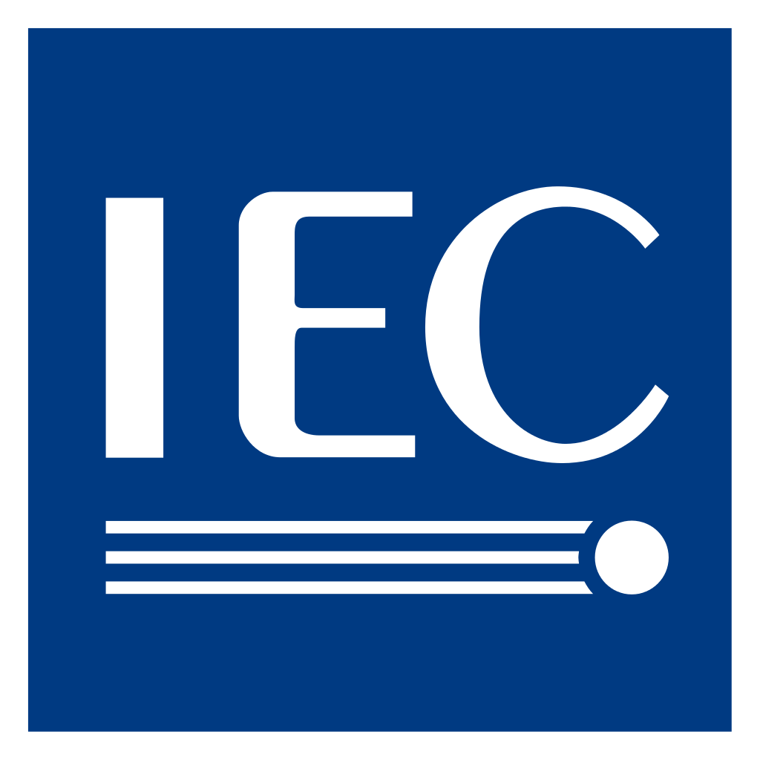

Secure and cyber resilient for peace of mind
Data security
The IoT SMM by IIC Based on IEC and UL standards |  | IEC 62443-4-1 IEC 62443-4-2 Security for industrial automation and control systems |  | UL 2900-2-3 Standard for Safety and Software Cybersecurity for Network-Connectable Products
Examines cybersecurity as a whole, not just processes or products, but also policies, as well as the system or product itself. Through process and product certification, we are able to build secure products with highly sophisticated penetration tests. Microsoft, SAP, NetApp, and NIST are IIC members. |  | Focuses on the processes and definitions around developing and creating secure products. It proves that Bosch can ensure a secure development process. Other manufacturers may not be able to implement security features they claim to have. |  | Includes penetration testing and provides proof that IEC 62443-4-1 has been implemented in a practical sense. Our certification is device specific up to level 3.
Certified |  | IEC 62443-4-1 Certified IEC 62443-4-2 expected 2024 |  | Certified

Slide 18

Our four-step approach to secure the complete infrastructure

Slide 19



A four-step approach considering complete infrastructure
Keep video data secure
Create trust
Secure data
Manage user access rights
Meet IT industry standards and certifications
Notes:
The Internet of Things makes our lives more connected.
As a consequence, video surveillance data is increasingly connected across local and global networks.
An ever-increasing number of network cameras send their data to servers over the Internet, leaving us vulnerable to cybercrime.
Video surveillance data can be particularly susceptible to security breaches when it’s connected across local and global networks.
Digital intruders are drawn to this method of data transfer, particularly if there are weak links in the network. To cancel out this risk, employ a data security system that’s effective from end-to-end.
Focusing on only one element, for example, cameras, would be insufficient.
A 360-degree view of data security is needed, that covers the entire security network including cameras, servers, clients, storage devices, network protocols and standard key infrastructures. A systematic approach is key to achieve the highest standards in end-to-end data security.
What is needed to ensure data security in a hyper connected world?
A systematic approach is needed covering all angles (taking into account the complete network infrastructure).
In order to ensure data security we cannot limit ourselves to only edge components (cameras):
Cameras (edge devices):
Access via passwords and user management, authentication via certificates, data encryption.
Servers, clients & storage devices (core devices):
Authentication, validity check of live and recorded videos, data encryption.
Security infrastructure:
Support standard key infrastructures, partnerships with authorized third-party certification.
Network protocols:
Encryption and data transfer in line with industry standards
A systematic approach is key to achieve the highest standards in data security.
Yet a systematic approach alone is not enough. We need to ensure / manage at least four steps to meet the demands in a hyper-connected world.
Four-step approach:
We need to create trust amongst all components in the network.
Subsequently, data exchanged and stored needs to be secure.
Systems and measures need to be in place to easily manage user access rights.
Meet leading industry standards in public key infrastructure (PKI).

Slide 20


Create trust with authentication
Keep video data secure
Verify the legitimacy of network components
Data exchange only between trusted partners
Avoid man-in-the-middle attacks with certificates
Use certificates and (public) keys for authentication
Safely store keys in camera’s Secure Element
Employ the above before communication (data transfer) starts
Notes:
Solutions for creating trust:
All hardware cameras and storage devices have a trusted platform module (TPM)
In-house Certification Authority (CA)
Support of 3rd party CA
Products with certificates ex factory
Creating trust with authentication involves the process of determining whether an entity is who they claim to be.
Verifying the legitimacy of network components involves:
•Authenticating the client/server communications
•Authenticating the edge devices
Why use authentication?
Authentication is used to prevent unauthorized entry by providing access to known entities only, and for whom we can verify their identity. Entities can be users, servers and workstations and web sites.
How to create trust
•By assigning every component in the network an authentication key.
•These keys are safely stored in the camera’s built-in Trusted Platform Module (TPM) to deliver an extra layer of security.
•Cryptographic operations required for authentication are only executed inside the built-in Trusted Platform Module of the camera.

Slide 21
Secure data
Keep video data secure
Creating and distributing cryptographic keys for protecting recorded data
Proprietary hardware key protects data even in case of a breach
Ensure authenticity of firmware updates
Configuration and commands are sent via a secured channel (HTTPS)
Cryptographic operations are executed inside Secure Element
HTTPS
HTTPS
HTTPS
Notes:
Solutions for securing data:
Trusted platform module (TPM)
Signed streams and recordings
Encryption of video, audio, metadata and serial communication
Encryption is the process of transforming information to make it unreadable for unauthorized users.
Why use encryption?
Encryption ensures privacy and protection of your data and secures intellectual property.
Cryptographic operations needed for data encryption are only executed inside the built-in Trusted Platform Module of the camera.

Slide 22
User access rights and IT industry standards
Keep video data secure
Managing user access rights:
Only authorized users have access to the system
Support of Microsoft’s Active Directory
Meet industry standards in public key infrastructure and IT:
Support third party solutions for:
  Public key infrastructure
  Management of user access rights
Notes:
Solutions for managing user access rights:
Secure and flexible management of user access rights in our cameras, storage devices and software.
Support of 3rd party solutions, like Microsoft Active Directory
The function of specifying which access rights someone has over resources, data and applications.
Authentication and encryption aren’t guaranteed to prevent unauthorized people gaining access to data, therefore a good user access right or authorization system needs to be in place.
Managing user access rights is necessary for control and flexibility over what users or entities can see and what activity they can undertake once authenticated to the system.

Slide 23


What can we do to optimize our systems for GDPR?
Ensuring security and privacy of data
Data collection
Cameras with built-in video analytics to intelligently decide which data to stream
Camera built-in privacy masking to hideaway sensitive information
Data protection and privacy
Flexible ways to manage user access rights to protect data and privacy
Support for Microsoft Active Directory for centralized user management

