Slide 1
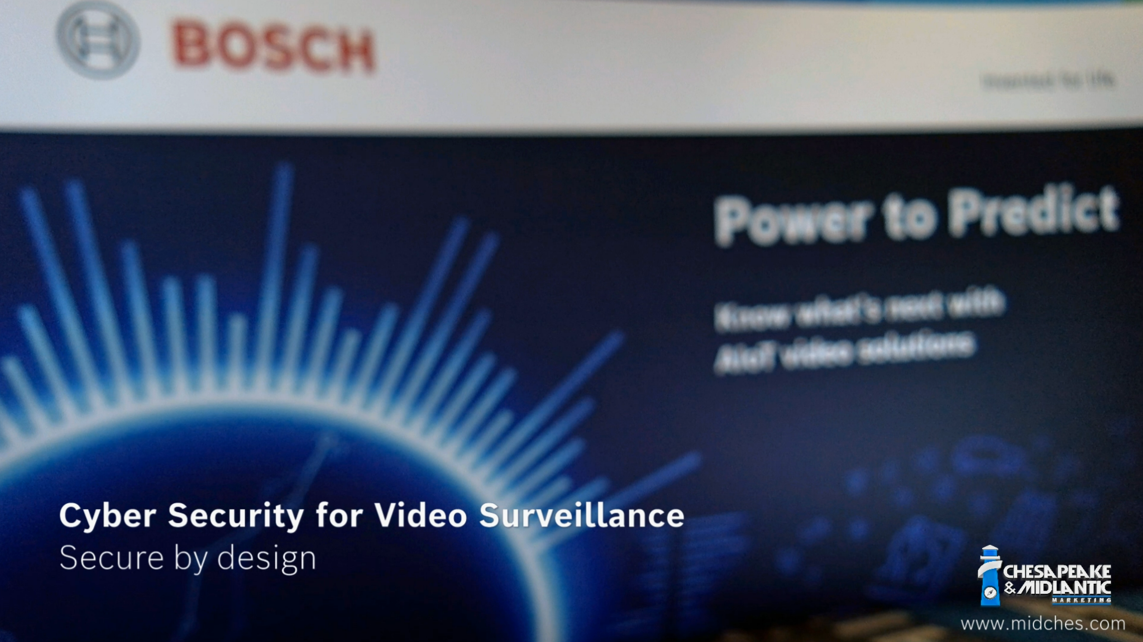
State of Cyber Security 2022 &
Bosch Mitigation Strategies
David Brent
October 2022

Slide 2
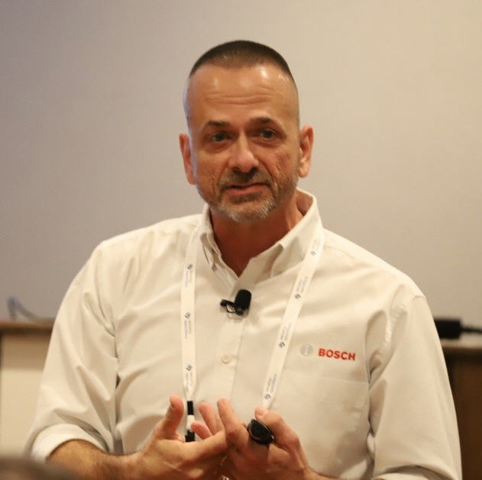
Presenter Info
David Brent: Network Video and Cyber Security Training Engineer, North America:
AS: Networking
BS: CFDI
MS: Data and Cyber Security
USMC Medically Retired Veteran 2001
Video Industry since 2001 and with Bosch since 2005
Certifications: A+, Net+, MCSE, CCNA, CWNA, SNIA
Contact info : david.brent@us.bosch.com

Slide 3

Objectives
State of Cyber Security
  Is it Getting Better or Worse?
Bosch and Cyber Security
  History and Stability
What the Future Looks Like
  SCEP and ACME
Just the facts
Cloud Based Security

Slide 4


Big Picture

Slide 5
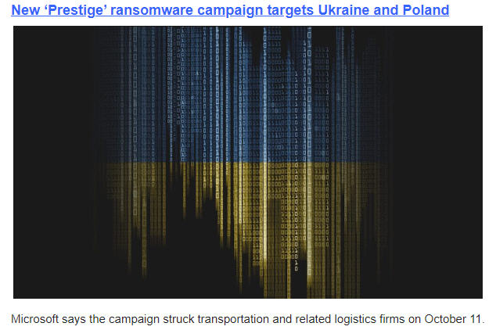

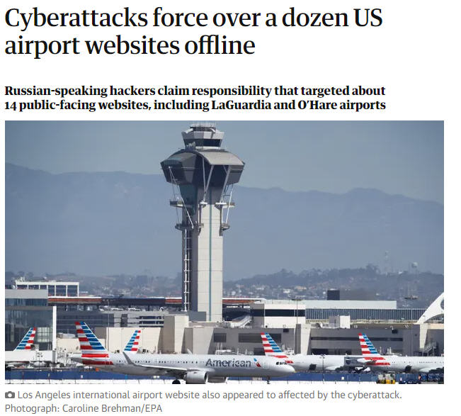
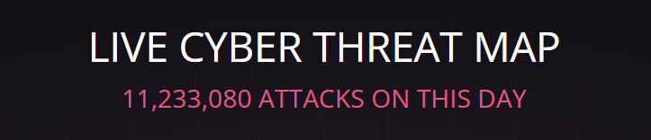
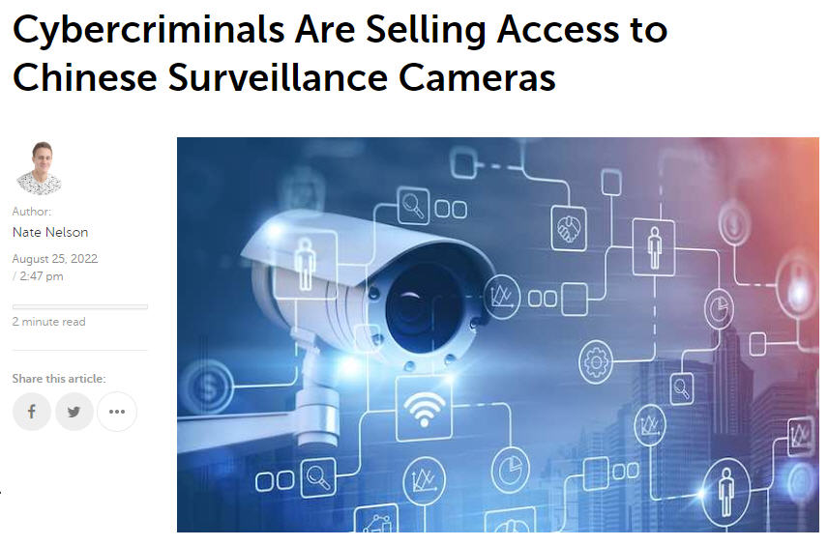
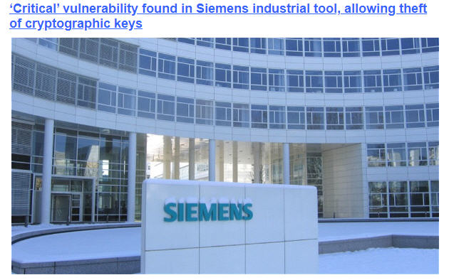
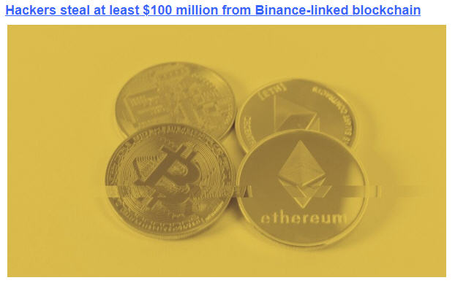
Current State of Cyber Security

Slide 6
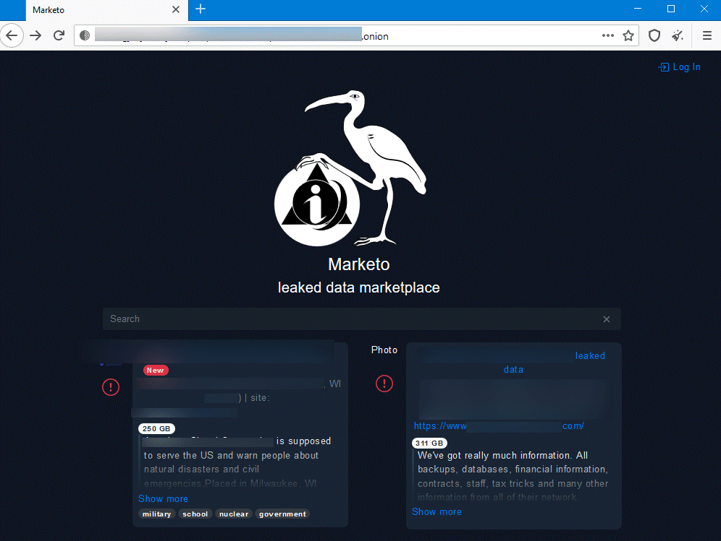
The New Business Model: RaaS and Extortion
RaaS is a evolving Business Model:
Franchise groups
Conti Group offers a Playbook
Extortion has been added to the mix
The Group that hits you may not have hacked you !

Slide 7
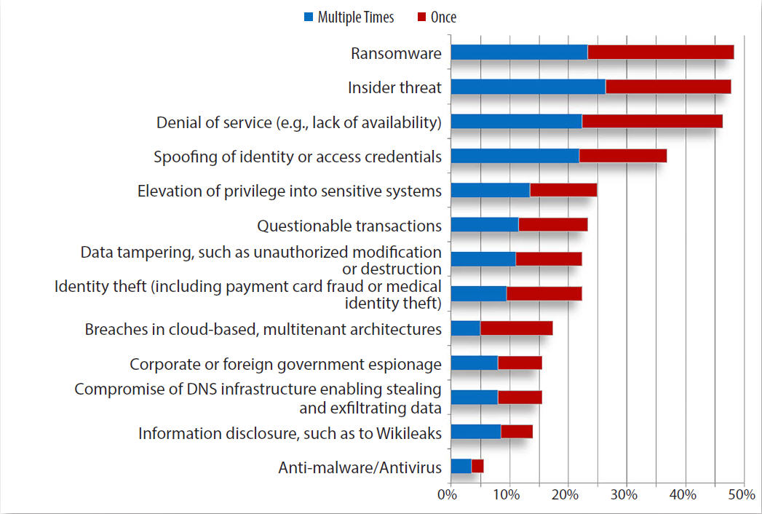
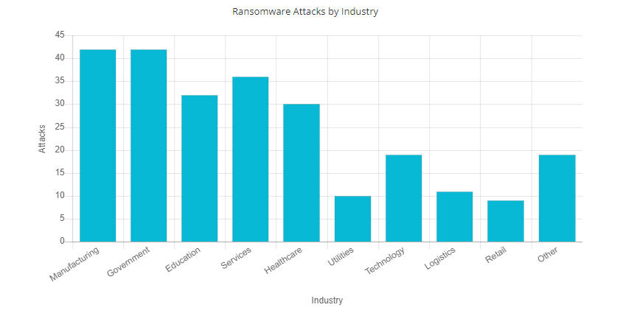
2021Survey: What Has Changed?
Average global cost of Insider Threats rose by 31% in the last two years
Frequency of incidents spiked by 47% in the same time period
(securityintelligence.com)
1,097 organizations were hit by ransomware attacks in the first half of 2021.
2020 had 1,112 ransomware attacks for the entire year
(BlackFog.com)
Apple had 17 Zero Days by NOV 2021 and 3 so far in 2022

Slide 8
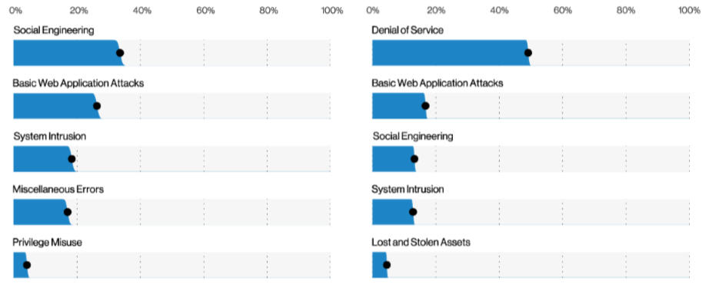
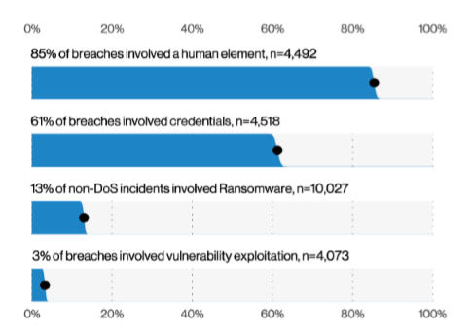
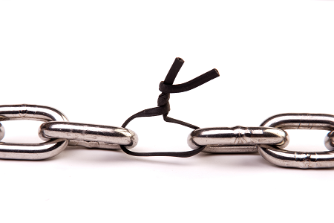

What are the Real Numbers?
For Every Attack Reported,
There are an estimated 100 to 250 that are not reported

Slide 9
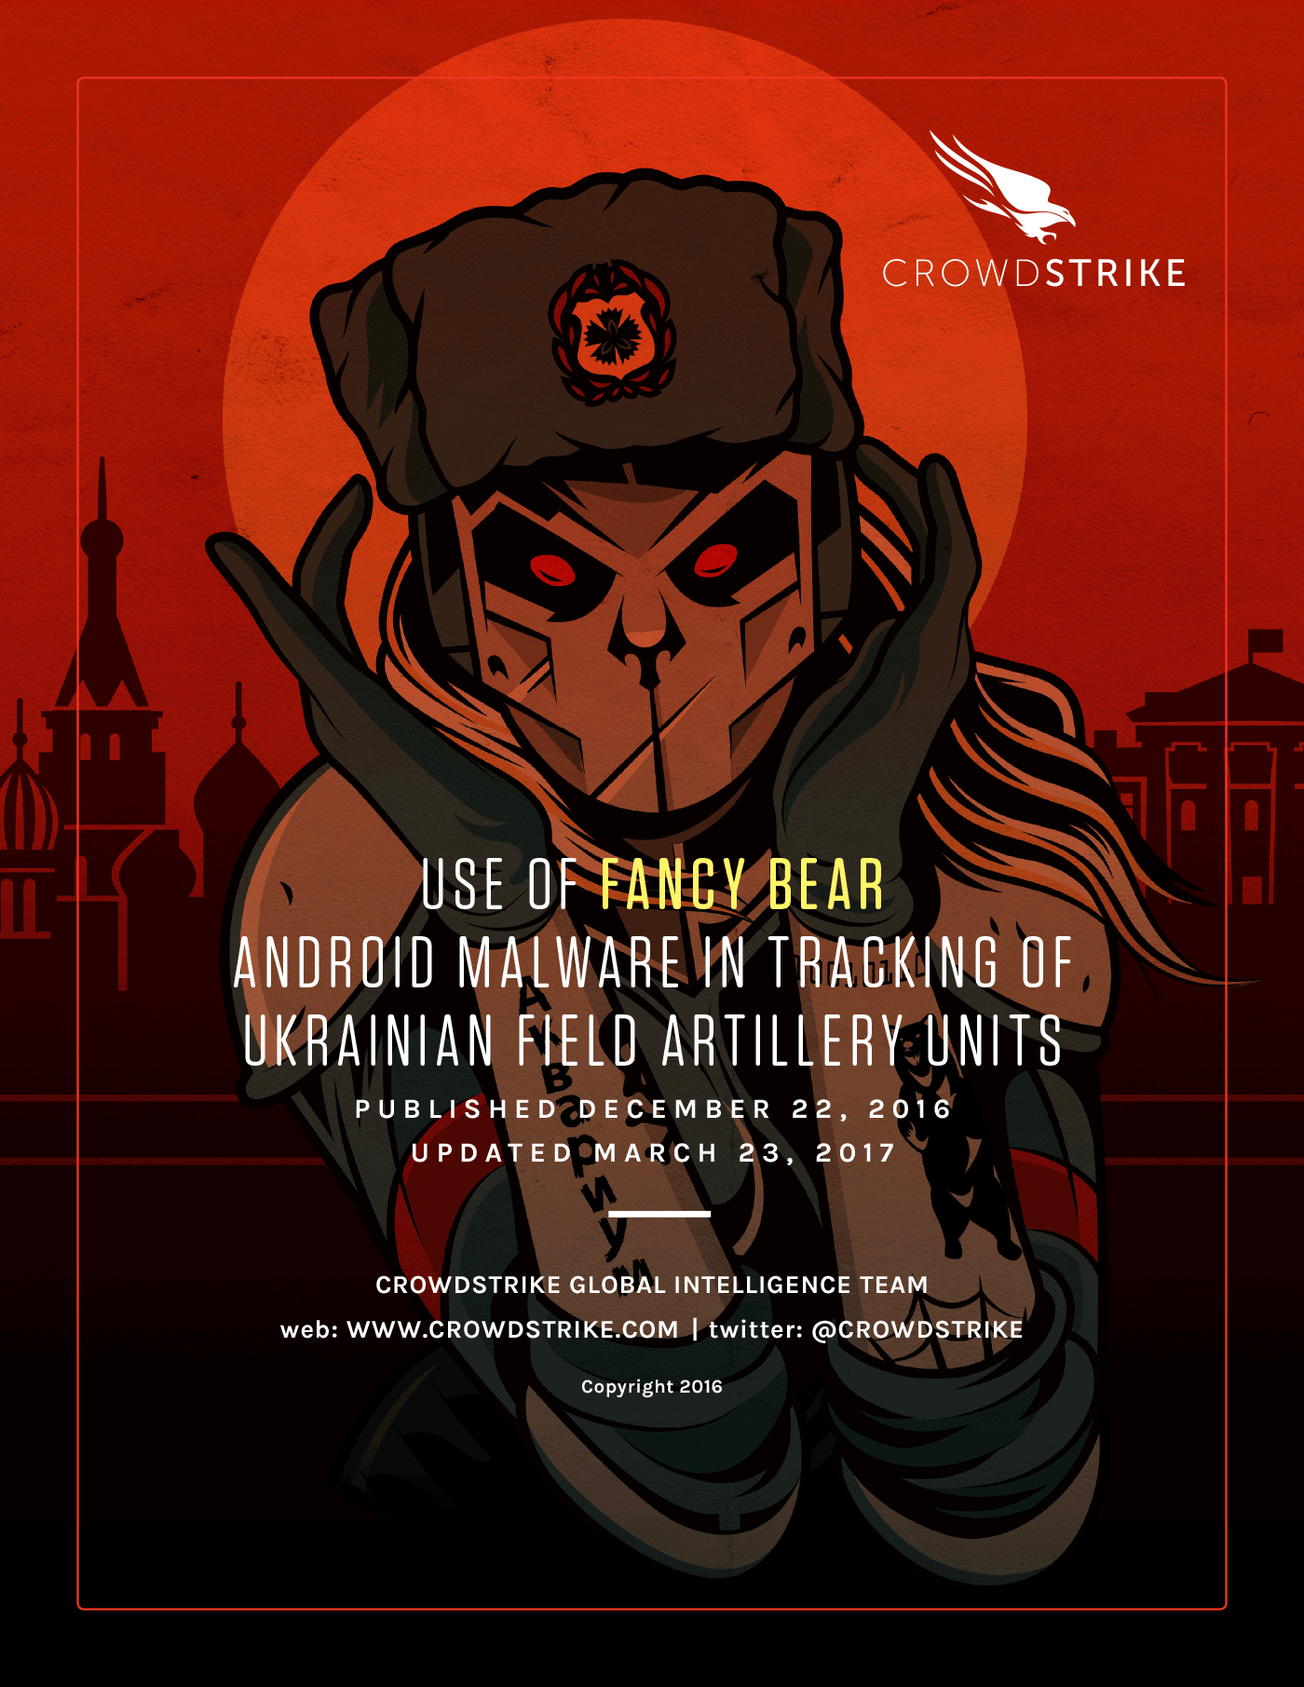
Why Should You Care?
Lazarus Group: North Korea
Turla: Eastern Europe
Sandworm: Ukraine
APT28 and 29: Russia State Sponsored
APT35: Middle East
These groups write their own Malware for C2 that is encrypted
Hash Signatures DO NOT WORK! (IOC)

Slide 10
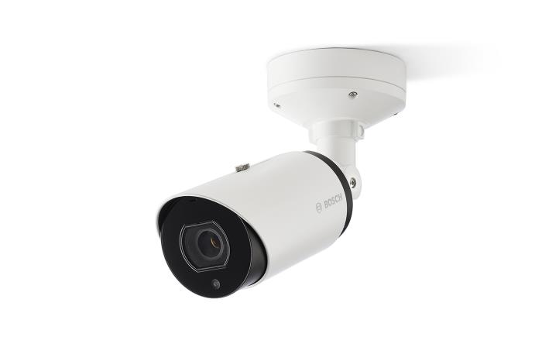
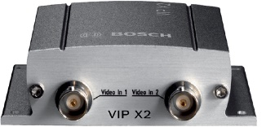
Bosch: A History of Focus On Security
Maybe the best kept secret in the industry is how long Bosch has been focused on cyber security
Some features that we will discuss today have been in place since 2004. This includes:
Crypto co-processors
Certificates
Closed operating systems and signed firmware
2004
ALL PRODUCTS. Not just SOME of them
2022

Slide 11


High Standards: Production and Testing
Bosch Utilizes a Security Engineering Process (SEP)
  Internal and third-party pen testing
Open Web Application Security Project Testing Guide (OWASP)
OWASP IOT Testing Guide / Mobile Security Project
NIST 800, CIS, STIG
MITRE.ORG Certificated Numbering Authority

Slide 12
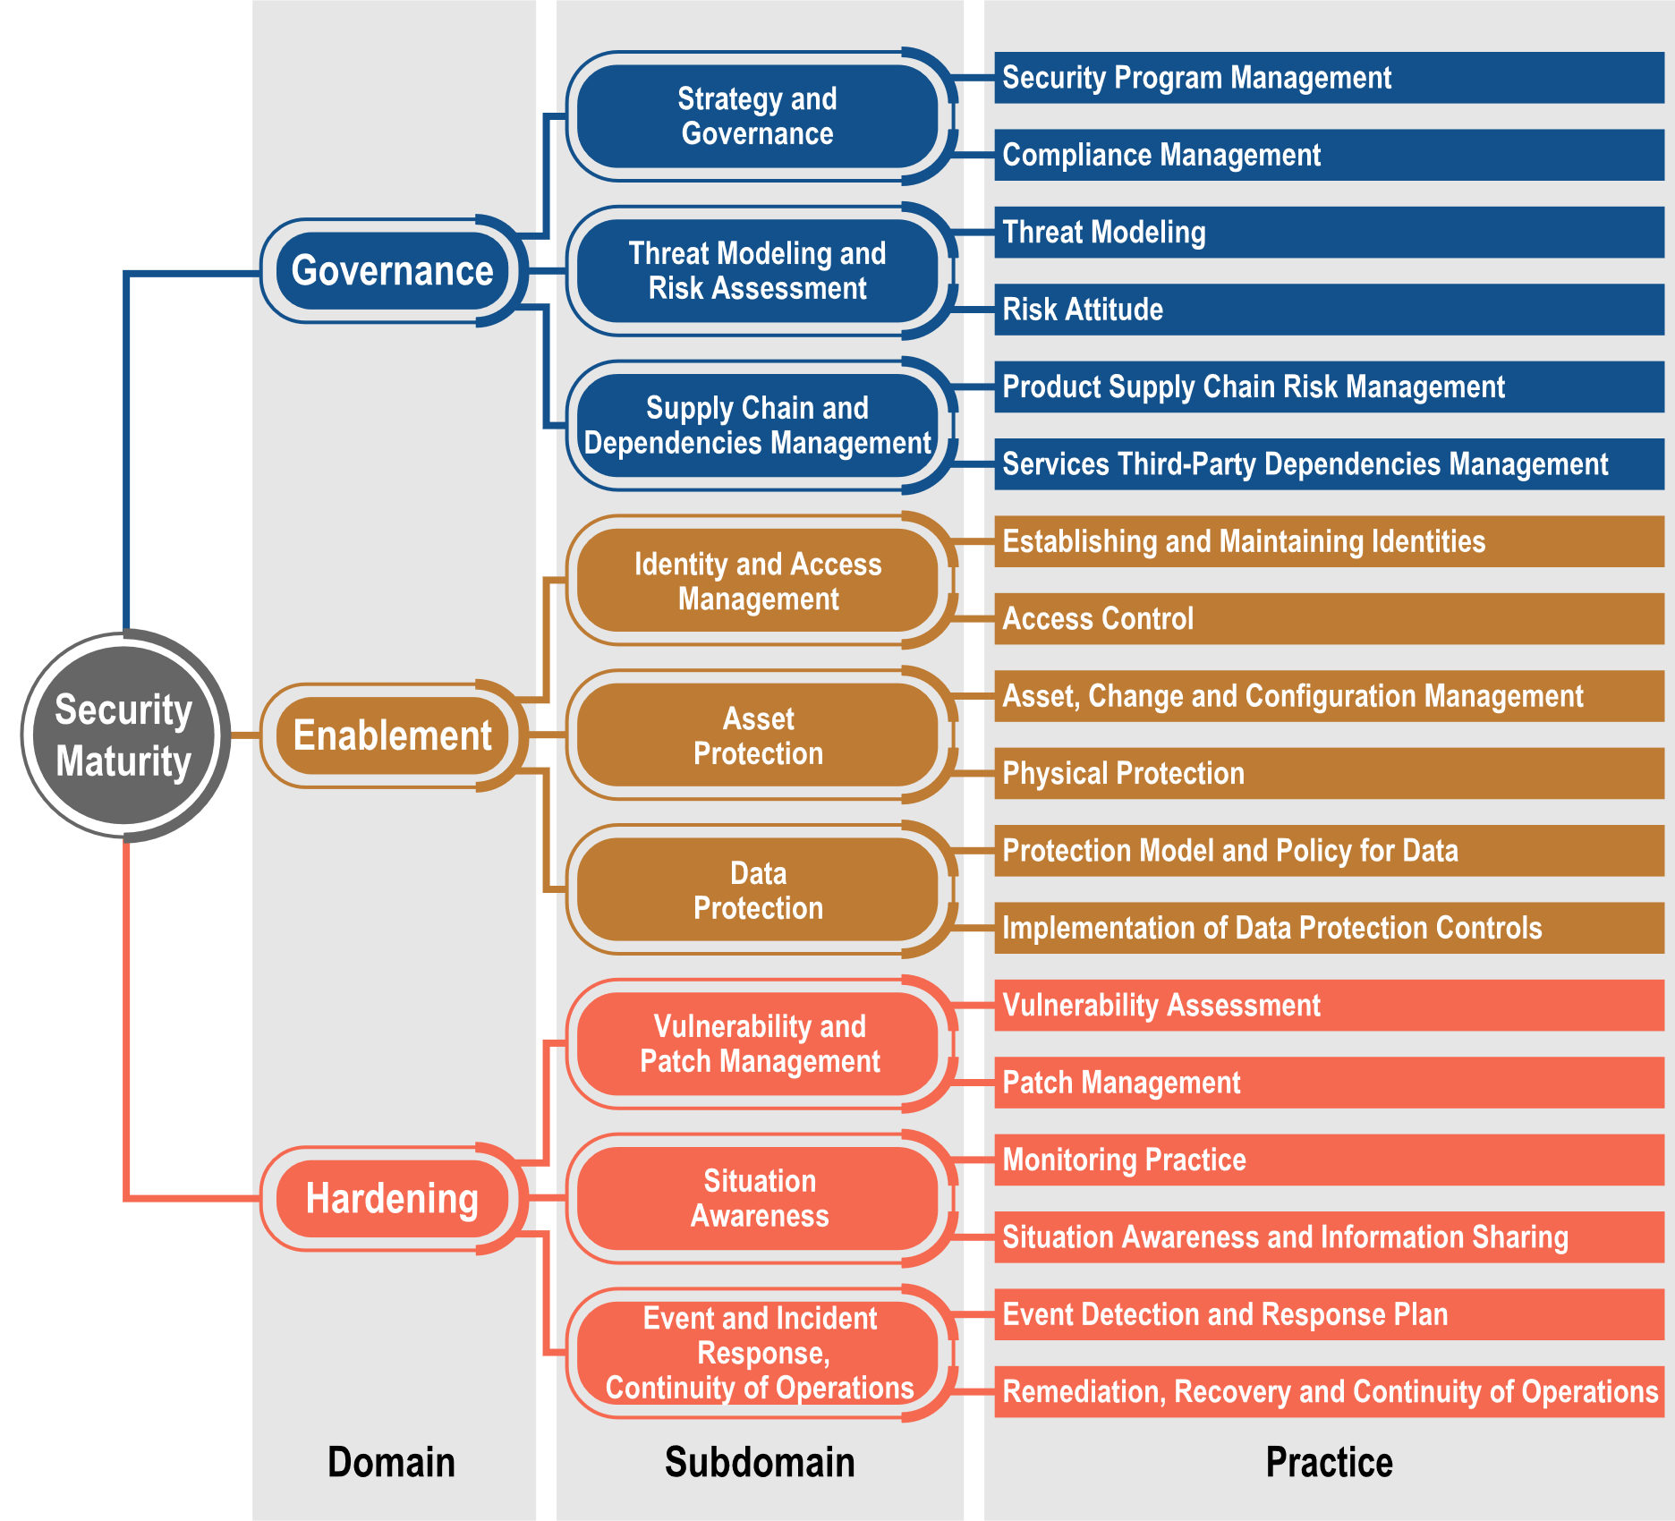
High Standards: Certifications
IoT Security Model Certified: IoT Industry Consortium
The IoT Security Maturity Model, defined by the Industry IoT Consortium (IIC)
UL29000 Certification : The standards present general software cyber security requirements for network-connectable products
IEC 62443: International standards for cybersecurity / operational technology in automation and control systems
Notes:
The Center for Internet Security (CIS) benchmarks are a set of best-practice cybersecurity standards for a range of IT systems and products

Slide 13


High Standards: Certifications
The IoT SMM by IIC
Based on the IEC and UL standards.
Addresses cybersecurity as a whole and not only the processes or products but also policies and it considers the system or product itself.
Microsoft, SAP, NetApp and NIST are IIC members.
IEC 62443-4-1
IEC 62443-4-2
Security for industrial automation and control systems
Focuses on the processes and definitions around developing and creating secure products.
Does not include penetration testing.
UL 2900-2-3
Standard for Safety. Software Cybersecurity for Network-Connectable Products
Includes pen testing and gives proof of IEC 62443-4-1 being implemented in a practical sense.
Establishment of the Bosch Center for Artificial Intelligence in 2017
By 2025, every Bosch product will either be equipped with AI or manufactured with its help
Notes:
Software and IoT company
Employ approx. 35,000 software developers
Annual investment in building up software competence > 4.5 bn dollars
Establishment of the Bosch Center for Artificial Intelligence in 2017
By 2025, every Bosch product will either be equipped with AI or manufactured with its help

Slide 14

Closed Operating System (2004)
Bosch cameras have a “closed” OS that runs in limited memory space
Bosch cameras are manufactured in a controlled and secure environment that is continually audited
  Chain of custody from cradle to customer
Devices can only be written to via a valid “signed” firmware upload, which is specific to hardware series and chipset
Up to and including CPP 7.3

Slide 15



Firmware 6.50 and Beyond: (2018)
“Two Factor Authentication Firmware Signature”
  This process takes effect when installing Firmware 6.51
Devices CANNOT be downgraded to an earlier version of firmware
  Protects devices from downgrade attacks!
RTOS + Digital Signatures + 2FA =

Slide 16
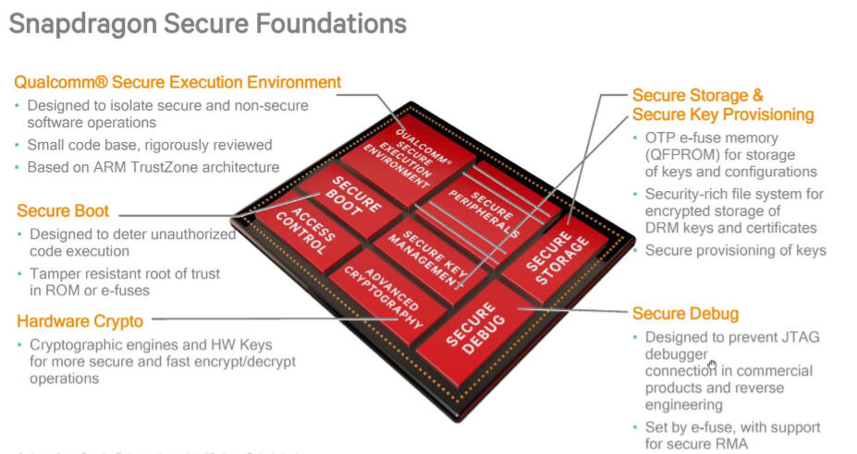

CPP 13: Embedded Android OS
Sandboxed OS
  Three Stage secure boot
  Encrypted firmware (2FA)
  Digital signatures
  Snap Dragon chipset
  Secure element

Slide 17
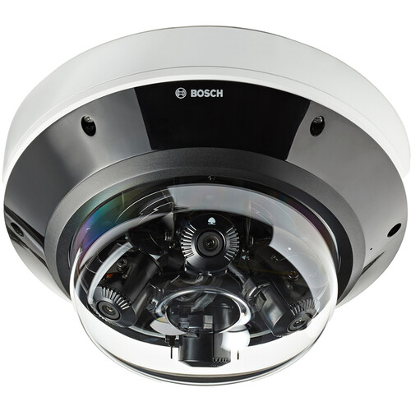
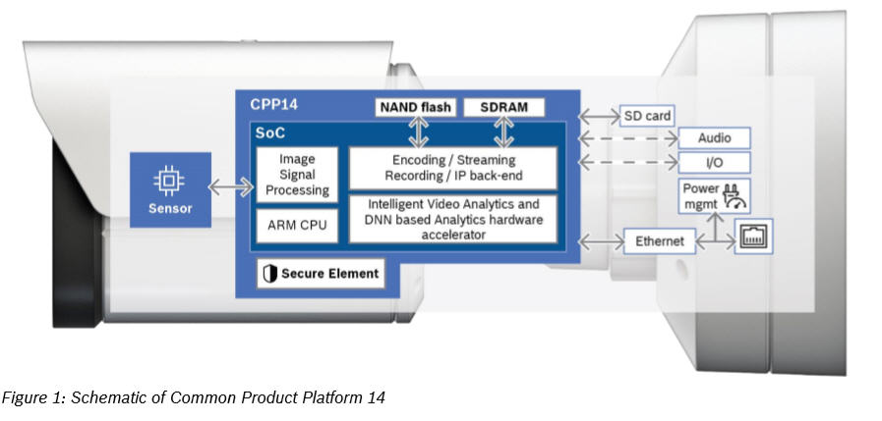

CPP 14 and Beyond
All CPP 14 devices and beyond are embedded Linux
  Embedded Ambarella SDK
  Three stage secure boot
  Migrating to Ubuntu Q3 2022

Slide 18
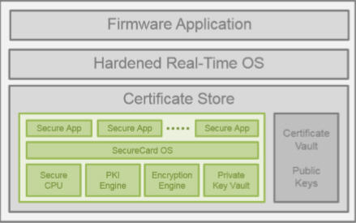
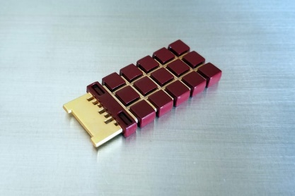
Hardened Crypto Co-Processor (2004)
The Crypto Co-Processor (CCP) is similar to a TPM and a HSM:
  More secure than a TPM
  Less processing power than HSM
Crypto Co-Processor is a dedicated, hardened, self-contained processor chip that is responsible for several key functions inside the camera
The CCP communicates with the camera's firmware via an internal secure app (encrypted)
Up to and including CPP 7.3
Notes:
The Crypto Co-Processor is responsible for storing private keys, encryption functions (Triple DES and AES 256), cryptographic functions such as generating Hashes, and PKI functions such as certificate validation. Any critical information placed inside the TPM, such as private keys, cannot be extracted

Slide 19
Secure Element: CPP 13 and 14 Devices
Why did we upgrade?
  Independently certified with Assurance Level (EAL) 6+ based on Common Criteria for Information Technology Security Evaluation
  Cryptography with up to 4096 bit RSA keys for up to TLS1.3 and device identity
  DES/AES/PKI crypto-coprocessors

Slide 20
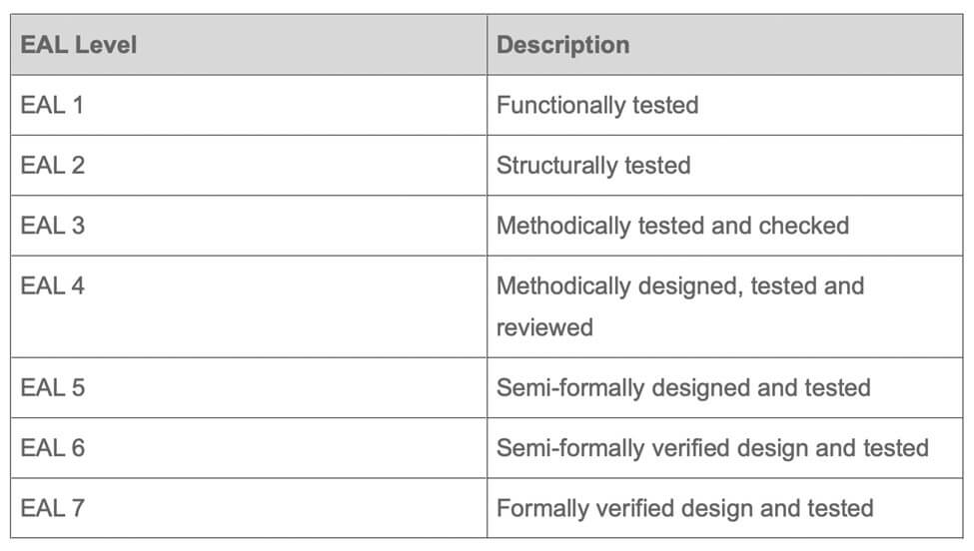

EAL: Evaluation Assurance Level
EAL is a numerical grade assigned following the completion of a Common Criteria Security Evaluation
International standard in effect since 1999

Slide 21
Certificates Capabilities and Hashing
CPP | Firmware Ceiling
4 | 7.10
6 | 7.85
7 | 7.85
7.3 | 7.85
13 | Current: 8.45
14.1 / 14.2 | 8.30/ 8.51
SHA 384 Hash Support: FWM 7.82 / CPP6 and above
4K Certs full functionality: 8.50
SCEP (8.60)

Slide 22
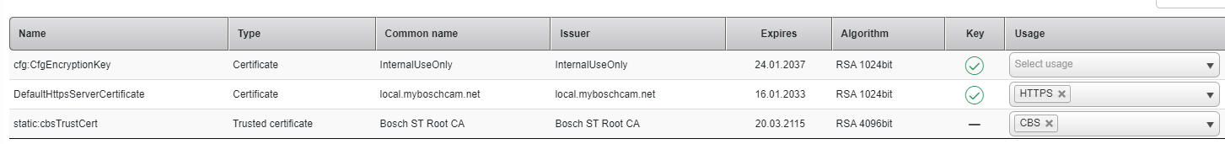
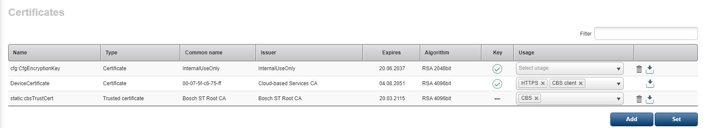
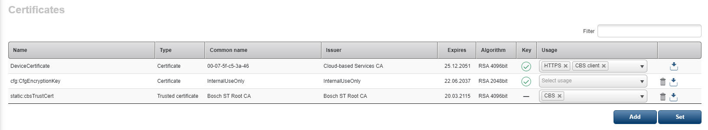
Built-In Certificates
All current devices are preloaded with certain default certificates:
7.3
13 and 14
Notes:
LunEncryption: This certificate and private key are used to encrypt local or "edge" recording media
CfgEncryption: This key is used to encrypt the configuration of the device. If the device is sold or needs to be returned to repair, deleting this key will essentially factory default the camera
Default HTTPS Server Certificate: Facilitates encrypted communications for communications and video
Bosch ST root CA: This is factory injected Escrypt root certificate for authenticity of manufacturing

Slide 23
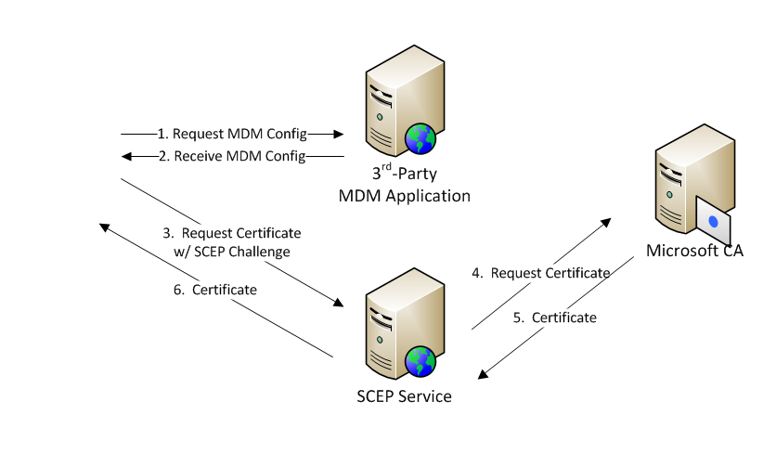
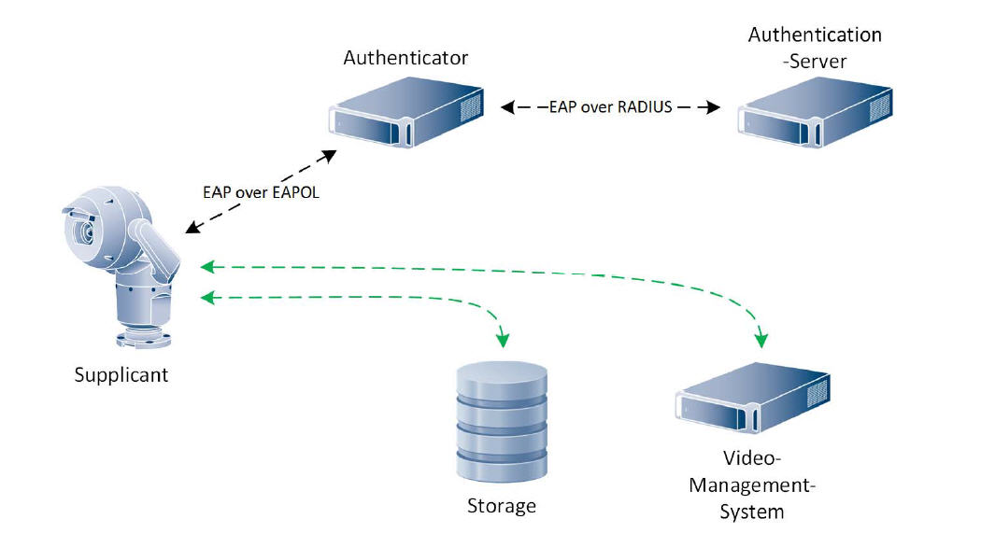
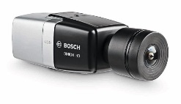
802.1x: SCEP and ACME
(SCEP) Simple Certificate Enrollment Protocol
(ACME) Automated Certificate Management Environment
Notes:
SCEP vs ACME
Automated Certificate Management Environment (ACME) is very similar to SCEP in regards to certificate management. ACME installs a certificate management tool, which generates a key pairing that can validate the CA and organization. Once validated, the management tool will be able to request certificates by generating and signing CSRs that will be sent to the CA. With the ACME protocol, organizations are able to have their managed devices automatically request certificates from the CA.
Like EST, ACME is relatively new and the amount of deployment requests received for ACME are nowhere near the amount of SCEP requests. The fact of the matter is that the SCEP protocol is more widely recognized and used

Slide 24
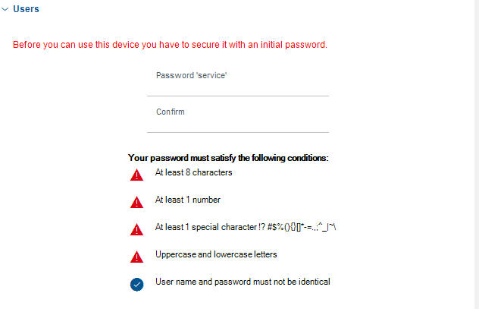
Complex Passwords and Firewalls
All defaulted devices with Firmware 6.4 (2017) and above cannot be accessed or configured without a Complex Password:
All devices with Firmware 6.3 (2015) or higher have an embedded login “Firewall”
3 failed login attempts within 20 seconds:
The camera Black Lists the attempting IP address

Slide 25
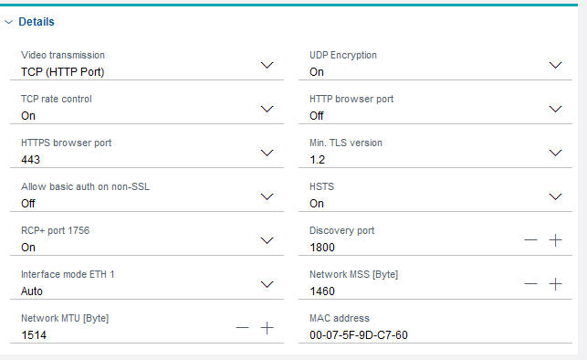
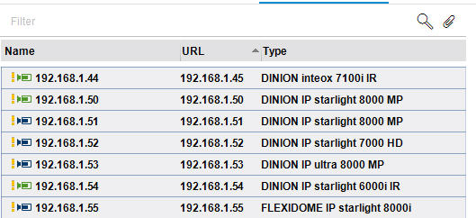
Easy Lock Down Configuration
Protocol and port usage:
TLS Version
HSTS
UDP encryption capable
  Multicast and Unicast
How many can you click?

Slide 26
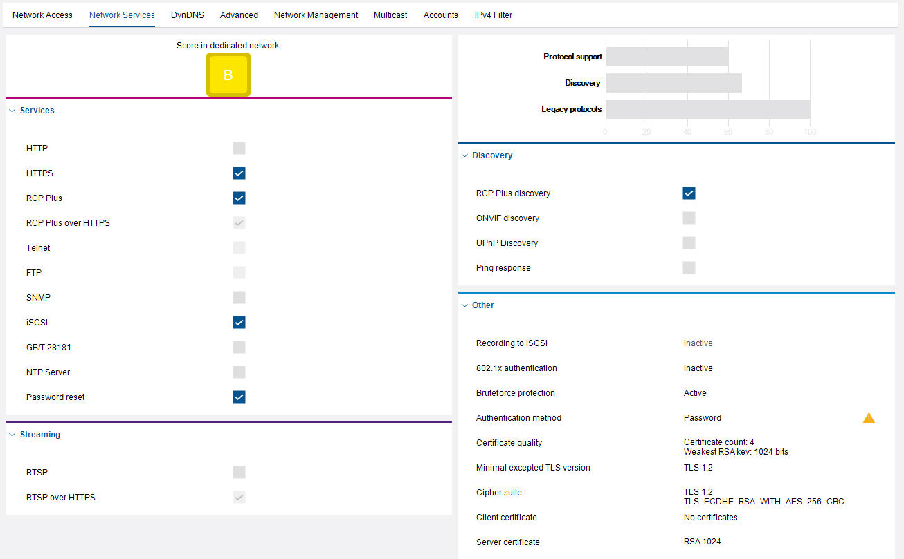
Easy to Configure
Quick Configuration for different deployment environments:
All legacy protocols have been disabled (2015)
Ping
Discovery Protocols
The Network Services Menu features a “Security Rating”
Default rating is a B
Rating meters increase as items are “Disabled”

Slide 27
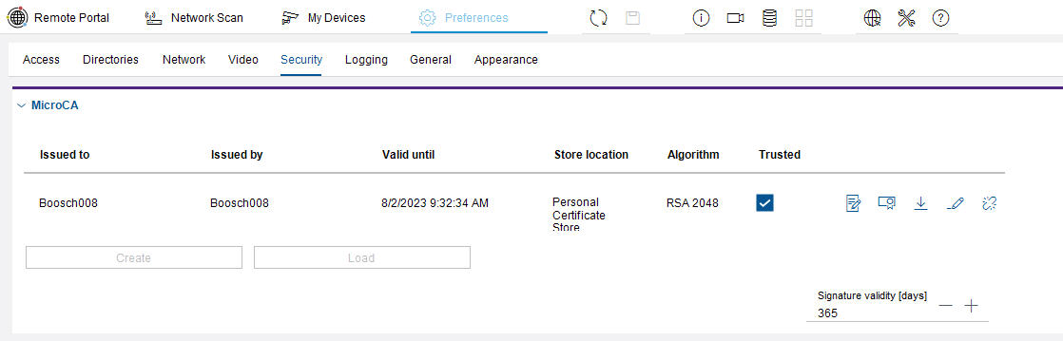
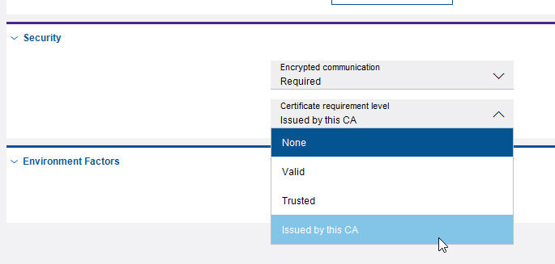
CFM: Built in Micro CA (FREE)
Configuration Manager has a built in Micro CA that is “FREE”:
Lock down an entire site with a few clicks
CFM has mandatory security measures in place by default

Slide 28
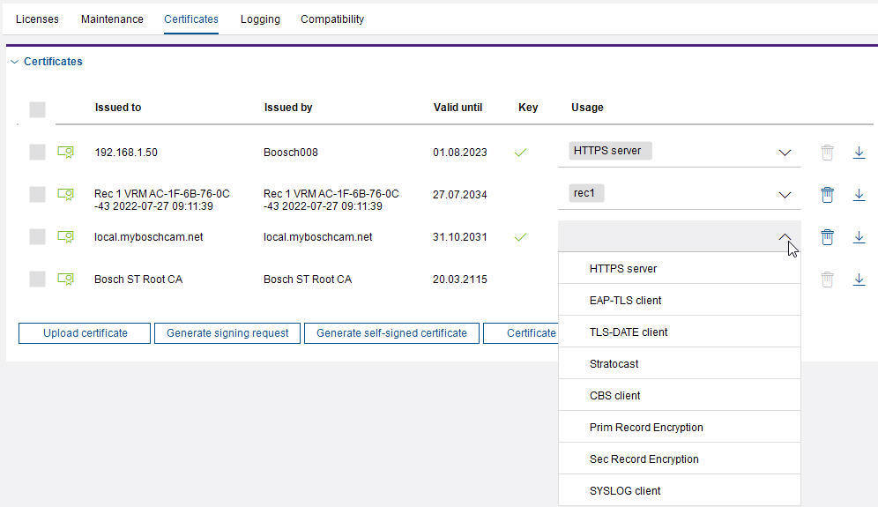
Easy to Configure Certificate Menus
Besides the default certificates loaded or generated in the device's certificate store, all devices can generate Certificate Signing Requests (CSR) that can be signed by a Certificate Authority
Certificates can also be uploaded from different Certificate Authorities to perform different roles. All newly generated or uploaded certificates can serve in a wide variety of roles, such as:

Slide 29
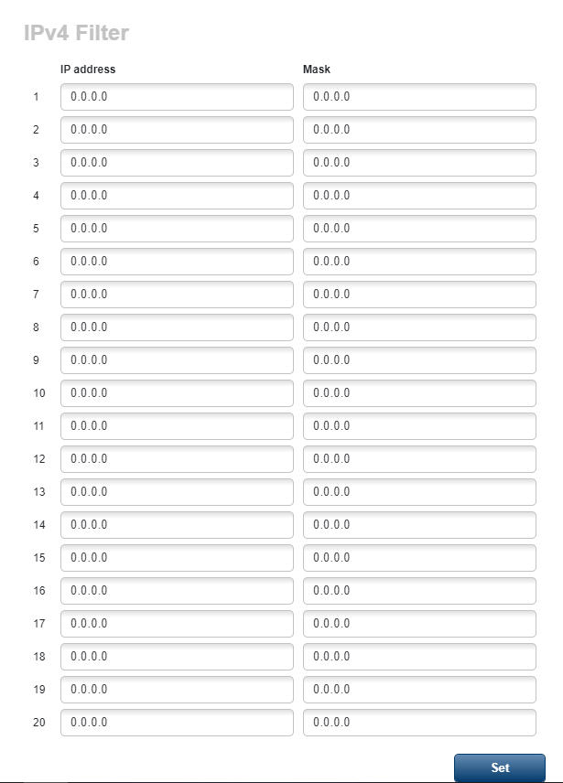
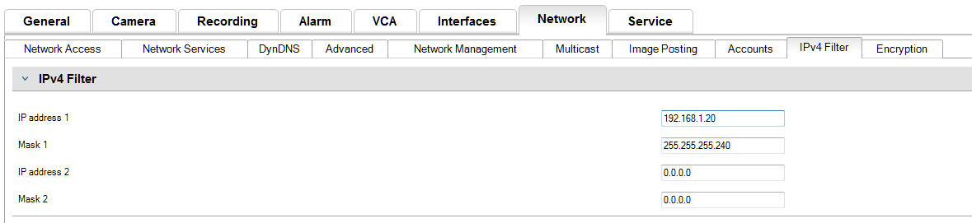
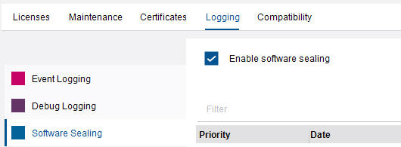
IPv4 Filter and Software Sealing
Easy to configure IP address filter that allows you to create up to two IP pools for authorized connection to the system’s cameras
FMW 8.4
All devices can have “Software Sealing” enabled. This provides alerts to any configuration changes!

Slide 30
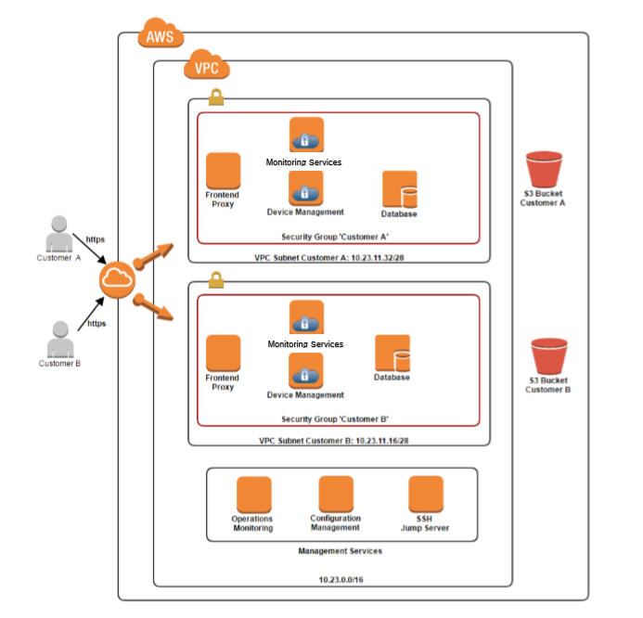
Remote Portal Structure
Bosch Cloud Services are “hosted” on the AWS platform:
When an account is created, a new Virtual Private Cloud (VPC) is created
All customers’ data and traffic are kept isolated and private
All communications are handled via Public Key Infrastructure (PKI) encryption

Slide 31
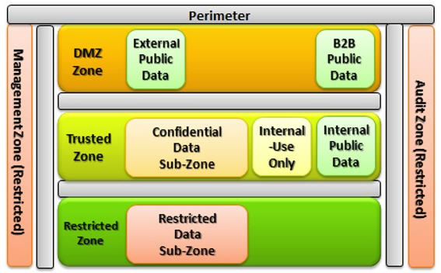
What if the Vendor has GOD Accounts
Looking at this from a higher level :
  Any camera in this eco-system that is accessible by a vendor’s employee such as: Tech Support, Engineer, or Sales can cause issues
NIST 800-53 stipulates that confidential internal data (VIDEO) should be kept internal in a trusted zone. If based in the Cloud, it should be ISOLATED, including from the provider
Legal Ramifications: HIPAA
NIST Standards / FIPS / STIG

Slide 32
FIPS Cheat Sheet
FIPS 140-2 defines four levels of security, simply named "Level 1" to "Level 4".
  It does not specify in detail what level of security is required by any particular application
Federal government requires: Security strength of at least 112 bits for applying cryptographic protection. This equals:
Minimum 128 bit symmetric keys for AES
Minimum 2048 bits for RSA
Block Ciphers: AES is the permitted cipher
Hash functions: SHA1 is allowed only for “non-digital signature” applications.
Otherwise, SHA-2 (any flavor)

