Slide 1



Slide 2

Quick Product Overview
Fiber • Hardened Ethernet • Commercial Ethernet
Retrofit • Wireless

Slide 3
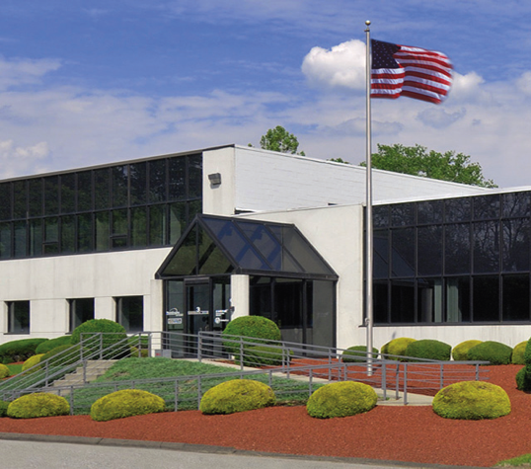
About Us
Founded in 2007 by George Lichtblau
Former GE IFS Team
Based in Danbury, CT
Focused on Made in America
Doing it right
Rooted in Security
“Old School” customer service
Bringing unique products to market
Tons of resources for pre- and post-sales
Notes:
ComNet has four main product lines that serve the Security, Transportation, Gov’t and Military markets.
We design and manufacture a complete line of the legacy fiber optic transmission products that transmit video, serial data, audio and CC’s over MM or SM fiber.
We can send one signal, or we can send up to 32 video and 8 data all over one fiber – and everything in between.
These products are far superior to anything made previously.
Hardened Ethernet, because that is our heritage – putting equipment into nasty places and making sure it works. We wanted to apply the same mentality to Ethernet products.
We offer two port media converters, managed and unmanaged Layer 2 switches up to 26 ports.
Commercial-grade switches – because we don’t want installers putting in consumer-grade product in places in doesn’t belong!
And our newest offering – Retrofit Network products that allow you to reduce both risks and costs while upgrading to an IP solution.
We want to be your One Stop Shopping for all transmission and communication products.

Slide 4
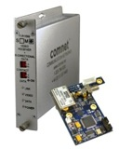
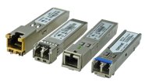

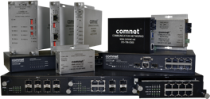

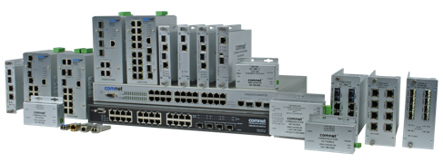



Product Scope
Legacy Fiber Optic
Hardened Ethernet
Commercial Ethernet
Retrofit Network
Wireless Ethernet
Notes:
ComNet has four main product lines that serve the Security, Transportation, Gov’t and Military markets.
We design and manufacture a complete line of the legacy fiber optic transmission products that transmit video, serial data, audio and CC’s over MM or SM fiber.
We can send one signal, or we can send up to 32 video and 8 data all over one fiber – and everything in between.
These products are far superior to anything made previously.
Hardened Ethernet, because that is our heritage – putting equipment into nasty places and making sure it works. We wanted to apply the same mentality to Ethernet products.
We offer two port media converters, managed and unmanaged Layer 2 switches up to 26 ports.
Commercial-grade switches – because we don’t want installers putting in consumer-grade product in places in doesn’t belong!
And our newest offering – Retrofit Network products that allow you to reduce both risks and costs while upgrading to an IP solution.
We want to be your One Stop Shopping for all transmission and communication products.

Slide 5


legacy fiber
Notes:
Our next application is another common situation. In this scenario we have an existing campus that has 8 channels of home run PTZ video at the edge and terminating back at a security operations center. Historically analog video over fiber has always been a point to point solution.
Often the integrator is tasked looking for a solution to incorporate new IP elements, but are limited on fiber. With our new SHR solution it now allows you to take the Analog video in a drop and repeat or self healing ring topology. This now allows for additional fibers to be allocated for other uses.

Slide 6
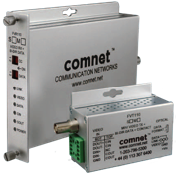
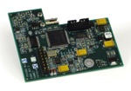
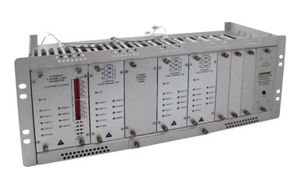
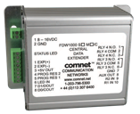
Analog Video, Data, Audio & Contacts Over Fiber
Full Fiber Product Line
1 to 32 cameras over 1 fiber, with optional data
In-dome modules for major manufacturers
Analog video with Ethernet
Data transceivers – point-to-point, add/drop, ring topologies
Specialty Products
HDMI over fiber
Wiegand data over fiber
ComFit Card Design
Cards can be wall or rack mounted

Slide 7


wireless

Slide 8
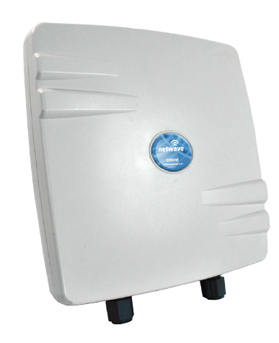
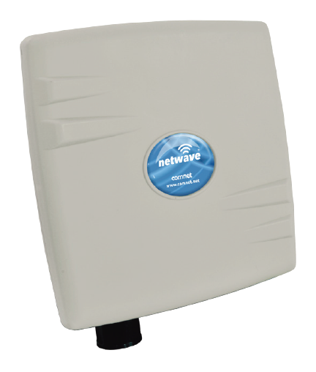
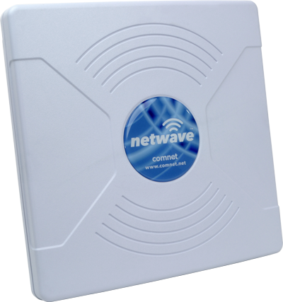
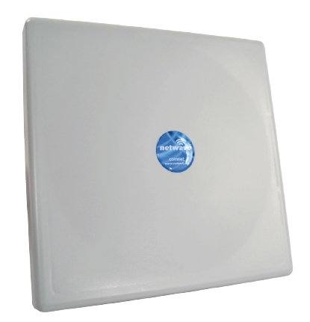
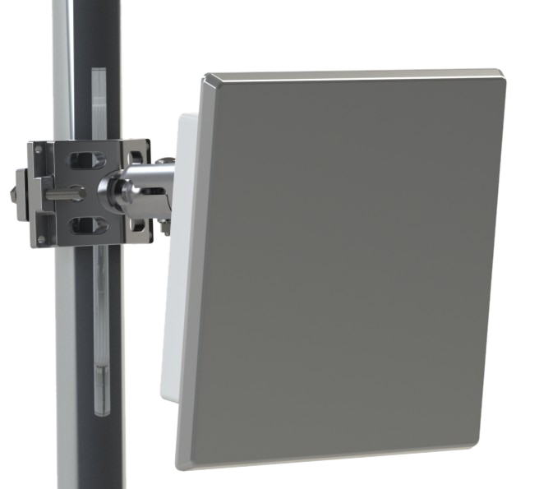
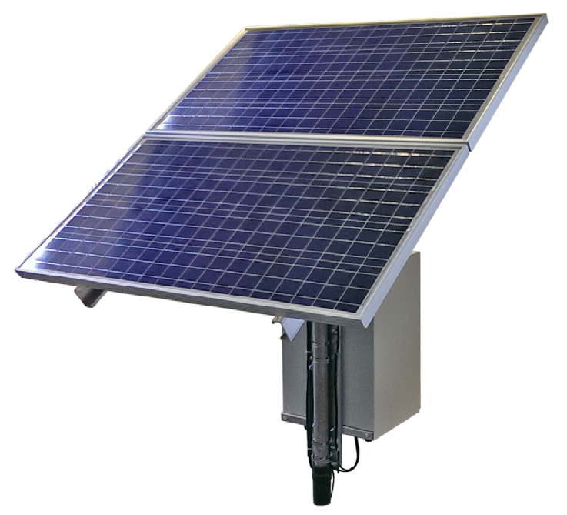
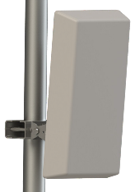
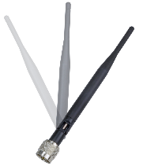
NetWave Wireless Ethernet
Versatile Product Line
Point-to-Point Preconfigured Kit
Point-to-Multipoint
Daisy Chain
Self Healing Ring
Backhaul
Solar Power & Battery Backup Options
Preconfigured kits allow Power, Point & Play setup
IP67 enclosures – glands and LEDs on bottom
Hardened operating temperature -40˚ to 70˚C
Multiple port models
Powered by PoE or PIM, some power your camera
5GHz 802.11a/n or 802.11ac radios
95 to 500 Mbps Max. throughput
Up to 4 miles distance

Slide 9


ethernet

Slide 10
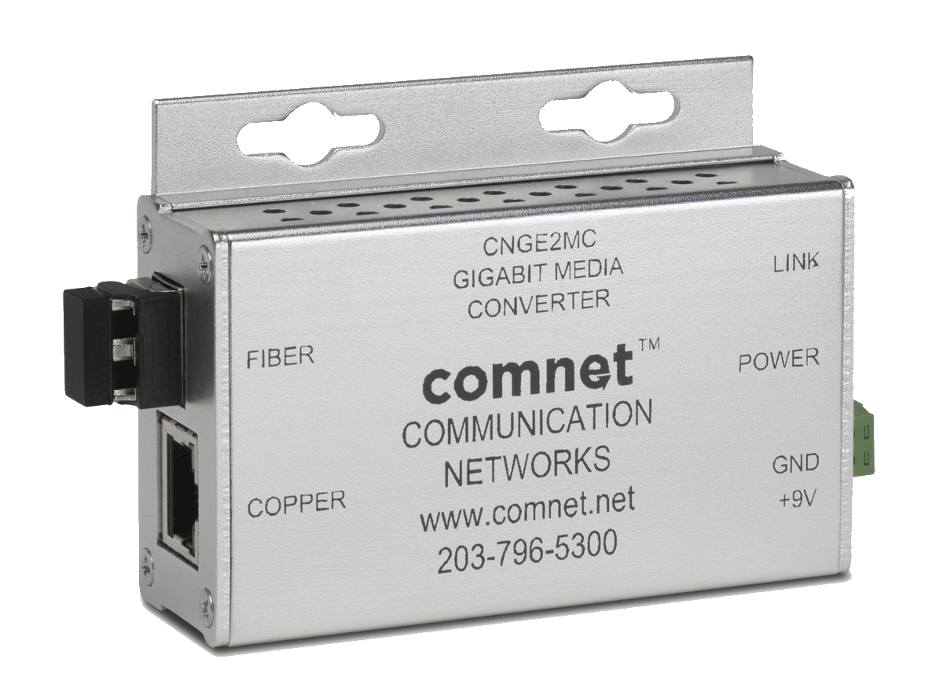
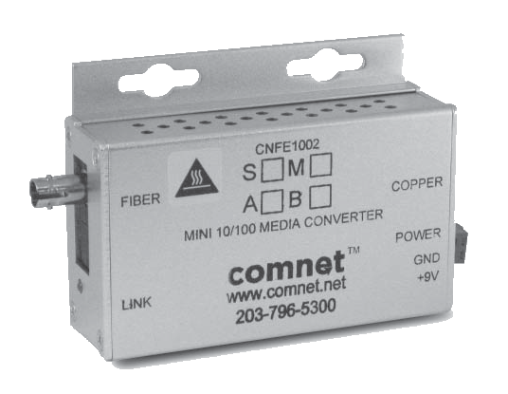
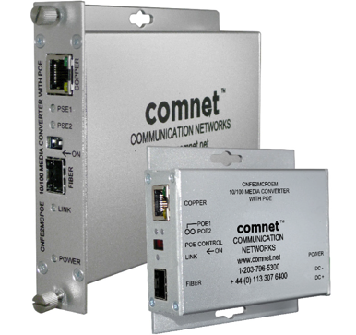
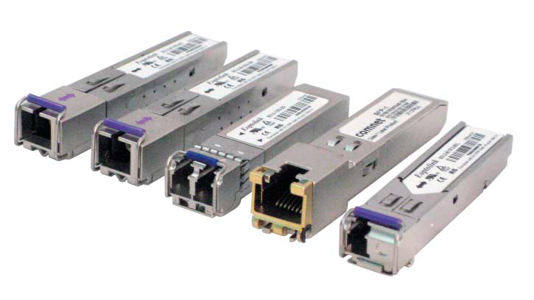
Ethernet
Media Converters
Any Combination of Features
Hardened or Commercial
Fixed optics or SFP
Mini or card cage mountable
100 Mbps, 1000 Mbps or dual rate
DC or AC/DC powered
15W, 30W or 60W PoE models
Options for contact closures

Slide 11
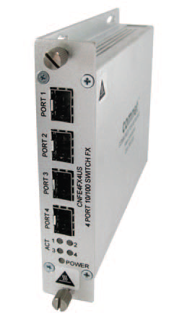
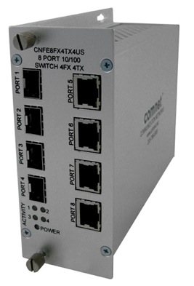
Ethernet
Unmanaged Switches
All in the ComFit card design
100 Mbps Fast Ethernet Models
All copper RJ45 ports
All SFP ports
Half & half
1000 Mbps Gigabit Models
All SFP ports
SFP-1 required for RJ45 copper connections

Slide 12
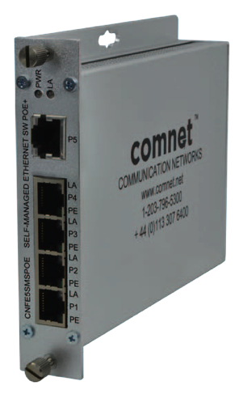
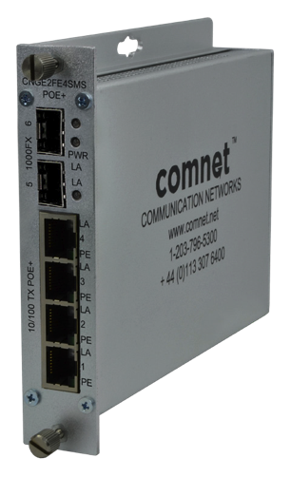
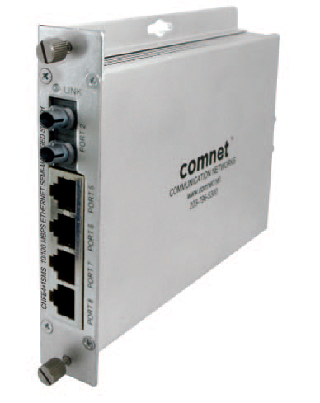
Ethernet
Self Managed Switches
Unique to ComNet
Unmanaged
DIP switch controlled Multicast support
  Stops flooding by sending multicast packets only out backbone port
4, 5, 6 or 8 port models
Copper and fiber options
Optional 30W PoE
Gigabit Model
Two Gigabit SFP ports for daisy chain topology
Four 10/100 copper ports
  Two ports supply 30W PoE
  Two ports supply 60W PoE

Slide 13

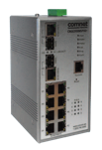

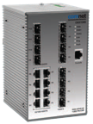


Managed Switches - Hardened
Layer 2 Switches
5 to 28 ports
100Mbps and 1000Mbps ports
Combo ports for copper or fiber (with SFP)
PoE – 15W or 30W
Very full featured – VLAN, RSTP, full Multicast, SNMP, and more
Lifetime Warranty
Notes:
ComNet has four main product lines that serve the Security, Transportation, Gov’t and Military markets.
We design and manufacture a complete line of the legacy fiber optic transmission products that transmit video, serial data, audio and CC’s over MM or SM fiber.
We can send one signal, or we can send up to 32 video and 8 data all over one fiber – and everything in between.
These products are far superior to anything made previously.
Hardened Ethernet, because that is our heritage – putting equipment into nasty places and making sure it works. We wanted to apply the same mentality to Ethernet products.
We offer two port media converters, managed and unmanaged Layer 2 switches up to 26 ports.
Commercial-grade switches – because we don’t want installers putting in consumer-grade product in places in doesn’t belong!
And our newest offering – Retrofit Network products that allow you to reduce both risks and costs while upgrading to an IP solution.
We want to be your One Stop Shopping for all transmission and communication products.

Slide 14
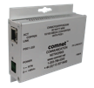

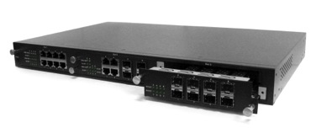


Managed Switches - Commercial
Layer 2 Switches
All the same features as the hardened, but at 0˚ to 50˚C
8 to 26 ports
100Mbps and 1000Mbps ports
Combo ports for copper or fiber (with SFP)
PoE – 15W or 30W
Very full featured – VLAN, RSTP, full Multicast, SNMP, and more
5 Year Warranty
Notes:
ComNet has four main product lines that serve the Security, Transportation, Gov’t and Military markets.
We design and manufacture a complete line of the legacy fiber optic transmission products that transmit video, serial data, audio and CC’s over MM or SM fiber.
We can send one signal, or we can send up to 32 video and 8 data all over one fiber – and everything in between.
These products are far superior to anything made previously.
Hardened Ethernet, because that is our heritage – putting equipment into nasty places and making sure it works. We wanted to apply the same mentality to Ethernet products.
We offer two port media converters, managed and unmanaged Layer 2 switches up to 26 ports.
Commercial-grade switches – because we don’t want installers putting in consumer-grade product in places in doesn’t belong!
And our newest offering – Retrofit Network products that allow you to reduce both risks and costs while upgrading to an IP solution.
We want to be your One Stop Shopping for all transmission and communication products.

Slide 15
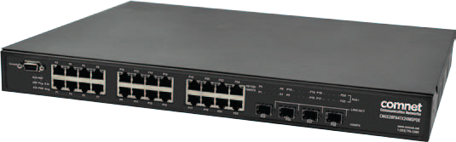
Switches Built for Security and Video
Featured Product CNGE28FX4TX24MSPOE
28 ports – all Gigabit
4 SFP ports
24 copper ports with 30W PoE
  30W simultaneously on all 24 ports at 50˚C
  1000W internal supply
Hardened
Lifetime Warranty
56Gbps switching fabric
FULL multicast support
Jumbo frame support
Notes:
ComNet has four main product lines that serve the Security, Transportation, Gov’t and Military markets.
We design and manufacture a complete line of the legacy fiber optic transmission products that transmit video, serial data, audio and CC’s over MM or SM fiber.
We can send one signal, or we can send up to 32 video and 8 data all over one fiber – and everything in between.
These products are far superior to anything made previously.
Hardened Ethernet, because that is our heritage – putting equipment into nasty places and making sure it works. We wanted to apply the same mentality to Ethernet products.
We offer two port media converters, managed and unmanaged Layer 2 switches up to 26 ports.
Commercial-grade switches – because we don’t want installers putting in consumer-grade product in places in doesn’t belong!
And our newest offering – Retrofit Network products that allow you to reduce both risks and costs while upgrading to an IP solution.
We want to be your One Stop Shopping for all transmission and communication products.

Slide 16

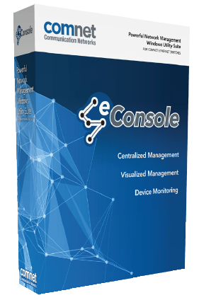
eConsole Software
Network Management Suite
  eVision
    Topology view
    Health visualization
  eCommander
    Device discovery/configuration
    Device status/Syslog
    IP address/firmware distribution
  eMonitor
    Detect all IP devices
    Monitor all IP devices

Slide 17
retrofit

Slide 18
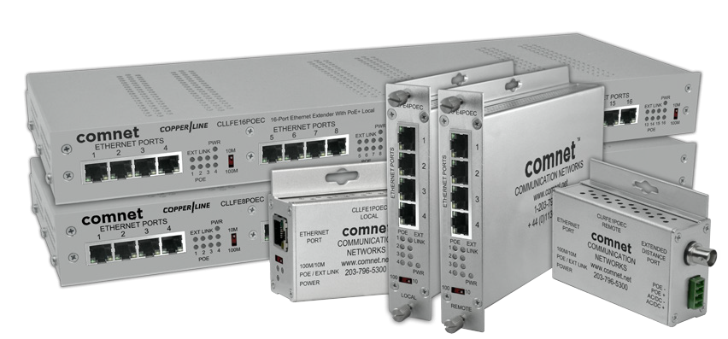
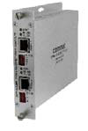
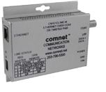
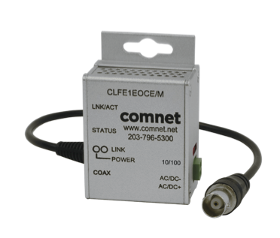
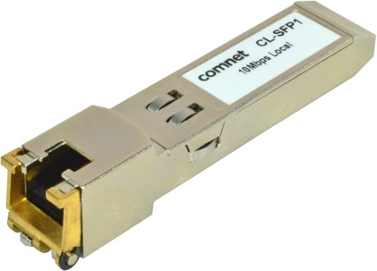
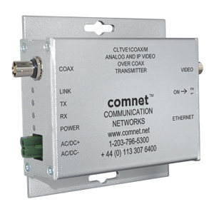
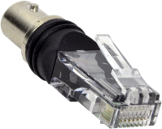
Retrofit
Multiple Technologies
Different products for different applications
CopperLine
15W or 30W Pass through PoE
Multiple powering scenarios
1, 4, 8 or 16 channels versions
VDSL
For longer distances or unstable copper cabling
Retrofit SFP
Fits in an SFP port with 100FX support
SLOC
Analog & IP over coax

Slide 19

Retrofit
NEW CopperLine Design
15 and 30 Watt PoE models
“Micro” model fits in a double gang box
Pass through PoE or AC/DC direct power
Local or Remote injection of power
4 Port Self-Managed Switch with
CopperLine Uplink port & 30W per port
Coax | Data Only | Distance 15W | Distance 30W
10 Mbps | 5,000 ft. | 750 ft. | 335 ft.
100 Mbps | 2,000 ft. | 850 ft. | 335 ft.
UTP | Data Only | Distance 15W | Distance 30W
10 Mbps | 3,000 ft. | 750 ft. | 335 ft.
100 Mbps | 2,000 ft. | 850 ft. | 335 ft.
Notes:
ComNet has four main product lines that serve the Security, Transportation, Gov’t and Military markets.
We design and manufacture a complete line of the legacy fiber optic transmission products that transmit video, serial data, audio and CC’s over MM or SM fiber.
We can send one signal, or we can send up to 32 video and 8 data all over one fiber – and everything in between.
These products are far superior to anything made previously.
Hardened Ethernet, because that is our heritage – putting equipment into nasty places and making sure it works. We wanted to apply the same mentality to Ethernet products.
We offer two port media converters, managed and unmanaged Layer 2 switches up to 26 ports.
Commercial-grade switches – because we don’t want installers putting in consumer-grade product in places in doesn’t belong!
And our newest offering – Retrofit Network products that allow you to reduce both risks and costs while upgrading to an IP solution.
We want to be your One Stop Shopping for all transmission and communication products.

Slide 20
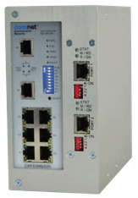
VDSL2
Retrofit
Ethernet over coax or UTP
Asymmetrical connection over coax or 1 pair UTP
12VDC powered
No PoE
Hardened or Commercial versions
Rack mounted options
Drop & Repeat model
Longer distances and better over troubled copper cabling
Lifetime Warranty on hardened,
5 Year Warranty on Commercial
Distance | Downstream | Upstream
1000 ft. | 70 Mbps | 65 Mbps
5000 ft. | 16 | 1
10,000 ft. | 1 | .25
Notes:
ComNet has four main product lines that serve the Security, Transportation, Gov’t and Military markets.
We design and manufacture a complete line of the legacy fiber optic transmission products that transmit video, serial data, audio and CC’s over MM or SM fiber.
We can send one signal, or we can send up to 32 video and 8 data all over one fiber – and everything in between.
These products are far superior to anything made previously.
Hardened Ethernet, because that is our heritage – putting equipment into nasty places and making sure it works. We wanted to apply the same mentality to Ethernet products.
We offer two port media converters, managed and unmanaged Layer 2 switches up to 26 ports.
Commercial-grade switches – because we don’t want installers putting in consumer-grade product in places in doesn’t belong!
And our newest offering – Retrofit Network products that allow you to reduce both risks and costs while upgrading to an IP solution.
We want to be your One Stop Shopping for all transmission and communication products.

Slide 21
CopperLine SFP – Distance Extending Module
CL-SFP(X)
  Extended distance Ethernet over UTP or Coax
    2,000 ft (609m) for 100Mbps
    3,000 ft (914m) for 10Mbps
  Coax adapter
  Can be used in any SFP port that supports 100Mbps
  100Mbps and 10Mbps versions
  Can also be used with CopperLine products
  No PoE support

Slide 22

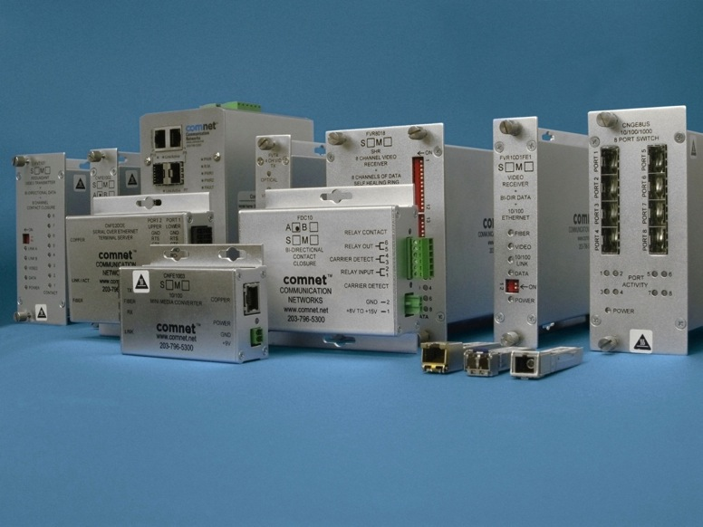
i n n o v a t i o n s
Call ComNet for all your transmission needs!
Notes:
Show distance/bandwidth capabilities

