Slide 1



Slide 2

Product Overview
Fiber • Hardened Ethernet • Commercial Ethernet
Retrofit • Wireless
Guy Walker
North America Trainer
A&E Program Manager

Slide 3
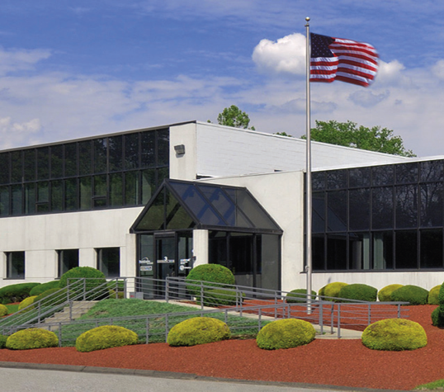
About Us
Founded in 2007 by George Lichtblau
Former GE IFS Team
Based in Danbury, CT
Focused on Made in America
Doing it right
Rooted in Security
“Old School” customer service
Bringing unique products to market
Notes:
ComNet has four main product lines that serve the Security, Transportation, Gov’t and Military markets.
We design and manufacture a complete line of the legacy fiber optic transmission products that transmit video, serial data, audio and CC’s over MM or SM fiber.
We can send one signal, or we can send up to 32 video and 8 data all over one fiber – and everything in between.
These products are far superior to anything made previously.
Hardened Ethernet, because that is our heritage – putting equipment into nasty places and making sure it works. We wanted to apply the same mentality to Ethernet products.
We offer two port media converters, managed and unmanaged Layer 2 switches up to 26 ports.
Commercial-grade switches – because we don’t want installers putting in consumer-grade product in places in doesn’t belong!
And our newest offering – Retrofit Network products that allow you to reduce both risks and costs while upgrading to an IP solution.
We want to be your One Stop Shopping for all transmission and communication products.

Slide 4
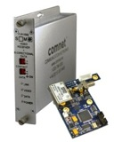
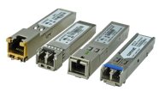

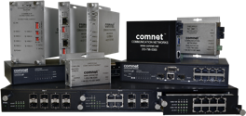

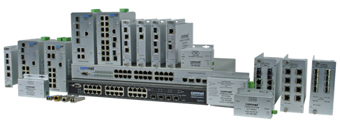



Product Scope
Legacy Fiber Optic
Hardened Ethernet
Commercial Ethernet
Retrofit Network
Wireless Ethernet
Notes:
ComNet has four main product lines that serve the Security, Transportation, Gov’t and Military markets.
We design and manufacture a complete line of the legacy fiber optic transmission products that transmit video, serial data, audio and CC’s over MM or SM fiber.
We can send one signal, or we can send up to 32 video and 8 data all over one fiber – and everything in between.
These products are far superior to anything made previously.
Hardened Ethernet, because that is our heritage – putting equipment into nasty places and making sure it works. We wanted to apply the same mentality to Ethernet products.
We offer two port media converters, managed and unmanaged Layer 2 switches up to 26 ports.
Commercial-grade switches – because we don’t want installers putting in consumer-grade product in places in doesn’t belong!
And our newest offering – Retrofit Network products that allow you to reduce both risks and costs while upgrading to an IP solution.
We want to be your One Stop Shopping for all transmission and communication products.

Slide 5
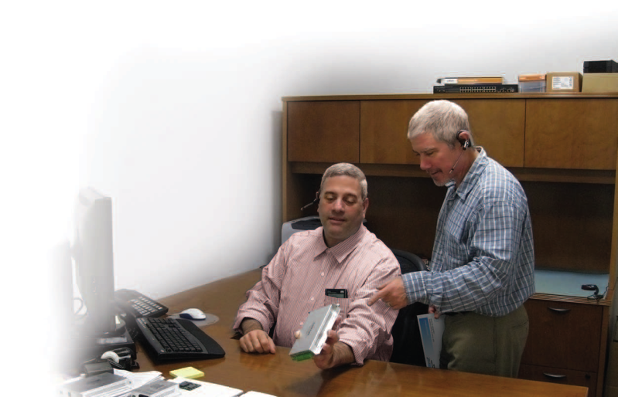
Resources
ComNet is in a different category:
Local Manufacturer’s Rep Support
Regional Sales Manager Support
Design Center
Live Technical Support
Educational Tools
Digital Tools
LIFETIME Warranty
Notes:
ComNet has four main product lines that serve the Security, Transportation, Gov’t and Military markets.
We design and manufacture a complete line of the legacy fiber optic transmission products that transmit video, serial data, audio and CC’s over MM or SM fiber.
We can send one signal, or we can send up to 32 video and 8 data all over one fiber – and everything in between.
These products are far superior to anything made previously.
Hardened Ethernet, because that is our heritage – putting equipment into nasty places and making sure it works. We wanted to apply the same mentality to Ethernet products.
We offer two port media converters, managed and unmanaged Layer 2 switches up to 26 ports.
Commercial-grade switches – because we don’t want installers putting in consumer-grade product in places in doesn’t belong!
And our newest offering – Retrofit Network products that allow you to reduce both risks and costs while upgrading to an IP solution.
We want to be your One Stop Shopping for all transmission and communication products.

Slide 6

Marketplace
Strong Sales Channel
Manufacturer’s Representatives in all
North American territories
Regional Sales Managers
National Account Managers
Vertical Sales Managers for ITS/Special Projects
Diverse Customer Base
All national distributors
Actively working with all national integrators
A&E Program engages system designers & specifiers
Notes:
ComNet has four main product lines that serve the Security, Transportation, Gov’t and Military markets.
We design and manufacture a complete line of the legacy fiber optic transmission products that transmit video, serial data, audio and CC’s over MM or SM fiber.
We can send one signal, or we can send up to 32 video and 8 data all over one fiber – and everything in between.
These products are far superior to anything made previously.
Hardened Ethernet, because that is our heritage – putting equipment into nasty places and making sure it works. We wanted to apply the same mentality to Ethernet products.
We offer two port media converters, managed and unmanaged Layer 2 switches up to 26 ports.
Commercial-grade switches – because we don’t want installers putting in consumer-grade product in places in doesn’t belong!
And our newest offering – Retrofit Network products that allow you to reduce both risks and costs while upgrading to an IP solution.
We want to be your One Stop Shopping for all transmission and communication products.

Slide 7
Resources
www.comnet.net
Notes:
ComNet has four main product lines that serve the Security, Transportation, Gov’t and Military markets.
We design and manufacture a complete line of the legacy fiber optic transmission products that transmit video, serial data, audio and CC’s over MM or SM fiber.
We can send one signal, or we can send up to 32 video and 8 data all over one fiber – and everything in between.
These products are far superior to anything made previously.
Hardened Ethernet, because that is our heritage – putting equipment into nasty places and making sure it works. We wanted to apply the same mentality to Ethernet products.
We offer two port media converters, managed and unmanaged Layer 2 switches up to 26 ports.
Commercial-grade switches – because we don’t want installers putting in consumer-grade product in places in doesn’t belong!
And our newest offering – Retrofit Network products that allow you to reduce both risks and costs while upgrading to an IP solution.
We want to be your One Stop Shopping for all transmission and communication products.

Slide 8
Resources
comnet.net
Models:
“CN…” is hardened
“CW…” is indoor
Notes:
ComNet has four main product lines that serve the Security, Transportation, Gov’t and Military markets.
We design and manufacture a complete line of the legacy fiber optic transmission products that transmit video, serial data, audio and CC’s over MM or SM fiber.
We can send one signal, or we can send up to 32 video and 8 data all over one fiber – and everything in between.
These products are far superior to anything made previously.
Hardened Ethernet, because that is our heritage – putting equipment into nasty places and making sure it works. We wanted to apply the same mentality to Ethernet products.
We offer two port media converters, managed and unmanaged Layer 2 switches up to 26 ports.
Commercial-grade switches – because we don’t want installers putting in consumer-grade product in places in doesn’t belong!
And our newest offering – Retrofit Network products that allow you to reduce both risks and costs while upgrading to an IP solution.
We want to be your One Stop Shopping for all transmission and communication products.

Slide 9

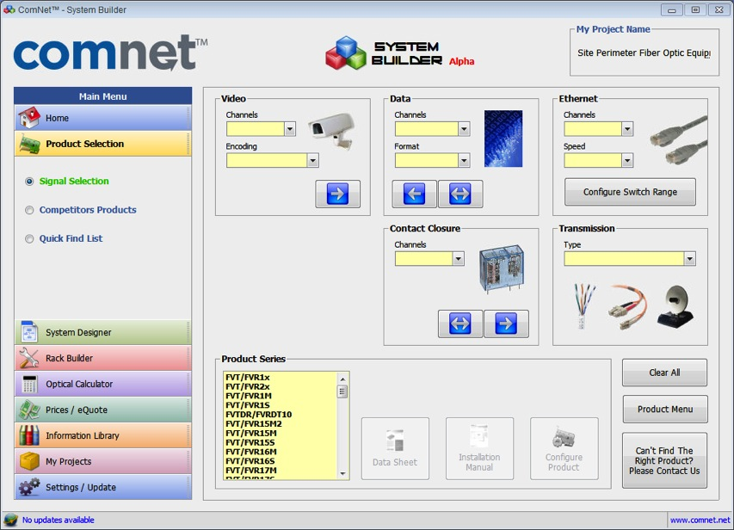
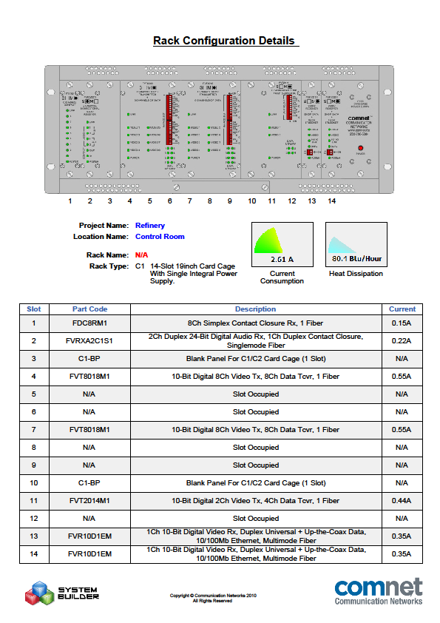

i n n o v a t i o n s
System Builder
Select product:
From pick list
From product comparision
From Q&A guide
Build projects:
BOM
By Location/closet
Get data:
Picture of rack w/BOM
Heat dissipation
Power requirements
PDF
Notes:
Show distance/bandwidth capabilities

Slide 10


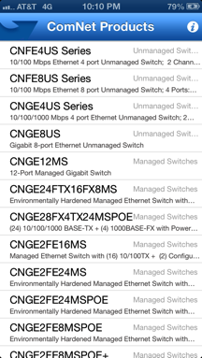
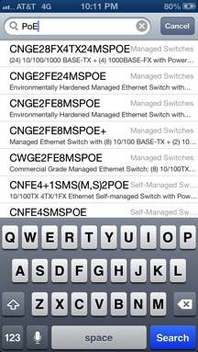
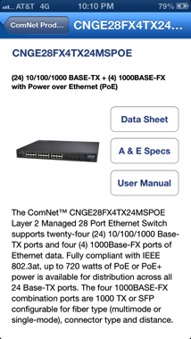
i n n o v a t i o n s
iPhone & iPad App
From pick list
Search
Browse
Contact Tech Support
Data Sheets
User Manuals
Notes:
Show distance/bandwidth capabilities

Slide 11


legacy fiber
Notes:
Our next application is another common situation. In this scenario we have an existing campus that has 8 channels of home run PTZ video at the edge and terminating back at a security operations center. Historically analog video over fiber has always been a point to point solution.
Often the integrator is tasked looking for a solution to incorporate new IP elements, but are limited on fiber. With our new SHR solution it now allows you to take the Analog video in a drop and repeat or self healing ring topology. This now allows for additional fibers to be allocated for other uses.

Slide 12
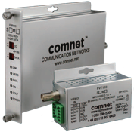
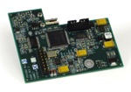
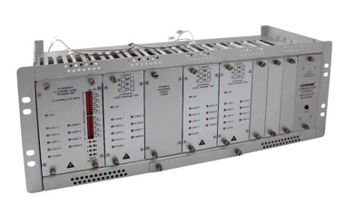
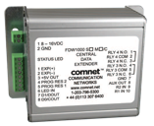
Analog Video, Data, Audio & Contacts Over Fiber
Full Fiber Product Line
1 to 32 cameras over 1 fiber, with optional data
In-dome modules for major manufacturers
Analog video with Ethernet
Data transceivers – point-to-point, add/drop, ring topologies
Specialty Products
HDMI over fiber
Wiegand data over fiber
ComFit Card Design
Cards can be wall or rack mounted

Slide 13


wireless

Slide 14
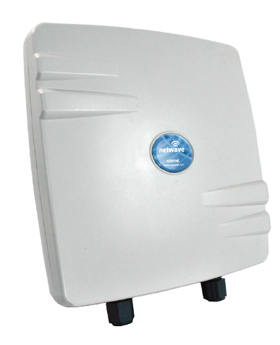
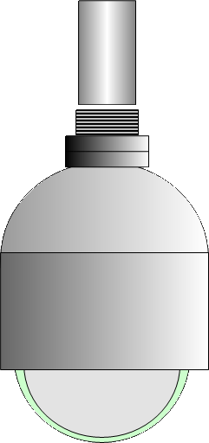




Primary Applications
Remote Location
Point-to-Point
NVR

Slide 15

Primary Applications
Multiple Locations
Point-to-Multipoint
NVR

Slide 16


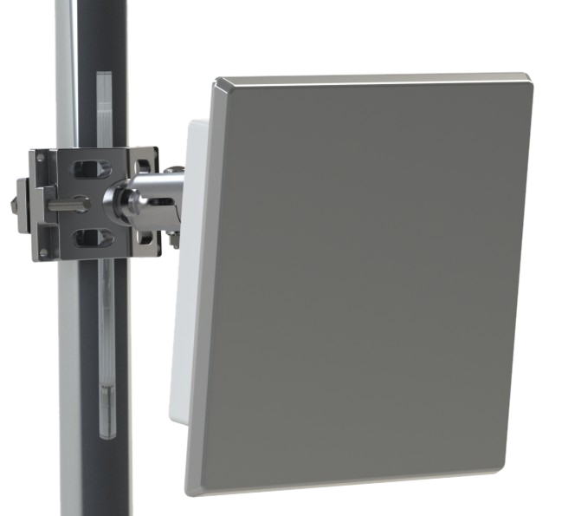
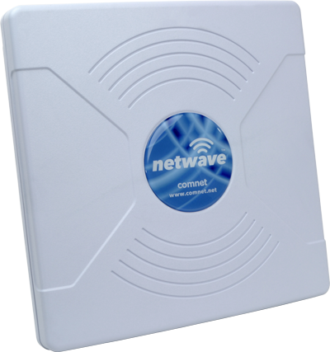
Primary Applications
Creating “Line of Sight”
Daisy Chain / Drop & Repeat
NVR

Slide 17
Primary Applications
Self Healing Ring
Using IEEE Spanning Tree Protocol
NVR

Slide 18
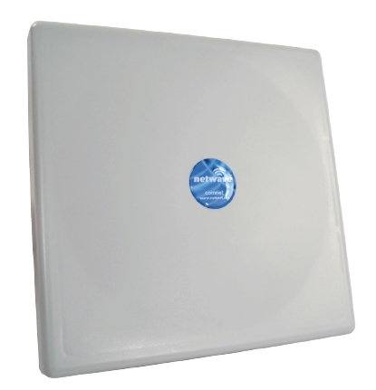
Primary Applications
Backhaul
High Bandwidth

Slide 19

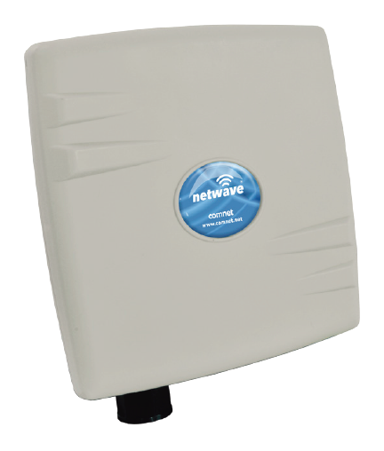



Hybrid Topologies
NW7/M
NW9
NW8
NW7
NW1/M
NW9
NW8
NVR
NW1
NW7
Notes:
ComNet also makes a complete line of Ethernet extenders using the VDSL2 technology.
It’s different because it is an asymetrical transmission technology originally designed for poor copper cabling over longer distances.
This is a very valuable product when you need to get any kind of bandwidth out to much longer distances.
You can see these can get out to 10,000 feet.
i.e. Think of an electrical sub-station that’s 8,000 feet from any type of network drop. It’s only 1Mbps, but that’s better than putting in a microwave relay…

Slide 20
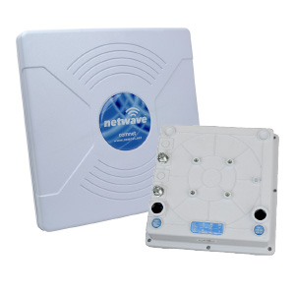
Wireless Ethernet Products
Power, Point & Play
  Pre-configured AP and Client
  Mount and connect AP to AC or PoE source and the network.
  Mount and connect Client to AC or PoE source and camera.
  Point them at each other until you get green signal strength LEDs.
  Done.
NWK7

Slide 21
NetWave Generation 2
NWK1
Point-to-Point Preconfigured Kit
Includes MAC-locked AP and Client
New IP67 ABS enclosure – glands and LEDs on bottom
Fully hardened -40˚ to 75˚C
Dual 10/100 Ethernet ports
Powered by PoE or included PIM
5GHz 802.11a/n radio
95 Mbps Max. throughput
Up to 2 miles distance
19dBi Internal antenna with 17° Beam
Includes power injection modules (PIM1)
Includes mounting brackets for 2 ½” pole

Slide 22
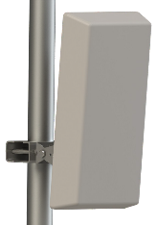
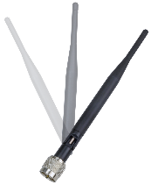
NetWave Generation 2
NW1
Point-to-Multipoint
Up to 15 clients
New IP67 ABS enclosure – glands and LEDs on bottom
Fully hardened -40˚ to 75˚C
Dual 10/100 Ethernet ports
Powered by PoE or included PIM
5GHz 802.11a/n radio
95 Mbps Max. throughput
Up to 2 miles distance
19dBi Internal antenna with 17° Beam
Includes power injection module (PIM1)
Includes mounting bracket for 2 ½” pole
Optional antennas for AP

Slide 23
NetWave Generation 2
NW1/M
Point-to-Point
Point-to-Multipoint
Smaller enclosure
New IP67 ABS enclosure – glands and LEDs on bottom
Fully hardened -40˚ to 75˚C
Single 10/100 Ethernet ports
Powered by PoE or included PIM
5GHz 802.11a/n radio
95 Mbps Max. throughput
Up to 2 miles distance
16dBi Internal antenna with 30° Beam
Includes power injection module (PIM1)
Available in Kit form
Optional antennas for AP

Slide 24
NetWave Generation 2
NW7 High Throughput
Point-to-Point
Point-to-Multipoint
Up to 15 clients
New IP67 ABS enclosure – glands and LEDs on bottom
Fully hardened -40˚ to 70˚C
Dual Gigabit Ethernet ports
Port 1 is a PD, port 2 is a PSE
Powered by PoE or PIM
5GHz 802.11a/n radio
120 Mbps full duplex throughput
180 Mbps Max. throughput in one direction
Up to 4 miles distance
19dBi Internal antenna with 17° Beam
Available in Kit form
Optional antennas for AP

Slide 25
NetWave Generation 2
NW7/M High Throughput
Point-to-Point
Point-to-Multipoint
Smaller enclosure
New IP67 ABS enclosure – glands and LEDs on bottom
Fully hardened -40˚ to 70˚C
Single Gigabit Ethernet port
Powered by PoE or included PIM
5GHz 802.11a/n radio
120 Mbps full duplex throughput
180 Mbps Max. throughput in one direction
Up to 4 miles distance
16dBi Internal antenna with 30° Beam
Includes Gigabit power injection module (PIM2)
Available in Kit form
Optional antennas for AP

Slide 26
NetWave Generation 2
NW8 High Throughput Dual Radio
Daisy Chain
Self-Healing Ring
IP67 enclosure
Fully hardened -40˚ to 75˚C
Dual Gigabit Ethernet ports
Port 1 is a PD, port 2 is a PSE
Powered by PoE or PIM
5GHz 802.11a/n radio
120 Mbps full duplex throughput
180 Mbps Max. throughput in one direction
Up to 2 miles distance
19dBi Internal antenna with 17° Beam
External antennas for radio 2

Slide 27
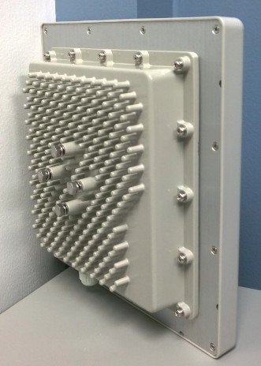
NetWave Generation 2
NW9 Ultra High Throughput
Point-to-Point
Point-to-Multipoint
802.11ac rated radios
Casted aluminum enclosure – glands/LEDs on bottom
Fully hardened -40˚ to 70˚C
Dual Gigabit Ethernet ports
Port 1 is a PD, port 2 is a PSE
Powered by PoE or PIM
867 Mbps radio throughput
500 Mbps Max. throughput in one direction
Up to 4 miles distance
19dBi Internal antenna with 17° Beam
Available in Kit form
Optional antennas for AP

Slide 28
NetWave Generation 2
Model | Enclosure | Ethernet Ports | PD | PSE on Port 2 | Internal Antenna | External Antenna Compatible | PIM included | Max Speed (true thrpt) | NWBKT Compatible
NW1 | ABS | 2 x 100Mbps | Yes | No port 2 | 17˚ | No | Yes/FE | 95Mbps | Yes
NW1/M | ABS Mini | 1 x 100Mbps | Yes | No | 30˚ | No | Yes/FE | 95Mbps | No
NW7 | ABS | 2 x 1000Mbps | Yes | Yes | 17˚ | No | No | 180Mbps | Yes
NW7/M | ABS Mini | 1 x 1000Mbps | Yes | No port 2 | 30˚ | No | Yes/GIG | 180Mbps | No
NW8 | Original NetWave | 2 x 1000Mbps | Yes | Yes | 17˚ | Yes | No | 180Mbps | Yes
NW9 | Casted | 2 x 1000Mbps | Yes | Yes | 17˚ | No | No | 500Mbps | No

Slide 29
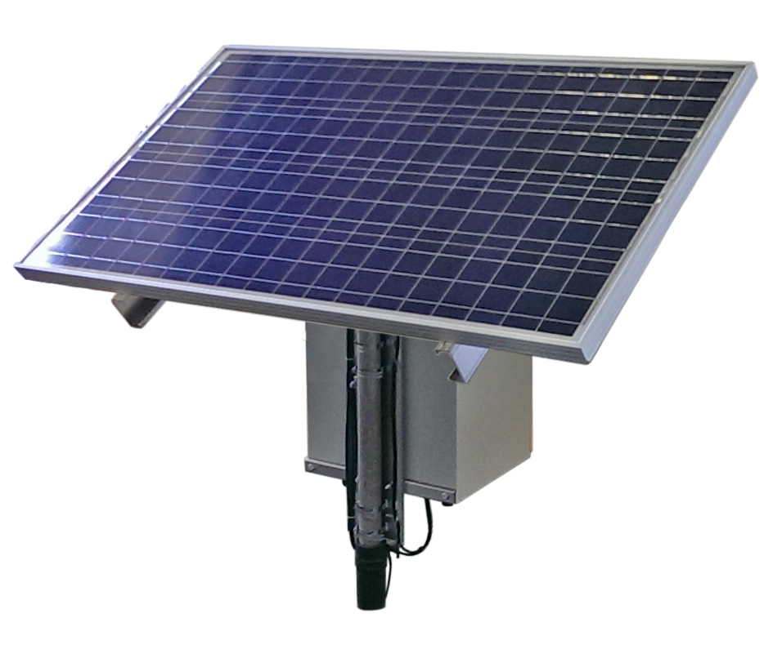
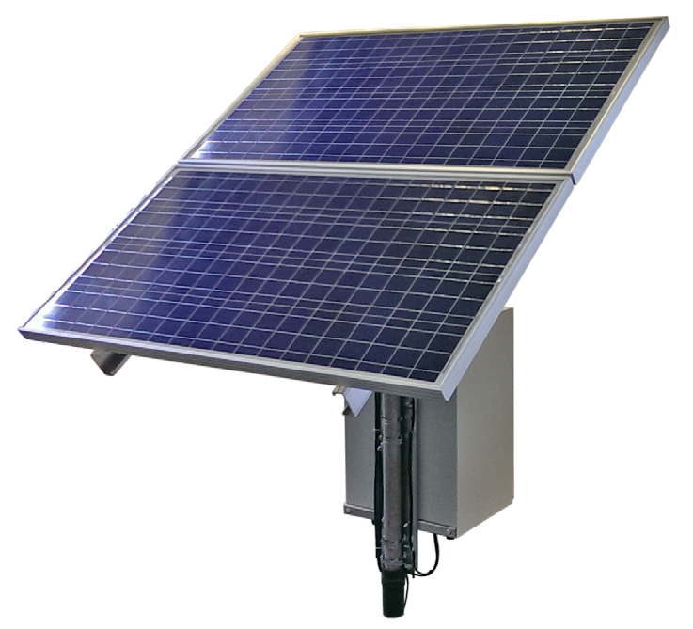
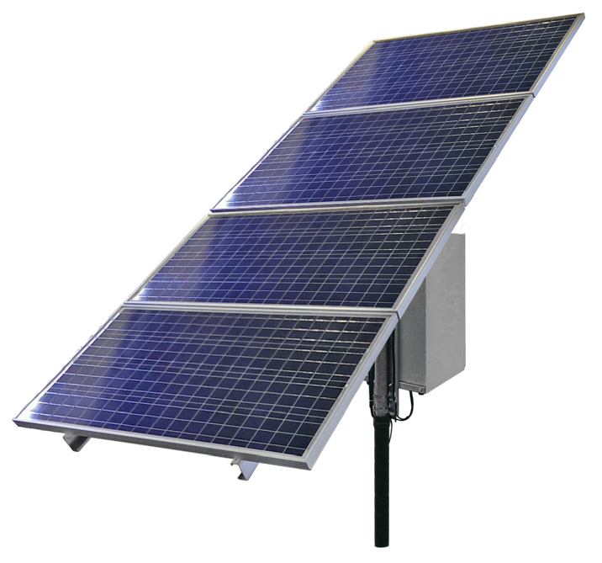
NetWave Solar
NetWave Solar
  Everything but the pole:
  120Watt PV solar panels
  Lead Acid Gel Batteries, glass mat
  Power controller, injector
  NEMA enclosure
  All cables & mounting brackets
4 Kits Based On:
  15W or 30W continuous output
  3 or 6 hours of peak sunlight
  40 hours reserve battery

Slide 30
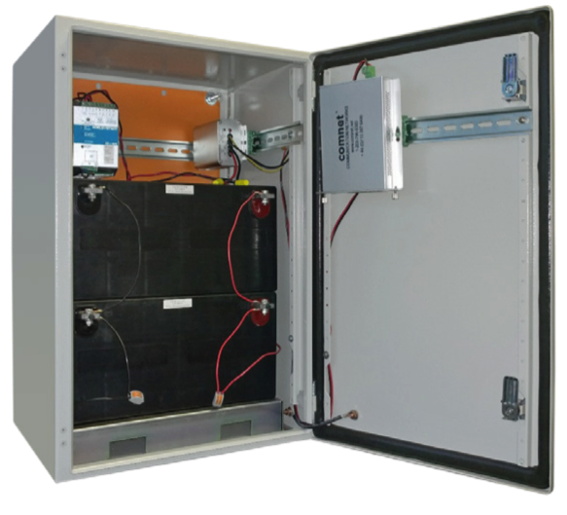
NetWave Battery Backup
NetWave Battery Backup
  277 VAC at the pole, but only at night:
  Valve regulated lead acid batteries
  Smart DC-UPS power controller
  Power inverter or injector
  NEMA box
  Mounting brackets/straps

Slide 31

ethernet

Slide 32
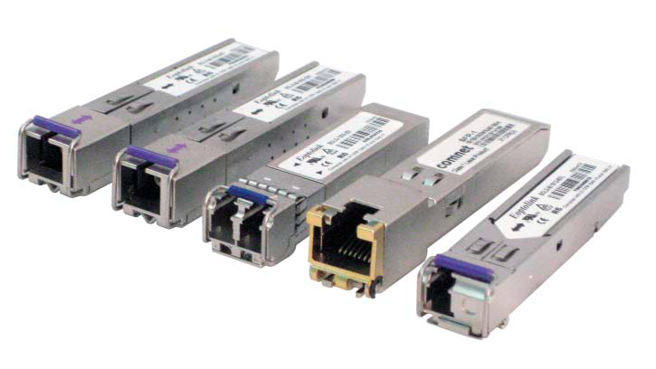
Small Form-Factor Pluggable (SFP)
35 Models of SFP’s
Multimode or singlemode
1 fiber or 2 fibers
100Mbps or 1000Mbps
220 meters to 120 kilometers
SC or LC connectors
MSA compliant
The ComNet Difference
Hardened
Lifetime Warranty
Less expensive
Notes:
ComNet has four main product lines that serve the Security, Transportation, Gov’t and Military markets.
We design and manufacture a complete line of the legacy fiber optic transmission products that transmit video, serial data, audio and CC’s over MM or SM fiber.
We can send one signal, or we can send up to 32 video and 8 data all over one fiber – and everything in between.
These products are far superior to anything made previously.
Hardened Ethernet, because that is our heritage – putting equipment into nasty places and making sure it works. We wanted to apply the same mentality to Ethernet products.
We offer two port media converters, managed and unmanaged Layer 2 switches up to 26 ports.
Commercial-grade switches – because we don’t want installers putting in consumer-grade product in places in doesn’t belong!
And our newest offering – Retrofit Network products that allow you to reduce both risks and costs while upgrading to an IP solution.
We want to be your One Stop Shopping for all transmission and communication products.

Slide 33
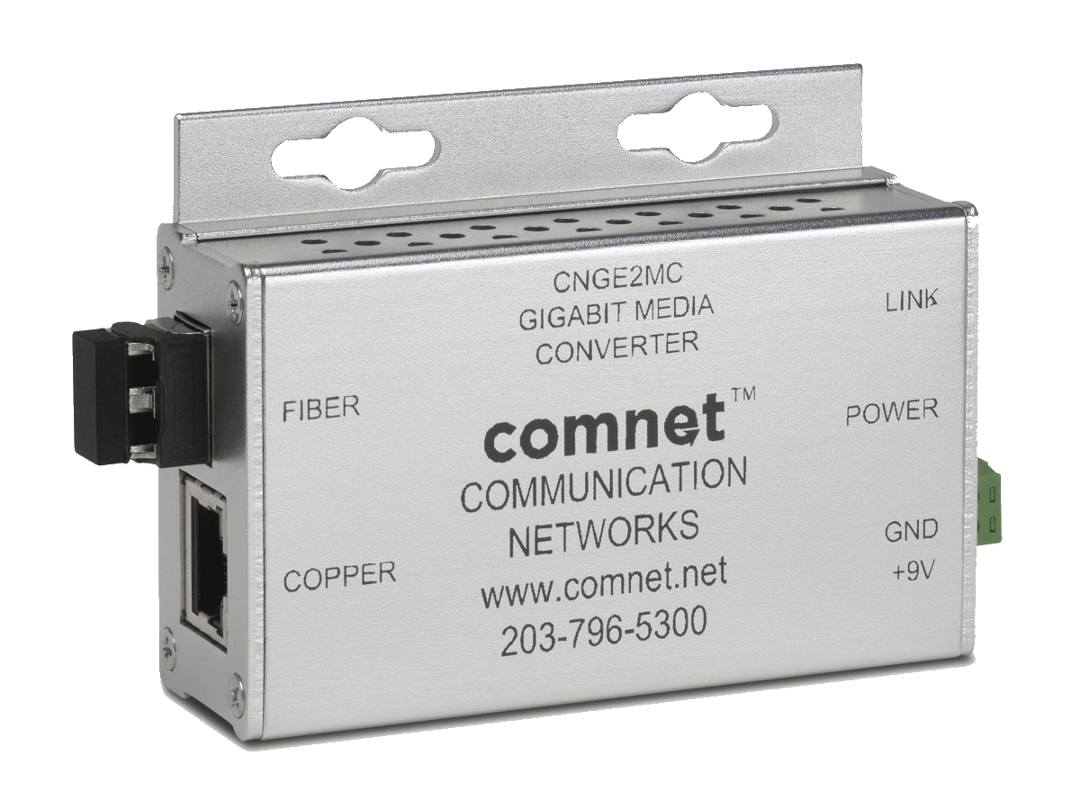
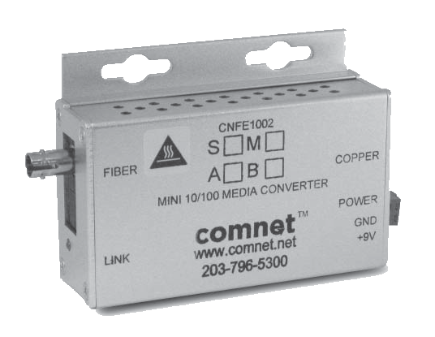
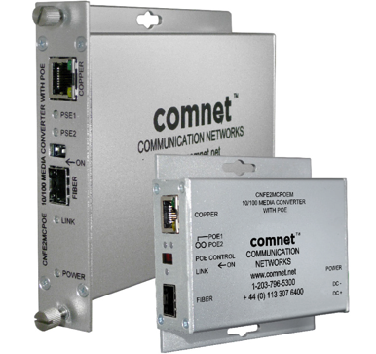
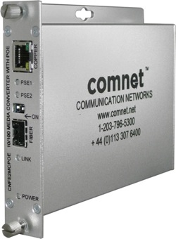
Media Converters
Every option available
Mini or ComFit card
100Mbps, 1000Mbps or Dual Rate
DC or AC power
ST, SC or SFP optics
15W, 30W or 60W PoE for your device
Notes:
ComNet has four main product lines that serve the Security, Transportation, Gov’t and Military markets.
We design and manufacture a complete line of the legacy fiber optic transmission products that transmit video, serial data, audio and CC’s over MM or SM fiber.
We can send one signal, or we can send up to 32 video and 8 data all over one fiber – and everything in between.
These products are far superior to anything made previously.
Hardened Ethernet, because that is our heritage – putting equipment into nasty places and making sure it works. We wanted to apply the same mentality to Ethernet products.
We offer two port media converters, managed and unmanaged Layer 2 switches up to 26 ports.
Commercial-grade switches – because we don’t want installers putting in consumer-grade product in places in doesn’t belong!
And our newest offering – Retrofit Network products that allow you to reduce both risks and costs while upgrading to an IP solution.
We want to be your One Stop Shopping for all transmission and communication products.

Slide 34
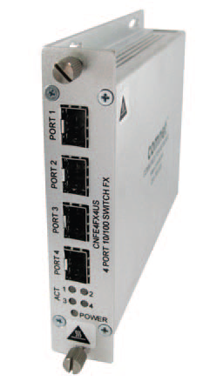
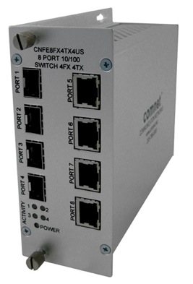
Unmanaged Switches
4 and 8 Ports
100Mbps or 1000Mbps
All Copper ports
All SFP ports
Half and Half
ComFit card design
Notes:
ComNet has four main product lines that serve the Security, Transportation, Gov’t and Military markets.
We design and manufacture a complete line of the legacy fiber optic transmission products that transmit video, serial data, audio and CC’s over MM or SM fiber.
We can send one signal, or we can send up to 32 video and 8 data all over one fiber – and everything in between.
These products are far superior to anything made previously.
Hardened Ethernet, because that is our heritage – putting equipment into nasty places and making sure it works. We wanted to apply the same mentality to Ethernet products.
We offer two port media converters, managed and unmanaged Layer 2 switches up to 26 ports.
Commercial-grade switches – because we don’t want installers putting in consumer-grade product in places in doesn’t belong!
And our newest offering – Retrofit Network products that allow you to reduce both risks and costs while upgrading to an IP solution.
We want to be your One Stop Shopping for all transmission and communication products.

Slide 35
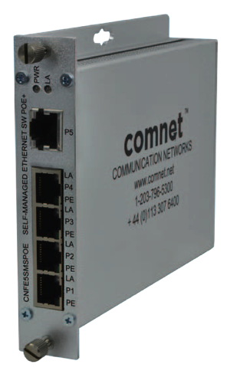
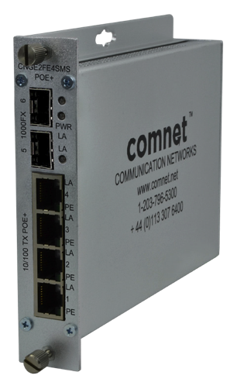
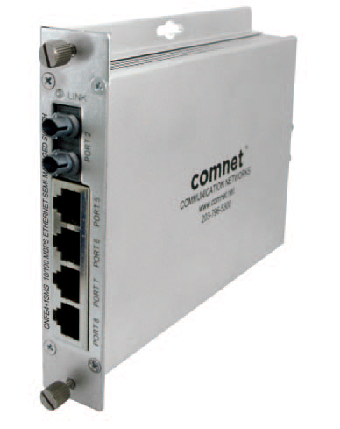
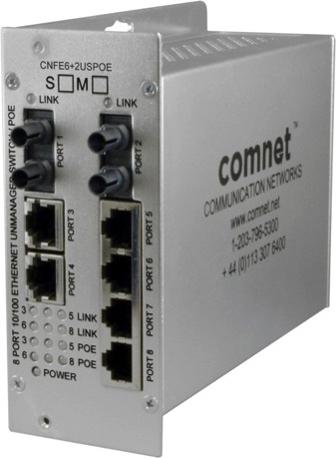
Self Managed Switches
Unmanaged, but with Multicast support
100Mbps
100Mbps with 1000Mbps SFP ports
Copper ports
Copper with fiber uplinks
30W PoE option
60W PoE option on Gig version
Dipswitch settings only
Notes:
ComNet has four main product lines that serve the Security, Transportation, Gov’t and Military markets.
We design and manufacture a complete line of the legacy fiber optic transmission products that transmit video, serial data, audio and CC’s over MM or SM fiber.
We can send one signal, or we can send up to 32 video and 8 data all over one fiber – and everything in between.
These products are far superior to anything made previously.
Hardened Ethernet, because that is our heritage – putting equipment into nasty places and making sure it works. We wanted to apply the same mentality to Ethernet products.
We offer two port media converters, managed and unmanaged Layer 2 switches up to 26 ports.
Commercial-grade switches – because we don’t want installers putting in consumer-grade product in places in doesn’t belong!
And our newest offering – Retrofit Network products that allow you to reduce both risks and costs while upgrading to an IP solution.
We want to be your One Stop Shopping for all transmission and communication products.

Slide 36
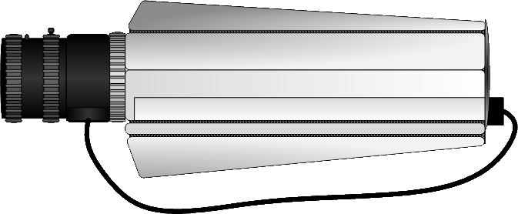

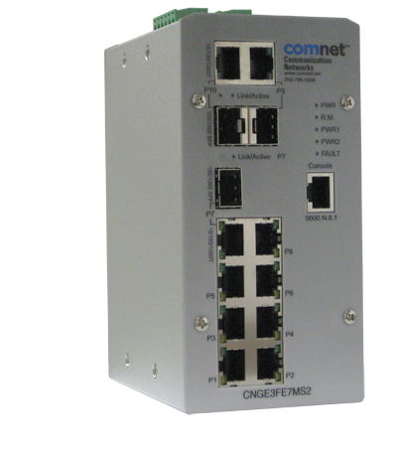


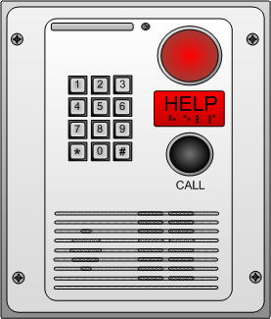

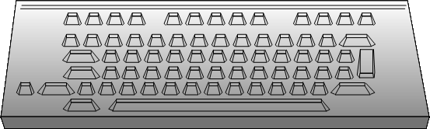
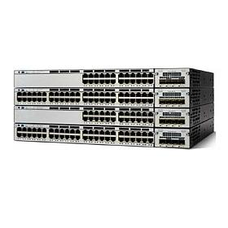
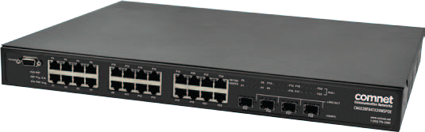
Layer 2
Layer 3
Remote Client
INTERNET
VMS
Layer 2 Switch
Router
WAN
Remote Client
Notes:
Okay, so what are your options for taking control?

Slide 37

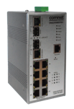

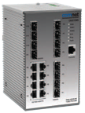


Managed Switches - Hardened
Layer 2 Switches
5 to 28 ports
100Mbps and 1000Mbps ports
Combo ports for copper or fiber (with SFP)
PoE – 15W or 30W
Very full featured – VLAN, RSTP, full Multicast, SNMP, and more
Lifetime Warranty
Notes:
ComNet has four main product lines that serve the Security, Transportation, Gov’t and Military markets.
We design and manufacture a complete line of the legacy fiber optic transmission products that transmit video, serial data, audio and CC’s over MM or SM fiber.
We can send one signal, or we can send up to 32 video and 8 data all over one fiber – and everything in between.
These products are far superior to anything made previously.
Hardened Ethernet, because that is our heritage – putting equipment into nasty places and making sure it works. We wanted to apply the same mentality to Ethernet products.
We offer two port media converters, managed and unmanaged Layer 2 switches up to 26 ports.
Commercial-grade switches – because we don’t want installers putting in consumer-grade product in places in doesn’t belong!
And our newest offering – Retrofit Network products that allow you to reduce both risks and costs while upgrading to an IP solution.
We want to be your One Stop Shopping for all transmission and communication products.

Slide 38
Managed Switches - Hardened
Featured Product
28 ports – all Gigabit
4 SFP ports
24 copper ports with 30W PoE
  30W simultaneously on all 24 ports at 50˚C
  1000W internal supply
Hardened
Lifetime Warranty
56Gbps switching fabric
FULL multicast support
Jumbo frame support
US$3,700 MSRP
Notes:
ComNet has four main product lines that serve the Security, Transportation, Gov’t and Military markets.
We design and manufacture a complete line of the legacy fiber optic transmission products that transmit video, serial data, audio and CC’s over MM or SM fiber.
We can send one signal, or we can send up to 32 video and 8 data all over one fiber – and everything in between.
These products are far superior to anything made previously.
Hardened Ethernet, because that is our heritage – putting equipment into nasty places and making sure it works. We wanted to apply the same mentality to Ethernet products.
We offer two port media converters, managed and unmanaged Layer 2 switches up to 26 ports.
Commercial-grade switches – because we don’t want installers putting in consumer-grade product in places in doesn’t belong!
And our newest offering – Retrofit Network products that allow you to reduce both risks and costs while upgrading to an IP solution.
We want to be your One Stop Shopping for all transmission and communication products.

Slide 39
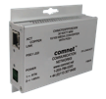

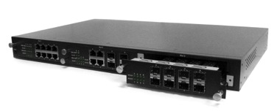


Managed Switches - Commercial
Layer 2 Switches
All the same features as the hardened, but at 0˚ to 50˚C
8 to 26 ports
100Mbps and 1000Mbps ports
Combo ports for copper or fiber (with SFP)
PoE – 15W or 30W
Very full featured – VLAN, RSTP, full Multicast, SNMP, and more
5 Year Warranty
Notes:
ComNet has four main product lines that serve the Security, Transportation, Gov’t and Military markets.
We design and manufacture a complete line of the legacy fiber optic transmission products that transmit video, serial data, audio and CC’s over MM or SM fiber.
We can send one signal, or we can send up to 32 video and 8 data all over one fiber – and everything in between.
These products are far superior to anything made previously.
Hardened Ethernet, because that is our heritage – putting equipment into nasty places and making sure it works. We wanted to apply the same mentality to Ethernet products.
We offer two port media converters, managed and unmanaged Layer 2 switches up to 26 ports.
Commercial-grade switches – because we don’t want installers putting in consumer-grade product in places in doesn’t belong!
And our newest offering – Retrofit Network products that allow you to reduce both risks and costs while upgrading to an IP solution.
We want to be your One Stop Shopping for all transmission and communication products.

Slide 40
Managed Switches - Commercial
Featured Product
26 ports – all Gigabit
2 SFP ports, 2 Combo ports
24 copper ports with 30W PoE
  30W support on all 24 ports (not at same time)
  400W internal supply
5 Year Warranty
Notes:
ComNet has four main product lines that serve the Security, Transportation, Gov’t and Military markets.
We design and manufacture a complete line of the legacy fiber optic transmission products that transmit video, serial data, audio and CC’s over MM or SM fiber.
We can send one signal, or we can send up to 32 video and 8 data all over one fiber – and everything in between.
These products are far superior to anything made previously.
Hardened Ethernet, because that is our heritage – putting equipment into nasty places and making sure it works. We wanted to apply the same mentality to Ethernet products.
We offer two port media converters, managed and unmanaged Layer 2 switches up to 26 ports.
Commercial-grade switches – because we don’t want installers putting in consumer-grade product in places in doesn’t belong!
And our newest offering – Retrofit Network products that allow you to reduce both risks and costs while upgrading to an IP solution.
We want to be your One Stop Shopping for all transmission and communication products.

Slide 41





Electric Power Transmission & Distribution
Specific product line for electrical substation use
  Meets IEC 61850-3
  Meets IEEE 1613 Class 2
  Meets UL 508 Class 1/Division 2
  Meets EN50155
  Meets NEMA TS-1/TS-2
  Wide ranging AC & DC inputs
  Fully managed
Notes:
ComNet also makes a complete line of Ethernet extenders using the VDSL2 technology.
It’s different because it is an asymetrical transmission technology originally designed for poor copper cabling over longer distances.
This is a very valuable product when you need to get any kind of bandwidth out to much longer distances.
You can see these can get out to 10,000 feet.
i.e. Think of an electrical sub-station that’s 8,000 feet from any type of network drop. It’s only 1Mbps, but that’s better than putting in a microwave relay…

Slide 42
Serial Data Over Fiber
RLFDX Series
  Substation Rated
  Dymec 5800 Series direct replacement
  RS-232, RS-422, RS-485 2/4 wire, TTL
  Various input power options
  Made in USA

Slide 43
Managed Switch
CN10GEMODMS
  10Gig capable
  Layer 3 capabilities
  Electrical substation rated
  (IEC 61850-3, IEEE 1613)
  Modular switch options:
  Chassis
  4 x 10Gig SFP ports
  8 x 100/1000FX SFP ports
  8 x Gigabit copper ports

Slide 44


eConsole Software Suite
Network Management Suite
  eVision
    Topology view
    Health visualization
  eCommander
    Device discovery/configuration
    Device status/Syslog
    IP address/firmware distribution
  eMonitor
    Detect all IP devices
    Monitor all IP devices

Slide 45




eConsole Software Suite

Slide 46
retrofit

Slide 47



Retrofit
NEW CopperLine Design
15 and 30 Watt PoE models
“Micro” model fits in a double gang box
Pass through PoE or AC/DC direct power
Local or Remote injection of power for 30W
4 Port Self-Managed Switch with
CopperLine Uplink port & 30W per port
Coax | Data Only | Distance 15W | Distance 30W
10 Mbps | 5,000 ft. | 750 ft. | 335 ft.
100 Mbps | 2,000 ft. | 850 ft. | 335 ft.
UTP | Data Only | Distance 15W | Distance 30W
10 Mbps | 3,000 ft. | 750 ft. | 335 ft.
100 Mbps | 2,000 ft. | 850 ft. | 335 ft.
Notes:
ComNet has four main product lines that serve the Security, Transportation, Gov’t and Military markets.
We design and manufacture a complete line of the legacy fiber optic transmission products that transmit video, serial data, audio and CC’s over MM or SM fiber.
We can send one signal, or we can send up to 32 video and 8 data all over one fiber – and everything in between.
These products are far superior to anything made previously.
Hardened Ethernet, because that is our heritage – putting equipment into nasty places and making sure it works. We wanted to apply the same mentality to Ethernet products.
We offer two port media converters, managed and unmanaged Layer 2 switches up to 26 ports.
Commercial-grade switches – because we don’t want installers putting in consumer-grade product in places in doesn’t belong!
And our newest offering – Retrofit Network products that allow you to reduce both risks and costs while upgrading to an IP solution.
We want to be your One Stop Shopping for all transmission and communication products.

Slide 48






Power Options
Power options are key to design & installation flexibility!
Available for 15W and 30W models
12 VDC
PoE Switch
COAX or UTP
IP CAMERA
24 VAC

Slide 49

PoE Negotiation on 15W Models
The ComNet modules simply pass through the negotiation between the
Power Source Equipment (PSE) and the Powered Device (PD)
PD
(Camera)
PoE Negotiation
PSE
(PoE Switch)
COAX or UTP
IP CAMERA

Slide 50
PoE Negotiation on 30W Models
The ComNet modules act as the PD and the PSE on the “Local” and “Remote” ends
This allows a more reliable solution over longer cable distances
PD
(Camera)
PoE Negotiation
PSE
(Remote)
PD
(Local)
PoE Negotiation
PSE
(PoE Switch)
COAX or UTP
IP CAMERA

Slide 51

Versatile Solution
Local injection scenario
Available on 30W models only
54VDC Injection
CAT6
IP CAMERA
Up to 1,000ft and 25W PoE
for your camera

Slide 52

Self Managed Switches
Remote injection on four port switch
48VDC Injection
IP CAMERAS
Coax or CAT6
30W PoE per port
Up to 2,000ft
For 100 Mbps

Slide 53



VDSL2
Retrofit
Ethernet over coax or UTP
Asymmetrical connection over coax or 1 pair UTP
12VDC powered
No PoE
Hardened or Commercial versions
Rack mounted options
Drop & Repeat model
Longer distances and better over troubled copper cabling
Lifetime Warranty on hardened,
5 Year Warranty on Commercial
Distance | Downstream | Upstream
1000 ft. | 70 Mbps | 65 Mbps
5000 ft. | 16 | 1
10,000 ft. | 1 | .25
Notes:
ComNet has four main product lines that serve the Security, Transportation, Gov’t and Military markets.
We design and manufacture a complete line of the legacy fiber optic transmission products that transmit video, serial data, audio and CC’s over MM or SM fiber.
We can send one signal, or we can send up to 32 video and 8 data all over one fiber – and everything in between.
These products are far superior to anything made previously.
Hardened Ethernet, because that is our heritage – putting equipment into nasty places and making sure it works. We wanted to apply the same mentality to Ethernet products.
We offer two port media converters, managed and unmanaged Layer 2 switches up to 26 ports.
Commercial-grade switches – because we don’t want installers putting in consumer-grade product in places in doesn’t belong!
And our newest offering – Retrofit Network products that allow you to reduce both risks and costs while upgrading to an IP solution.
We want to be your One Stop Shopping for all transmission and communication products.

Slide 54


CopperLine SFP – Distance Extending Module
CL-SFP(X)
  Extended distance Ethernet over UTP or Coax
    2,000 ft (609m) for 100Mbps
    3,000 ft (914m) for 10Mbps
  Coax adapter
  Can be used in any SFP port that supports 100Mbps
  100Mbps and 10Mbps versions
  Can also be used with CopperLine products
  No PoE support

Slide 55

CopperLine SFP
CL-SFP(X)
UTP
Coax
CAT6
Fiber

Slide 56

SLOC®
Security Link Over Coax
Licensed chipset for analog & IP over coax
ComNet builds our products around the chipset
Security Link Over Coax
TX and RX models
Keeps analog & IP separate
No data channel (use fixed analog cams)
Provides:
  Full analog signal
  36Mbps of Ethernet down, 11Mbps up
  24VAC powered, and can provide PoE to IP camera
  500m over RG59
  Hardened
Notes:
ComNet has four main product lines that serve the Security, Transportation, Gov’t and Military markets.
We design and manufacture a complete line of the legacy fiber optic transmission products that transmit video, serial data, audio and CC’s over MM or SM fiber.
We can send one signal, or we can send up to 32 video and 8 data all over one fiber – and everything in between.
These products are far superior to anything made previously.
Hardened Ethernet, because that is our heritage – putting equipment into nasty places and making sure it works. We wanted to apply the same mentality to Ethernet products.
We offer two port media converters, managed and unmanaged Layer 2 switches up to 26 ports.
Commercial-grade switches – because we don’t want installers putting in consumer-grade product in places in doesn’t belong!
And our newest offering – Retrofit Network products that allow you to reduce both risks and costs while upgrading to an IP solution.
We want to be your One Stop Shopping for all transmission and communication products.

Slide 57





SLOC®
Basic Application
24VAC
DVR
PoE
coax
NVR

Slide 58

Hardened Encoder
CNVETX1
  One part number (configure as encoder or decoder)
  Hardened to -40˚ - 75˚ C
  NEMA TS-1 and TS-2
  H.264, MPEG-4, MPEG-2, MJPEG
  Up to D1 and 30 fps
  Up to 3 simultaneous streams
  Duplex mono audio
  Serial data (translation)
  Onboard storage with microSD card (32GB option, 64GB testing)
  12VDC or PoE, plus 12VDC output for camera
  VMD and onboard analytics (options) (Object Video on edge)
  Conformally coated
$2,500 MSRP

Slide 59

i n n o v a t i o n s
Call ComNet for all your transmission needs!
Notes:
Show distance/bandwidth capabilities

