Slide 1

NetWave 2nd Generation Product Overview
  Guy Walker
  North America Trainer
  A&E Program Manager

Slide 2



wireless

Slide 3
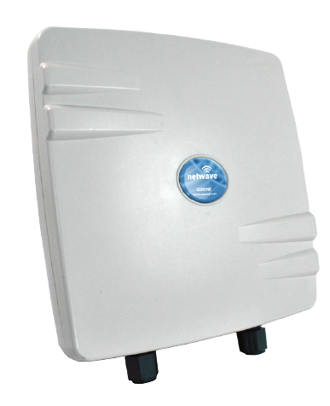
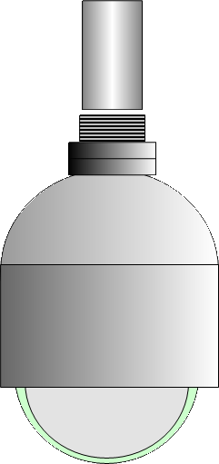




Primary Applications
Remote Location
Point-to-Point
NVR

Slide 4

Primary Applications
Multiple Locations
Point-to-Multipoint
NVR

Slide 5


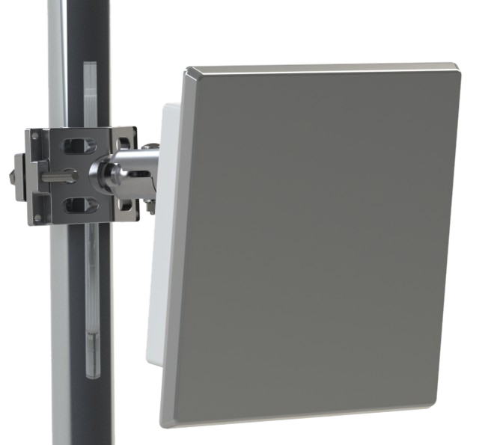
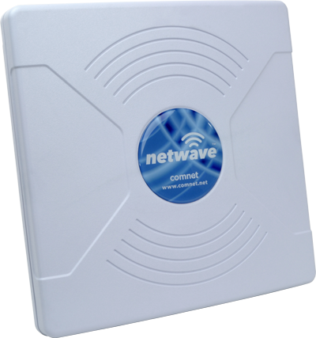
Primary Applications
Creating “Line of Sight”
Daisy Chain / Drop & Repeat
NVR

Slide 6
Primary Applications
Self Healing Ring
Using IEEE Spanning Tree Protocol
NVR

Slide 7
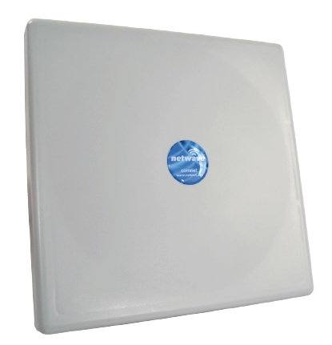
Primary Applications
Backhaul
High Bandwidth

Slide 8

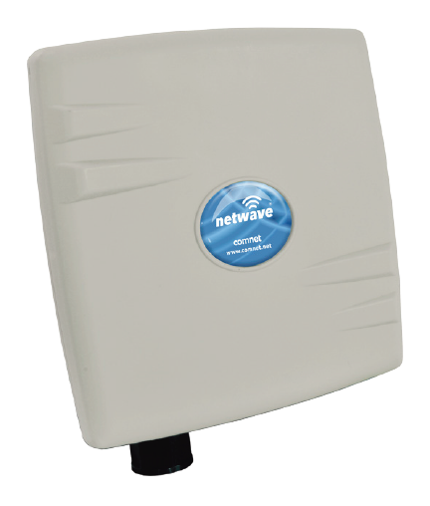



Hybrid Topologies
NW7/M
NW9
NW8
NW7
NW1/M
NW9
NW8
NVR
NW1
NW7
Notes:
ComNet also makes a complete line of Ethernet extenders using the VDSL2 technology.
It’s different because it is an asymetrical transmission technology originally designed for poor copper cabling over longer distances.
This is a very valuable product when you need to get any kind of bandwidth out to much longer distances.
You can see these can get out to 10,000 feet.
i.e. Think of an electrical sub-station that’s 8,000 feet from any type of network drop. It’s only 1Mbps, but that’s better than putting in a microwave relay…

Slide 9
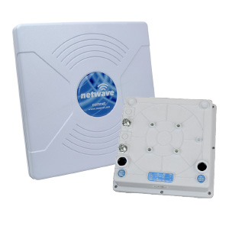
Wireless Ethernet Products
Power, Point & Play
  Pre-configured AP and Client
  Mount and connect AP to AC or PoE source and the network.
  Mount and connect Client to AC or PoE source and camera.
  Point them at each other until you get green signal strength LEDs.
  Done.
NWK7

Slide 10
NetWave Generation 2
NWK1
Point-to-Point Preconfigured Kit
Includes MAC-locked AP and Client
New IP67 ABS enclosure – glands and LEDs on bottom
Fully hardened -40˚ to 75˚C
Dual 10/100 Ethernet ports
Powered by PoE or included PIM
5GHz 802.11a/n radio
95 Mbps Max. throughput
Up to 2 miles distance
19dBi Internal antenna with 17° Beam
Includes power injection modules (PIM1)
Includes mounting brackets for 2 ½” pole

Slide 11
NetWave Generation 2
NW1
Point-to-Multipoint
Up to 15 clients
New IP67 ABS enclosure – glands and LEDs on bottom
Fully hardened -40˚ to 75˚C
Dual 10/100 Ethernet ports
Powered by PoE or included PIM
5GHz 802.11a/n radio
95 Mbps Max. throughput
Up to 2 miles distance
19dBi Internal antenna with 17° Beam
Includes power injection module (PIM1)
Includes mounting bracket for 2 ½” pole

Slide 12
NetWave Generation 2
NW1/M
Point-to-Point
Smaller enclosure
New IP67 ABS enclosure – glands and LEDs on bottom
Fully hardened -40˚ to 75˚C
Single 10/100 Ethernet ports
Powered by PoE or included PIM
5GHz 802.11a/n radio
95 Mbps Max. throughput
Up to 2 miles distance
16dBi Internal antenna with 30° Beam
Includes power injection module (PIM1)

Slide 13
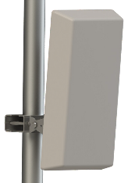
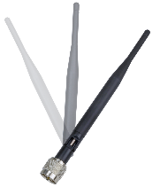
NetWave Generation 2
NW7 & NWK7 High Throughput
Point-to-Point
Point-to-Multipoint
Up to 15 clients
New IP67 ABS enclosure – glands and LEDs on bottom
Fully hardened -40˚ to 70˚C
Dual Gigabit Ethernet ports
Port 1 is a PD, port 2 is a PSE
Powered by PoE or PIM
5GHz 802.11a/n radio
120 Mbps full duplex throughput
180 Mbps Max. throughput in one direction
Up to 4 miles distance
19dBi Internal antenna with 17° Beam
Optional antennas for AP

Slide 14
NetWave Generation 2
NW7/M High Throughput
Point-to-Point
Smaller enclosure
New IP67 ABS enclosure – glands and LEDs on bottom
Fully hardened -40˚ to 70˚C
Single Gigabit Ethernet port
Powered by PoE or included PIM
5GHz 802.11a/n radio
120 Mbps full duplex throughput
180 Mbps Max. throughput in one direction
Up to 4 miles distance
16dBi Internal antenna with 30° Beam
Includes Gigabit power injection module (PIM2)

Slide 15
NetWave Generation 2
NW8 High Throughput Dual Radio
Daisy Chain
Self-Healing Ring
IP67 enclosure
Fully hardened -40˚ to 75˚C
Dual Gigabit Ethernet ports
Port 1 is a PD, port 2 is a PSE
Powered by PoE or PIM
5GHz 802.11a/n radio
120 Mbps full duplex throughput
180 Mbps Max. throughput in one direction
Up to 2 miles distance
19dBi Internal antenna with 17° Beam
External antennas for radio 2

Slide 16
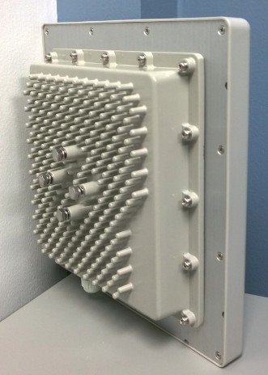
NetWave Generation 2
NW9 Ultra High Throughput
Point-to-Point
802.11ac rated radios
Casted aluminum enclosure – glands/LEDs on bottom
Fully hardened -40˚ to 70˚C
Dual Gigabit Ethernet ports
Port 1 is a PD, port 2 is a PSE
Powered by PoE or PIM
867 Mbps radio throughput
500 Mbps Max. throughput in one direction
Up to 4 miles distance
19dBi Internal antenna with 17° Beam

Slide 17
NetWave Generation 2
Model | Enclosure | Ethernet Ports | PD | PSE on Port 2 | Internal Antenna | External Antenna Compatible | PIM included | Max Speed (true thrpt) | NWBKT Compatible
NW1 | ABS | 2 x 100Mbps | Yes | No port 2 | 17˚ | No | Yes/FE | 95Mbps | Yes
NW1/M | ABS Mini | 1 x 100Mbps | Yes | No | 30˚ | No | Yes/FE | 95Mbps | No
NW7 | ABS | 2 x 1000Mbps | Yes | Yes | 17˚ | No | No | 180Mbps | Yes
NW7/M | ABS Mini | 1 x 1000Mbps | Yes | No port 2 | 30˚ | No | Yes/GIG | 180Mbps | No
NW8 | Original NetWave | 2 x 1000Mbps | Yes | Yes | 17˚ | Yes | No | 180Mbps | Yes
NW9 | Casted | 2 x 1000Mbps | Yes | Yes | 17˚ | No | No | 500Mbps | No

Slide 18
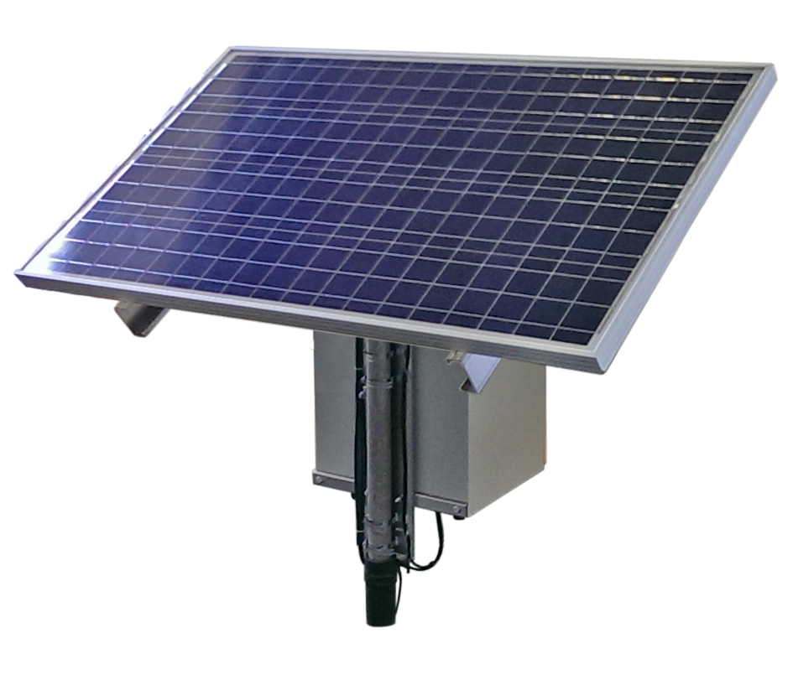
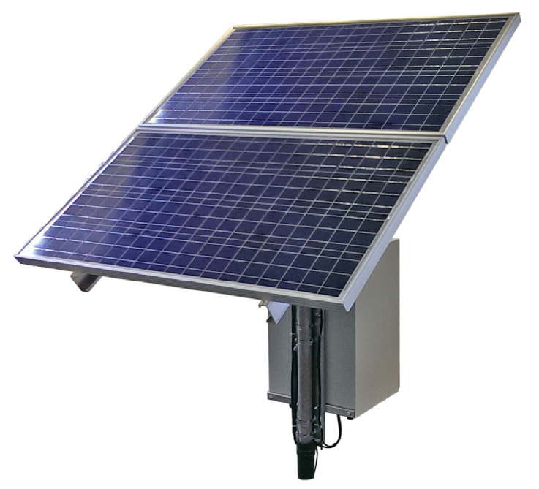
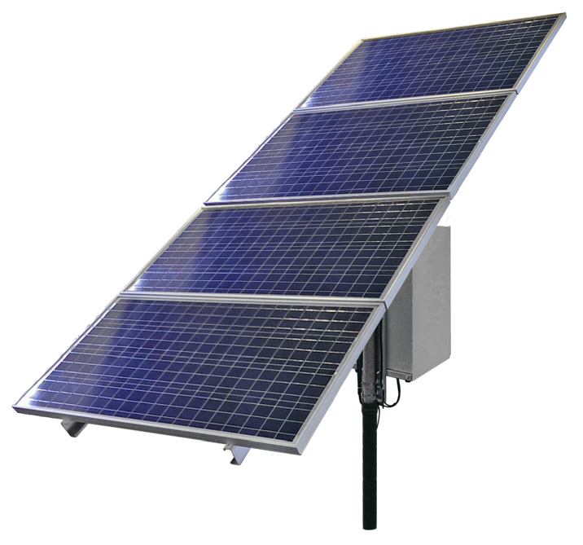
NetWave Solar
NetWave Solar
  Everything but the pole:
  120Watt PV solar panels
  Lead Acid Gel Batteries
  Power controller, injector
  NEMA enclosure
  All cables & mounting brackets
4 Kits Based On:
  15W or 30W continuous output
  3 or 6 hours of peak sunlight
  40 hours reserve battery

Slide 19
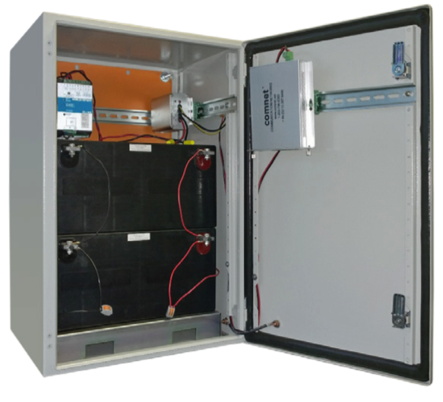
NetWave Battery Backup
NetWave Battery Backup
  277 VAC at the pole, but only at night:
  Valve regulated lead acid batteries
  Smart DC-UPS power controller
  Power inverter or injector
  NEMA box
  Mounting brackets/straps

