Slide 1
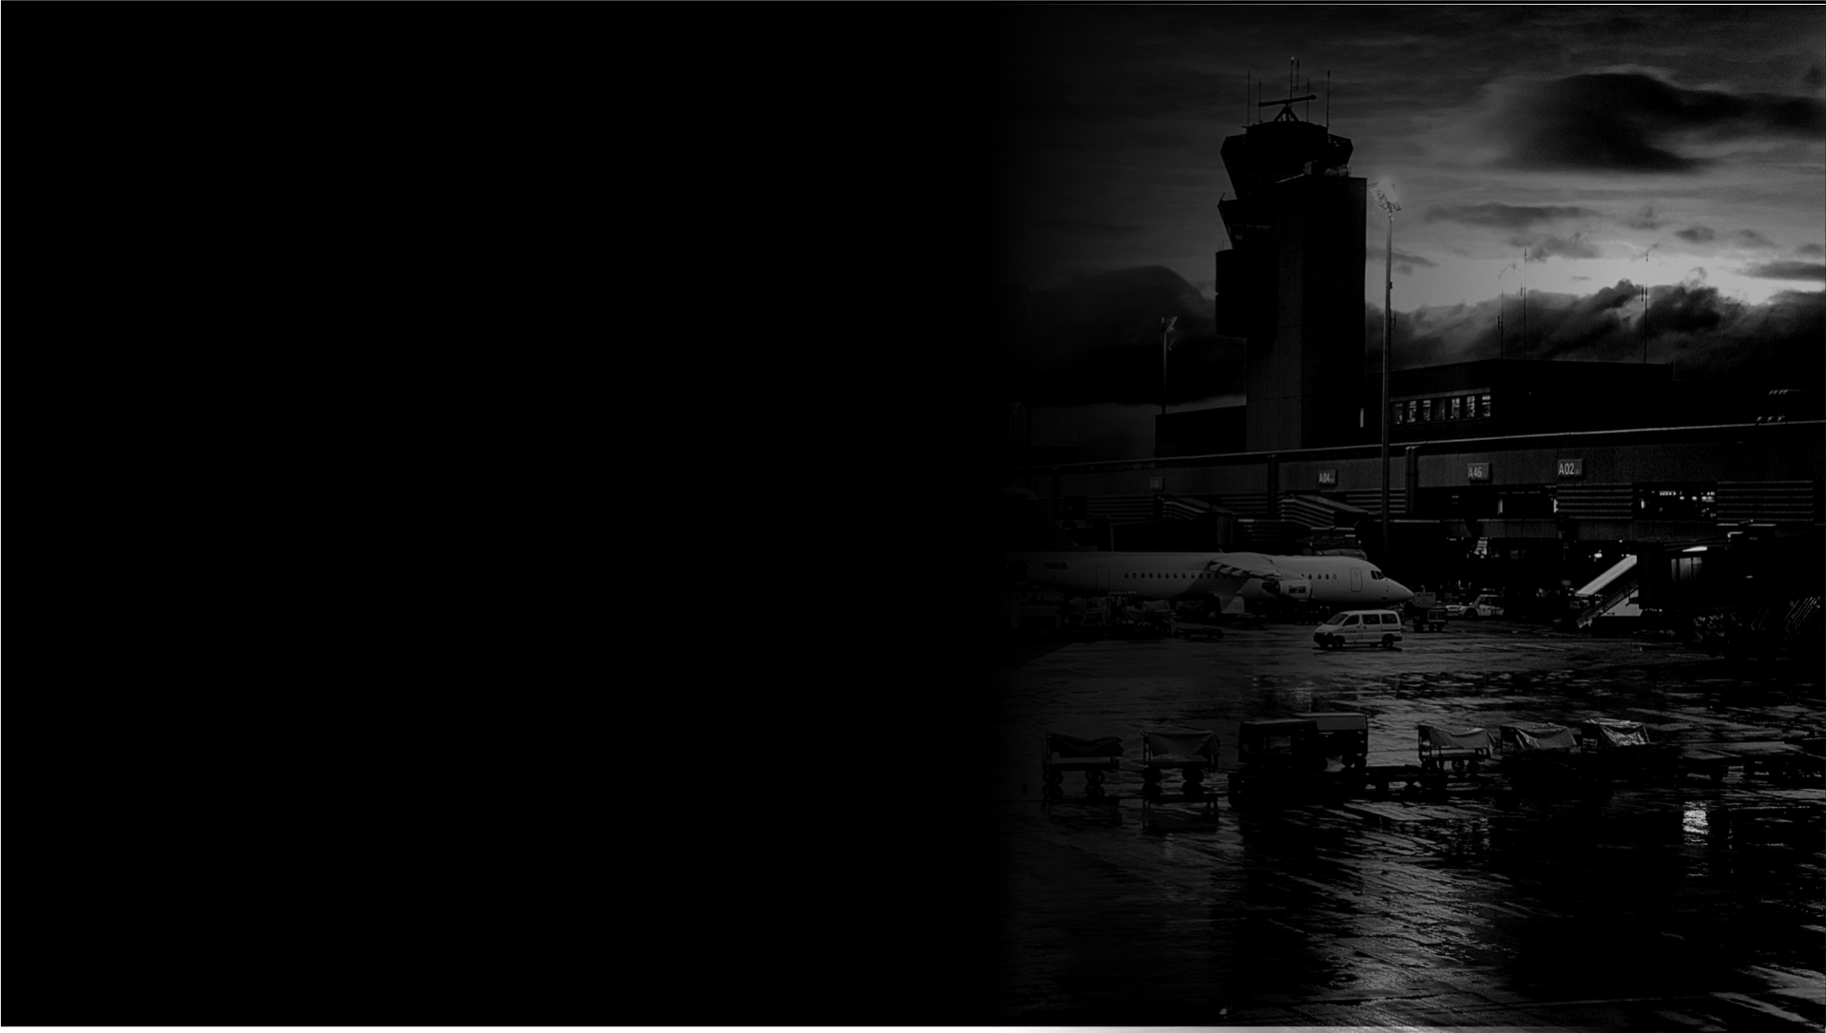
O
Our focus is to make
darkness totally visible
BOSCH owns the night
Steve Pennington, Chesapeake & Midlantic Marketing
www.MidChes.com | steve@MidChes.com | 410.612.9640

Slide 2
BOSCH owns the night
starlight
stärˌlīt noun the light that comes from the stars.
As related to video surveillance:
A Bosch camera with the ability to make a usable image
in near darkness, also referred to as ‘starlight’

Slide 3
starlight :: Bosch camera | usable image in near darkness
BOSCH owns the night
BOSCH starlight highlights
improved performance for 2016
resolution
body style
dynamic range
frame rate
video analytics

Slide 4
starlight :: Bosch camera | usable image in near darkness
BOSCH owns the night
Improved performance for 2016
Back in 2012, Bosch introduced the world’s first starlight cameras.
Designed to give excellent images, even in the lowest light conditions.
Revolutionized the industry and created true 24/7 surveillance.
The latest sensor technology, combined with sophisticated noise suppression, results in full color images in the dark.
¹ DINION IP starlight 8000 MP

Slide 5
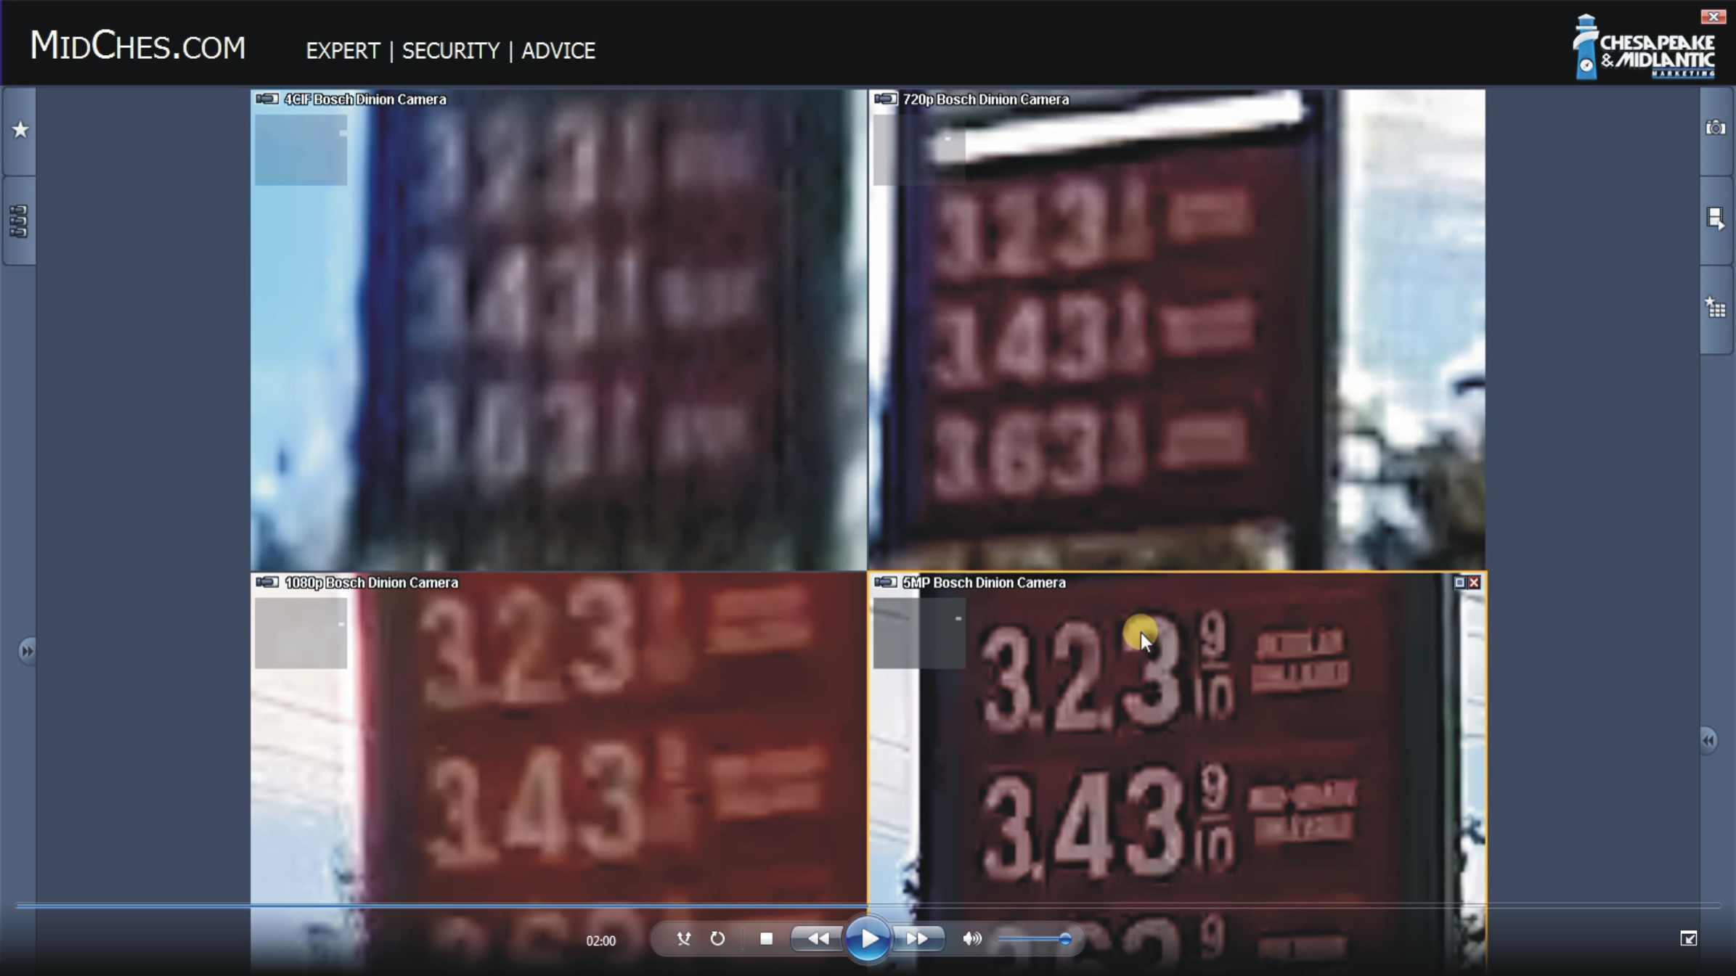
starlight :: Bosch camera | usable image in near darkness
BOSCH owns the night
resolution 720p, 1080p, 5MP

Slide 6
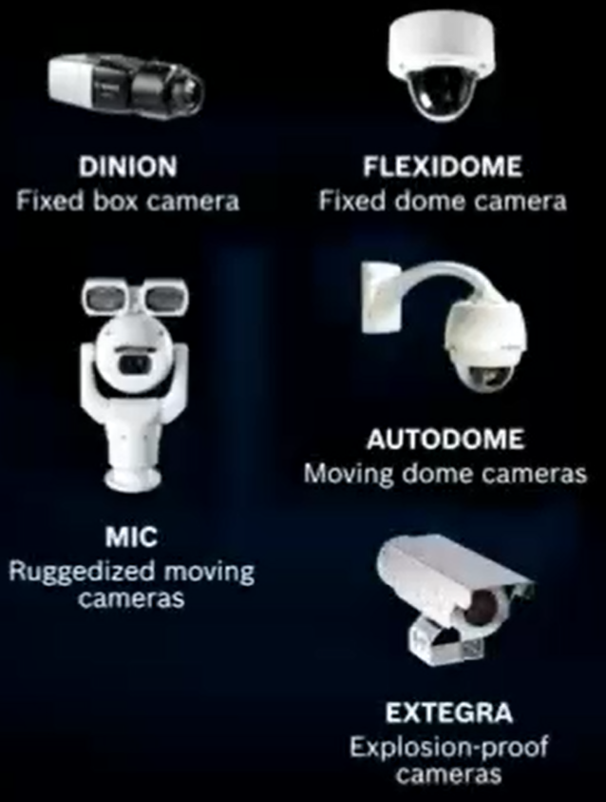
starlight :: Bosch camera | usable image in near darkness
BOSCH owns the night
MIC, AutoDome, FlexiDome or Dinion

Slide 7
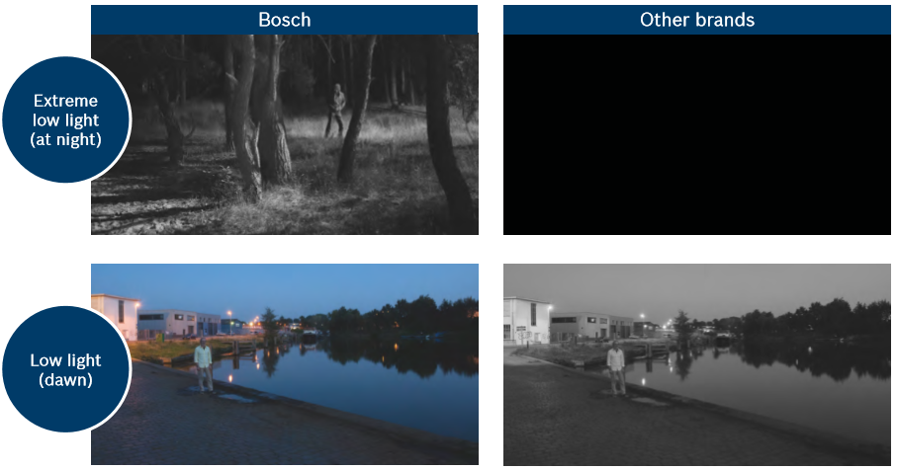
starlight :: Bosch camera | usable image in near darkness
BOSCH owns the night
dynamic range up to 120db
The latest sensor technology, combined with sophisticated noise suppression, results in a light sensitivity of 0.00825 lux in color and 0.00275 lux in monochrome¹.
This enables starlight cameras to produce full color images in the dark beyond the point where other cameras have switched to monochrome.
¹ DINION IP starlight 8000 MP

Slide 8

starlight :: Bosch camera | usable image in near darkness
BOSCH owns the night
frame rate up to 60 frames per second

Slide 9
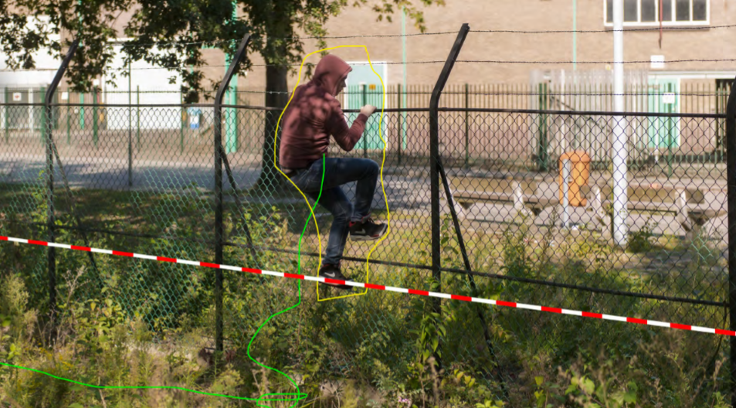
starlight :: Bosch camera | usable image in near darkness
BOSCH owns the night
video analytics at the edge

Slide 10

starlight :: Bosch camera | usable image in near darkness
BOSCH owns the night

Slide 11
O
Our focus is to make
darkness totally visible
BOSCH owns the night
Steve Pennington, Chesapeake & Midlantic Marketing
www.MidChes.com | steve@MidChes.com | 410.612.9640

