Slide 1


Ensure data security in a hyper-connected world
What it takes to safeguard video surveillance data
1
Security Systems | ST/SRM3-NA | 4/6/2016
© 2016 Robert Bosch LLC and affiliates. All rights reserved.

Slide 2


Motivation for Migration to Encryption Secured Camera Technologies
  Cyber Network Exploitation- US Federal government
  Supply Chain Security and embedded Malware data
  Cyber Data Breaches from endpoint devices
Nation state and domestic surveillance/eavesdropping
Firmware and software vulnerable to denial of service and malicious attack
Lack of confidence in securing end point devices
2
Security Systems | ST/SRM3-NA | 4/6/2016
© 2016 Robert Bosch LLC and affiliates. All rights reserved.

Slide 3
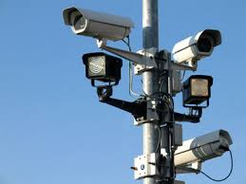

Relevant News Events
Surveillance cameras turned into zombie computers
http://www.securityinfowatch.com/news/12132212/cctvs-turned-into-zombie-computers-says-imperva
IP Cameras and DVR’s wide open to hacking
http://www.theregister.co.uk/2014/11/21/hikvision_dvrs_wide_open_to_hacking_say_security_analysts/
Firmware and software vulnerable to denial of service and malicious attack
Peeping into 73,000 Security Cameras http://www.networkworld.com/article/2844283/microsoft-subnet/peeping-into-73-000-unsecured-security-cameras-thanks-to-default-passwords.html
2
Security Systems | ST/SRM3-NA | 4/6/2016
© 2016 Robert Bosch LLC and affiliates. All rights reserved.

Slide 4


Need for data security in security surveillance
Security focus extends from the physical level into the digital domain
Exploits of personal data is rising
March 2013:
Products shipped with unauthenticated firmware, left port 9000 open with UPnP enabled
September 2015:
Malicious X code used in app downloading malware onto users devices
March 2015:
Network Video Recorder hacked an turned into a bitcoin miner
June 2015:
Buffer overflow vulnerability that can be exploited by a remote attacker for arbitrary code execution
3
Security Systems | ST/SRM3-NA | 4/6/2016
© 2016 Robert Bosch LLC and affiliates. All rights reserved.

Slide 5

What to expect?
Malware
Intrusion of privacy
Privilege misuse
Denial of service
Physical theft
Side channel attacks
4
Security Systems | ST/SRM3-NA | 4/6/2016
© 2016 Robert Bosch LLC and affiliates. All rights reserved.

Slide 6

What is data security?
“Data security means protecting data, such as a database, from destructive forces and from the unwanted actions of unauthorized users.”
Securing stored data involves preventing unauthorized people from accessing it as well as preventing accidental or intentional destruction, infection or corruption of information.
5
Security Systems | ST/SRM3-NA | 4/6/2016
© 2016 Robert Bosch LLC and affiliates. All rights reserved.

Slide 7







What is needed in a hyper-connected world?
Systematic approach:
Four-step approach:
Create trust
Secure data
Manage user access rights
Meet industry standards
CHAVE Technology Provides the Solution
6
Security Systems | ST/SRM3-NA | 4/6/2016
© 2016 Robert Bosch LLC and affiliates. All rights reserved.

Slide 8
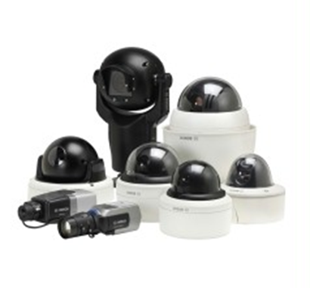
What is CHAVE?
CHAVE stands for Credentialed High Assurance Video Encryption
CHAVE will consist of three major components
  Selected CHAVE-enabled Bosch Cameras
  CHAVE-enabled Genetec Security Center VMS
  Digital Certificate Services provided by SecureXperts, Inc.
7
Security Systems | ST/SRM3-NA | 4/6/2016
© 2016 Robert Bosch LLC and affiliates. All rights reserved.

Slide 9

Create trust
Assigning each component authentication keys
Data exchange only between trusted partners
Data of verified devices can serve as legal evidence
CHAVE
CHAVE cameras are pre-loaded with X.509 certificates from trusted authorities
Highly-vulnerable user names and password authorization for workstations and cameras replaced by secure credential-based authentication
Genetec CHAVE-enabled Security Center software requires the use of either a US government issued HSPD-12 compliant smart card or Non-federal issuers (PIV-I) compliant card.
Users are subject to strong validation of identities including a background check with proof of citizenship, proof of identity, biometrics, and agency affiliation.
Automatic camera certificate renewal (certificates have three-year validity)
Signed camera firmware ensures authenticity of firmware updates
8
Security Systems | ST/SRM3-NA | 4/6/2016
© 2016 Robert Bosch LLC and affiliates. All rights reserved.

Slide 10

Secure data
Creating and distributing cryptographic keys for protecting recorded data
Modern encryption algorithms ensure high security
CHAVE
X.509 compliant private/public encryption key pairs are used to ensure secure communication
CHAVE cameras support 2048bit RSA and 256bit elliptic curve cryptography, meeting NSA Suite B Secret protection level.
Trusted Platform Module within cameras protects data even in case of a breach (FIPS 140-2 level 3 data protection)
9
Security Systems | ST/SRM3-NA | 4/6/2016
© 2016 Robert Bosch LLC and affiliates. All rights reserved.

Slide 11

Manage user access rights
Only authorized individuals get access to the data
Ensure easy management of user access rights
CHAVE
Smart card-based multi-factor authentication required to gain access to Genetec Security Center
Active directory integration for enterprise wide access rights management
10
Security Systems | ST/SRM3-NA | 4/6/2016
© 2016 Robert Bosch LLC and affiliates. All rights reserved.

Slide 12

Meet industry standards
Meet industry standards in public key infrastructure and IT
Support 3rd party solutions for:
  Public key infrastructure
  Management of user access rights
CHAVE
Based on X.509 and PKI compliant certificates
Supports HTTPS with the latest TLS 1.2 Encryption
Supports 2048bit RSA and up to 256bit elliptic curve cryptography
Genetec Security Center compatible with LDAP and Active Directory for User Management
Genetec Security Center compatible with HSPD-12 and PIV-I Compliant smart cards (among others)
11
Security Systems | ST/SRM3-NA | 4/6/2016
© 2016 Robert Bosch LLC and affiliates. All rights reserved.

Slide 13
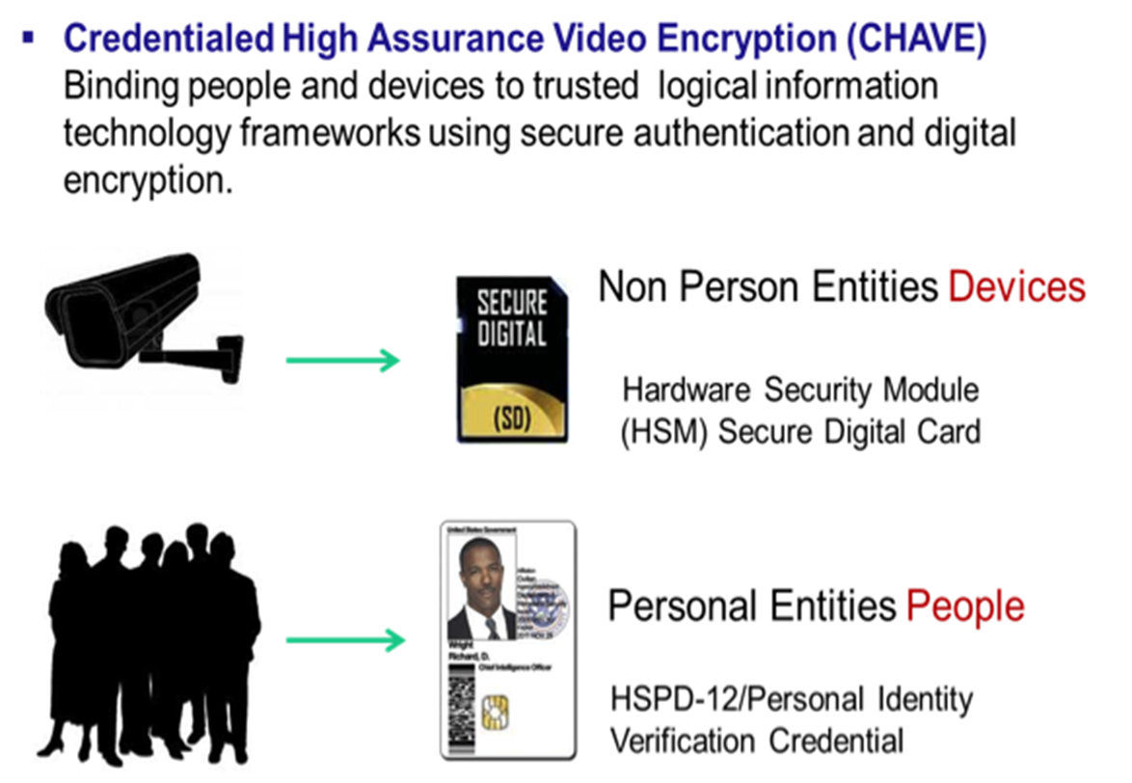
7
© 2016 Robert Bosch LLC and affiliates. All rights reserved.

Slide 14


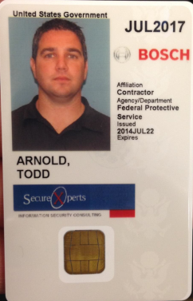

How CHAVE Works
Hardware Security Module (HSM) on circuit board
(HSM) Secure Digital Chip with Encryption Certificates
FIPS 140-2 Level 3 (High Assurance)
HSPD-12 / Personal Identity Verification Card With Authentication, Signing and Encryption Certificates
7
© 2016 Robert Bosch LLC and affiliates. All rights reserved.

Slide 15

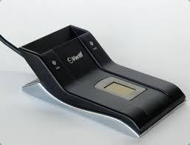
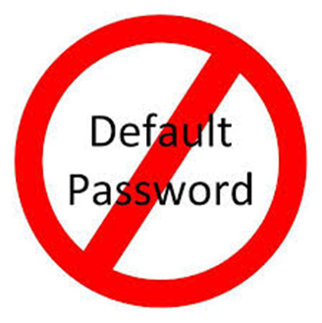
How CHAVE Works
No username password/combination
Requires user to have a government or commercial issued smartcard and smart card reader to connect to camera
7
© 2016 Robert Bosch LLC and affiliates. All rights reserved.

Slide 16

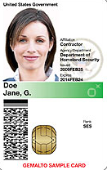
Typical CHAVE system
Certificate validity checks, certificate renewals
Certificate Authority
(Entrust SCC for Federally-trusted certificates or
Entrust NFI for commercially-trusted)
Genetec Archiver Servers
Local Area Network
Encrypted
Storage
Servers
(optionally cloud-hosted)
Secure access, encrypted video & data
LDAP Server
(Certificate-based user access & privileges management)
Smart Card (E.g. Government issued PIV card or commercially issued PIV-I card)
Genetec Security Center Server
Genetec
Security Center
Workstations
12
Security Systems | ST/SRM3-NA | 4/6/2016
© 2016 Robert Bosch LLC and affiliates. All rights reserved.

Slide 17
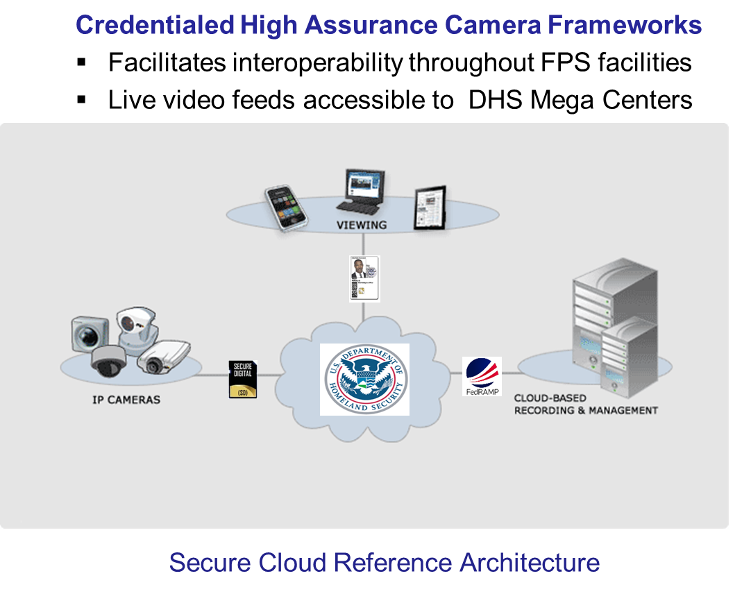
Use Case for High Assurance Framework
US Department of Homeland Security
12
Security Systems | ST/SRM3-NA | 4/6/2016
© 2016 Robert Bosch LLC and affiliates. All rights reserved.

Slide 18
Key Solution Benefits
Interoperability with disparate solutions and vendors
Cyber security alignment with NIST and FedRAMP
Force Multiplication /Operational Effectiveness
Compliance with federal regulations and mandates
Cost effectiveness leveraging cloud hosted shared services model
12
Security Systems | ST/SRM3-NA | 4/6/2016
© 2016 Robert Bosch LLC and affiliates. All rights reserved.

