Slide 1

Access management system 3.0.1
High-end access control with intuitive operation

Slide 2
Why access control

Slide 3

Why do you need an access control system?
Today’s challenges
Increasing demand for security
Growing need to restrict access to buildings and areas
Mechanical access systems are prone to misuse
More flexible working time models
3

Slide 4







Typical applications
Why is access control so important?
Access control is one of the most important subsystems in a security installation
Access in a company
Protect secure areas
Unlock doors in the case of an emergency
4

Slide 5









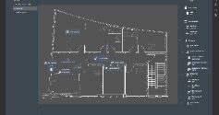

Access control at a glance
New to access control?
How it works in basic terms:
Identification
Interface
Decision
Operation
RF
Wiegand/
RS-485
IP
Component
Credential
Reader
Controller
Server / Client
Via card, key-fob, pin, biometric data
Via card reader, keypad, display or biometric reader
Interface between server/reader to grant/deny access
System operation, configuration and data-base management
Function
5

Slide 6
Why AMS 3.0.1

Slide 7
Simple, scalable and always available
Access Management System
The Access Management System (AMS) 3.0.1 is an access control system that addresses the commercial access control market. It supports up to 200,000 cardholders, up to 10,000 doors, up to 40 workstation clients and up to 400 divisions.
Simplicity:
Easy-to-order thanks to three ready-to-use license bundles (Lite, Plus, Professional)
Easy-to-use software with intuitive, modern GUI and user-friendly operation tools
Easy-to-use map view for fast reaction
Advanced integration capabilities:
Integration with video: BVMS and Milestone XProtect
Integration with intrusion: B Series and G Series
Further integrations with Bosch and third party products will follow
Multiple functionalities:
Visitor management
Global anti-passback
Office mode
Random screening
Mantrap
Occupancy Limit Control
Guard tour
Highest resilience thanks to 3-layer architecture:
AMS server, Access Management Controller and additional Master Access Controller (MAC)
Controllers can share information and perform important activities even when server fails
High level of data security and privacy protection:
Encrypted database and encrypted communication at all stages
Support of Open Supervised Device Protocol (OSDPv2 secure channel)
Future-proof investment:
High level of scalability of cardholders and doors
Seamless upgrade from Lite to Plus and Professional
Regular software updates

Slide 8

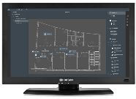
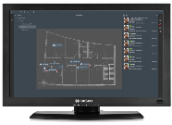







Access Control
software
Simplicity
Threat level management for increased safety on site
Easy to order:
Lite
Plus
Professional
Up to 15 configurable
threat levels
Initiation of safety
measure with one click
Simple, scalable and always available
Ready-to-use license bundles
Easy to USE:
Situational awareness for fast and most efficient reaction
Easy installation
and basic configuration
Intuitive GUI
Easy-to-use
map viewer
Multiple functionalities
Map viewer
Swipe Ticker
Access Management System
Future-proof investment
Global
anti-passback
Random screening
Occupancy
Limit Control
High scalability
The Access Management System is your choice for medium- to large-sized access control solutions such as office buildings, educational institutes or hospitals. It supports up to 200,000 cardholders, up to 10,000 doors, up to 40 workstation clients and up to 400 divisions.
up to 200,000 cardholders
up to 10,000 doors
Office mode
Mantrap
Guard tour
Visitor management
Lite
Plus
Professional
Seamless upgrade from Lite to Plus and Professional
Highest resilience based on three layers
Comprehensive application for receptionists
Self-registration option for visitors
Host view for employees
Regular software updates
Third layer
AMS server
Constant operation
Second layer
MAC
Redundant services
Data security and privacy protection
Integration
First layer
AMC
Offline operation
Readers
via API
B Series and G Series
BVMS and Milestone XProtect
Encrypted database and
encrypted communication
Support of OSDPv2
secure channel

Slide 9


Choose your target group:
High-end access control with intuitive operation
End users and consultants
System integrators / installers
9

Slide 10
Why AMS 3.0.1 for
End customers and consultants

Slide 11

Benefits and functionalities for end customers and consultants
Access Management System 3.0.1
Efficient operation thanks to simplicity
Highest system availability
Efficient operation thanks to situational awareness
High data security and data protection
Integrated security with BVMS and B and G Series
Future-proof investment
High level of safety thanks to threat level management

Slide 12

Quick onboarding for employees with customizable Dialog Manager
Efficient operation thanks to simplicity
All cardholder data is managed in one dialog to make the onboarding as time-saving and straightforward as possible:
  Collection of personal data
  Upload of photo and signature
  Registration of PIN codes and biometric data (no additional third party system needed)
  Assignment of access profiles with multiple authorizations
  Assignment of ID cards
Only relevant data is collected to save time and comply with privacy regulations:
  Only relevant fields are visible (defined by customer)
  Possibility to restrict data format (drop down menu, no free forms, etc.)
12

Slide 13

Easy registration process with visitor management
Efficient operation thanks to simplicity
Web browser based visitor management system
Comprehensive and user-friendly application for receptionists
Host view for employees to pre-register their visitors
Self-registration option for visitors
Scanning of ID / passport for fast upload of personal information
Upload and signing of documents
Flexible configuration options to adjust the system to individual requirements and legal needs
13
Notes:
Works with AMS 3.0.1 and higher

Slide 14
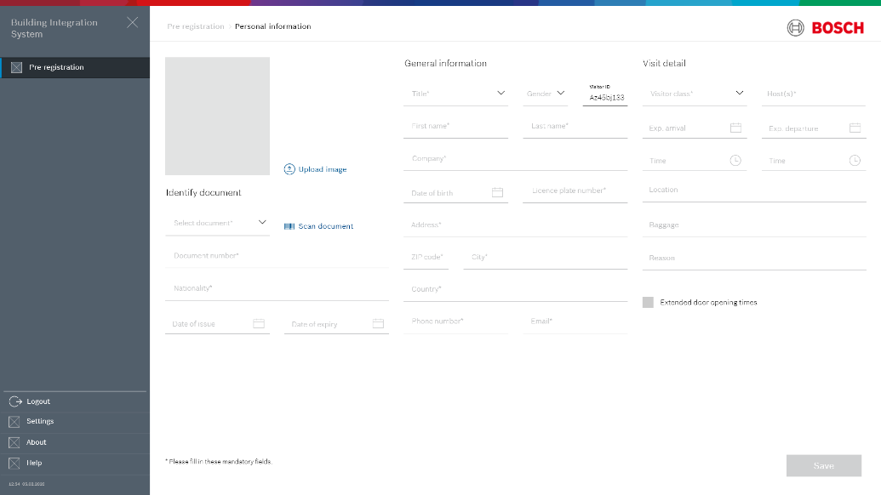
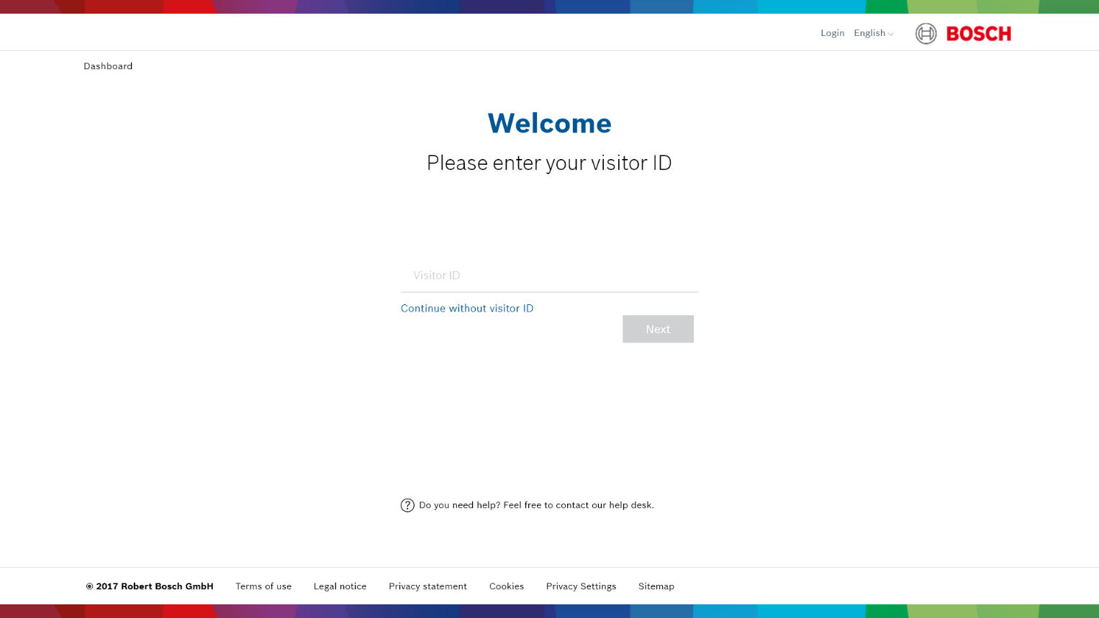
Easy registration process with visitor management
Efficient operation thanks to simplicity
Benefits:
Increases security of the premise
Increases user experience for visitors
Increases efficiency for receptionists and allows them to focus on other tasks
Overview of past and upcoming visits helps receptionists and security managers to organize their day
Self-onboarding streamlines registration process
Modern user interface provides easy and intuitive navigation
14

Slide 15

Efficient operation thanks to simplicity
Time saving data transfer with web based importer/exporter tool
Quick data import from several thousand cardholders from third party systems, e.g.:
  One time data migration from legacy system
  Scheduled regular import from HR system
  Simple migration from APE to AMS via APE exporter
Simple and fast process:
  Simple configuration of templates in 3 steps
  Scheduler for automatic import / export for regular updates at fixed times
  Import of cardholders master data from Active Directory server via LDAP protocol
15

Slide 16

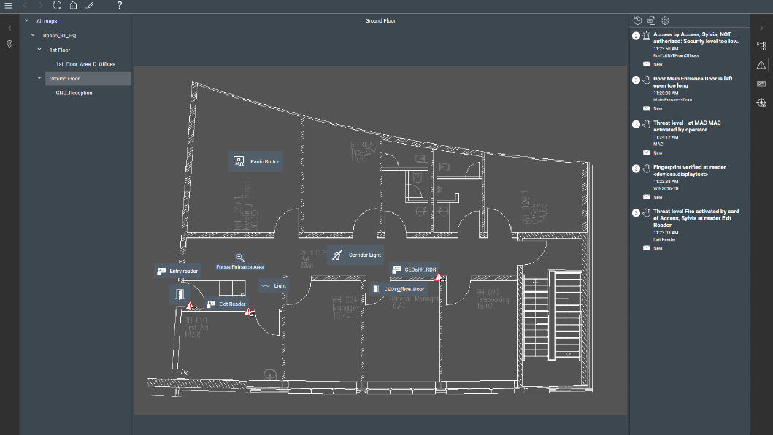
Intuitive graphical user interface (GUI) for easy operation
Efficient operation thanks to usability
  Dark GUI to reduce operator fatigue
  Icons presented in a simple and easy to understand way
  Color scheme aligned with BVMS GUI to make the operation as smooth as possible when using both systems
  User-friendly alarm concept:
  New alarms slide in from the side and rank themselves in the correct position in the alarm list according to their priority
  Initial flashing of an alarm icon when it is raised, statically highlighted after a few seconds to prevent confusion
  Disabling of irrelevant commands for better UX:
  Only relevant commands can be executed
  Irrelevant commands are shown in grey
16

Slide 17
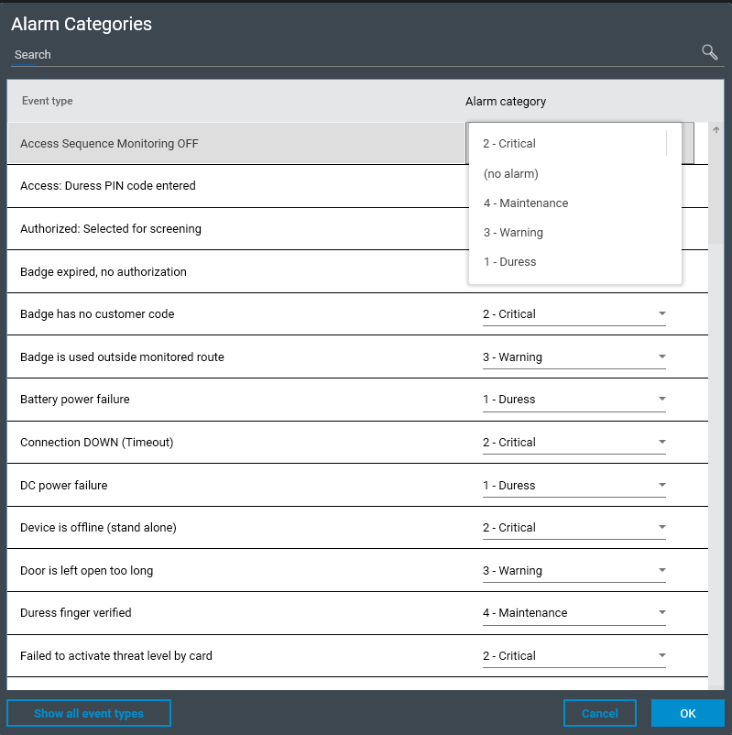
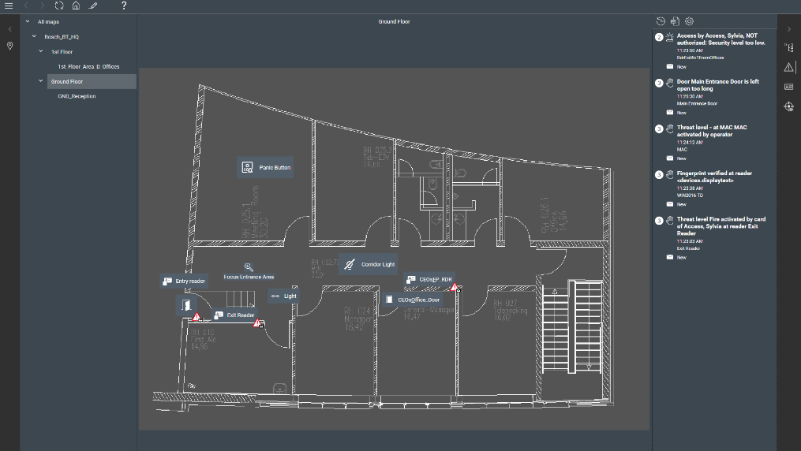
Intuitive event view for quick reaction
Efficient operation thanks to usability
Events for access control and intrusion are preconfigured in four prioritized categories (each with individual optional sound), making sure that the operator notices the most important events first:
  Duress (imminent life threat, holdup)
  Alarm
  Warning
  Maintenance
Simple reconfiguration of event categories if necessary
Event location is shown simultaneously on map when clicking on the event
Synchronization of new, accepted and closed alarms across workstations for efficient alarm handling:
  Events can be accepted and processed by any operator
  Once an event is accepted by an operator, it is blocked for the other ones
17

Slide 18


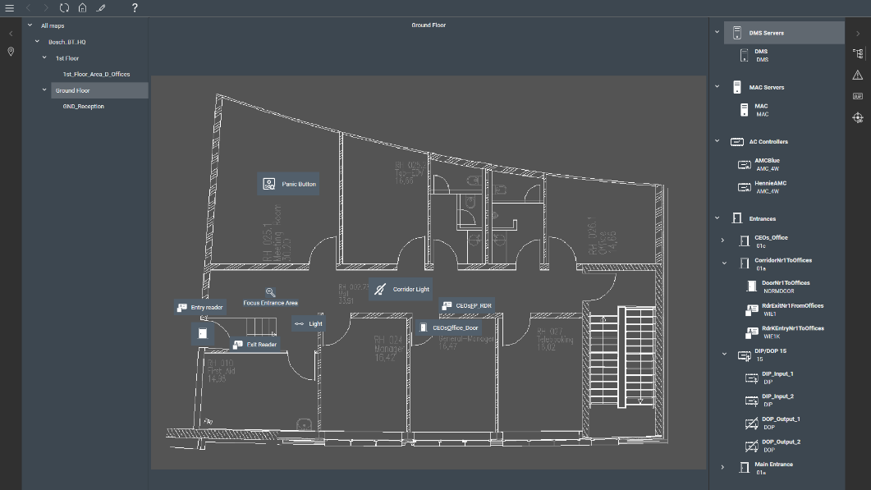




Easy-to-use map view for comprehensive overview
Efficient operation thanks to situational awareness
Building and floor plans are easily imported in JPG/PNG format
Intuitive icon and color scheme provide clear situational awareness
All devices (readers, doors, intrusion panels and points) are easily moved on the map via drag and drop for set-up
Locations of events are indicated on the map when clicking on the event
I/Os, intrusion detectors and defined access or intrusion areas are displayed with icons
Entrances are monitored for quick reaction in the case of forced open or open too long
18
Notes:
I/O: input / output

Slide 19
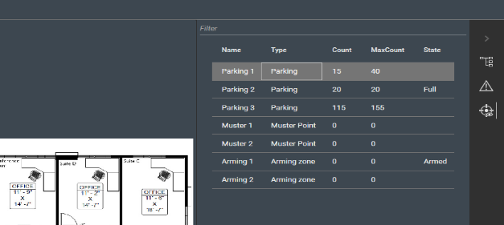
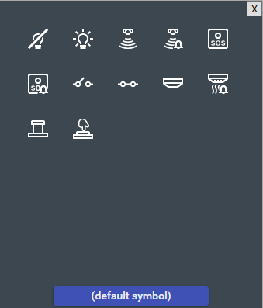
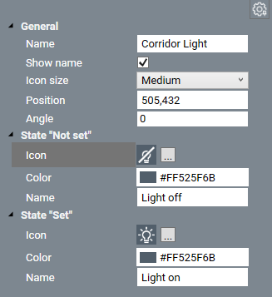
Map view for enhanced information
Efficient operation thanks to situational awareness
Monitoring of areas
(e.g. outside: parking zones, inside: data center)
  Current and max. number of persons / cars is shown
  Occupancy state (full, almost full…) is displayed
  Visitors can be advised by the operator where to park
  Arming state is shown in overlay color
Automation of building functions
  Inputs (PIR, smoke detector, switch) and outputs (lights, etc.) are displayed with icons
  Display of devices’ current states (on/off, idle/alarm, …)
  Triggering of outputs (switch on/off)
19

Slide 20
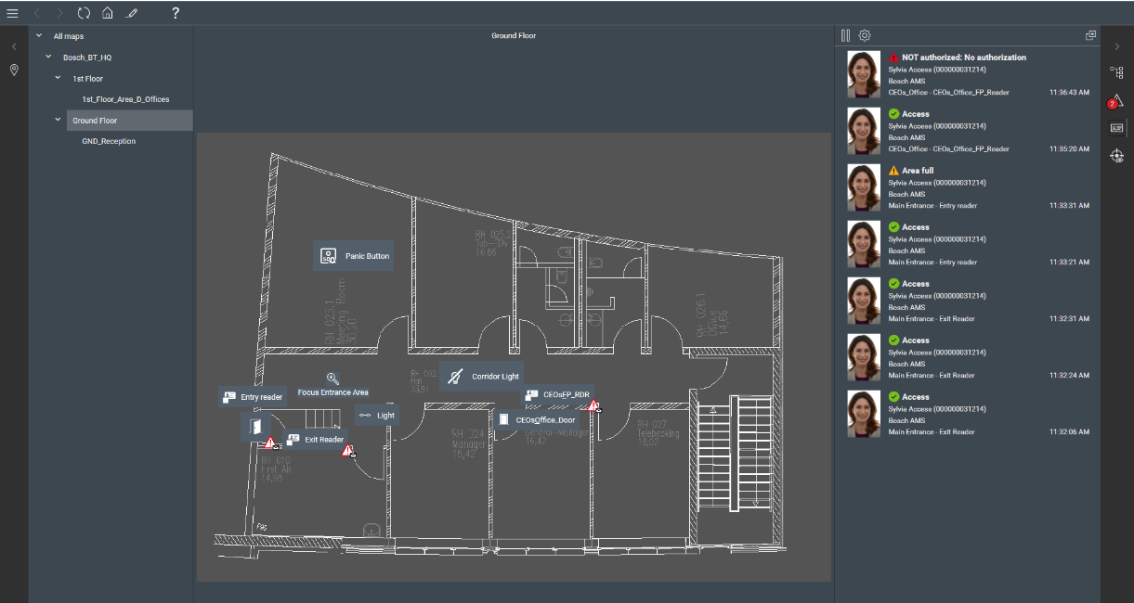





Swipe Ticker for constant overview of access events
Efficient operation thanks to situational awareness
Shows access events:
Over selected doors
With direct link to map
On free floating window
Shows cardholder data and photo
Shows reader offline states
Prevents misuse of ID cards
Validation / check of photo (i.e. whether the photo is too old)
Information shown when cardholder requested access:
  Green check mark:
  Access (granted and taken)
  Yellow warning sign:
  Authorized but did not enter
  Red warning sign:
  NOT authorized
20

Slide 21







Multiple functionalities
Effective system to achieve a high level of security
Global anti-passback
Random screening
Occupancy limit control
Office mode
Mantrap
Guard tour
21
Notes:
Anti-passback: A simple form of Acces Sequence Monitoring in which a cardholder is prevented from entering an Area twice within a defined time period, unless the card has been scanned to exit that area in the meantime. Anti-passback deters a person from passing credentials back through an entrance for use by an unauthorized second person.
Office mode: The suspension of access control at an entrance during office or business hours
Random screening feature: Cardholders accessing or leaving the site can be stopped at random intervals and directed to security personnel for closer inspection. Cards belonging to designated “VIPs“ can be excluded from random screening
Mantrap: Feature for managing two cooperating doors with two pairs of readers; recommended for high security levels, e.g. entrances to server rooms or research departments.
Guard Tour: A route around the premises, punctuated by card readers, where persons of employee-type Guard, must present a special guard card to prove that they have physically visited the reader. Guard cards do not open entrances, but are used solely for tracking. To open entrances the guard requires an access card in addition. The Guard tour consists of a series of readers with the approximate walking times in between. The maximum tolerable delay between readers, and the tolerable deviation (+/-) from the start time, are also attributes of the Guard tour. Deviations outside of these defined tolerances can potentially trigger alarms, and are recorded in Patrols

Slide 22


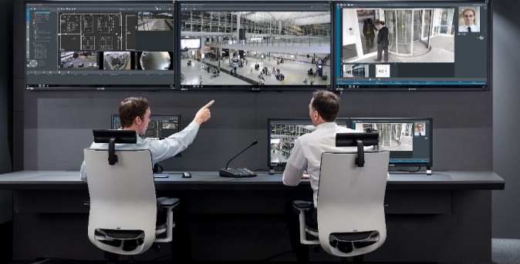
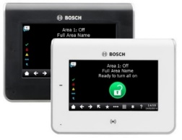




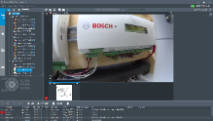
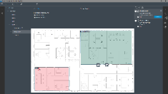
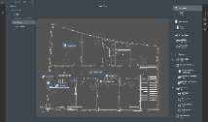
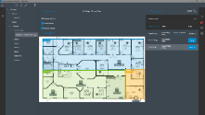
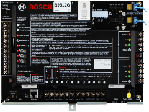
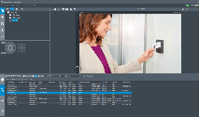





Integrated security solutions
Improve security and safety
Intrusion detection you can rely on
Access management made simple and scalable
Video security unified for improved safety
B and G Series
Access Management System 3.0.1
BVMS 10.1
Up to 599 inputs
Up to 32 areas
Up to 25 panels
B and G Series
integration
Up to 200,000
cardholders
Up to 10,000 doors
Seamless integration with
B and G Series and
Access Management System 3.0.1
22

Slide 23
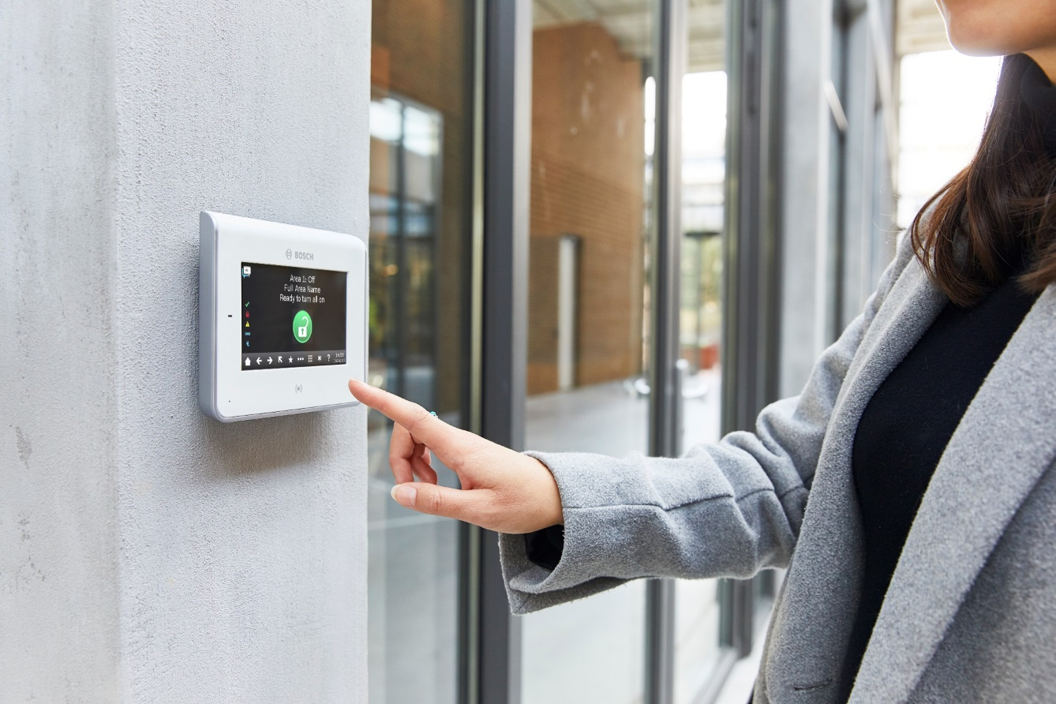
Integrated security solutions
How B and G Series integrates into Access Management System
  Central user management
  Add / delete / modify user passcodes and authorities, assign key fobs
  Print user reports
  Organize users by group or function for one or several panels
  Integrate with HR software such as Active Directory
  Efficient authorization management
  Central overview of all access and intrusion authorizations
23

Slide 24


Integrated security solutions
How B and G Series integrates into Access Management System
  Central alarm management
  Arm / disarm intrusion panels and areas directly in the GUI of the Access Management System
  View intrusion areas with status on map or in table view
  View intrusion events and alarms in the alarm list and on the map
  Silence alarms directly from the map
  Arm / disarm areas from an access control reader
  Central overview of all access and intrusion states
  Easy and remote handling of intrusion events
24

Slide 25
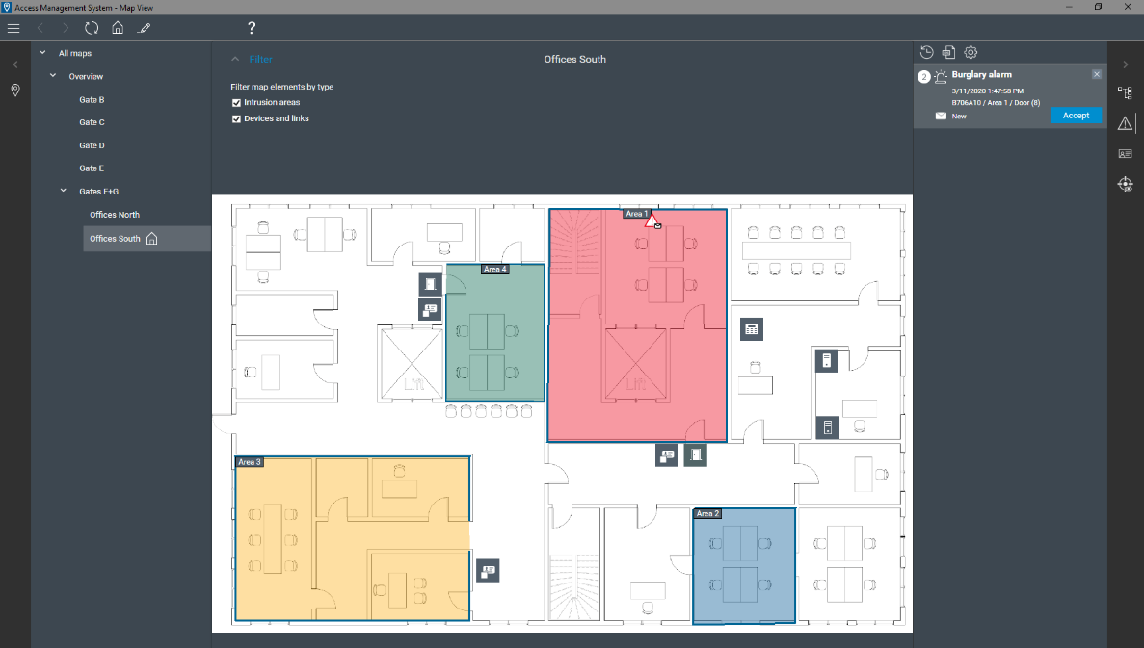
Area views
B Series and G Series Intrusion Control Panels
  Blue: Disarmed and not ready to arm
  Green: Disarmed and ready to arm
  Yellow: Armed
  Red: Alarm situation
Notes:
Disarmed and not ready to arm because e.g. a window is open

Slide 26
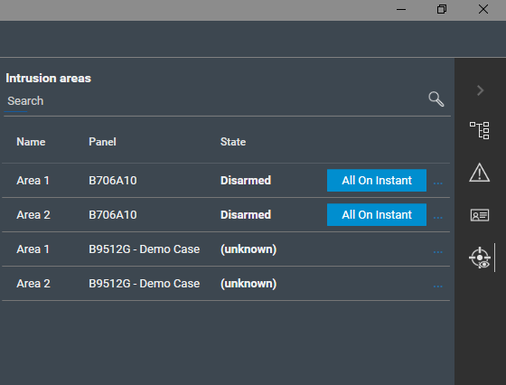
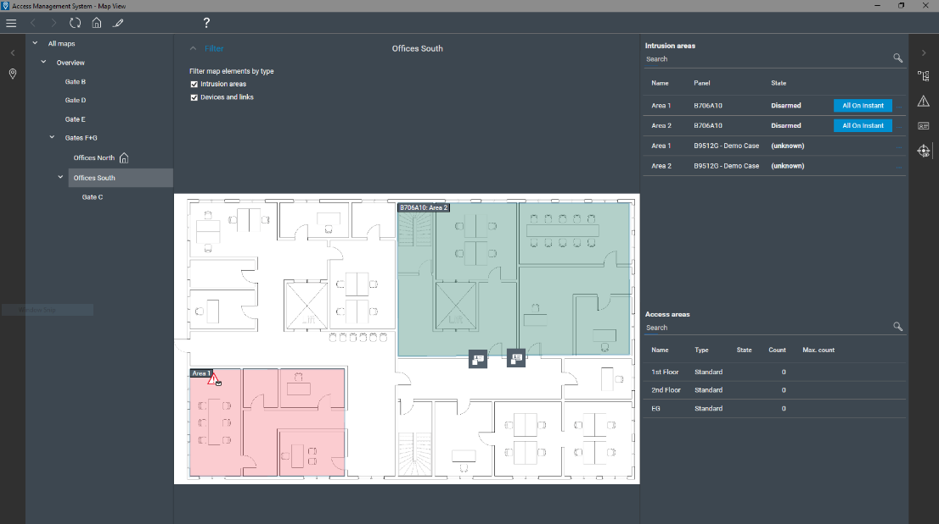
Arm and disarm areas with one click
B Series and G Series Intrusion Control Panels

Slide 27
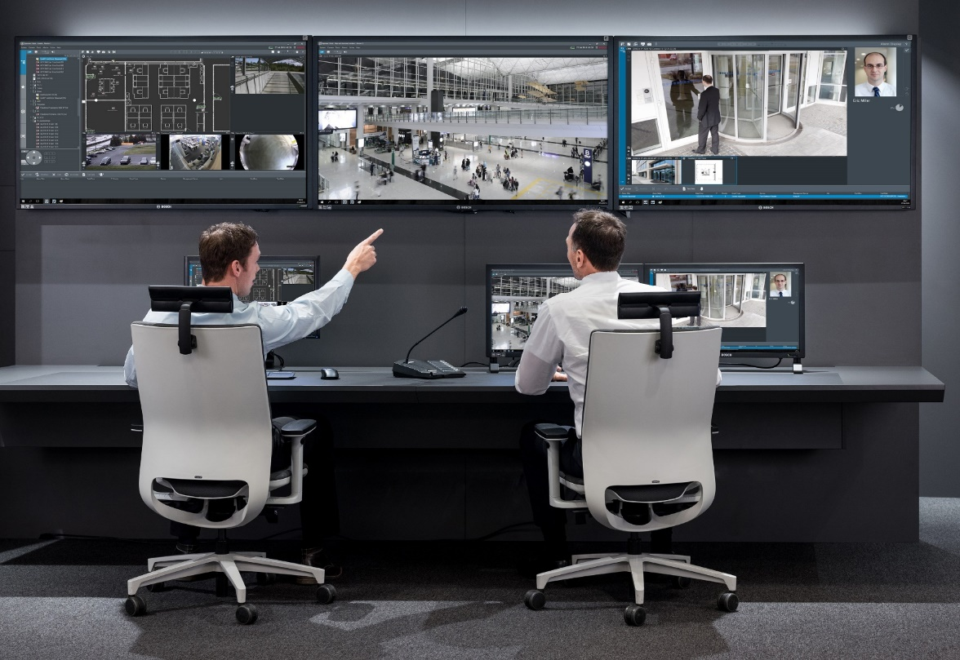
Integrated security solutions
How Access Management System integrates into BVMS 10.1
  Management of access devices and events in BVMS:
  Display and management of access devices in BVMS map view
  Handling of access events in BVMS
  Execution of access commands in BVMS
  Triggering of camera actions by access events (e.g. start / stop recording, pan/tilt/zoom)
  Triggering of door commands by video events (e.g. unlock / lock door)
  Search functionality for cardholder activities and activities at doors for forensic purposes
  Efficient operation of access and video within one GUI
  Increased security due to additional layer of video surveillance
27

Slide 28

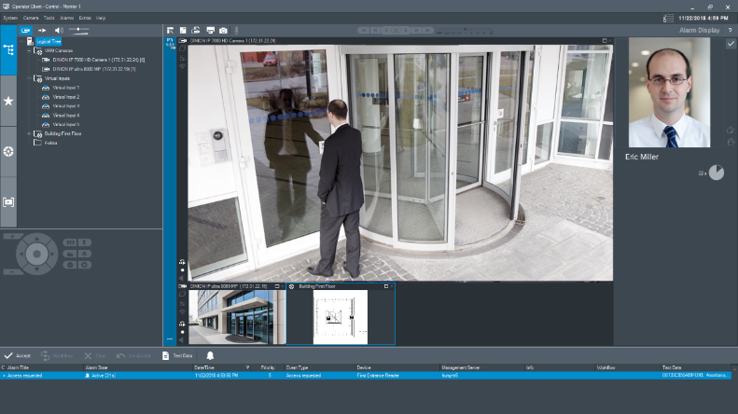
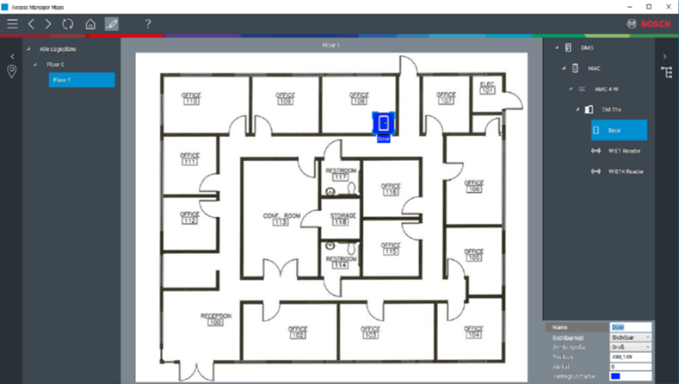
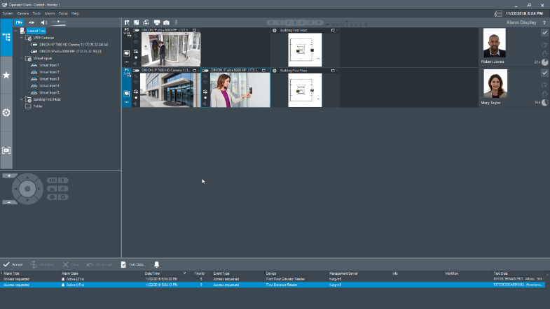
Integrated security solutions
High level of security at doors with BVMS video verification
A cardholder image pops up automatically when someone requests access
Operator compares cardholder image and surveillance video stream and grants or denies access via the control buttons
  Increases door security
  Prevents forced access or tailgating
  Video and Access unified in one GUI
28

Slide 29
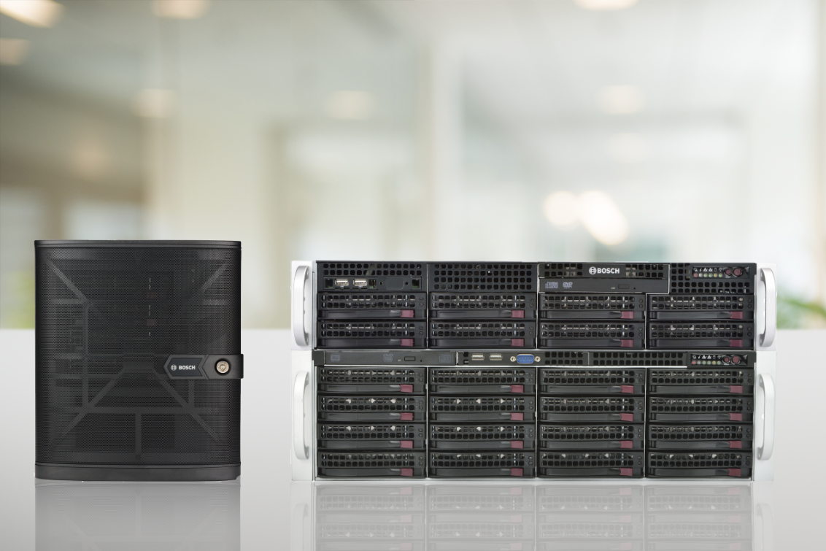
Integrated security solutions
Integration of DIVAR IP all-in-one recording units
  Seamless integration with DIVAR IP all-in-one 5000 and DIVAR IP all-in-one 7000
  DIVAR IP all-in-one recording units are BVMS ready and allow for native, free-of-charge integration with Access Management System via BVMS
  Benefit from all available BVMS / Access Management System integration features while relying on two separate, coexisting servers:
    Increased reliability by preventing single-point-of-failure scenarios
    Improved performance
    Hardware optimization for video and access control
29

Slide 30
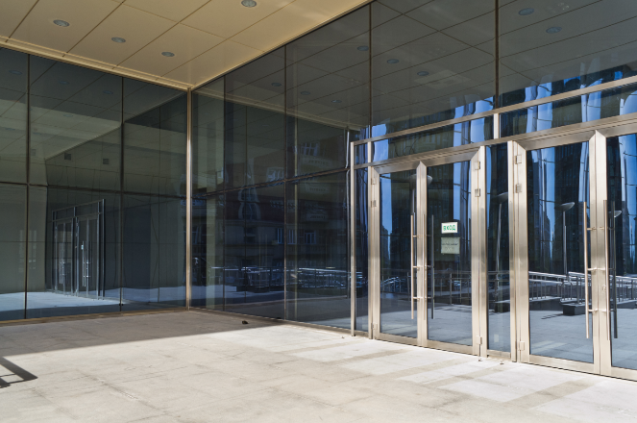
Ensure highest level of safety for your employees and children
Threat Level Management
Proactive preparation for various high and low threat situations
Quick initiation of safety measures in the case of an imminent threat / emergency
Behavior of all doors changed within seconds
Threat levels are defined and configured by the user to change the behavior of all doors with just one click.
Possible high threat levels: attack, fire
Possible low threat levels: sports event, family day in a company, parents’ evening in a school
Threat level state can be changed quickly and easily via three ways:
Trigger threat level at the operator workstation
Push emergency button
Present specially configured “emergency card” to any reader
30

Slide 31
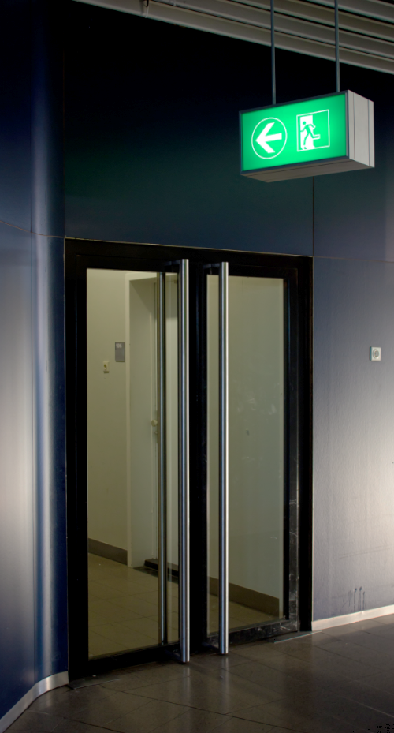
Ensure highest level of safety for your employees and children
Threat Level Management
Up to 15 different threat levels can be configured with the following options:
Secured (Lockdown):
  Certain or all doors are completely blocked
  Access rights of cardholders are invalid for these doors
Open (Evacuation):
  Certain or all doors are completely unlocked
  No access credentials are needed to open the doors, allowing everybody to enter / leave without barriers
Customized (Controlled Lockdown / Lockout):
  Individual definition of each door’s behavior
  Possibility to assign security levels (from 1 to 100) to cardholders and doors; in this case door opens only if the cardholder’s profile is equal or higher than the door’s current security level
31

Slide 32
Highest system reliability
Three-tier architecture
Highest availability thanks to three-tier architecture
Additional third layer Master Access Controller (MAC) between the server and the controllers
If the server fails, the controllers still communicate with each other and share relevant information through the MAC
Consequence: even functionalities that include two or more readers such as anti-passback, access sequence check or guard tour can still be performed
If the AMS server and the MAC are down, cardholders can still enter and leave because of the database which is saved directly on the AMCs. Thanks to this offline capability, it is possible to save millions of events even during down times.
Third layer
AMS server
Constant operation
Second layer
Master Access Controller
Redundant services
Information is still exchanged via MAC
First layer
Access Modular Controller (AMC)
Offline operation
Readers
32
Notes:
AMS base package includes 1 MAC free of charge to cover up to 125 AMCs, i.e. max. 1,000 doors
A second MAC is needed if:
the project requires more than 125 AMCs
less than 125 AMCs are needed but the performance is reduced due to high traffic, many changes in the system, etc.
the AMCs are installed in different time zones (every time zone needs a separate MAC to be able to show the correct date and time in the log file)
customer wants to increase resilience (if one MAC fails, not all the AMCs get offline, but just the ones that are connected to this MAC)

Slide 33

Peace of mind
How Access Management System ensures security by design
Data Privacy:
Strict access authorizations to personal data
Only relevant data can be collected
Print out consent to store personal data
Data storage duration to comply with company policy
Data Security:
Secure-by-design: encryption, authentication, certificates
Secure-by-default: all security settings on high per default
Principle of least knowledge: assign granular privileges for operators
33

Slide 34

Future-proof investment
How Access Management System protects your investment
Scalability within and between the different license types: Lite, Plus and Professional
High scalability to up 200,000 cardholders, up to 10,000 doors and up to 400 divisions
Access Management System works across multiple sites and time zones, allowing you to expand the system according to your needs
When your security requirements grow, switch to full Building Integration System - keep the same hardware components
34

Slide 35

Flexibility thanks to divisions
Future-proof investment
Up to 400 divisions
Multiple companies can share one system in one building
Only information from own company as well as shared areas are shown
Building owners buy only one access control system
  offers full access control functionality
  individual settings to each of their renters
  Divisions can be adjusted and enhanced at any time, making sure that the investment is protected
35

Slide 36

Future-proof investment
Software Maintenance Agreement (SMA)
Order a Bosch Software Maintenance Agreement (SMA) to have a premium software maintenance and support service offer for your Access Management System
The coverage of an SMA applies to a specific system
Contractual period is for 1 year
36

Slide 37
Why AMS 3.0.1 for system Integrators

Slide 38

Access Management System
Benefits and functionalities for System Integrators
Time saving thanks to simplicity
Benefits for APE installers
Benefits for BVMS and B and G Series installers
Win more tenders
38

Slide 39
Straightforward licensing structure for easy ordering
Time saving thanks to simplicity
Three ready-to-use base packages to address appropriate system size and separate licenses to expand the system:
Lite
16 doors (max. 144)
1,000 cards
(max. 200.000)
1 workstation (max. 2)
1 MAC (max. 1)
1 division (max. 1)
API
Plus
32 doors (max. 512)
2,000 cards
(max. 200.000)
1 workstation (max. 5)
3 MAC (max. 10)
1 division (max. 10)
API
Professional
32 doors (max 10.000)
5.000 cards
(max. 200.000)
1 workstation (max 40)
5 MAC (max. 40)
1 division (max. 400)
API
Expansion licenses
Base package can be enhanced with additional:
Doors
Remote online doors
Cards
Divisions
Operator clients
MAC servers
Visitor management
39

Slide 40
Quick basic configuration
Time saving thanks to simplicity
User-friendly tools for quick and easy configuration:
  Standard configuration:
  Selection of ready-to-use door models for standard doors, turnstiles, car park barriers, elevators, mantrap
  Optional configuration:
  Time & Attendance (via 3rd party integration)
  Intrusion: arm/disarm function
  Basic building management functions
  Functions for n-person-access, office mode, disabled persons mode
Quick creation of map view:
  Import of existing floor maps in JPG/PNG format
  Drag & drop of icons to represent doors, controllers and building objects (lights, etc.) on the map
  No AutoCAD knowledge needed
Time-saving set-up of alarms:
  Four pre-defined, prioritized alarm types
  (“duress”, “alarm”, “warning”, “maintenance”)
  Individual re-assignment of alarm types with a few mouse clicks if categorization needs to be changed
40

Slide 41

Win larger and more complex projects with AMS
Benefit for APE installers
Higher scalability for large projects:
Control of up to 10,000 doors instead of 512
Administration of up to 200,000 cardholders instead of 10,000
Set-up of 1,024 time models instead of 255
Creation of up to 400 divisions
High usability for easy configuration and operation despite large project size:
Fully integrated and customizable enrollment dialog
Scheduled and reoccurring data imports with the importer/exporter tool
Many pre-defined reports (e.g. master data, events and system data)
More functionalities for more demanding projects:
BVMS integration
Threat level management with 15 customizable threat level scenarios
Car park management, guard tour management
Migration from APE to AMS:
Export tool to migrate personal data from APE to AMS
Templates to easily import this data into AMS via importer / exporter tool
41

Slide 42
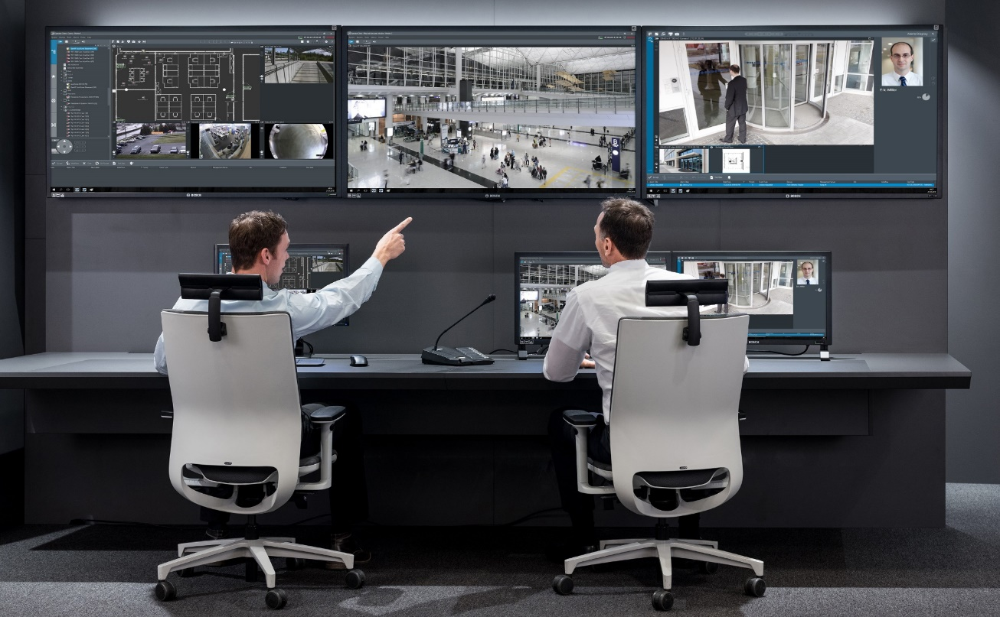
Additional value with AMS integration
Benefit for BVMS installers
AMS integrated in BVMS for increased security:
Video Management and Access Control (AMS) in one GUI for smooth and easy operation
Handling of access devices and alarms in BVMS
Manual video verification for two-factor authentication at doors
Bosch certified and secure interface
AMS relies on robust, highly capable and secure Access Modular Controller (AMC)
Offer regular upgrades:
New functionalities and improvements in every new version with a valid SMA for BVMS
42

Slide 43

Additional value with AMS integration
Benefit for B and G Series installers
Intrusion integrated in AMS for increased security:
Access Control (AMS) and intrusion in one GUI for smooth and easy operation
Central user management and central alarm management in AMS
Bosch certified and secure interface
AMS relies on robust, performant and secure Access Modular Controller (AMC)
Offer regular upgrades:
New functionalities and improvements in every new version with a valid SMA for AMS
43

Slide 44
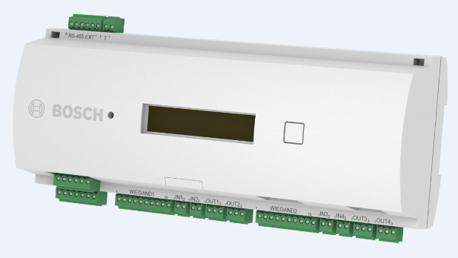
With new two-reader controller
Win more tenders
Dual Wiegand Reader Controller:
Can manage one two-way door or two one-way doors
In total up to three two-way doors or up to six one-way doors can be managed via extension module
Win tenders by being able to offer a one-door controller:
One-door controller is often requested as basic requirement
Product specifications:
  Wiegand interface
  RS-485 extension supported
  2 connectable readers
  4 inputs
  4 outputs
44

Slide 45
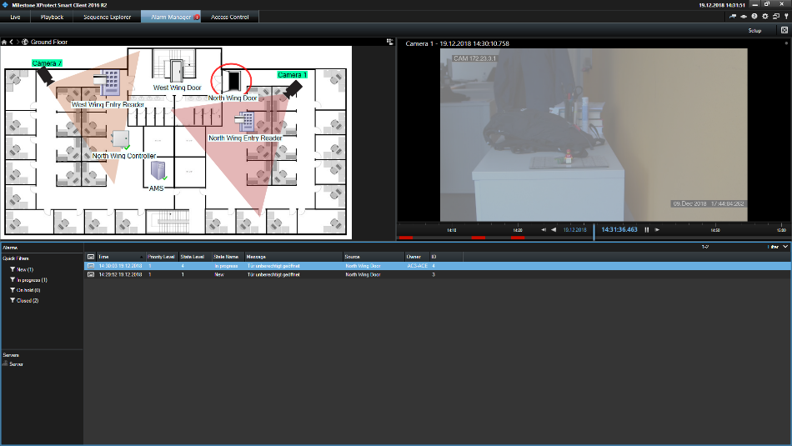
With Milestone XProtect Integration
Win more tenders
AMS plugin is deployed on Milestone XProtect backend
The integration provides:
  Configuration such as event types, state types and command types
  Runtime data such as events and device states
Use cases:
Video verification
Live access monitoring
XProtect map with states of access devices
Display of AMS events in XProtect
Execution of AMS commands in XProtect
Alarm handling of AMS events in XProtect
45

Slide 46



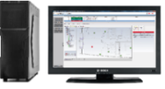











System Design example
Access Management System
Access Management System
Server Client
RS-485 max. 1200m
max. 8 readers
System requirements
150 doors 1200 cardholders Three operators
AMS features | AMC features | Reader features
Max. 10,000 doors Max. 200,000 cardholders 5 cards per person 1024 authorizations per MAC Graphical location map Video integration for video verification via BVMS Intrusion integration via G Series | 2 RS-485 buses 8 inputs 8 relays TCP/IP, RS-485 connection | Support OSDPv2 secure channel Outdoor resistant (up to IP67) Multitechnology support (125kHz and 13.56MHz) Wiegand and RS485 support Keypad or fingerprint for verification
1 - 8
RS-485 max. 1200m
max. 8 readers
9 - 16
Enrollment
reader
Signature
pad
Camera
Card
printer
RS-485 max. 1200m
max. 8 readers
Products | Item type
Readers | ARD-AYBS6380, ARD-FPBEW2-H2, ARD-SER90-WI
Lock | 4710760066
Magnet contact | ISN-CSM35-W
REX button | 4710760047
AMS Software | 1 x AMS-BASE-PLUS30, 1 x AMS-XDRS-128V30, 2 x AMS-XCLI-1V30
Controller | APC-AMC2-4R4CF, APC-AMC2-4WCF
Power supply | APS-PSU-60
Battery | D126
BVMS Software | MBV-BPLU-100
Cameras | NDE-8504-R
Intrusion control panel | B8512G
Intrusion touch screen keypad | B942
Intrusion detectors | ISC-CDL1-W15G
193 - 200
Wiegand max. 120m
BVMS Server and Client
Intrusion panels and detectors
46

Slide 47
Thank you

