Slide 1

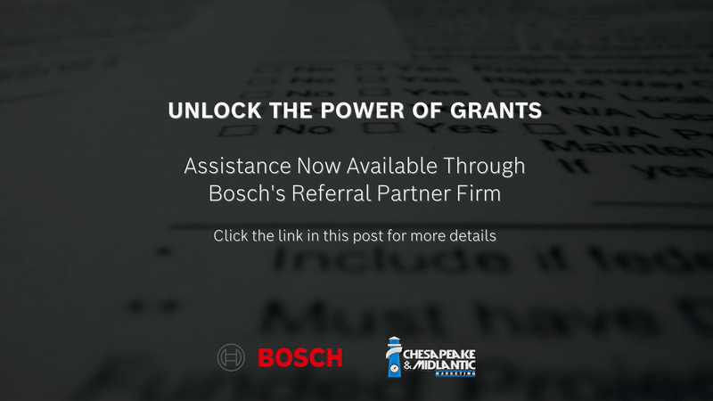

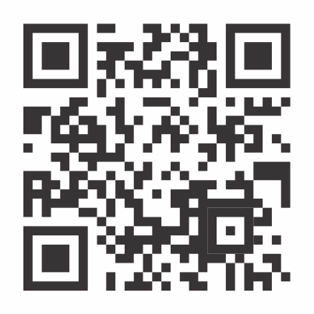
Security Grant Assistance Program

Slide 2

Security Grant Assistance Program

Slide 3

Security Grant Assistance Program

Slide 4
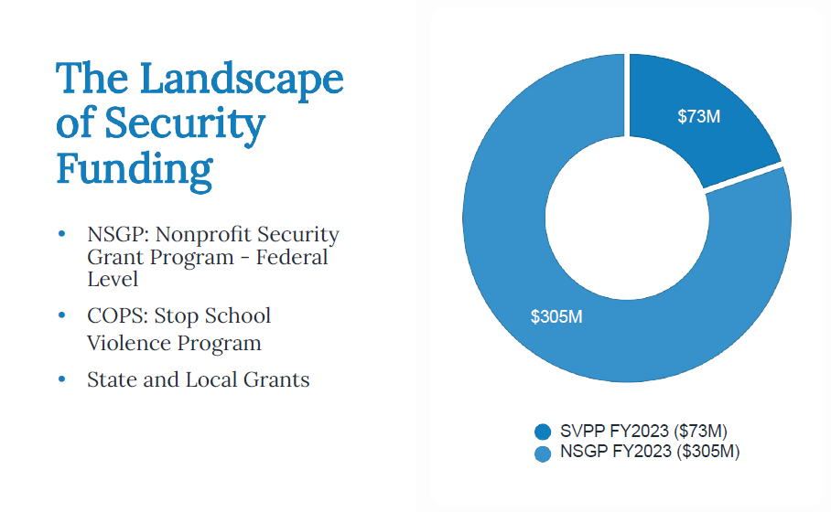
Security Grant Assistance Program

Slide 5
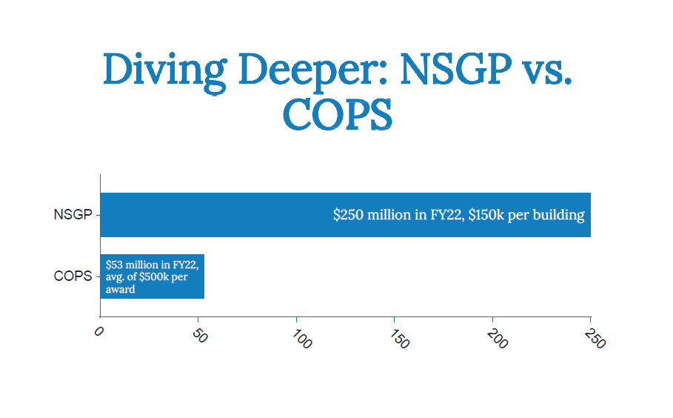
Security Grant Assistance Program

Slide 6
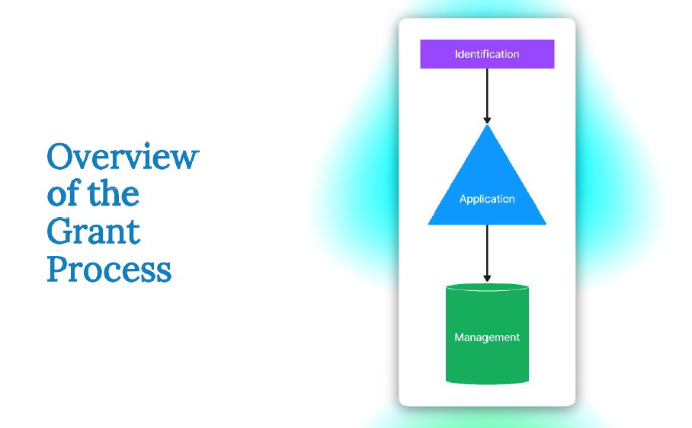
Security Grant Assistance Program

Slide 7

Security Grant Assistance Program

Slide 8

Security Grant Assistance Program

Slide 9
Security Grant Assistance Program
Getting started…
Contact your Chesapeake and Midlantic Marketing representative or email support@midches.com
Complete a short questionnaire
Questionnaire is reviewed by Bosch
Once approved, connection is made to referral firm
Cost for application process versus management is discussed

Slide 10


