Slide 1

B6800 Software Central Station Receiver
Ari Erenthal
Chesapeake & Midlantic Marketing
support@midches.com

Slide 2
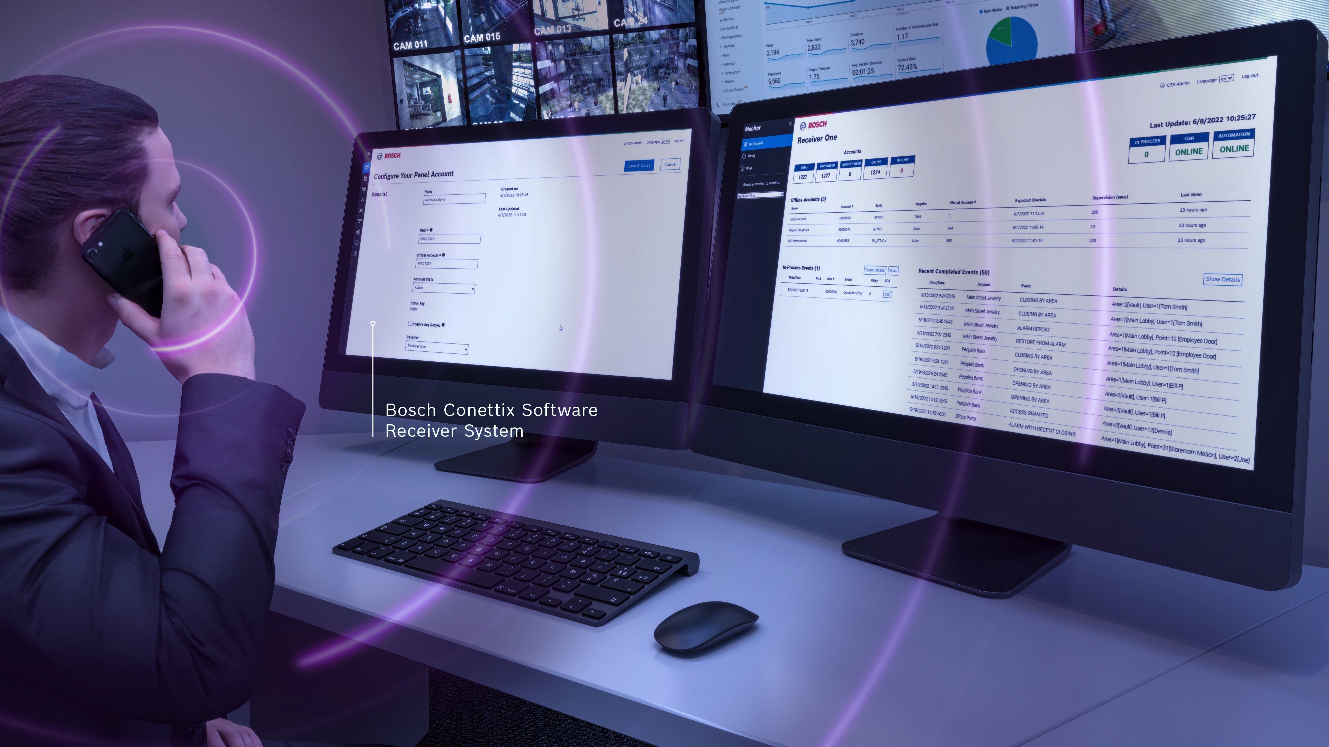
B6800 - Highlights
What is it?
Up to 10,500 panel accounts
Customer off-the-shelf computer equipment running Windows
Browser UI for easy and secure operator access
Compatible with all major automation software
Dashboard view of event traffic, panel offline status
Supports Ethernet and Cellular IP, No support for PSTN

Slide 3
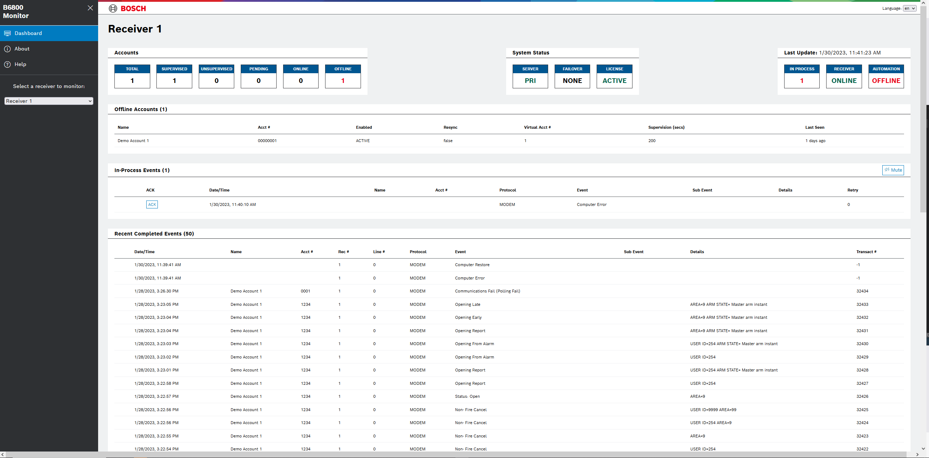
B6800 – New Monitoring Center Receiver
What is it?
B6800 : New software monitoring center receiver solution
  Runs on Customer’s existing computer hardware
  Compatible with Windows 10, Windows Server 2019, and Windows Server 2022
  Windows Hyper-V VM
Significantly modernized from our legacy receivers, while largely retaining backward compatibility
  Retains primary functionality of D6600 and D6100IPv6 receivers for IP applications
  Import existing Panel Account database
  Supports the CONETTIX IP communication protocol (No support for PSTN lines)
  Same output formats for automation software
  Added TCP/IP for automation software
Notes:
The highlights on this slide are that the system uses customer’s hardware, there is not any dedicated hardware like the D6x00. The supported Operating Systems are for the Host Operating Systems, not a dedicated OS license required. Since it will work with Windows 10, this can simplify deployment. Since this is a Virtual Machine (VM), there is not a dedicated license required as there is for competitive systems. If they install into a Virtual environment, they will need the OS license, this does not.
Backwards compatible with the Conettix IP communications. The addition of TCP/IP for Automation to connect to the receiver (versus the UDP with the receiver connecting to automation) is a big add.

Slide 4
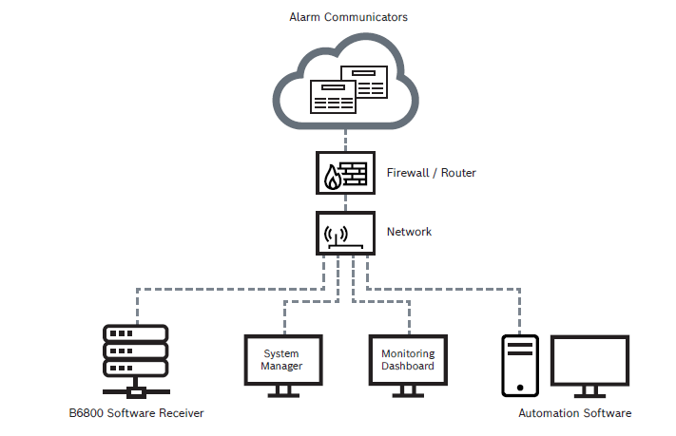
B6800 - System Components
What is it?
Receiver(s)
  One or two receivers per System Manager
System Manager
  Manages Receivers, Accounts, Operators
  One System Manager per installation
  Accessible via browser from anywhere
Monitoring Dashboard
  View receiver event traffic to automation
  Visual and audible notifications
  Accessible via browser from anywhere

Slide 5

B6800 – Communication Security
Communication Security
Accounts must be pre-loaded
  Only accepts messages from known systems
  Allows simple mitigation of run-away devices
Secure UDP Communication
  Mitigates denial of service attack risk
  All messages are verified
Built-in anti-substitution and anti-replay
  Eliminates surreptitious attacks
128 - 256 bit AES Encryption
  High level of data security
  Security Cipher Block Chaining encryption ID
  All Bosch communicators support encryption

Slide 6
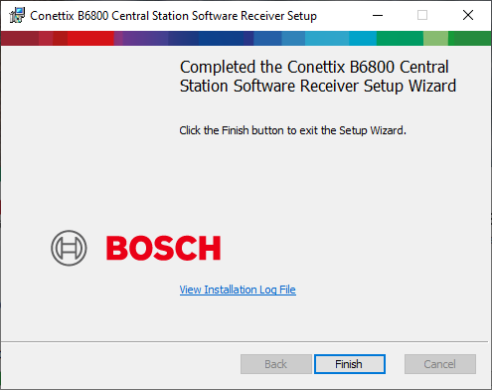
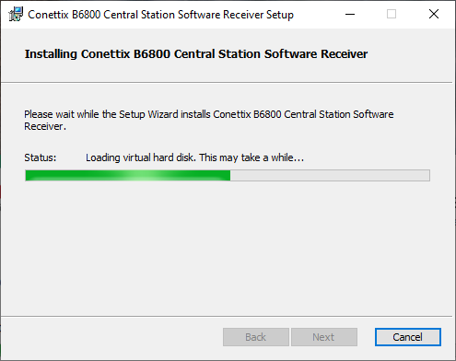
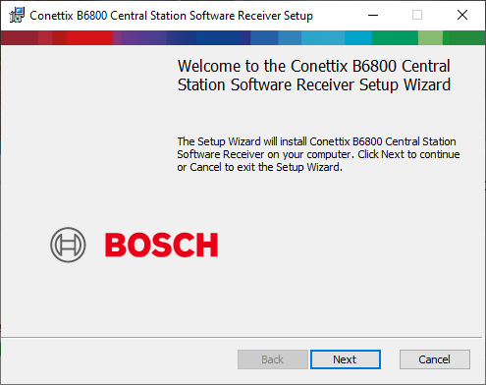
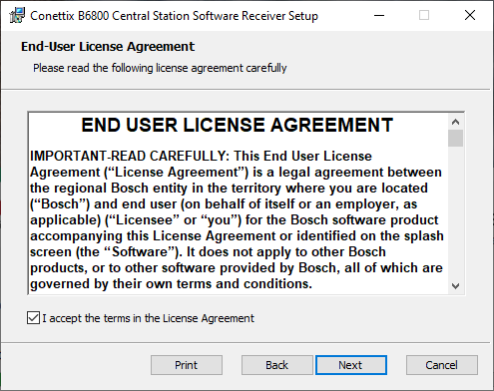
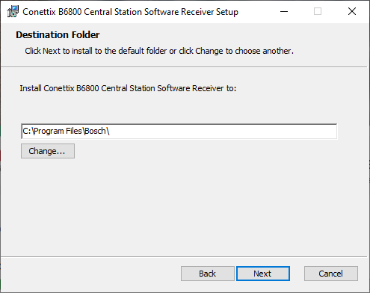
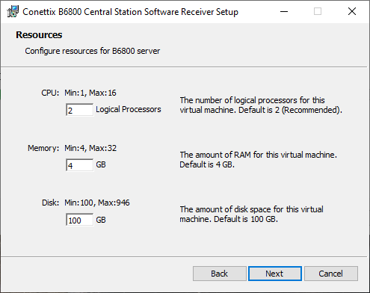
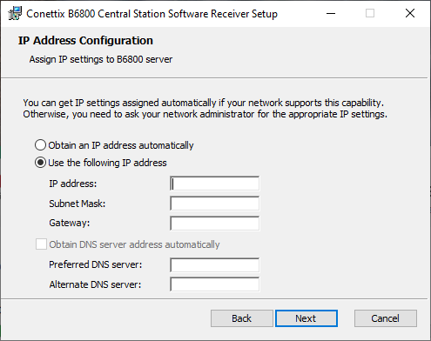
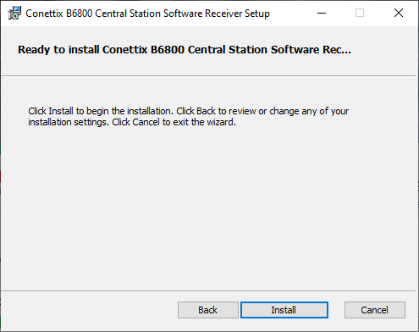
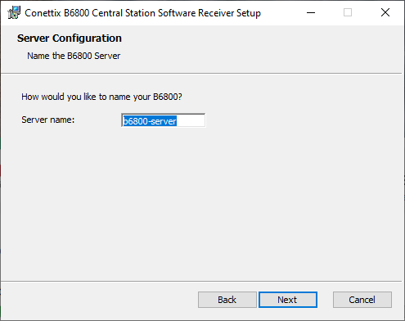
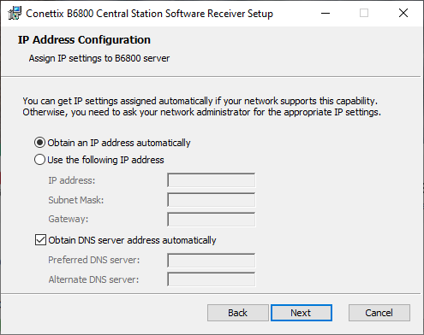
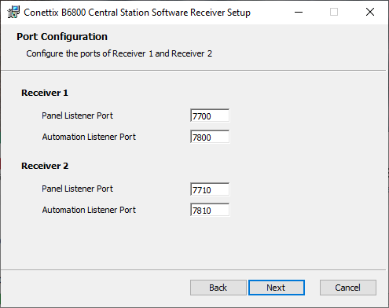
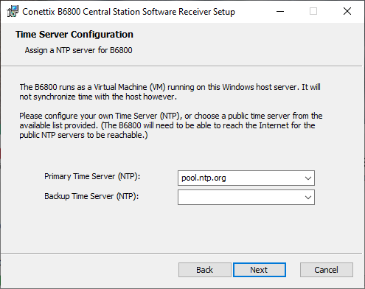
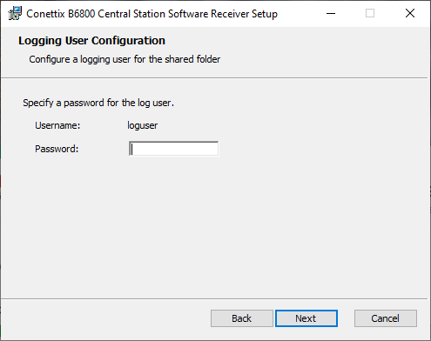
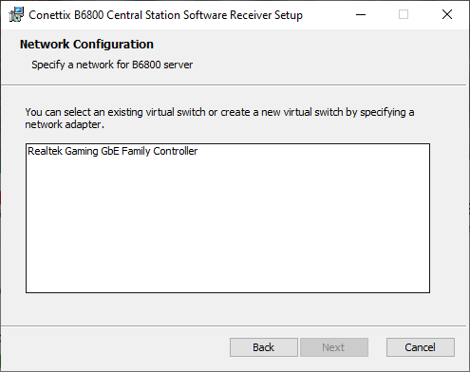
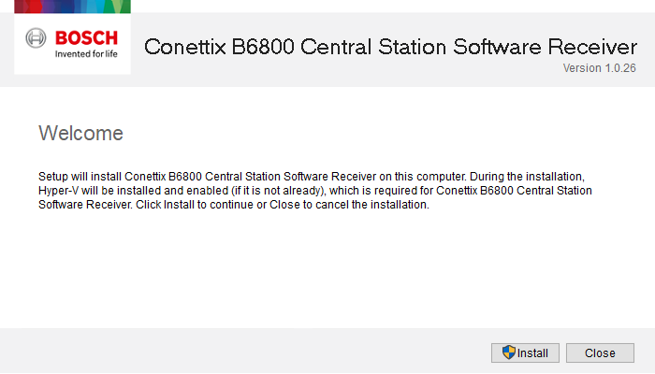
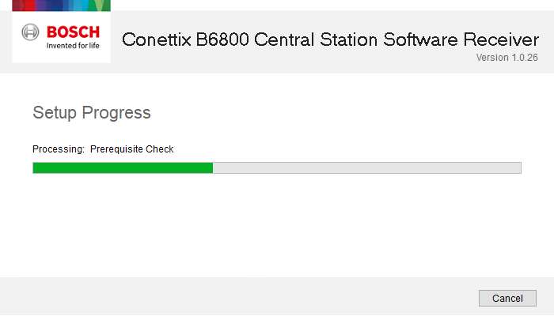
B6800 – Installation Process
Simple to Install
Windows Executable
  Installation Wizard
    Checks for Hyper-V or enables it
    B6800 Install and EULA
    Location for the VM files to be installed
    Resources for the VM
      Number of Cores
      Memory
      Drive Space
    Network Configuration
      Which network adapter
      DHCP or Static IP Address for the VM
    Port Configuration
    Time Server Configuration
    Server Name
    Logging Configuration
Notes:
This is an animated slide with all of the screens that show the install process. It can be used to show for training or for ease of installation, especially compared to the D6x00 installation setup. There is no installation on a workstation, it is just URL/IP Address to the login/dashboard pages.

Slide 7
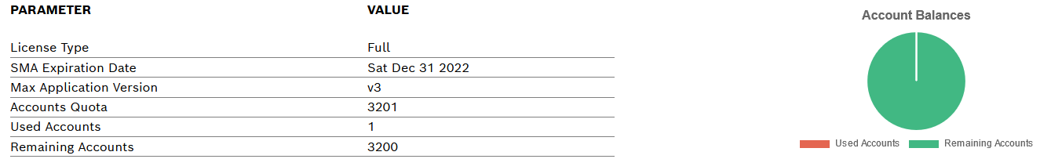
B6800 – Operation Advantages
Simple to Use
Ultimate flexibility
  No proprietary hardware
  Two Receivers available
  Licensing options: Additive software keys (500, 2500, 10K account units) for up to 10,500 accounts
    Customer chooses how to spread accounts across receivers
Operational excellence
  Simple User Interface for configuring and operating the system with a Standard Web Browser
  Automated failover solution
  Output format for Automation software same as D6x00 HW receivers (6500 Mode & Bosch SIA mode)
  Real time receiver monitoring dashboard
    Online/Offline status of: Accounts, Receivers, Automation SW
    Live view of account messages with manual acknowledgement option
Notes:
The highlights here are again, no proprietary hardware. There are two receivers available per system, one could be encrypted, one not; they could be used as two different receivers, etc. The number of accounts is per system, not per receiver. The licenses are Additive, which means that if they purchase the Base (D6800-SR and an additional 500 Accounts, they would have 100 accounts. This was not available in the D6x00 hardware. There is no software for management to be installed, it simply uses a standard web browser at the workstations. The Automated Failover is a huge update from the D6x00, it will automatically fail over with no intervention required to get it running. More on that on the next slide. Automation output is the same, so no changes required on the Automation side. Real-time dashboard is like the front of the receiver, so keep the user informed of status and details of the receiver system. More in a following slide.

Slide 8
B6800 – Automatic Failover
Simple to Use
Failover Process
  Failover will occur when two systems are connected together, and one supervises the other.
  In case of failure, the second system will take over all processing automatically
  Failover will require failover license B6800-FS
Failover Setup
  The process to setup the failover process is completely documented for the user to set it up
  Support will be available to help those that need it
Notes:
The failover process is completely automatic. Server B (the “backup” system) will monitor Server A (the “active” server) and in case of failure it will assume all operations of the system. There is not a primary versus secondary or backup, either can be the primary that is running. The only manual process will be the initiation of the “backup” server to bring the Cluster up.

Slide 9
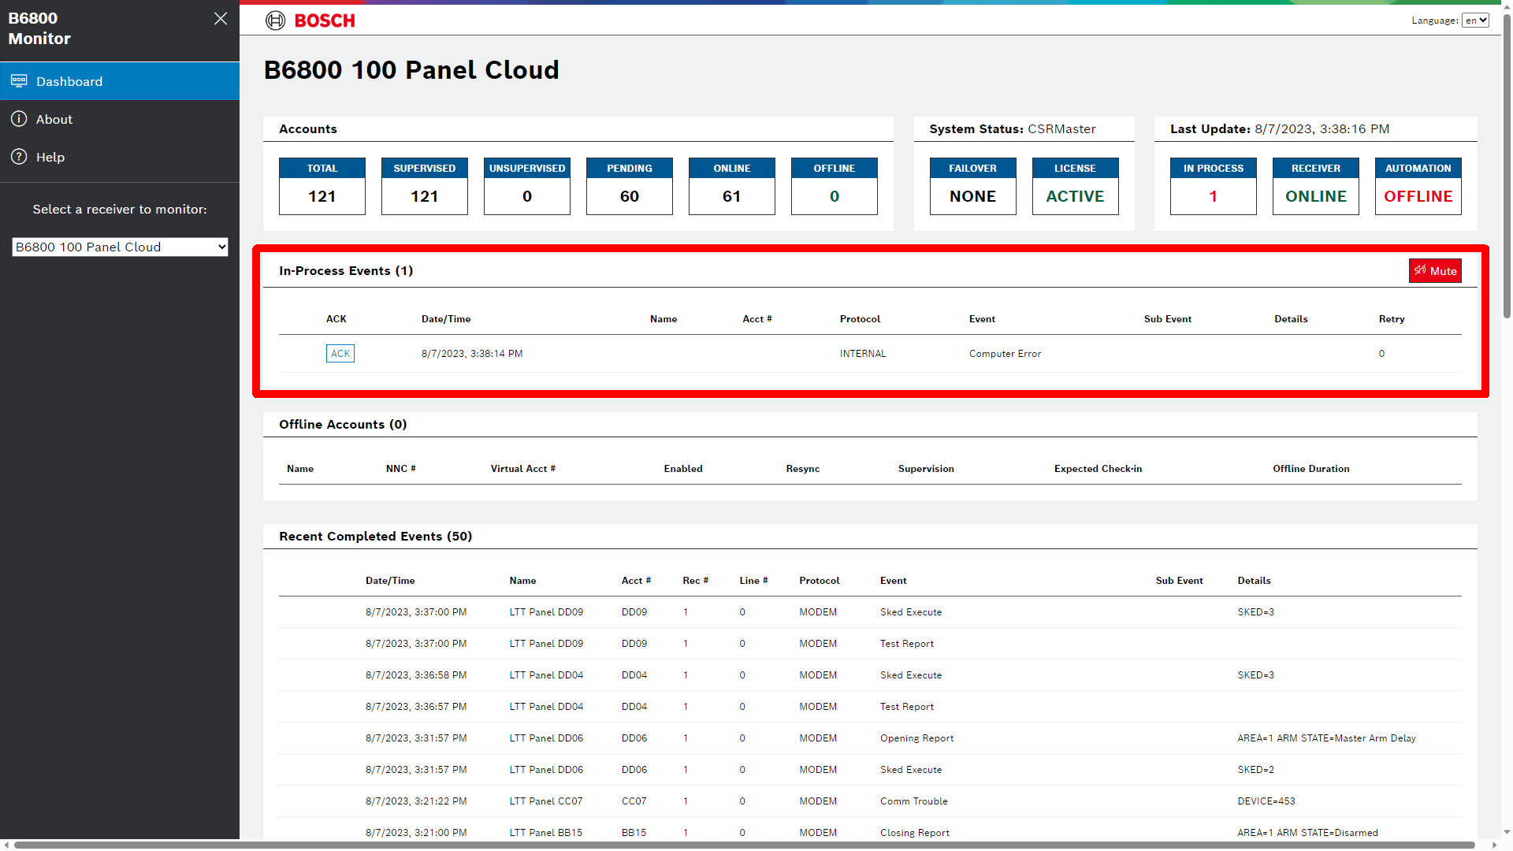
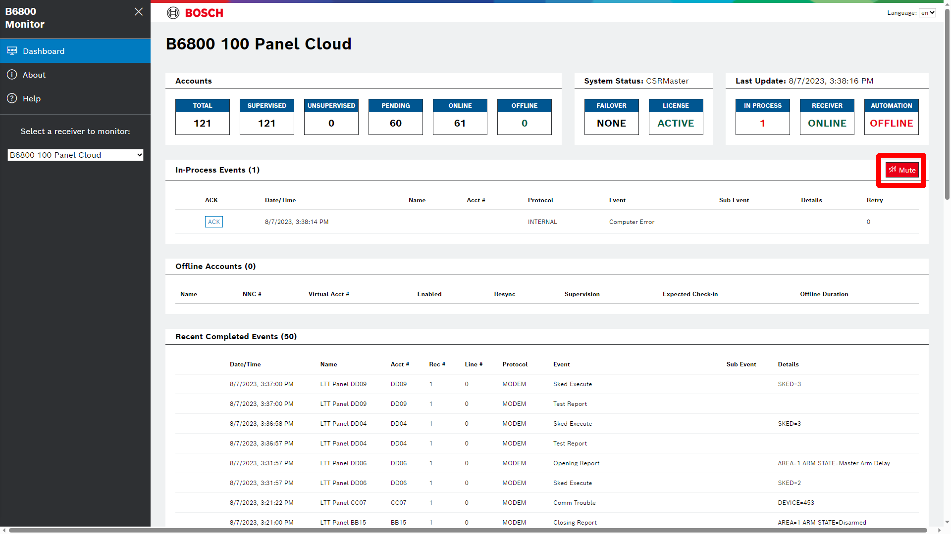
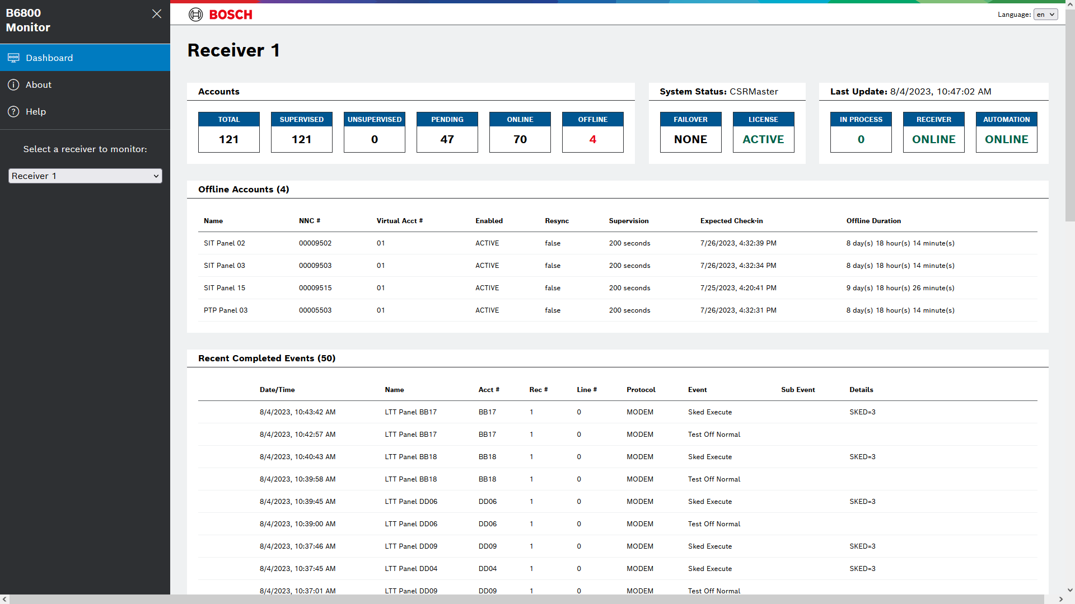
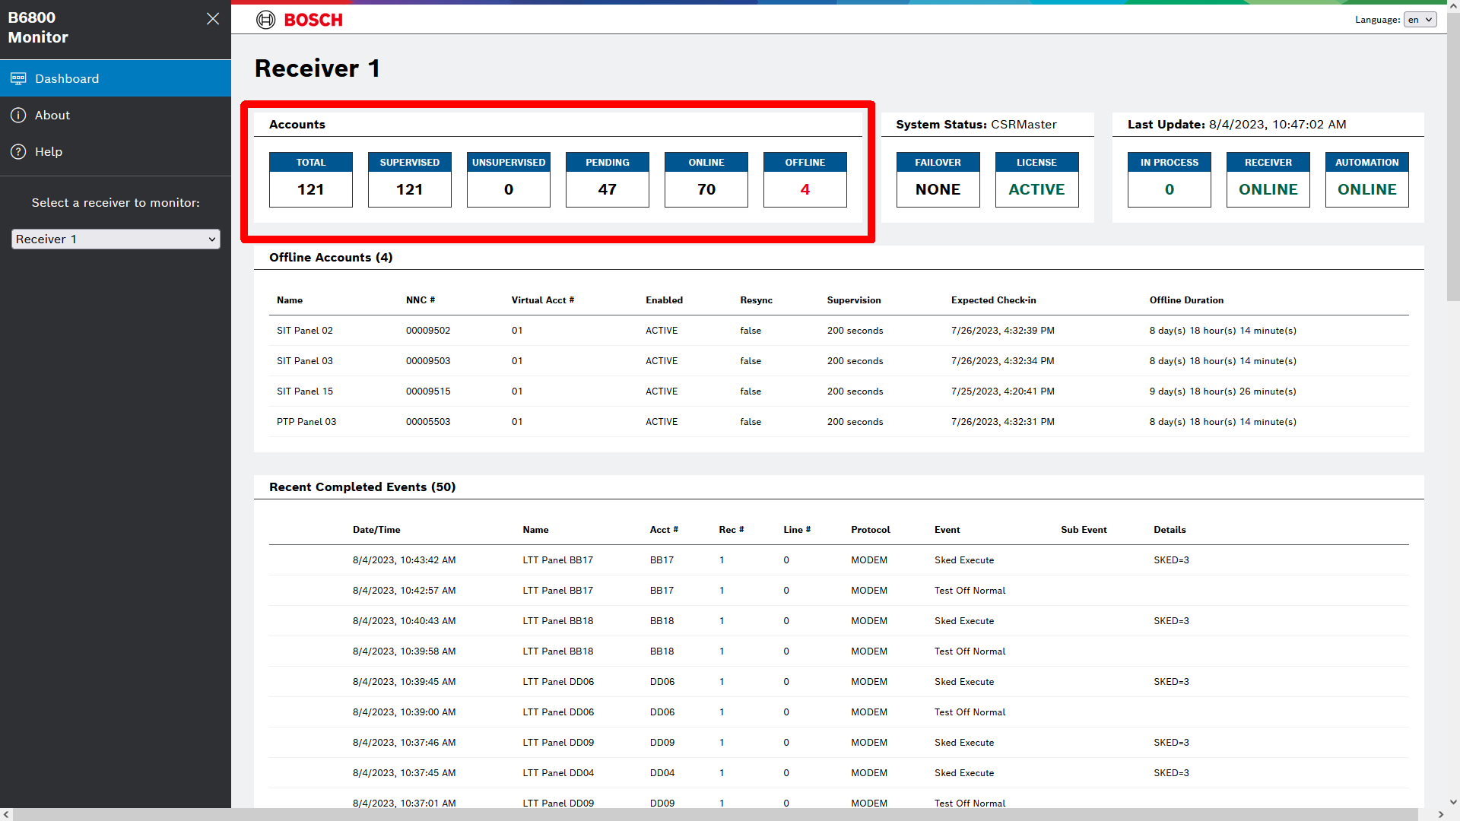
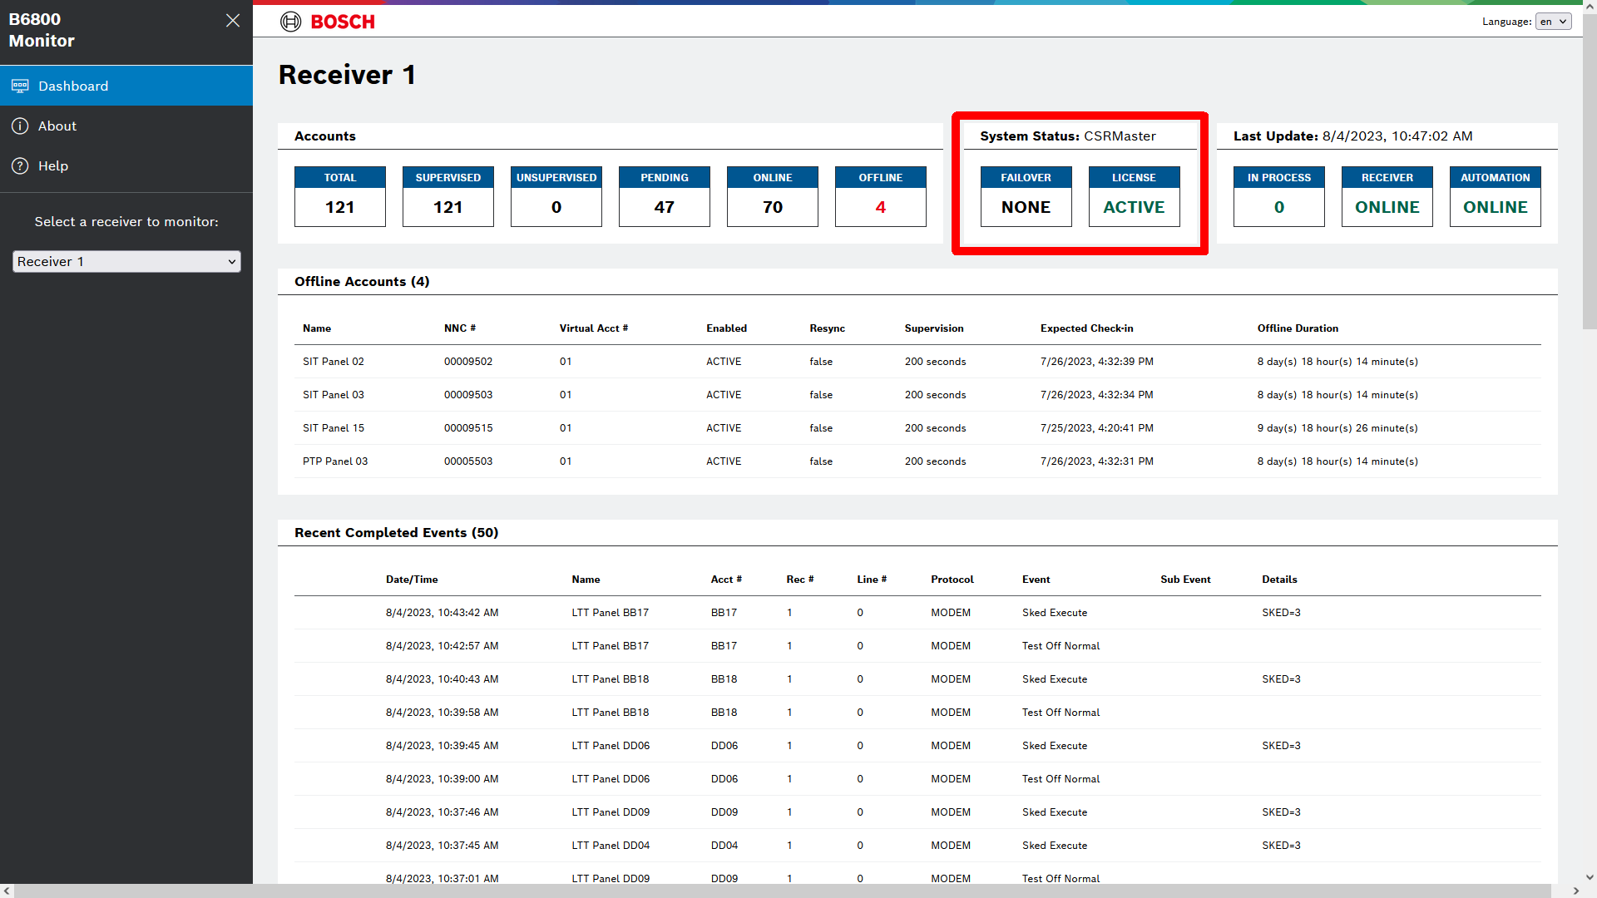
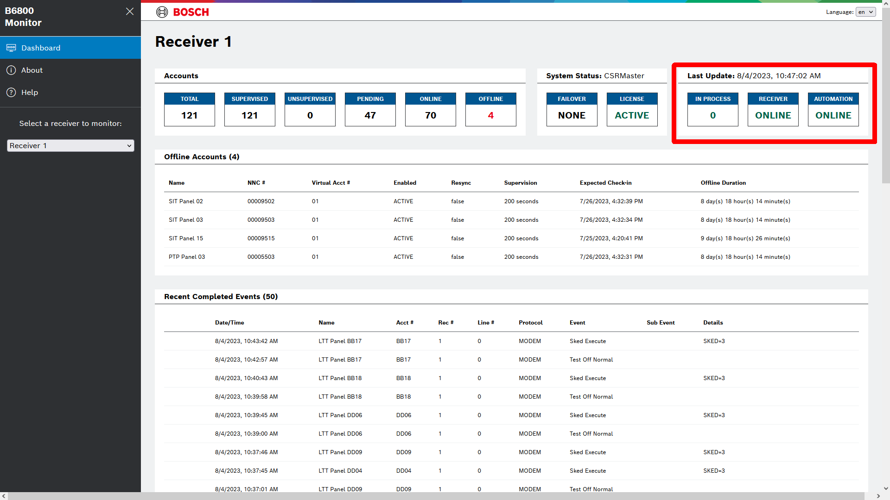
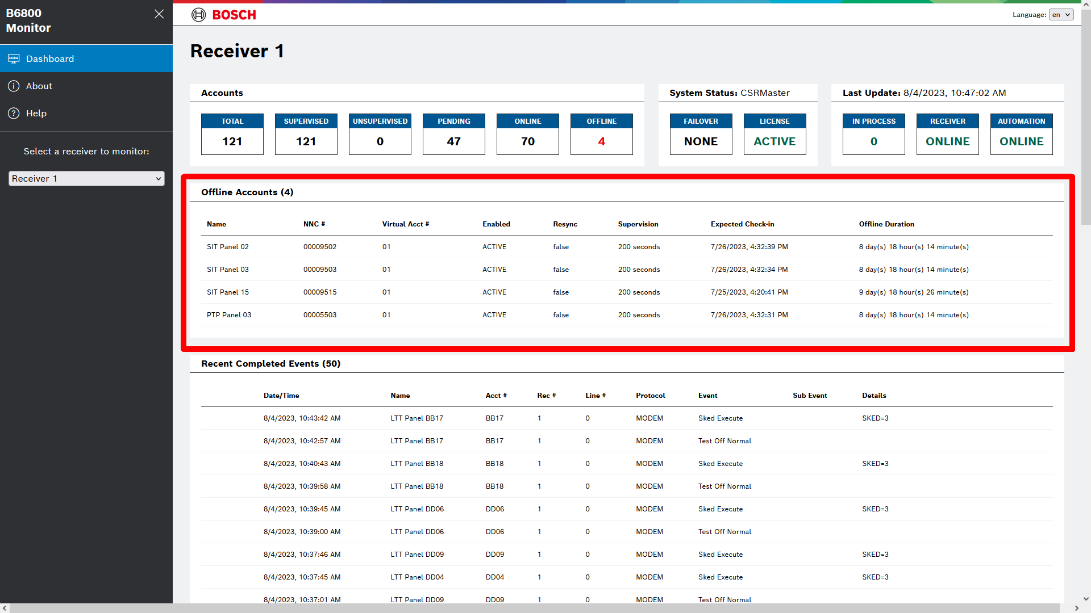
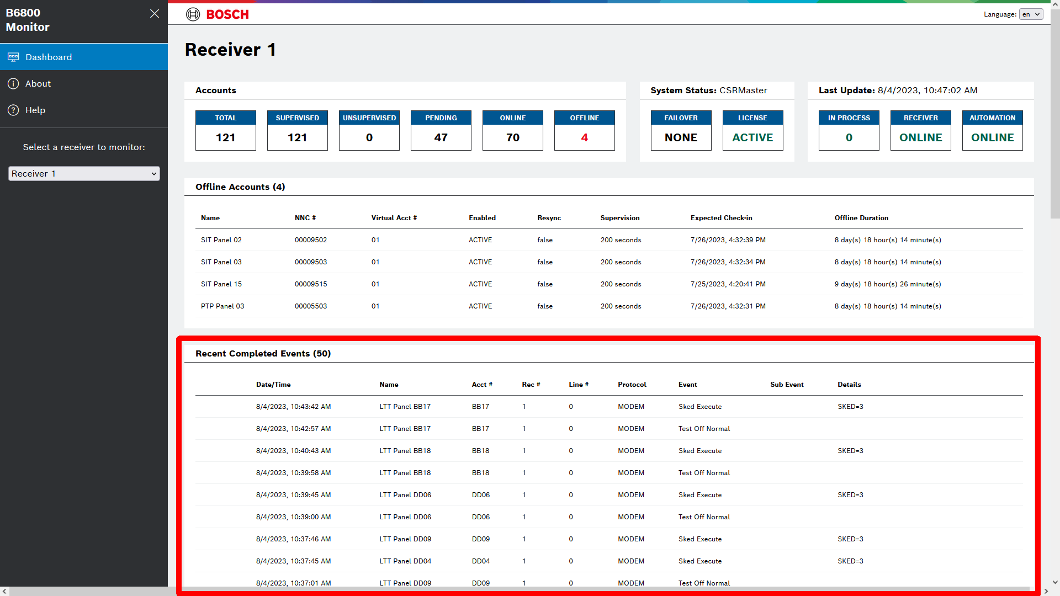
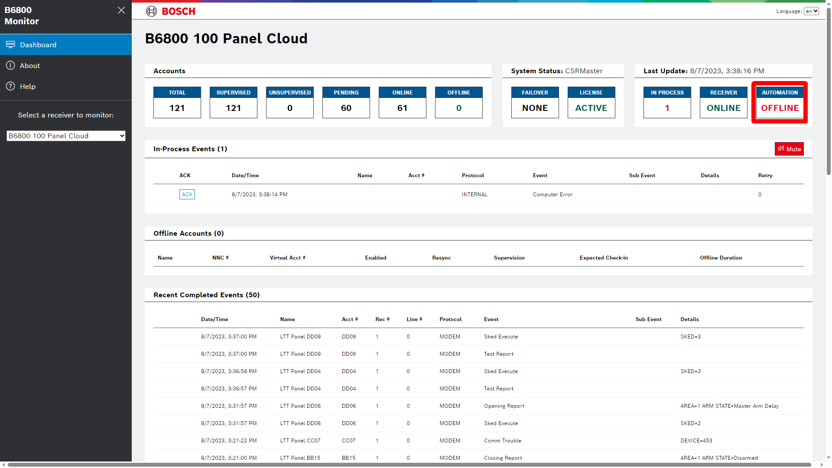
B6800 Monitor Page
Simple to Use
Shows Real-Time Status of
  Accounts
  System
  Automation / Receiver
  Offline Accounts
  Recently Completed
  Automation Offline
  In-Process Events
    Mute
Notes:
This is an animated slide with all of the items of the “Dashboard” Monitor page highlighted that are being talked about:
Accounts: It shows the number of accounts and their various statuses as shown.
System Status shows the Active server (in Failover this is important), if there is a Failover configured and its status, and the current License (Demo, Expired (demo), or Active.)
Automation / Receiver shows the if there events in manual process, if the receiver is online or offline, and Automation status.
Offline Accounts shows the list of accounts that have been declared as Offline.
Recently Completed shows events that have been processed by Automation.
Automation Offline shows when Automation is not responding.
In-Process Events (Mute) shows if Automation is Offline and the Mute is to silence any new events

Slide 10
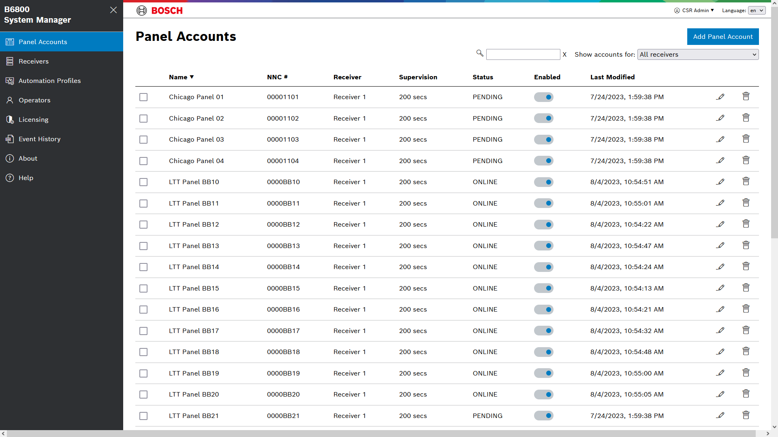
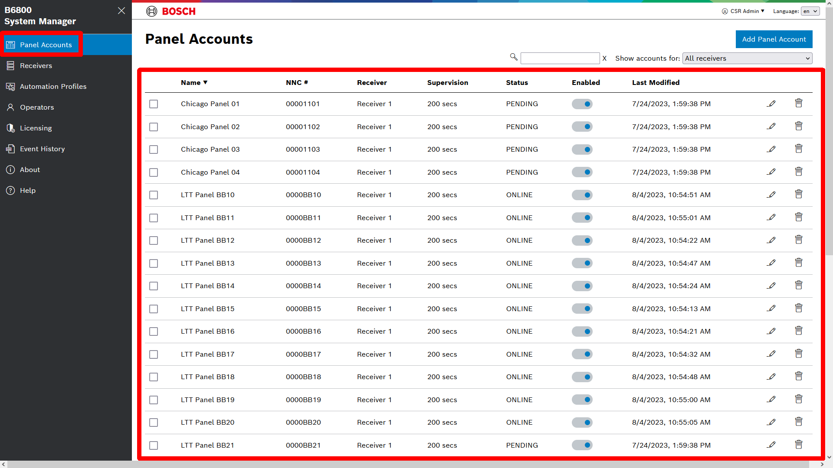
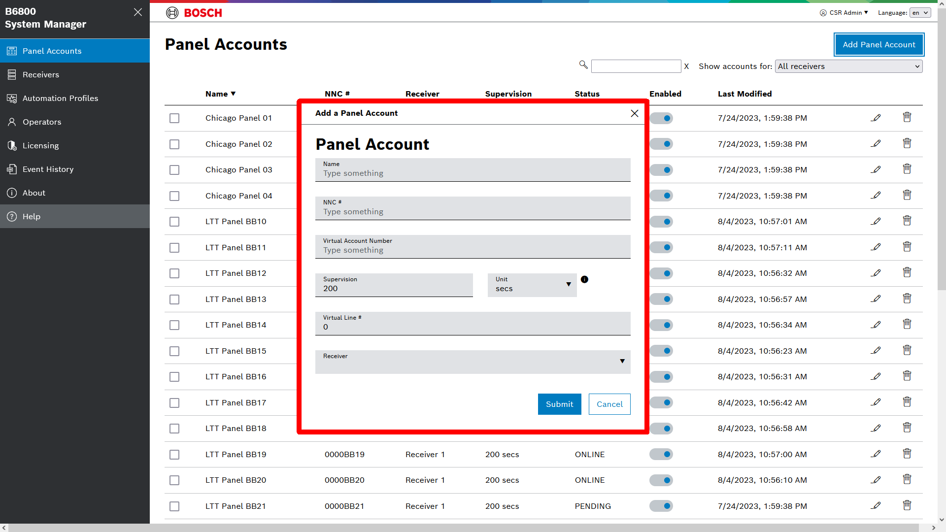
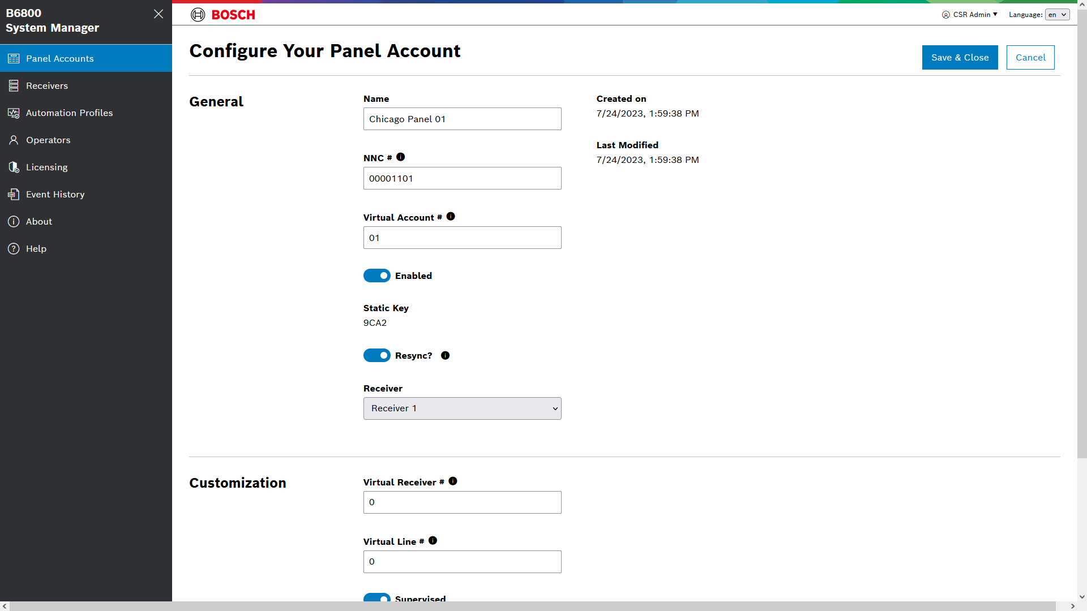
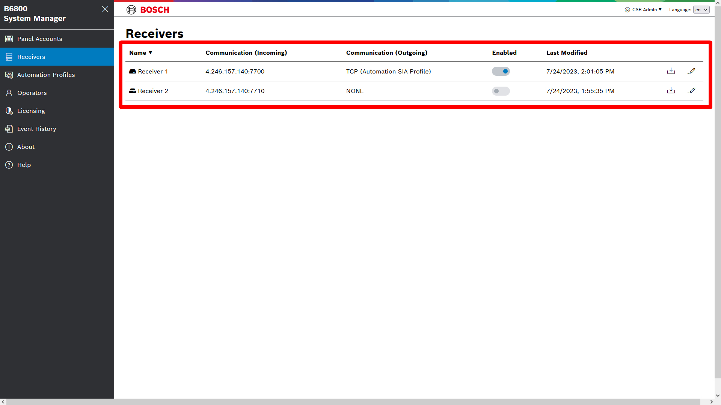
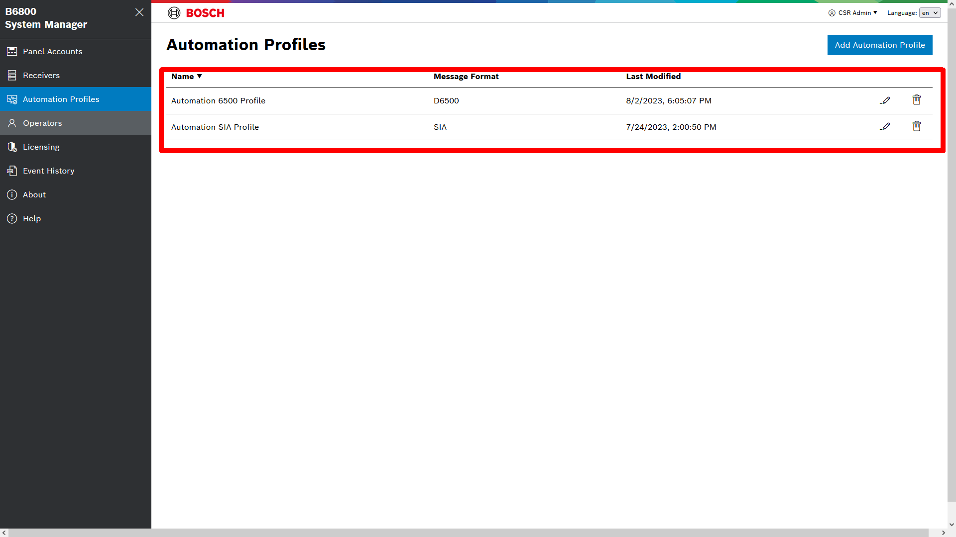
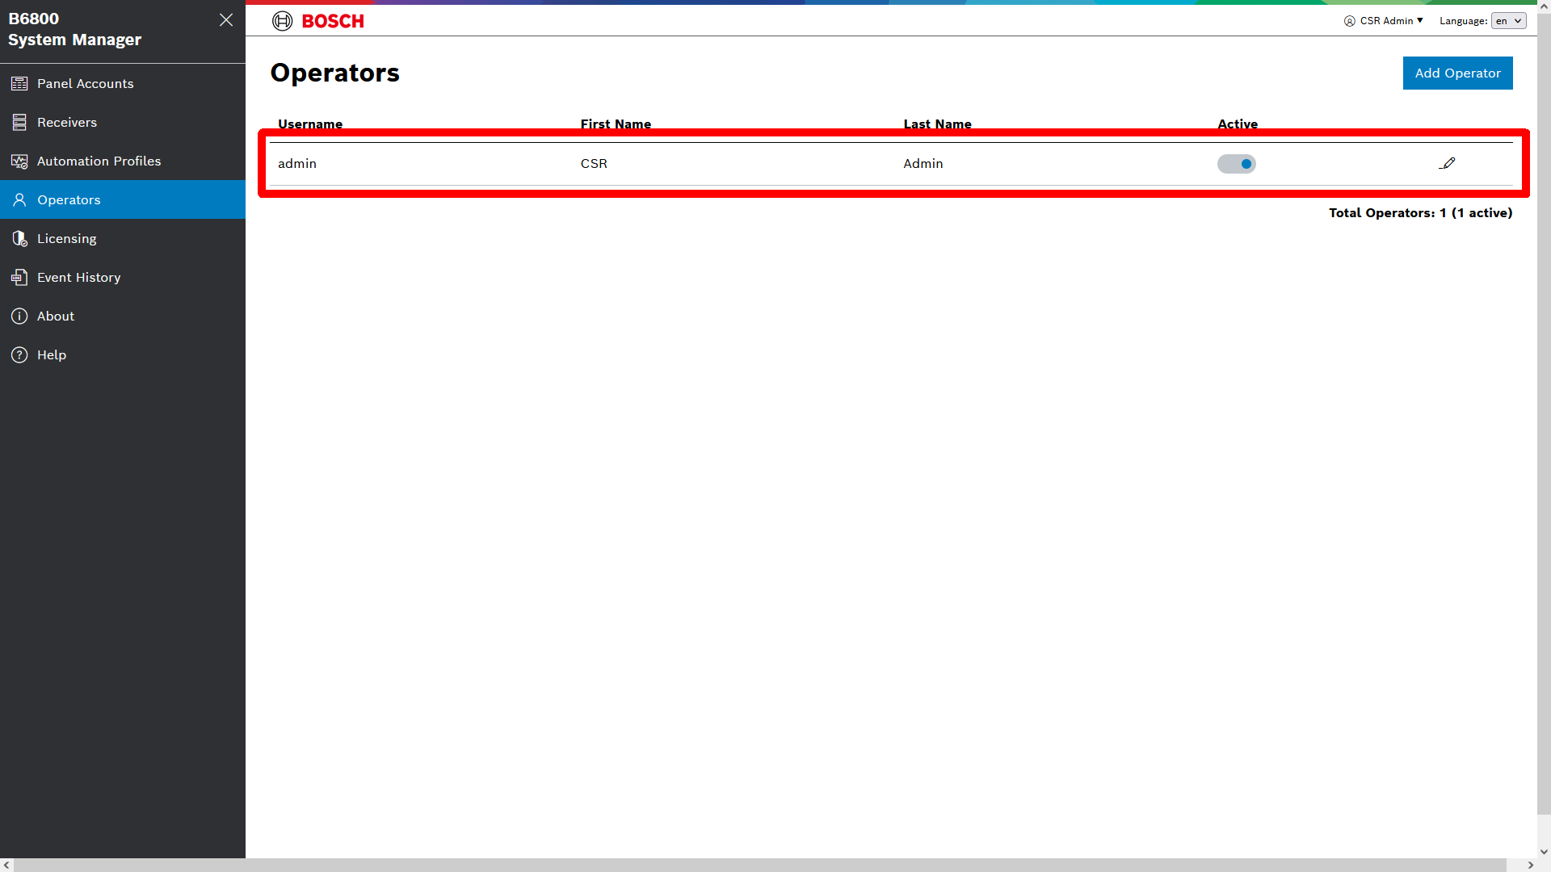
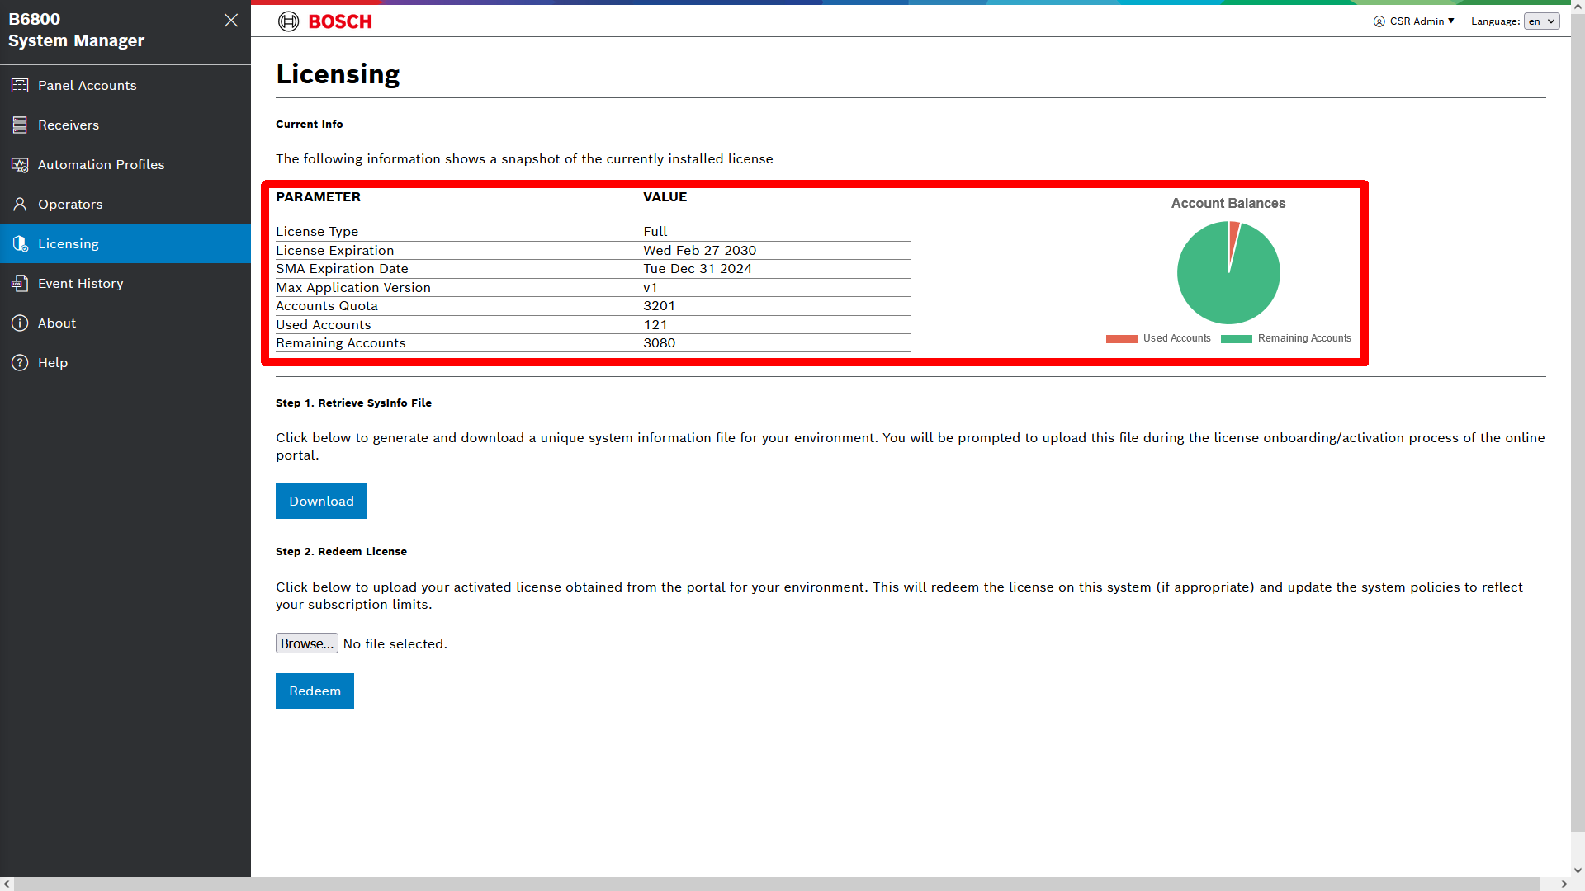
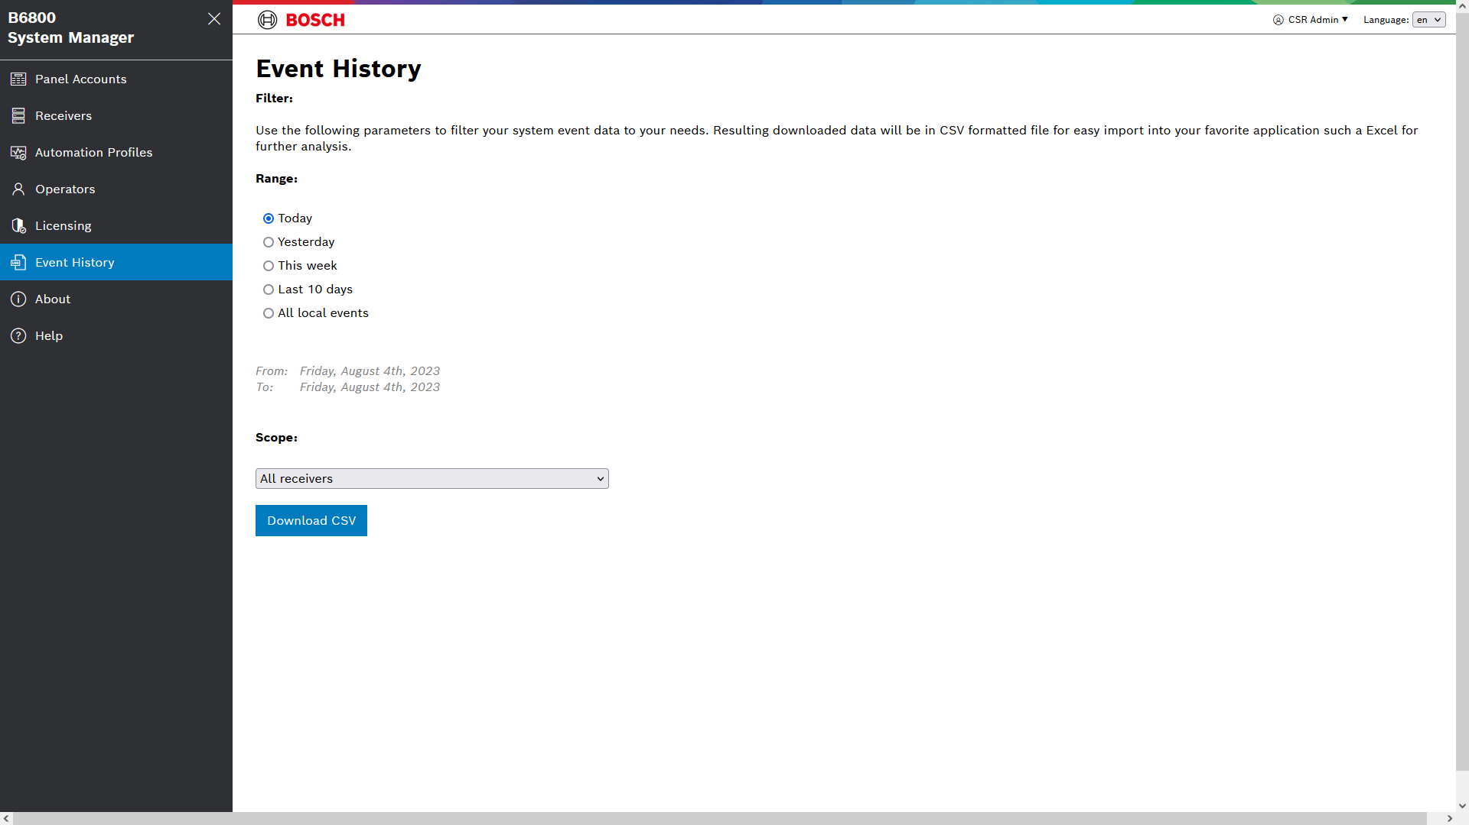
B6800 System Manager
Simple to Use
Configuration Using Standard Web Browser
  Panel Accounts
    Add
    Edit
  Receivers
  Automation Profiles
  Operators
  Licensing
  Event History
Notes:
This is an animated slide with all of the items of the System Manager page highlighted that are being talked about:
Panels Account is the list of accounts that are in the system
Add is where new accounts can be added. These can be done from any workstation connected to the receiver. They are done in real time with no send or receive.
Edit is where existing accounts can be edited.
Receivers is where the receivers are configured. This is restricted to Administrator Operators.
Automation Profiles are where configurations specific to an automation package are configured. This is restricted to Administrator Operators.
Operators is where new logins are created. There are only two operator types, Administrator and Standard. This is restricted to Administrator Operators.
Licensing is where the licensing is configured and checked. This is restricted to Administrator Operators.
Event history is where the Event History logs can be retrieved. The system holds the last 30 days of events and is not limited by number of events.

Slide 11
B6800 – CTNs and How to Order
How to Order
The CTNs are
Ordering Process
  Starts with the B6800-SR that includes the first year SMA
  Additional licenses can be purchased to add to existing installation (i.e. B6800-SR + B6800-LIC-500 will provide 1000 panel accounts)
  Order additional SMA updates based on panel accounts or renewals
B6800-SR-DEMO | Software Receiver, Demo | 10 accounts, 30 days, renew 3 times, free
B6800-SR | Software Receiver, 500 Acct, 1yr SMA | Receiver purchase, includes 500 accounts & 1st Year of SMA
B6800-LIC-500 | Software Receiver, 500 Acct Add-on | Expansion license for additional 500 accounts
B6800-LIC-2500 | Software Receiver, 2500 Acct Add-on | Expansion license for additional 2500 accounts
B6800-LIC-10000 | Software Receiver, 10000 Acct Add-on | Expansion license for additional 10,000 accounts
B6800-SMA-SR | Software Receiver 1yr SMA for SR | Annual SMA for tech support and new version upgrades
B6800-SMA-500 | Software Receiver 1yr SMA for 500 Acct | Annual SMA for tech support and new version upgrades
B6800-SMA-2500 | Software Receiver 1yr SMA for 2500 Acct | Annual SMA for tech support and new version upgrades
B6800-SMA-10000 | Software Receiver 1yr SMA for 10000 Acct | Annual SMA for tech support and new version upgrades
B6800-FS | Software Receiver Failover License | Failover License
Notes:
These are the CTNs for ordering a system.

Slide 12
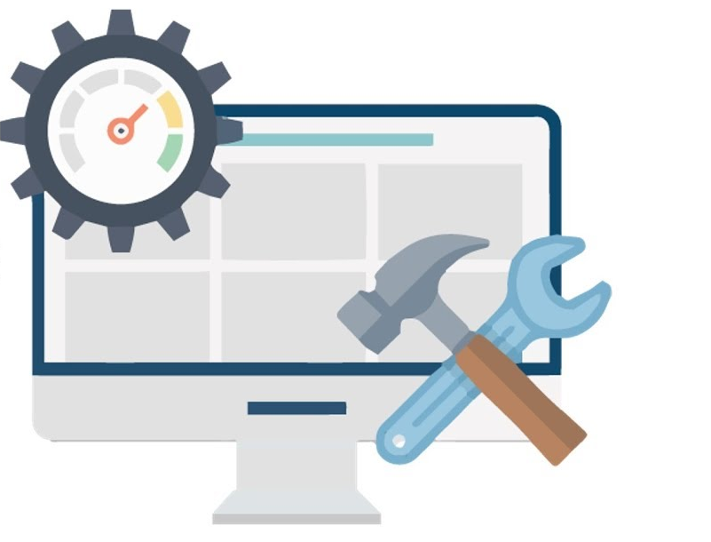
B6800 – What is the SMA & Why is it needed?
How to Order
SMA: Software Maintenance Agreement
  Yearly Maintenance Agreement (First Year Included with License Purchase)
  Provides the funding for on-going updates and feature enhancements
  Two Updates per year are expected to be released
What does SMA Control?
  Required for Technical Support
  Required for upgrades to new major versions
  Patches or updates to existing major version will always work
  Receiver will continue to work regardless of the state of the SMA

Slide 13
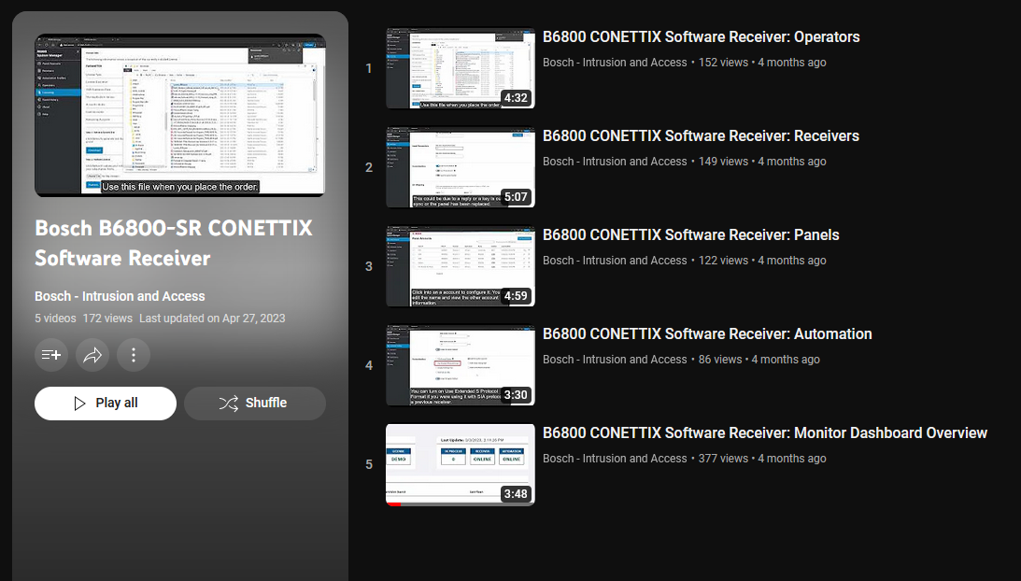
B6800 Training
Training
Training will be available online on Bosch YouTube channel.
Module in the Academy
Optional Webinar Sessions

